Slide 1
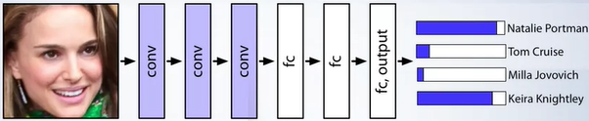
L4.1 CNN and RNN
Zonghua Gu 2021
Acknowledgement: some contents taken from UC Berkeley CS231n https://cs231n.github.io
Coursera MOOC on CNN: https://www.coursera.org/learn/convolutional-neural-networks
Hung-yi Lee: https://speech.ee.ntu.edu.tw/~hylee/ml/2021-spring.html

Slide 2
Outline
CNN Convolution layers
Pooling and Fully-Connected layers
CNN case studies
RNNs
Notes:
Safety plan
The safety plan gives an overview of how you are going to achieve a safe system. A few of the major elements include:
what system is under consideration
the goal of the project
what steps will be taken to ensure safety
the roles and personnel involved in the project
the project timeline

Slide 3

Classic Computer Vision
Most “classic” (non-ML) CV algorithms are implemented in the OpenCV library, including
  Core Operations:
    basic operations on image like pixel editing, geometric transformations...
  Image Processing
    Thresholding, smoothing, edge detection, Hough Line Transform…
  Feature Detection and Description
    HOG, SIFT, SURF, BRIEF, ORB…
  Video analysis
    Object tracking w. optical flow
  Camera Calibration and 3D Reconstruction
They are simple, fast and reliable (e.g., for lane detection), and are often used in place of or in conjunction w. complex ML/DL algorithms, which may sometimes be unreliable and unpredictable.
Notes:
https://docs.opencv.org/trunk/d6/d00/tutorial_py_root.html

Slide 4
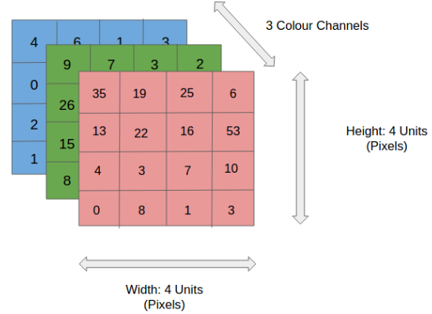
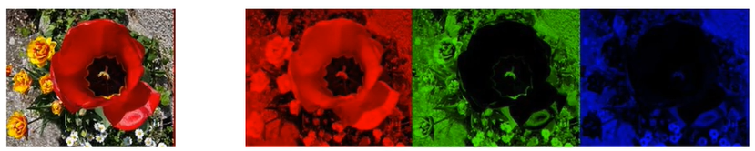
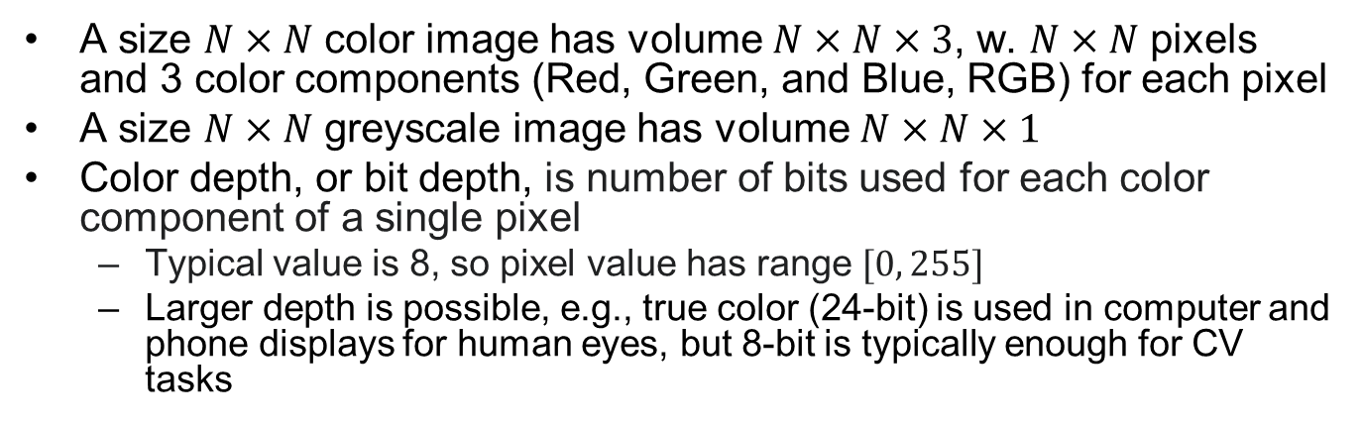
Input Image Encoding
A size $N×N$ color image has volume $N×N×3$, w. $N×N$ pixels and 3 color components (Red, Green, and Blue, RGB) for each pixel
A size $N×N$ greyscale image has volume $N×N×1$
Color depth, or bit depth, is number of bits used for each color component of a single pixel
  Typical value is 8, so pixel value has range $[0, 255]$
  Larger depth is possible, e.g., true color (24-bit) is used in computer and phone displays for human eyes, but 8-bit is typically enough for CV tasks
=
Notes:
Input encoding:e.g. a 128x128 pixel color image is a 128x128x3 tensor, encoded as a vector of 128*128*3=49152 8-bit integers; a greyscale image is a 128x128x1 tensor
There are a number of color space encodings, incl. RGB, HSV, CMYK, etc.
A color image is a 3D tensor encoded as a vector of integers between [0, 255] (assuming 8-bit pixel depth) denoting pixel intensities for 3 RGB channels, e.g. a 128x128 pixel color image is a 128x128x3 tensor, encoded as a vector of size 128*128*3=49152
A greyscale image is a 128x128x1 tensor
Right: a $4×4$ pixels color image w. volume $4×4×3$, w.

Slide 5
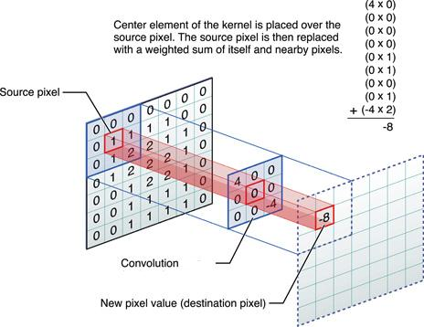
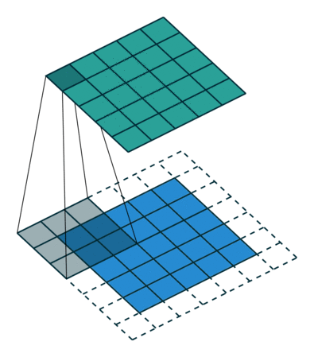

Filters/Kernels in Computer Vision
Convolution operation: we slide (convolve) each filter across the width and height of the input volume and compute dot products between the entries of the filter (kernel) and the input at any position. As we slide the filter over the width and height of the input volume we will produce a 2-dimensional activation map that gives the responses of that filter at every spatial position.
  dot product operation: elementwise multiplication of a filter w. corresponding input values, then summing them to generate one output value
  Used to extract features for downstream tasks (classification or regression)
Notes:
Convolution of a filter/kernel $w$ w. size $2a×2b$ w. a 2D image $f(x,y)$ generates another filtered 2D image $g(x,y)$, by elementwise multiplying corresponding elements then summing them:
of w. an input image/volume generates another filtered output volume, by Fig shows convolution operation of $3×3$ filter w. a greyscale image patch produces an output $−8$
$$g\left(x,y\right)=w∗f\left(x,y\right)=\sum_{dx=−a}^{a}{\sum_{dy=−b}^{b}{w\left(dx,dy\right)f\left(x+dx,y+dy\right)}}$$

Slide 6



A Filter for Vertical Edge Detection
10 | 10 | 10 | 0 | 0 | 0
10 | 10 | 10 | 0 | 0 | 0
10 | 10 | 10 | 0 | 0 | 0
10 | 10 | 10 | 0 | 0 | 0
10 | 10 | 10 | 0 | 0 | 0
10 | 10 | 10 | 0 | 0 | 0
0 | 30 | 30 | 0
0 | 30 | 30 | 0
0 | 30 | 30 | 0
0 | 30 | 30 | 0
1 | 0 | -1
1 | 0 | -1
1 | 0 | -1
$$∗$$
$$=$$
0 | 0 | 0 | 10 | 10 | 10
0 | 0 | 0 | 10 | 10 | 10
0 | 0 | 0 | 10 | 10 | 10
0 | 0 | 0 | 10 | 10 | 10
0 | 0 | 0 | 10 | 10 | 10
0 | 0 | 0 | 10 | 10 | 10
0 | -30 | -30 | 0
0 | -30 | -30 | 0
0 | -30 | -30 | 0
0 | -30 | -30 | 0
1 | 0 | -1
1 | 0 | -1
1 | 0 | -1
$$∗$$
$$=$$

Slide 7
Sobel Filter for Vertical Edge Detection
10 | 10 | 10 | 0 | 0 | 0
10 | 10 | 10 | 0 | 0 | 0
10 | 10 | 10 | 0 | 0 | 0
10 | 10 | 10 | 0 | 0 | 0
10 | 10 | 10 | 0 | 0 | 0
10 | 10 | 10 | 0 | 0 | 0
0 | 40 | 40 | 0
0 | 40 | 40 | 0
0 | 40 | 40 | 0
0 | 40 | 40 | 0
1 | 0 | -1
2 | 0 | -2
1 | 0 | -1
$$∗$$
$$=$$
0 | 0 | 0 | 10 | 10 | 10
0 | 0 | 0 | 10 | 10 | 10
0 | 0 | 0 | 10 | 10 | 10
0 | 0 | 0 | 10 | 10 | 10
0 | 0 | 0 | 10 | 10 | 10
0 | 0 | 0 | 10 | 10 | 10
0 | -40 | -40 | 0
0 | -40 | -40 | 0
0 | -40 | -40 | 0
0 | -40 | -40 | 0
1 | 0 | -1
2 | 0 | -2
1 | 0 | -1
$$∗$$
$$=$$

Slide 8
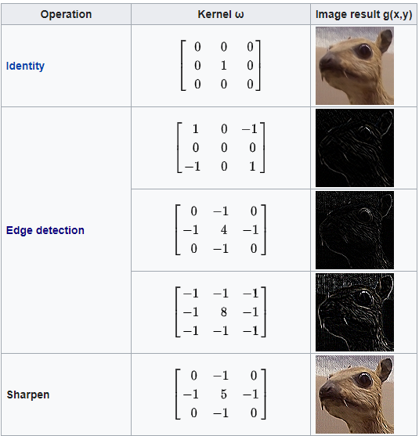
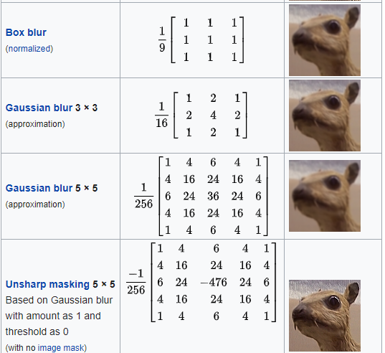
Common Filters in CV
These filters were designed, or “hand-crafted”, by CV researchers. They extract features used by downstream tasks such as classification, image segmentation, etc.

Slide 9

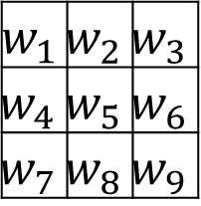
Machine Learning Meets CV
Instead of hand-crafted filters in classic CV, why not learn custom convolutional filters from data by supervised learning?
  For easy tasks like edge detection, learning may recover filters similar to hand-crafted ones.
  For difficult CV tasks, learning is essential to achieving good results
$$w_{1}$$ | $$w_{2}$$ | $$w_{3}$$
$$w_{4}$$ | $$w_{5}$$ | $$w_{6}$$
$$w_{7}$$ | $$w_{8}$$ | $$w_{9}$$
$$∗$$
$$=$$

Slide 10
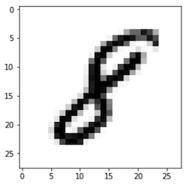
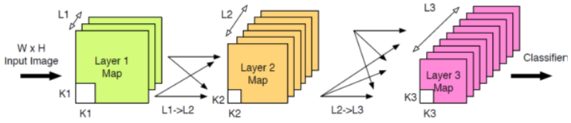
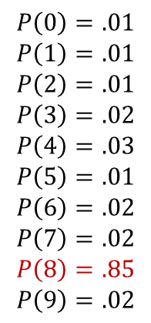
Convolutional Neural Networks (CNN)
$$P\left(0\right)=.01$$
$$P\left(1\right)=.01$$
$$P\left(2\right)=.01$$
$$P\left(3\right)=.02$$
$$P\left(4\right)=.03$$
$$P\left(5\right)=.01$$
$$P\left(6\right)=.02$$
$$P\left(7\right)=.02$$
$$P\left(8\right)=.85$$
$$P\left(9\right)=.02$$
Feature
Extraction
Classifier
(e.g., SoftMax)
A CNN (also called ConvNet) is a sequence of Convolutional (CONV) Layers, Pooling (POOL) Layers and non-linear activation functions for feature extraction, followed by one or more Fully-Connected (FC) Layers for classification based on the extracted features
Notes:
A CNN (also called ConvNet) Combination of convolution (CONV), pooling, and rectification stages

Slide 11
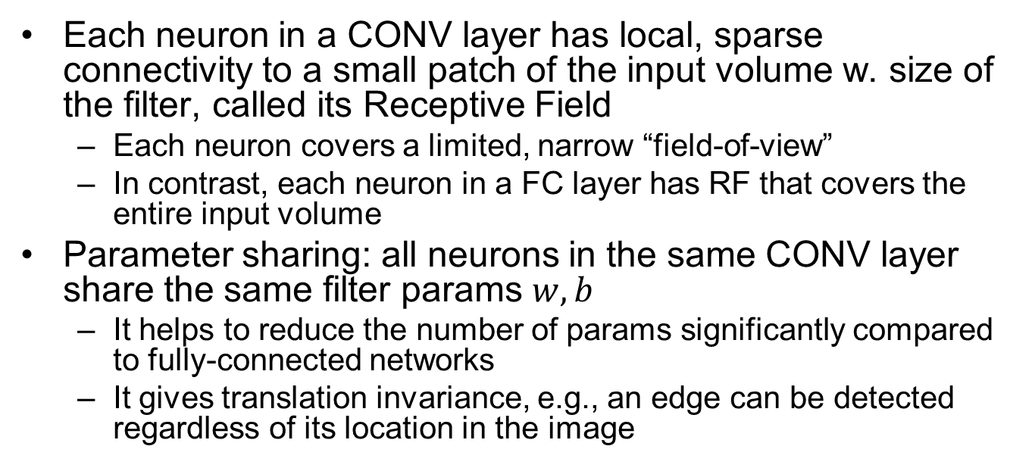
Receptive Field and Parameter Sharing
Each neuron in a CONV layer has local, sparse connectivity to a small patch of the input volume w. size of the filter, called its Receptive Field
  Each neuron covers a limited, narrow “field-of-view”
  In contrast, each neuron in a FC layer has RF that covers the entire input volume
Parameter sharing: all neurons in the same CONV layer share the same filter params $w,b$
  It helps to reduce the number of params significantly compared to fully-connected networks
  It gives translation invariance, e.g., an edge can be detected regardless of its location in the image

Slide 12

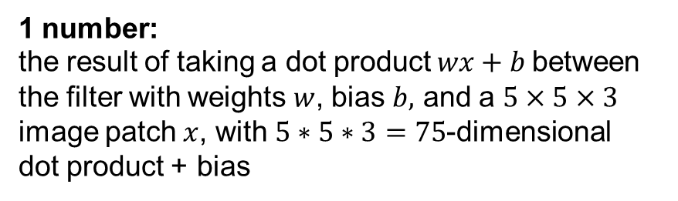
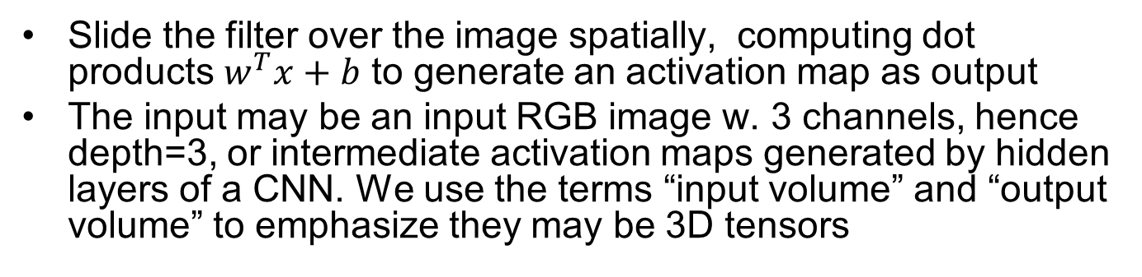
Convolution Operation
Slide the filter over the image spatially, computing dot products $w^{T}x+b$ to generate an activation map as output
The input may be an input RGB image w. 3 channels, hence depth=3, or intermediate activation maps generated by hidden layers of a CNN. We use the terms “input volume” and “output volume” to emphasize they may be 3D tensors
32x32x3 input 5x5x3 filter
32
1 number:
the result of taking a dot product $wx+b$between the filter with weights $w$, bias $b,$ and a $5×5×3$ image patch $x$, with $5∗5∗3=75$-dimensional dot product + bias
32
3

Slide 13
32x32x3 input
5x5x3 filter
32
One (blue) filter generates one 2D activation map as output
28
convolve (slide) over all spatial locations
32
28
32x32x3 input 5x5x3 filter
Multiple (blue and green) filters generate multiple (blue and green) 2D activation maps, stacked along the depth dimension to produce the 3D output volume
3
1
32
28
convolve (slide) over all spatial locations
32
28
3
1

Slide 14
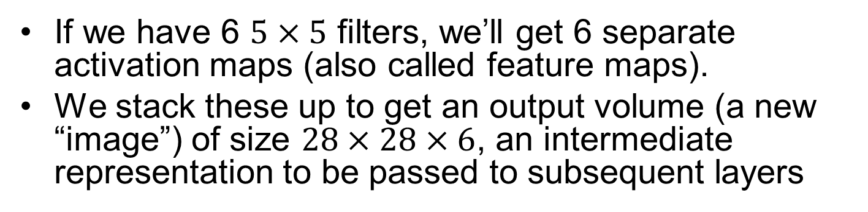
Stacked Activation Maps
If we have 6 $5×5$ filters, we’ll get 6 separate activation maps (also called feature maps).
We stack these up to get an output volume (a new “image”) of size $28×28×6$, an intermediate representation to be passed to subsequent layers
activation maps
32
28
Convolution Layer w.
6 5x5 filters
32
28
3
6

Slide 15
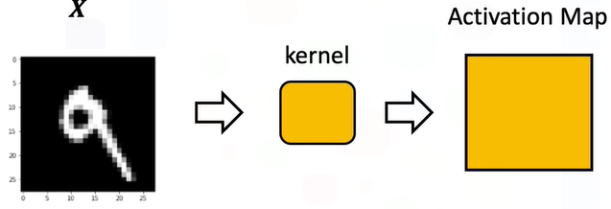
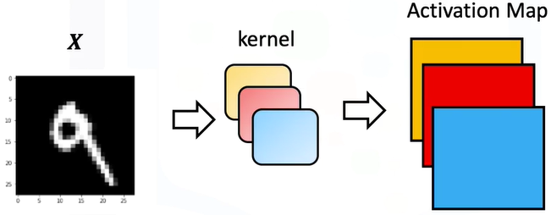
Activation Maps Illustration
1 filter/kernel, 1 output activation map
3 filters/kernels, 3 output activation maps
Notes:
redundant

Slide 16
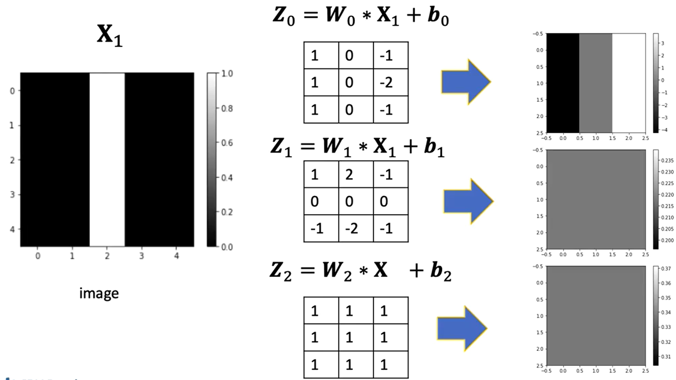
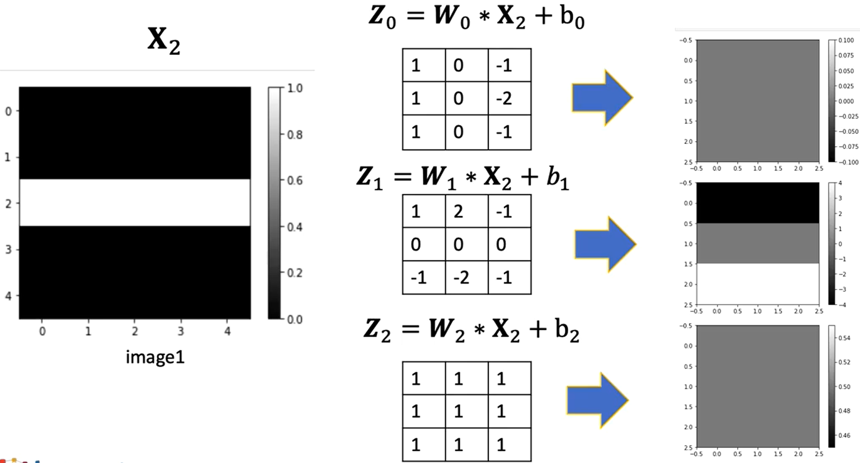
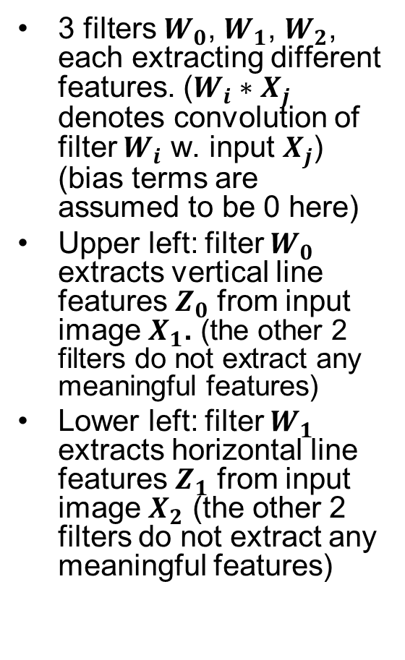
Concrete Example: 3 Filters
3 filters $W_{0}$, $W_{1}$, $W_{2}$, each extracting different features. ($W_{i}∗X_{j}$ denotes convolution of filter $W_{i}$ w. input $X_{j}$) (bias terms are assumed to be 0 here)
Upper left: filter $W_{0}$ extracts vertical line features $Z_{0}$ from input image $X_{1}$. (the other 2 filters do not extract any meaningful features)
Lower left: filter $W_{1}$ extracts horizontal line features $Z_{1}$ from input image $X_{2}$ (the other 2 filters do not extract any meaningful features)

Slide 17


Convolution of a Filter on RGB Image w. 3 Channels
$$∗$$
$$=$$
3 x 3 x 3
4 x 4
6 x 6 x 3

Slide 18



Convolution of 2 Filters on RGB Image w. 3 Channels
Important
$$∗$$
3 x 3 x 3
$$=$$
$$∗$$
6 x 6 x 3
3 x 3 x 3
4 x 4 x 2
6x6 input feature map w. 3 channels; two 3x3 filters with depth 3; 4x4 output feature map w. 2 channels
# channels of input feature map == # depth of each filter (= 3 in figure)
# channels of output feature map == # filters (=2 in figure)
Notes:
In contrast to a CONV filter, which always has the same depth $D_{1}$ as the input volume, and output volume has depth $D_{2}=K$, the No. filters So we often omit the filter depth in coding
Each filter has the same number of channels (depth) as its input volume
The number of filters always equals the depth (2) of its output volume

Slide 19
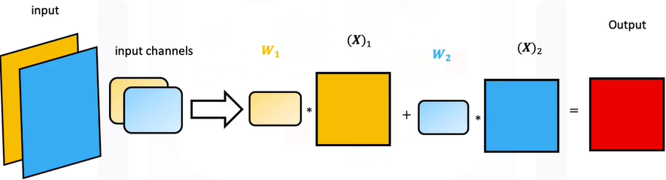
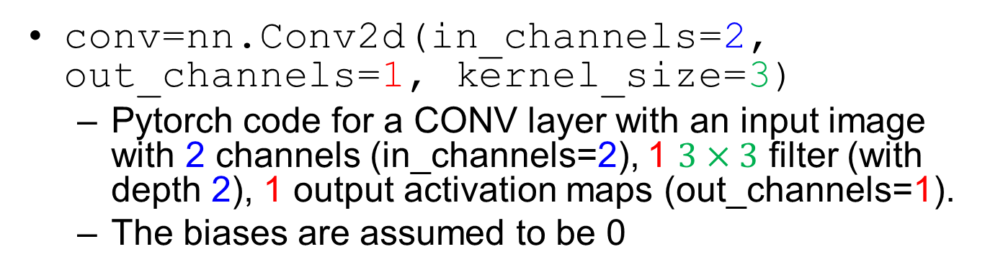
Convolution Example 1
conv=nn.Conv2d(in_channels=2, out_channels=1, kernel_size=3)
  Pytorch code for a CONV layer with an input image with 2 channels (in_channels=2), 1 $3×3$ filter (with depth 2), 1 output activation maps (out_channels=1).
  The biases are assumed to be 0
input
1 filter/kernel
output
https://www.coursera.org/learn/deep-neural-networks-with-pytorch/lecture/1rUTu/9-3-multiple-input-and-output-channels

Slide 20
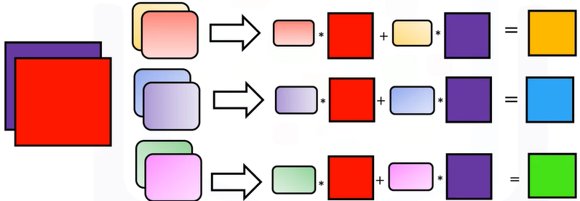
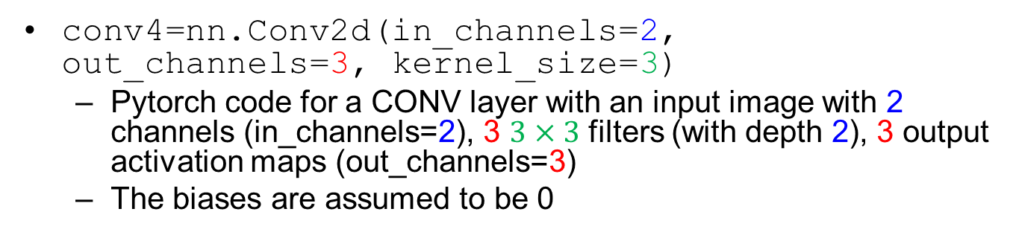
Convolution Example 2
conv4=nn.Conv2d(in_channels=2, out_channels=3, kernel_size=3)
  Pytorch code for a CONV layer with an input image with 2 channels (in_channels=2), 3 $3×3$ filters (with depth 2), 3 output activation maps (out_channels=3)
  The biases are assumed to be 0
input
3 filters/kernels
output

Slide 21
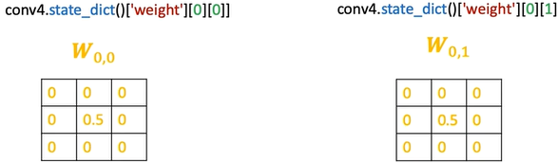
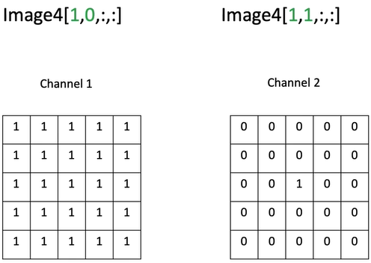
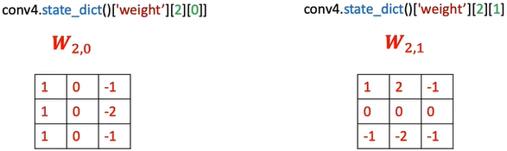
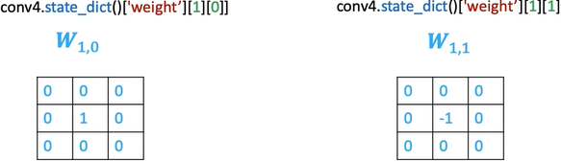

Convolution Example 2: Filters and Input Image
3 $3×3$ filters
input image with 2 channels

Slide 22
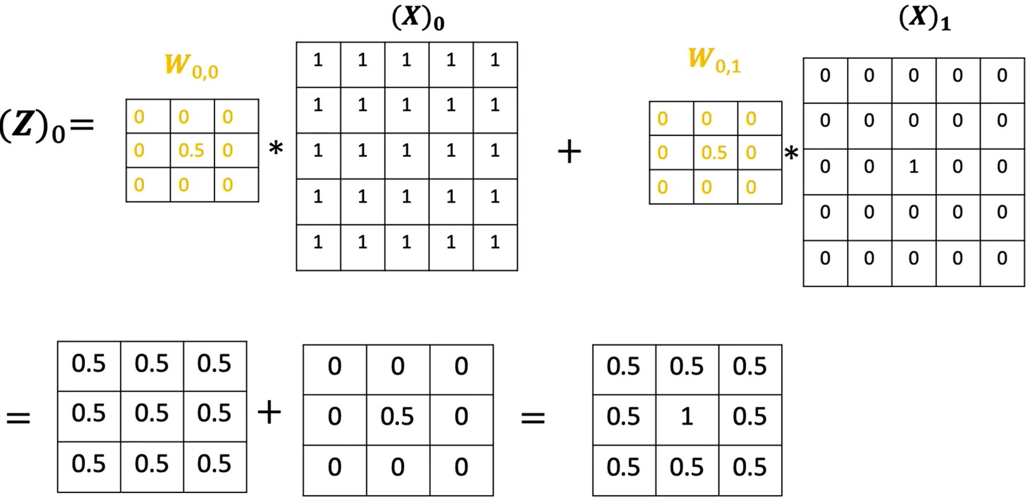
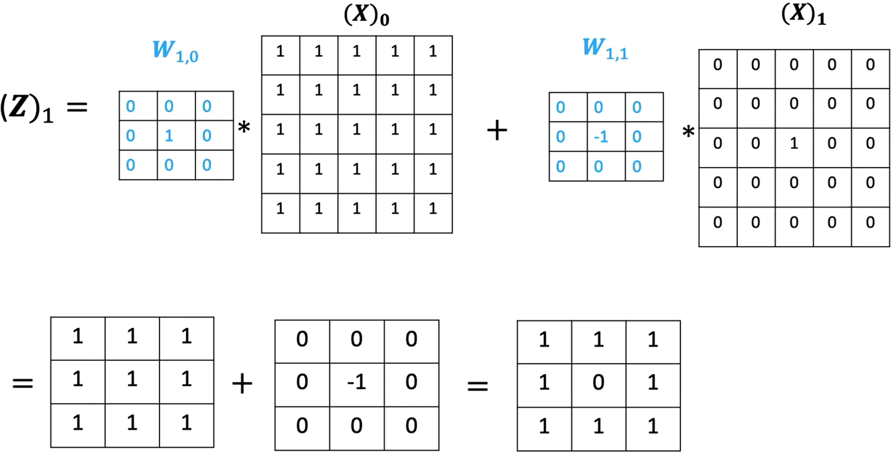
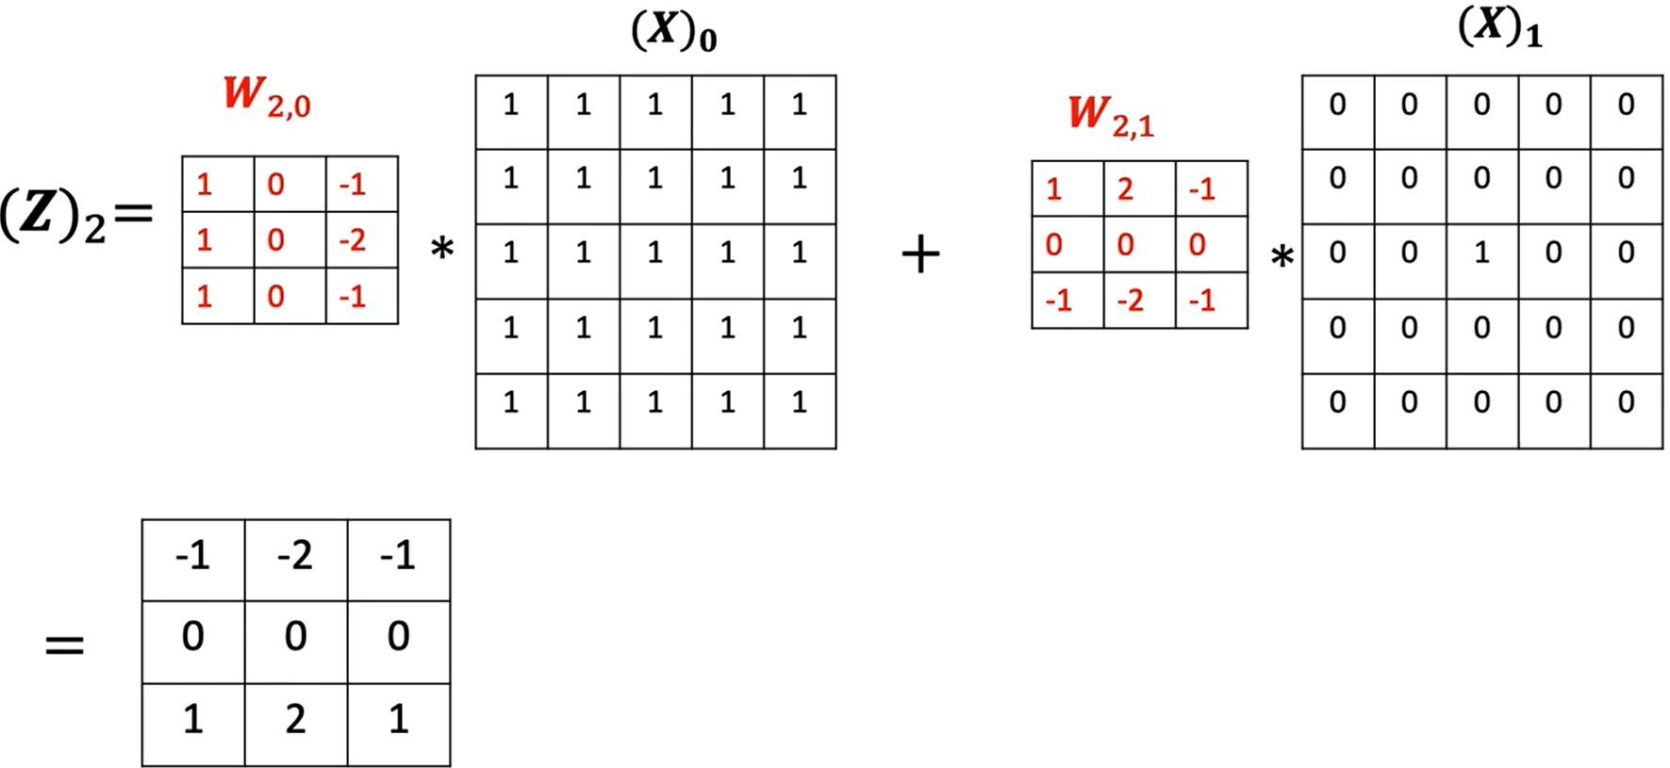
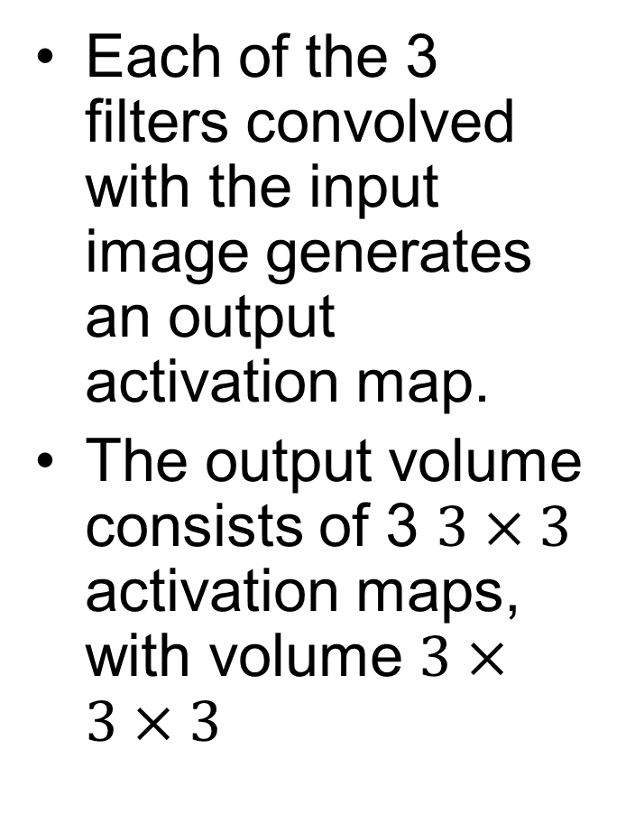
Convolution Example 2: Output
Each of the 3 filters convolved with the input image generates an output activation map.
The output volume consists of 3 $3×3$ activation maps, with volume $3×3×3$

Slide 23
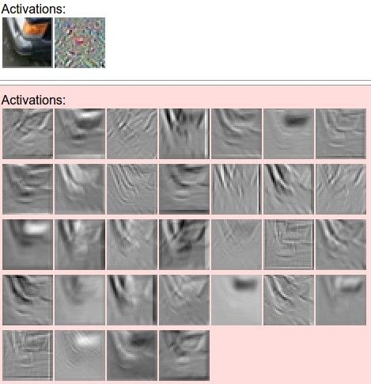
Filters and Activation Maps Example
filters
one filter =>
one activation map
example 5x5 filters
(32 total)
Section 6 - 21

Slide 24
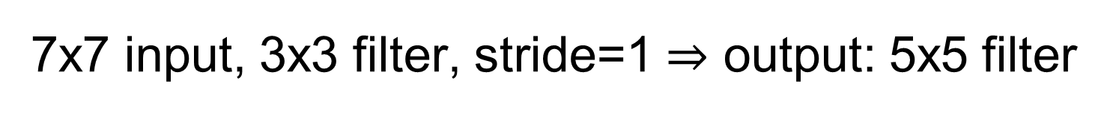
7x7 input, 3x3 filter, stride=1 $⇒$ output: 5x5 filter

Slide 25
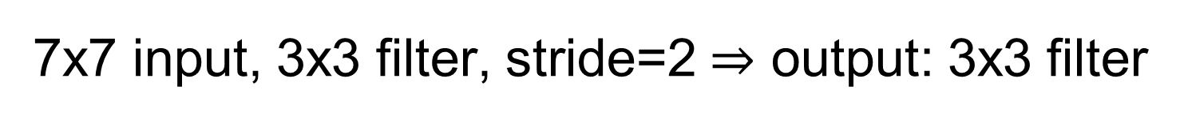
7x7 input, 3x3 filter, stride=2 $⇒$ output: 3x3 filter

Slide 26
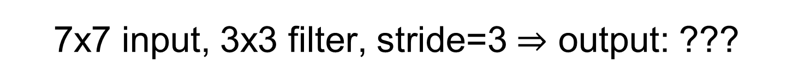
7x7 input, 3x3 filter, stride=3 $⇒$ output: ???
The rightmost and bottom columns are not processed!

Slide 27

Solution: Add Padding
7x7 input, 3x3 filter, stride=3, zero padding w. 1 $⇒$ output: 3x3 filter
0 | 0 | 0 | 0 | 0 | 0 | 0 | 0 | 0
0
0
0
0
0 | 0 | 0 | 0 | 0 | 0 | 0 | 0 | 0
0
0
0
0
0 | 0 | 0 | 0 | 0 | 0 | 0 | 0 | 0
0
0
0
0

Slide 28
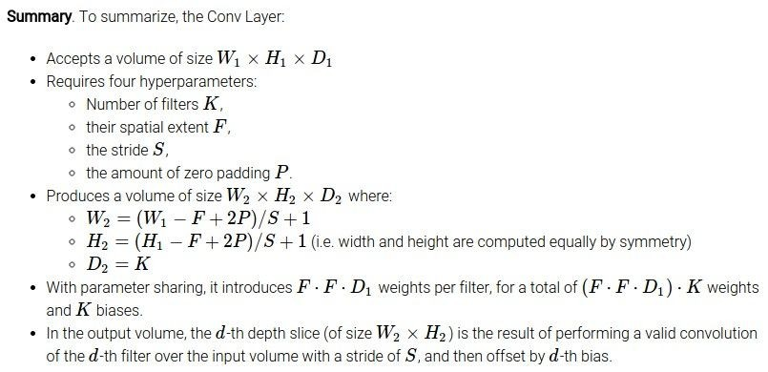
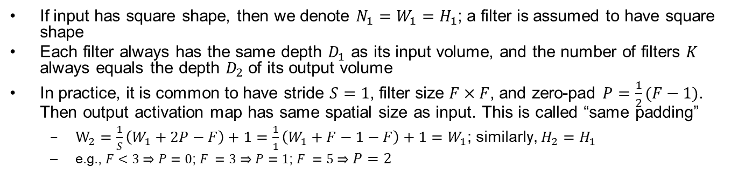
Computation of CONV Layer Sizes
Important
Common settings:
K = (powers of 2, e.g. 32, 64, 128, 512)
- F = 3, S = 1, P = 1
- F = 5, S = 1, P = 2
- F = 1, S = 1, P = 0
If input has square shape, then we denote $N_{1}=W_{1}=H_{1}$; a filter is assumed to have square shape
Each filter always has the same depth $D_{1}$ as its input volume, and the number of filters $K$ always equals the depth $D_{2}$ of its output volume
In practice, it is common to have stride $S=1$, filter size $F×F$, and zero-pad $P=\frac{1}{2}(F−1)$. Then output activation map has same spatial size as input. This is called “same padding”
  $W_{2}=\frac{1}{S}\left(W_{1}+2P−F\right)+1=\frac{1}{1}\left(W_{1}+F−1−F\right)+1=W_{1}$; similarly, $H_{2}=H_{1}$
  e.g., $F<3⇒P=0$; $F =3⇒P=1$; $F =5⇒P=2$

Slide 29
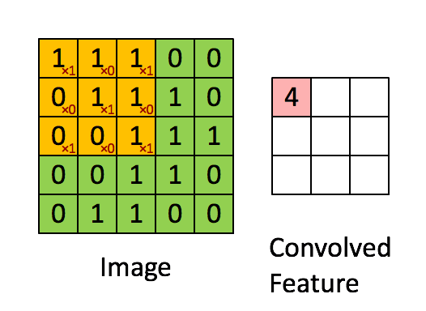
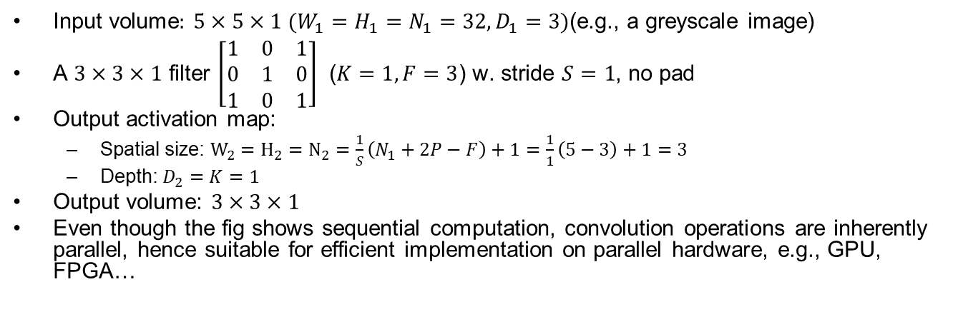
CONV Example 1: No Pad
Input volume$:$ $5×5×1$ $(W_{1}=H_{1}=N_{1}=32,D_{1}=3)$(e.g., a greyscale image)
A $3×3×1$ filter $\left[\begin{matrix}1 & 0 & 1 \\ 0 & 1 & 0 \\ 1 & 0 & 1\end{matrix}\right]$ ($K=1,F=3$) w. stride $S=1$, no pad
Output activation map:
  Spatial size: $W_{2}=H_{2}=N_{2}=\frac{1}{S}\left(N_{1}+2P−F\right)+1=\frac{1}{1}\left(5−3\right)+1=3$
  Depth: $D_{2}=K=1$
Output volume: $3×3×1$
Even though the fig shows sequential computation, convolution operations are inherently parallel, hence suitable for efficient implementation on parallel hardware, e.g., GPU, FPGA…

Slide 30
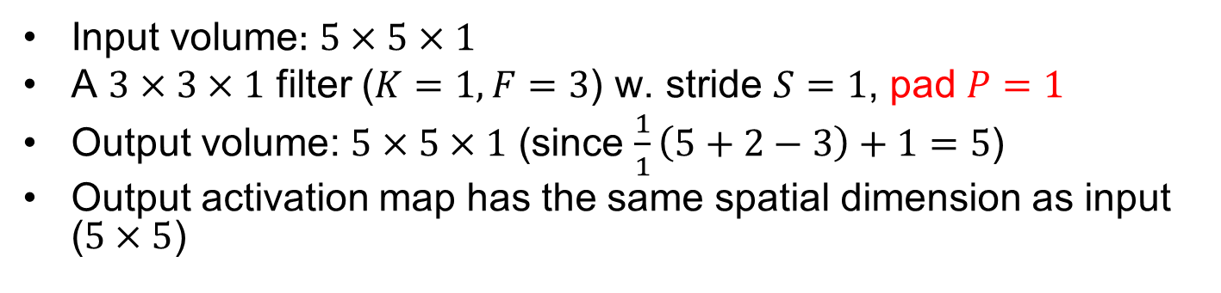
CONV Example 2: Same Padding
Input volume$:$ $5×5×1$
A $3×3×1$ filter ($K=1,F=3$) w. stride $S=1$, pad $P=1$
Output volume: $5×5×1$ (since $\frac{1}{1}\left(5+2−3\right)+1=5$)
Output activation map has the same spatial dimension as input ($5×5$)

Slide 31
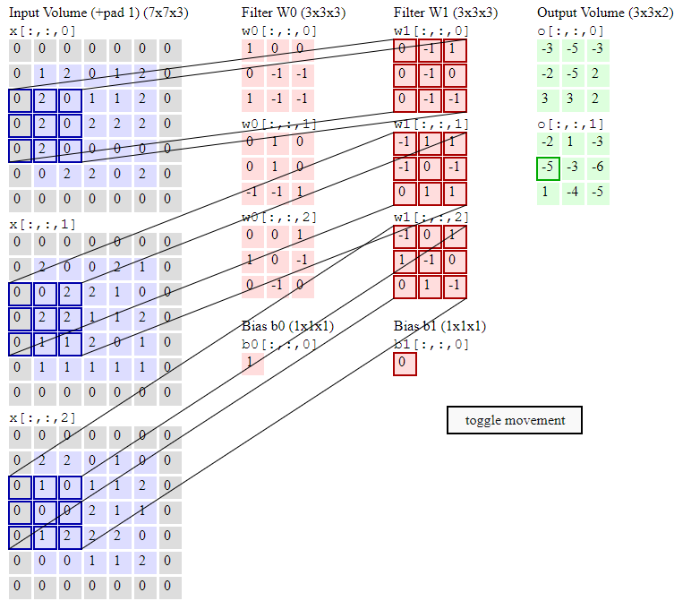
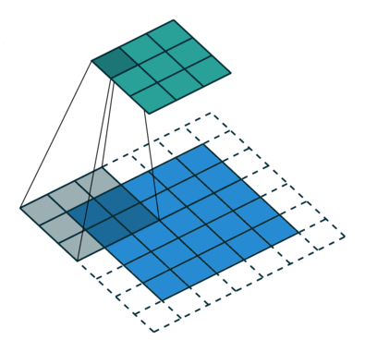
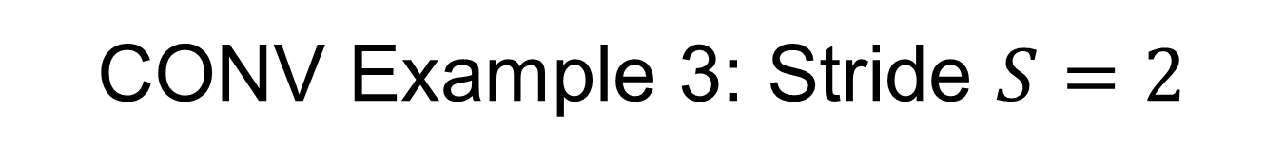
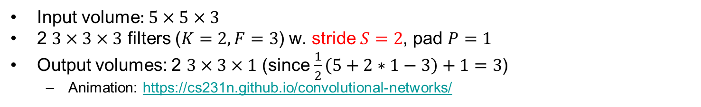
CONV Example 3: Stride $S=2$
Input volume$:$ $5×5×3$
2 $3×3×3$ filters ($K=2,F=3$) w. stride $S=2$, pad $P=1$
Output volumes: 2 $3×3×1$ (since $\frac{1}{2}\left(5+2∗1−3\right)+1=3$)
  Animation: https://cs231n.github.io/convolutional-networks/

Slide 32
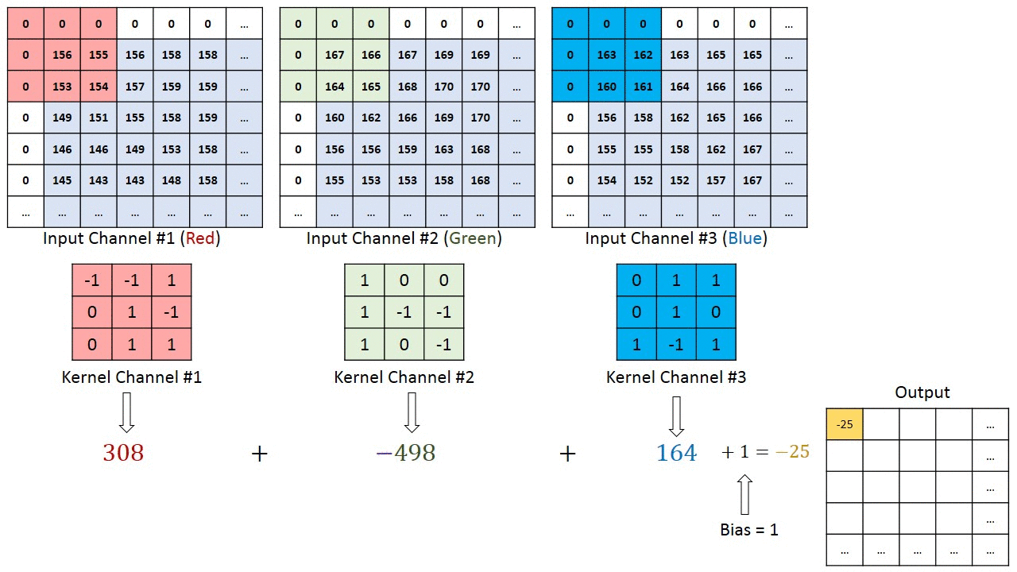
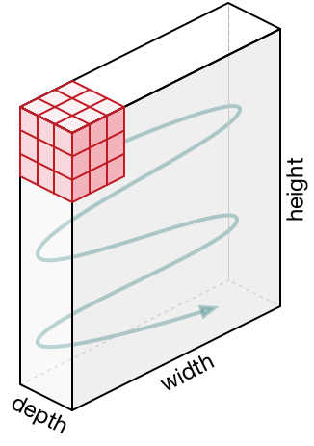
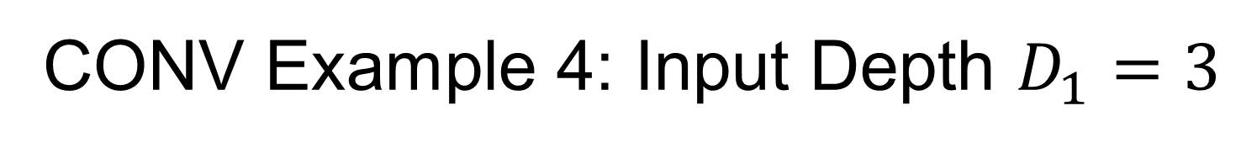

CONV Example 4: Input Depth $D_{1}=3$
Movement of the filter
Input volume$:$ $M×N×3$
A $3×3×3$ filter ($K=1,F=3$) w. stride $S=1$, pad$P=1$
Output volume: $M×N×1$ (since $\frac{1}{1}\left(M+2∗1−3\right)+1=M, \frac{1}{1}\left(N+2∗1−3\right)+1=N$)
https://towardsdatascience.com/a-comprehensive-guide-to-convolutional-neural-networks-the-eli5-way-3bd2b1164a53
Notes:
Convolution of $3×3×3$ filter on a input volume w. stride $S=1$, padding $P=1$, produces a $M×N×3$ output volume (since $\frac{1}{1}\left(M+2∗1−3\right)+1=M,\frac{1}{1}\left(N+2∗1−3\right)+1=N$)

Slide 33


CONV Example 5: Multiple Filters $K=10$
Input volume$:$ $32×32×3$ $(W_{1}=H_{1}=N_{1}=32,D_{1}=3)$
$10 5×5×3$ filters ($K=10,F=5$) w. stride $S=1$, no pad ($P=0$)
Each output activation map:
  Spatial size: $W_{2}=H_{2}=N_{2}=\frac{1}{S}\left(N_{1}+2P−F\right)+1=\frac{1}{1}\left(32−5\right)+1=28$
  Depth: $D_{2}=K=10$
Output volume: $28×28×10$
No. params (weights and biases) in this layer: each filter has $5∗5∗3+1=76$ params, so 10 filters add up to $76∗10=760$ params
32
32
28
28
…
(10 neurons)
32
32
28
28
3
3
10
Notes:
(32+2*2-5)/1+1 = 32 spatially, so
32x32x10

Slide 34


CONV Example 5: Neuron View
One activation map is a $28×28$ sheet of neuron outputs.
With 10 filters, the CONV layer consists of neurons arranged in a 3D grid ($28×28×10$).
  For each $5×5$ patch of the input, there are 10 different neurons all looking at it, each extracting different features
32
32
28
28
…
(10 neurons)
32
32
28
28
3
3
10

Slide 35


CONV Example 6: Pad$P=2$
Input volume$:$ $32×32×3$ $(W_{1}=H_{1}=N_{1}=32,D_{1}=3)$
$10 5×5×3$ filters ($K=10,F=5$) w. stride $S=1$, pad$P=2$
Each activation map:
  Spatial size: $W_{2}=H_{2}=N_{2}=\frac{1}{S}\left(N_{1}+2P−F\right)+1=\frac{1}{1}\left(32+2∗2−5\right)+1=32$
  Depth: $D_{2}=K=10$
Output volume:$32×32×10$
No. params: each filter has $5∗5∗3+1=76$ params, so 10 filters add up to $76∗10=760$ params
Notes:
(32+2*2-5)/1+1 = 32 spatially, so
32x32x10

Slide 36







Pointwise Convolution with $1×1$ Filter
A $1×1$ filter performs “mixing” of the input channels, then applies a non-linear activation function
Can be used to reduce the number of channels (volume depth); the non-linear activation function also helps increase model capacity
$$∗$$
$$=$$
6 $×$ 6 $×$ 32
1 $×$ 1 $×$ 32
6 $×$ 6 $×$ # filters

Slide 37


$1×1$ Filter Example
Input volume$:$ $56×56×64$ $(W_{1}=H_{1}=N_{1}=56, D_{1}=64)$
$32 1×1×64$ filters ($K=32,F=1$) w. stride $S=1$, no pad
Each activation map:
  Spatial size: $W_{2}=H_{2}=N_{2}=\frac{1}{S}\left(N_{1}+2P−F\right)+1=\frac{1}{1}\left(56−1\right)+1=56$
  Depth: $D_{2}=K=32$
Output volume:$56×56×32$
No. params: each filter has $1∗1∗64+1=65$ params, so 32 filters add up to $65∗32=2080$ params
1x1 Conv
w. 32 filters
56
56
(each filter has size 1x1x64, and performs a 64-dimensional dot product)
56
56
64
32
Notes:
(32+2*2-5)/1+1 = 32 spatially, so
32x32x10

Slide 38


Dilated Convolution
Insert 0s between input elements to increase receptive field size without increasing # params
Regular convolution
(1-dilated)
2-dilated
convolution

Slide 39

3D Convolution
3D filter slides along all 3 axes (width, height, depth). Very computation intensive
Useful for 3D images such as medical CT/MRI images, or Point Clouds from Lidar

Slide 40










Converting Convolution to Matrix Multiplication: 1D CONV Example
Since parallel hardware (GPU, FPGA…) can handle matrix multiplication efficiently, this conversion increases computation efficiency at the expense of increased memory size for storing the weights (the biases are not shown in fig)
Input
Kernel
$$x_{0}$$
$$x_{1}$$
$$x_{2}$$
$$x_{3}$$
$$x_{4}$$
Output
$$w_{0}$$
$$w_{1}$$
$$w_{2}$$
$$y_{1}$$
$$y_{2}$$
$$y_{3}$$
$$∗$$
$$=$$
$$x_{0}$$
$$x_{1}$$
$$x_{2}$$
$$x_{3}$$
$$x_{4}$$
$$w_{0}$$ | $$w_{1}$$ | $$w_{2}$$ | $$0$$ | $$0$$
$$0$$ | $$w_{0}$$ | $$w_{1}$$ | $$w_{2}$$ | $$0$$
$$0$$ | $$0$$ | $$w_{0}$$ | $$w_{1}$$ | $$w_{2}$$
$$y_{1}$$
$$y_{2}$$
$$y_{3}$$
$$×$$
$$=$$
Notes:
Facilitates parallel hardware implementation,

Slide 41


Converting Convolution to Matrix Multiplication: 2D CONV Example
Two different ways

Slide 42
Outline
CNN Convolution layers
Pooling and Fully-Connected layers
CNN case studies
RNNs
Notes:
Safety plan
The safety plan gives an overview of how you are going to achieve a safe system. A few of the major elements include:
what system is under consideration
the goal of the project
what steps will be taken to ensure safety
the roles and personnel involved in the project
the project timeline

Slide 43

Typical CNN Architecture
Multiple layers, each consisting of CONV, POOL and non-linear activation functions (e.g., ReLU), are stacked into a deep network
  Many variants possible, e.g., multiple CONV layers can be stacked without POOL and activation functions in-between
32
28
24
….
CONV,
POOL, ReLU
e.g. 6 5x5x3 filters
CONV,
POOL, ReLU
e.g. 10 5x5x6 filters
CONV,
POOL, ReLU
32
28
24
3
6
10
ReLU Activation Function

Slide 44


Feature Hierarchy
Multiple hidden layers extract a hierarchy of increasingly-abstract features layer-by-layer, until the last layer produces a classification result
$$P\left(car\right)=.9$$
$$P\left(truck\right)=. 1$$
Notes:
Fig shows hierarchy of features extracted by different layers of the CNN

Slide 45


Pooling (Sub-Sampling) Layer
Important
A pooling filter has depth 1, and operates over each activation map independently, hence the input volume and output volume always have the same depth $D_{1}=D_{2}$
  In contrast, a CONV filter always has the same depth $D_{1}$ as its input volume, and the number of filters $K$ always equals the depth $D_{2}$ of its output volume
  Common settings: $F=2, S=2$, or $F=3, S=2$
Example: pooling w. a $2×2$ filter w. stride $S=2$, no pad
Output volume: $\frac{W_{1}}{2}×\frac{H_{1}}{2}×D_{1}$(since $\frac{1}{2}\left(W_{1}−2\right)+1=\frac{W_{1}}{2},\frac{1}{2}\left(H_{1}−2\right)+1=\frac{H_{1}}{2}$)

Slide 46


Max Pooling w. Examples
Max pooling: take the max element among the $F∗F$ elements in each $F×F$ patch of each input activation map to reduce its dimension ($F=2,S=2$ in upper right fig)
Alternative: average pooling is less commonly used
Pooling is also called subsampling or downsampling
6 | 8
3 | 4
1 | 1 | 2 | 4
5 | 6 | 7 | 8
3 | 2 | 1 | 0
1 | 2 | 3 | 4
max pooling
3.3 | 5.3
2 | 2
avg pooling
Notes:
Operates over each activation map to reduce its dimension independently
e.g. each activation map is reduced from 224x224 to 112x112 w. 2x2 filter and stride 2
always has the same depth $D_{1}$ as the input volume

Slide 47

Overlapping Pooling
Input volume: $N×N×D_{1}$
A $3×3$ pooling filter w. stride $S=1$, no pad
Output volume: $(N−2)×(N−2)×D_{1}$(since $\frac{1}{1}\left(N−3\right)+1=N−2$)
  In practice, it is more common to have $F=3, S=2$ for overlapping pooling
1 | 3 | 2 | 1 | 3
2 | 9 | 1 | 1 | 5
1 | 3 | 2 | 3 | 2
8 | 3 | 5 | 1 | 0
5 | 6 | 1 | 2 | 9
9 | 9 | 5
9 | 9 | 5
8 | 6 | 9
max pool w. 3x3
filter and stride 1
Notes:
$$F=3, S=2$$

Slide 48


FC Layer
Contains neurons that connect to the entire input volume w. no weight sharing
  No. params for FC layer of size $N_{out}$ connected to input layer of size $N_{in}$ is $(N_{in}+1)∗N_{out}$
bias

Slide 49

CNN Toy Example
A CNN with 1 CONV layer and 1 FC layer
Huang C, Fan J, Chen X, et al. Divide and slide: Layer-wise refinement for output range analysis of deep neural networks[J]. IEEE Transactions on Computer-Aided Design of Integrated Circuits and Systems, 2020, 39(11): 3323-3335.

Slide 50




No. Params in Each Layer
 | CONV | POOL | FC
Input size | $$W_{1}×H_{1}×D_{1}$$ | $$W_{1}×H_{1}×D_{1}$$ | $$N_{in}$$
Output Size | $$W_{2}×H_{2}×K$$ | $$W_{2}×H_{2}×K$$ | $$N_{out}$$
No. params | $$\left(F∗F∗D_{1}+1\right)∗K$$ | $$0$$ | $$\left(N_{in}+1\right){∗N}_{out}$$
https://stanford.edu/~shervine/teaching/cs-230/cheatsheet-convolutional-neural-networks
Notes:
(Here $C$ denotes the depth $D$, also called number of Channels)
In practice, FC layers contribute the most number of parameters (well over 90% for large CNNs)

Slide 51


Fully-Connected NN vs. CNN
In a FCNN, all layers are Fully-Connected
Cannot alter input image size
No translation invariance
No. params can grow very large, prune to overfitting
In a CNN, only the last few (typically <=3) layer(s) are FC
CONV layers can handle images of arbitrary size
Translation invariance
Fewer params than MLP

Slide 52
Outline
CNN Convolution layers
Pooling and Fully-Connected layers
CNN case studies
RNNs
Notes:
Safety plan
The safety plan gives an overview of how you are going to achieve a safe system. A few of the major elements include:
what system is under consideration
the goal of the project
what steps will be taken to ensure safety
the roles and personnel involved in the project
the project timeline

Slide 53


LeNet-5
Layer | Input $$W_{1}×H_{1}×D_{1}$$ | No. Filters | Filter $$K×K×D/S$$ | Output $$W_{2}×H_{2}×D_{2}$$ | No. params
C1:CONV | $$32×32×1$$ | $$6$$ | $$5×5×1$$ | $$28×28×6$$ | $$156$$
S2:POOL | $$28×28×6$$ | $$6$$ | $$2×2×1/2$$ | $$14×14×6$$ | $$0$$
C3:CONV | $$14×14×6$$ | $$16$$ | $$5×5×6$$ | $$10×10×16$$ | $$2416$$
S4:POOL | $$10×10×16$$ | $$16$$ | $$2×2×1/2$$ | $$5×5×16$$ | $$0$$
C5:CONV | $$5×5×16$$ | $$120$$ | $$5×5×16$$ | $$1×1×120$$ | $$48120$$
F6 | FC | - | $$−$$ | $$84$$ | $$10164$$
Output | FC |  |  | $$10$$ | $$850$$

Slide 54

LeNet-5 Details
Input image: $32×32×1$(grey-scale images of hand-written digits w. size $32×32$ pixels)
Conv filters $5×5×1$ w. stride 1; Pooling filters $2×2$ w. stride $2$
Conv layer C1 maps from input volume $32×32×1$ to 6 feature maps w. volume $28×28×6$ (since $\frac{1}{1}(32−5)+1=28$). No params: $\left(5∗5∗1+1\right)∗6=156$
Pooling layer S2 maps from input volume $28×28×6$ to 6 feature maps w. volume $14×14×6$ (since $\frac{1}{2}(28−2)+1=14$).
Conv layer C3 maps from input volume $14×14×6$ to 16 feature maps w. volume $10×10×16$ (since $\frac{1}{1}(14−5)+1=10$). No params: $\left(5∗5∗6+1\right)∗16=2416$
Pooling layer S4 maps from input volume $10×10×16$ to 16 feature maps w. volume $5×5×16$ (since $\frac{1}{2}(10−2)+1=5$)
Conv layer C5 maps from input volume $5×5×16$ to 120 feature maps w. volume $1×1×120$ (since $\frac{1}{1}(5−5)+1=1$). No params: $\left(5∗5∗16+1\right)∗120=48120$
  You can also view it as an equivalent Fully-Connected layer that maps from the flattened input of size $400×1$ ($5∗5∗16=400$) to output of size $120×1$. For details, refer to L4.2 “Turning FC layer into CONV Layers”
FC layer F6 maps from input of size $120×1$ to output of size $84×1$. No params: $(120+1)∗84=10164$
Output layer (SoftMax) maps from input of size $84×1$ to output of size $10$. No params: $(84+1)∗10=850$
https://www.analyticsvidhya.com/blog/2021/03/the-architecture-of-lenet-5/
https://towardsdatascience.com/understanding-lenet-a-detailed-walkthrough-17833d4bd155

Slide 55


AlexNet [Krizhevsky et al. 2012]
Input image: $227×227×3$
1st layer (CONV1): $96 11×11$ filters w. stride $S=4$, w. ReLU activation function
Output volume: $55×55×96$ (since $\frac{1}{4}\left(227−11\right)+1=55$).
2nd layer (POOL1): $3×3$ filters w. stride $S=2$ (overlapping)
Output volume: $27×27×96$ (since $\frac{1}{2}\left(55−3\right)+1=27$)
…
Total No. params: 60M
Introduced ReLU activation function
Notes:
[227x227x3] INPUT
[55x55x96] CONV1: 96 11x11 filters w. stride 4, pad 0 [27x27x96] MAX POOL1: 3x3 filters w. stride 2 [27x27x96] NORM1: Normalization layer
[27x27x256] CONV2: 256 5x5 filters w. stride 1, pad 2 [13x13x256] MAX POOL2: 3x3 filters at stride 2 [13x13x256] NORM2: Normalization layer [13x13x384] CONV3: 384 3x3 filters w. stride 1, pad 1 [13x13x384] CONV4: 384 3x3 filters w. stride 1, pad 1 [13x13x256] CONV5: 256 3x3 filters w. stride 1, pad 1 [6x6x256] MAX POOL3: 3x3 filters w. stride 2
[4096] FC6: 4096 neurons
[4096] FC7: 4096 neurons
[1000] FC8: 1000 neurons (class scores)
ImageNet top 5 error: 15.4%

Slide 56


VGGNet [Simonyan 2014] (the best performing variant VGG-16)
Same padding used for all CONV layers

Slide 57

VGG-16 Details
VGG-16 has 16 weight layers, not including POOL layers w. 0 weight
Input image: $224×224×3$
1st and 2nd CONV layers: $64 3×3$ filters w. stride $S=1$, pad $P=1$
  Output volume: $224×224×64$ (since $\frac{1}{1}\left(224+2∗1−3\right)+1=224$)
3rd POOL layer: $2×2$ filters w. stride $S=2$
  Output volume: $112×112×64$ (since $\frac{1}{2}\left(224−2\right)+1=112$)
4th and 5th CONV layers: $128 3×3$ filters w. stride $S=1$, pad $P=1$
  Output volume: $112×112×128$ (since $\frac{1}{1}\left(112+2∗1−3\right)+1=112$)
6th POOL layer: $2×2$ filters w. stride $S=2$
  Output volume: $56×56×128$ (since $\frac{1}{2}\left(112−2\right)+1=56$)
Total No. params: 60M
ImageNet top 5 error: 7.3%

Slide 58




Stacked $3×3$ CONV Layers
2 stacked $3×3$ CONV layers w. pad $P=1$ have the same effective receptive field as a $5×5$ CONV layer; 3 stacked $3×3$ CONV layers w. pad $P=1$ have RF of $7×7$; $L$ stacked $3×3$ CONV layers w. pad $P=1$ have RF of $1+2L$
Benefits:
  Fewer params. Suppose all volumes have the same depth $D$, then a $7×7$ CONV layer has $\left(7∗7∗D+1\right)∗D≈49D^{2}$ params, while three stacked 3x3 CONV layers have only $\left(3∗3∗D+1\right)∗D∗3)≈27D^{2}$ params
  Two layers of non-linear activation functions increases CNN depth, hence larger model capacity
https://zhuanlan.zhihu.com/p/79258431

Slide 59

VGGNet No. Params
Memory refers to memory size of activation maps
For ease of calculation, only the No. weights are counted, not the biases

Slide 60

VGGNet Variants
Best performing variant
VGG-16

Slide 61

GoogLeNet [Szegedy et al., 2014]
Additional classification heads
for regularization
Inception Module

Slide 62


Inception Module
Can’t make up your mind about filter size? Have them all in the Inception Module!
  But this increases computation load
Additional $1×1$ CONV layers serve as bottleneck to reduce number of parameters and computation load

Slide 63










CONV
32,
5 $×$ 5 $×$ 192
Same padding ($P=2$)
28 $×$ 28 $×$ 192
28 $×$ 28 $×$ 32
Without the bottleneck layer: No. params: $5∗5∗192∗32=153600$; No. multiplications: $5∗5∗192∗32∗28∗28=120$M
CONV
32,
5 $×$ 5 $×$ 16
Same padding ($P=2$)
CONV
16,
1 $×$ 1 $×$ 192
28 $×$ 28 $×$ 192
28 $×$ 28 $×$ 16
28 $×$ 28 $×$ 32
With the bottleneck layer: No. params: $1∗1∗192∗16+5∗5∗16∗32=15872$; No. multiplications: $1∗1∗192∗16∗28∗28+5∗5∗16∗32∗28∗28=12.4$M

Slide 64

GoogLeNet Size
Compared to AlexNet:
  12x less params (only 5M, due to no FC layers), 2x more compute (due to more CONV layers)

Slide 65



Xception [Chollet 2017] MobileNets [Howard et al. 2017] : Depthwise Separable Convolution
Each filter is convolved with one input channel
Each filter is convolved with all input channels
Regular Convolution
The intermediate feature maps serve as bottleneck to reduce number of parameters and computation load
(Optional) Depthwise Separable Convolution - A FASTER CONVOLUTION! https://www.youtube.com/watch?v=T7o3xvJLuHk
Followed by pointwise convolution
Depthwise Separable Convolution:

Slide 66

Example: Regular Convolution
Input feature map
No. params: $3∗3∗2∗4=72$ (Four $3×3×2$ filters) (not counting biases)
No. MULs: $3∗3∗2∗4∗4∗4=1152$ ($3∗3∗2$ MULs to compute each output element; $4∗4∗4$ output elements)
2 channels
Notes:
No. params: $5∗5∗192∗32=153600$; No. multiplications: $5∗5∗192∗32∗28∗28=120$M

Slide 67


Example: Depthwise Separable Convolution
1. Depthwise Convolution
No. params: $3∗3∗2+2∗4=26$ (Two $3×3×1$ filters and four $1×1×2$ filters) (not counting biases)
No. MULs: $3∗3∗1∗2∗4∗4+1∗1∗2∗4∗4∗4=416$ (Depthwise Conv: $3∗3∗1$ MULs to compute each output element; $4∗4∗2$ output elements; Pointwise Conv: $1∗1∗2$ MULs to compute each output element; $4∗4∗4$ output elements)
2. Pointwise Convolution
$1×1$
filters
Notes:
$$3×3×2=182×4=8$$

Slide 68


Residual Networks (ResNet) [He et al. 2015]
Based on VGG-19, adding more layers and skip connections
ImageNet top 5 error: 3.6%

Slide 69


ResNet Skip Connection
In a standard network, output from a given layer is $F\left(x\right)$
In ResNet w. the identity skip (or short-cut) connection, output from a given layer is $H\left(x\right)=F\left(x\right)+x$
Benefits:
  Residual connections help in handling the vanishing gradient problem in very deep NNs
  If identify mapping is close to optimal, then weights can be small to capture minor differences only, in other words, “unnecessary layers” can learn to be identity mapping. This allows stacking many layers (e.g., 152) without overfitting

Slide 70











Consider a 3-layer Network
Standard NN:
  $x_{3}=f_{3}\left(f_{2}(f_{1}(x_{0}\right)))$
ResNet:
  $x_{1}=f_{1}\left(x_{0}\right)+x_{0}$
  $x_{2}=f_{2}\left(x_{1}\right)+x_{1}=f_{2}\left(f_{1}\left(x_{0}\right)+x_{0}\right)+f_{1}\left(x_{0}\right)+x_{0}$
  $x_{3}=f_{3}\left(x_{2}\right)+x_{2}=f_{3}\left(f_{2}\left(f_{1}\left(x_{0}\right)+x_{0}\right)+f_{1}\left(x_{0}\right)+x_{0}\right)+f_{2}\left(f_{1}\left(x_{0}\right)+x_{0}\right)+f_{1}\left(x_{0}\right)+x_{0}$
Suppose $f2(x1)$ is a vector of very small values (layer 2 is “off”/skipped), then it looks like the input $x_{0}$ bypassed the second layer completely on its way to the output $x_{3}$
$$x_{0}$$
$$x_{1}$$
$$x_{2}$$
$$x_{3}$$
$$x_{0}$$
$$x_{1}$$
$$x_{2}$$
$$x_{3}$$

Slide 71


ResNet is an Ensemble of Models
Every input $x_{0}$ to ResNet may activate a unique path to the output. Total number of possible paths is $2^{N}$, where $N$ is the total number of layers in the network, since each layer may be either “on” or “off” for a given input $x_{0}$
  Compare w. a standard network, where there is only one single path for any input corresponding to all layers being “on”, and no layer is skipped
Consequences:
  Resilience to layer deletion: deleting 1-3 layers in a large ResNet introduces only around 6-7% error
  Shortening of effective paths: w. 152-layer ResNet, most paths are only 20-30 levels deep!
Notes:
At every single node, there are multiple paths, each of which may or may not contribute to the overall output. So

Slide 72

Deeper Nets have Better Performance

Slide 73


ResNet Training with Stochastic Depth
For each minibatch of inputs, randomly skip some layers (replaced w. identity mapping)
Reduced network depth during training; full depth during inference
MB1
MB2
MB3

Slide 74


ImageNet Large Scale Visual Recognition Challenge
1,000 object classes, 1.4 M labeled images

Slide 75


CNN Layer Patterns
A typical CNN architecture looks like: INPUT->[[CONV->RELU]*N->POOL?]*M->[FC->RELU]*K->FC
  where * indicates repetition, and POOL? indicates an optional pooling layer. $N≥0$ (usually $N≤3$), $M≥0$, $K≥0$ (and usually $K<3$)
Some common architectures:
  INPUT->FC, implements a linear classifier. Here N = M = K = 0.
  INPUT->CONV->RELU->FC
  INPUT->[CONV->RELU->POOL]*2->FC->RELU->FC (fig below). There is a single CONV layer between every POOL layer.
  INPUT->[CONV->RELU->CONV->RELU->POOL]*3->[FC->RELU]*2->FC There are two CONV layers stacked before every POOL layer, e.g., two stacked $3×3$ CONV Layers. This is generally a good idea for larger and deeper networks, because multiple stacked CONV layers can develop more complex features of the input volume before the destructive pooling operation.
Notes:
[(CONV-RELU)*N-POOL?]*M-(FC-RELU)*K,SOFTMAX, where N is usually up to ~5, M is large, K <= 3
But recent architectures (ResNet/GoogLeNet) challenge this paradigm

Slide 76
Layer Sizing Rules-of-Thumb
The input layer (that contains the image) should be divisible by 2 many times. Common numbers include 32 (e.g. CIFAR-10), 64, 96 (e.g. STL-10), or 224 (e.g. ImageNet), 384, and 512.
The CONV layers should use small filters (e.g. 3x3 or at most 5x5), stride S=1. The input volume should have “same padding”, i.e., the conv layer does not alter the spatial size of the input. For any F, pad P=(F−1)/2 preserves the input size, e.g., when F=3, P=1; when F=5, P=2. This means the CONV layers only transform the input volume depth-wise, but do not perform downsampling. (c.f. CONV Example 3 and VGGNet).
The POOL layers are in charge of downsampling the spatial dimensions of the input. The most common setting is to use max-pooling with 2x2 receptive fields (F=2), with stride of 2 (S=2). A less common setting is to use F=3, S=2. It is uncommon to see receptive field sizes for max pooling that are larger than 3, because the pooling is then too lossy and aggressive.
In some cases (especially in early layers), the memory size can build up very quickly with the rules of thumb presented above. For example, filtering a 224x224x3 image with three 3x3 CONV layers with 64 filters each and padding 1 would create 3 activation volumes, each with size 224x224x64. This amounts to a total of about 10 million activations, or 72MB of memory (per image, for both activations and gradients). Since GPUs are often bottlenecked by memory, it may be necessary to compromise. In practice, make the compromise at only the first CONV layer that is looking at the input image. For example, AlexNet uses filter size of 11x11 and stride of 4 in the first CONV layer.
Notes:
CNN is the dominant modeling paradigm for perception tasks in modern CV (detection, classification, tracking, segmentation)
ConvNets stack multiple CONV,POOL,FC layers
Recent trend: smaller filters, more layers, no POOL/FC layers (just CONV)
That is, when F=3, then using P=1 will retain the original size of the input. When F=5, P=2.
Note that this discards 75% of the activations in an input volume (due to downsampling by 2 in both width and height). Only use bigger filter sizes (such as 7x7 or 11x11) on the very first conv layer that is looking at the input image.

Slide 77
Memory Size Considerations
From the intermediate volume sizes:
  These are the raw number of activations at every layer of the CNN, and also their gradients (of equal size). Usually, most of the activations are on the earlier CONV layers of a CNN. These are kept around because they are needed for backpropagation during training, but for inference, we can store only the current activations at the current layer and discarding the activations from previous layers.
From the parameter sizes:
  These are the weights and biases, and their gradients during backprop, and also a step cache if the optimization is using momentum, Adagrad, or RMSProp. Therefore, the memory to store the parameter vector alone usually should be multiplied by a factor of at least 3 or so.
Each number may need 4 B storage space for floating point, 8 B for double, or 1 B or smaller for optimized fixed-point implementations.
Notes:
Misc memory, such as the image data batches, perhaps their augmented versions, etc.

Slide 78
Transfer Learning
Instead of training your CNN from scratch, start from a pre-trained CNN (e.g., ResNet) and fine-tune it for your task
First, replace SoftMax layer (classification head) with your own
Next, train the CNN while keeping parameters frozen for
  all CONV layers and only train the SoftMax layer
  or part of the earlier CONV layers close to the input layer (since earlier layers extract lower-level features that are more likely to be common among different tasks)
  or none of the layers
  The decision depends on how much training data you have, and how similar your task is to that of the pre-trained CNN
Keep frozen earlier layers
Retrain one or more later layers
Replace SoftMax layer

Slide 79
Outline
CNN Convolution layers
Pooling and Fully-Connected layers
CNN case studies
RNNs
Notes:
Safety plan
The safety plan gives an overview of how you are going to achieve a safe system. A few of the major elements include:
what system is under consideration
the goal of the project
what steps will be taken to ensure safety
the roles and personnel involved in the project
the project timeline

Slide 80

Recurrent Neural Network (RNN)
An RNN has connections between nodes that form a directed graph along a temporal sequence. This allows it to process variable-length input sequences and take into account dynamic temporal behavior
  e.g., To take into account temporal sequence of consecutive image frames in a video clip, we can either stack together a fixed number of frames as input to a CNN (e.g., grouping four $N×N×3$ input images to form a $N×N×12$ input image), or we can use an RNN (combined w. CNN) to process any variable-length sequence of frames
  (Optional) Michael Phi, Illustrated Guide to Recurrent Neural Networks: Understanding the Intuition https://www.youtube.com/watch?v=LHXXI4-IEns
Notes:
Combining CNN and RNN results in Convolutional RNN.
RNN can process variable-length input sequence, suitable for tasks such as machine translation and speech recognition.

Slide 81

RNN Architecture Variants
Regular Feedforward NN
e.g. Image Captioning
image -> sequence of words
e.g. Sentiment Classification
sequence of words -> sentiment
e.g. Machine Translation
seq of words -> seq of words
e.g., video classification
on frame level

Slide 82




RNN Many-to-Many Architecture
RNN can process a sequence of inputs $x$ recurrently at every time step, w. the same activation function and parameters $f_{W}$
  e.g. $h_{t}=\tanh{(W_{hh}h_{t−1}+W_{xh}x_{t})}, y_{t}=W_{hy}h_{t}$
  $h_{t}$ can even be a large CNN (without the last classification layer)
new state at timestep $t$
old state input at
at $t−1$ timestep $t$
Activation function
w. params W
y
y_{t-1}
y_{t}
y_{t+1}
W_{hy}
W_{hy}
W_{hy}
Unroll
W_{hh}
W_{hh}
h
h_{t-1}
h_{t}
h_{t+1}
W_{xh}
W_{xh}
W_{xh}
x
x_{t-1}
x_{t}
x_{t+1}
Notes:
$h_{t}=f_{W}(h_{t−1},x_{t})$ https://en.wikipedia.org/wiki/Recurrent_neural_network

Slide 83

Example: Character-Level Language Model, Training Time
Task: predict the next char from current char sequence
Example training sequence: “hello” w. vocabulary: [h,e,l,o]
  Input is one-hot encoding of each char
  Hidden layer is learned embedding
  Output layer is a probability vector w. size 4, denoting prob distribution of next char. (Fig shows the activation values before applying the SoftMax function for computing probabilities).
Notes:
At each timestep, we sample from the prob distribution of the output to generate the next input char. (Here we assume the char w. highest prob is always selected at each timestep, but it is possible to select the other choices)

Slide 84


Example: Character-Level Language Model, Inference Time
Initial input is char “h”
At each timestep, sample from the prob vector of the output $yt$ to generate the next input char
  The char w. largest logit (highest probability) is likely, but not always selected as output at each timestep, i.e., “e”, “l”, “l” in sequence (but it is possible to select the other choices, e.g., “l”, “e”, “e”)
sample
sample
sample
Initial Input

Slide 85

Example: Image Captioning
CNN processes the input image and generates a feature vector as input to RNN
Recurrent Neural Network
Convolutional Neural Network

Slide 86



Image Captioning: Word-Level Language Model, Inference Time
The last 2 layers of the CNN for classification (FC-1000 and SoftMax) are not used, since we only need the extracted features from the layer FC-4096
At each timestep, sample from the prob vector of the output $yt$ to generate the next input word
y0
y1
y2
h0
h1
h2
sample
sample
sample
<END> token
=> finish.
x0
<STA RT>
straw
hat
<START>

Slide 87

Image Captioning Examples
Bottom row shows failure cases

Slide 88

RNN in AD
Combined with CNN, RNN can handle Non-Markovian behavior, i.e, the current action depends not just on the current observation (input image), but on a recent history of observations

Slide 89
RNN Summary
Training of RNNs requires back propagation through time, which may cause exploding or vanishing gradient problems
More sophisticated architectures are more practical
  LSTM (Long Short-Term Memory Model) or GRU (Gated Recurrent Unit)
RNNs are most widely used in Natural Language Processing, but it is also useful for processing videos, w. applications in autonomous driving

