Slide 1
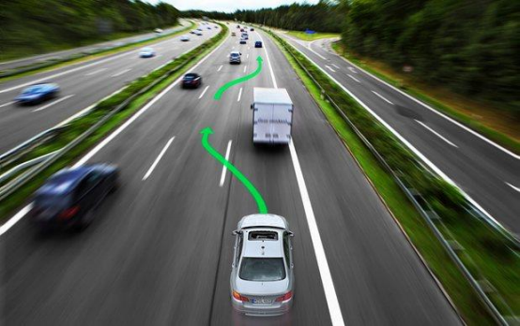
L5 Planning
Zonghua Gu 2021
Acknowledgement: slides partly based on https://www.coursera.org/learn/motion-planning-self-driving-cars

Slide 2
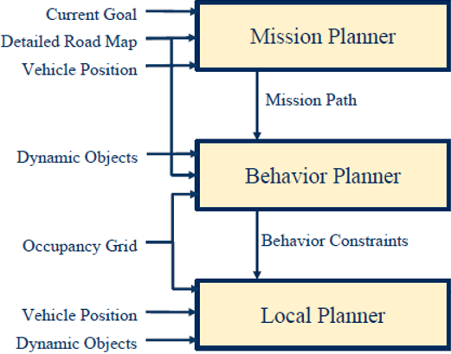
A Hierarchy of Planners
Mission Planning: map-level navigation
Behavior Planning: choosing a behavior based on environmental conditions
Motion Planning: includes path planning and speed profile generation, generates a reference trajectory to be tracked by controller
Reference Trajectory
Controller (PID, MPC…)

Slide 3
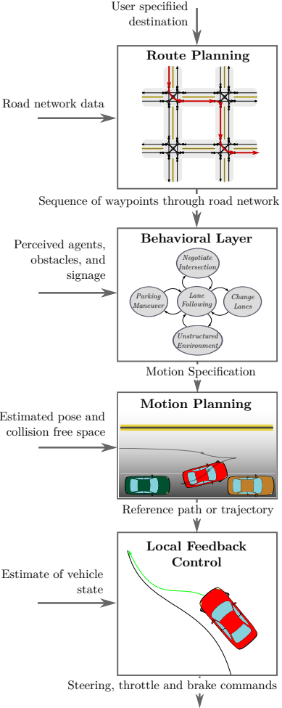
Outline
Route planning
Behavior planning
Motion Planning
Responsibility-Sensitive Safety (RSS)
Paden B, Čáp M, Yong S Z, et al. A survey of motion planning and control techniques for self-driving urban vehicles[J]. IEEE Transactions on intelligent vehicles, 2016, 1(1): 33-55.
Notes:
Safety plan
The safety plan gives an overview of how you are going to achieve a safe system. A few of the major elements include:
what system is under consideration
the goal of the project
what steps will be taken to ensure safety
the roles and personnel involved in the project
the project timeline

Slide 4
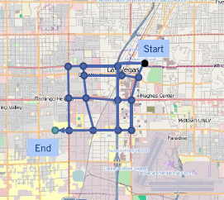
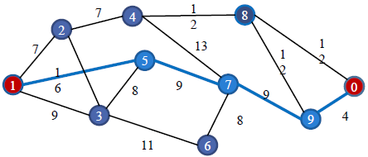
Route Planning
Find the optimal path for navigation from Start to Goal on a weighted graph
Graph search algorithms
  Dijkstra’s, A*,…
Notes:
Use graph search to find a high-level path from source to destination on the map

Slide 5
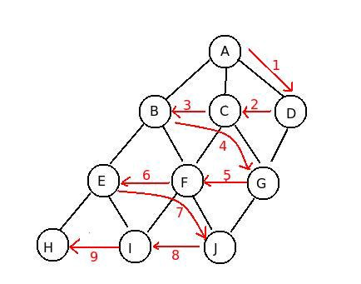
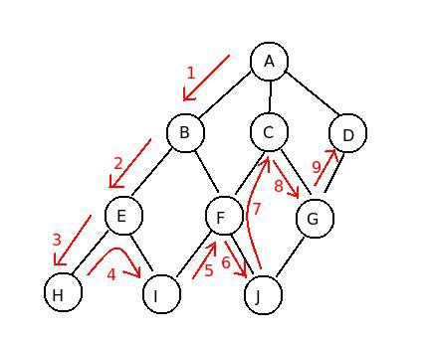
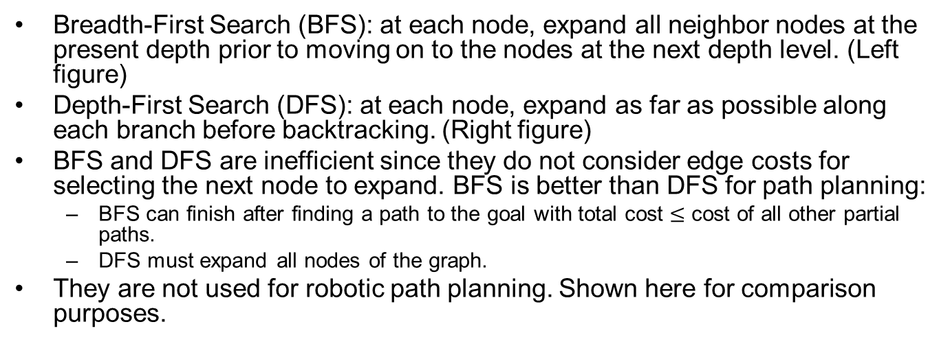
BFS and DFS
Breadth-First Search (BFS): at each node, expand all neighbor nodes at the present depth prior to moving on to the nodes at the next depth level. (Left figure)
Depth-First Search (DFS): at each node, expand as far as possible along each branch before backtracking. (Right figure)
BFS and DFS are inefficient since they do not consider edge costs for selecting the next node to expand. BFS is better than DFS for path planning:
  BFS can finish after finding a path to the goal with total cost $≤$ cost of all other partial paths.
  DFS must expand all nodes of the graph.
They are not used for robotic path planning. Shown here for comparison purposes.
https://medium.com/@nihatkoc/dfs-vs-bfs-6b632c381ed6
Notes:
We will discuss Dijkstra’s and A* algorithm:
Both can finish after finding a path to goal, and the path is

Slide 6

Running Example
Shortest path is $S→C→E$ with length $10+12=22$
S
2
A
3
B
10
20
C
12
G

Slide 7

BFS
S
2
A
3
B
S
2
A
3
B
10
20
10
20
C
12
G
C
12
G
S
2
A
3
B
S
2
A
3
B
10
20
10
20
C
12
G
C
12
G
S
2
A
3
B
S
2
A
3
B
10
20
10
20
C
12
G
C
12
G
Cannot finish here, must expand node C, since total cost $25>10$, cost of the other partial path through C.
Notes:
(Cannot finish here, must expand node B
since B’s cost to S 5 is less than 22.)

Slide 8
DFS
S
2
A
3
B
S
2
A
3
B
10
20
10
20
C
12
G
C
12
G
S
2
A
3
B
S
2
A
3
B
10
20
10
20
C
12
G
C
12
G
S
2
A
3
B
S
2
A
3
B
10
20
10
20
C
12
G
C
12
G
Must always expand all nodes.

Slide 9
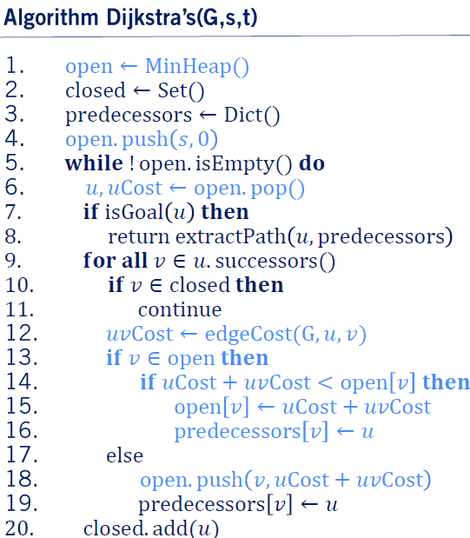
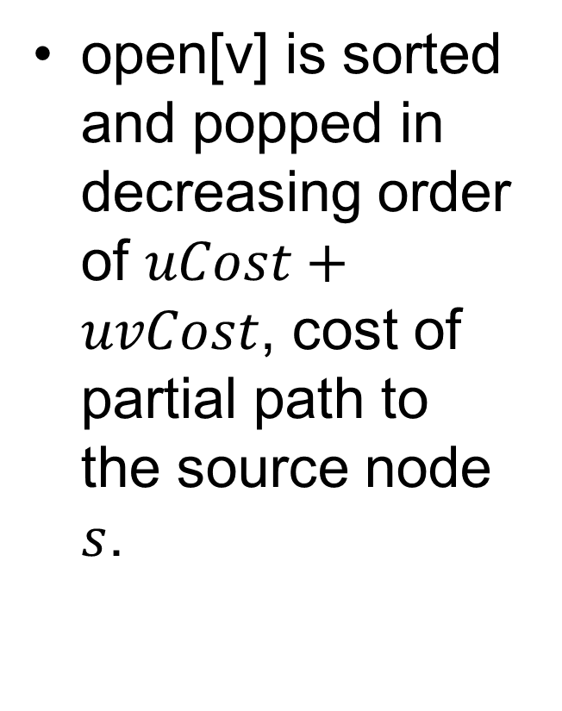
Dijkstra’s Algorithm
open[v] is sorted and popped in decreasing order of $uCost+uvCost$, cost of partial path to the source node $s$.

Slide 10
Dijkstra Example
S
2
A
3
B
Node | Cost to S
S | 0
10
20
C
12
G
Node | Cost to S
A | 2
C | 10
S
A
B
2
3
10
20
Closed set: S
C
12
G
Node | Cost to S
B | 5
C | 10
S
2
A
3
B
10
20
C
12
G
Closed set: S, A

Slide 11
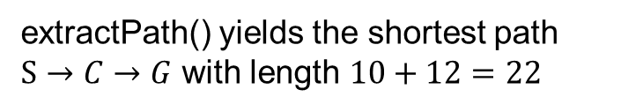
Dijkstra Example cont’
S
2
A
3
B
Node | Cost to S
C | 10
G | 25
10
20
C
12
G
Closed set: S, A, B
Node | Cost to S
G | 22
S
2
A
3
B
10
20
Closed set: S, A, B, C
C
12
G
S
2
A
3
B
extractPath() yields the shortest path $S→C→G$ with length $10+12=22$
10
20
C
12
G

Slide 12
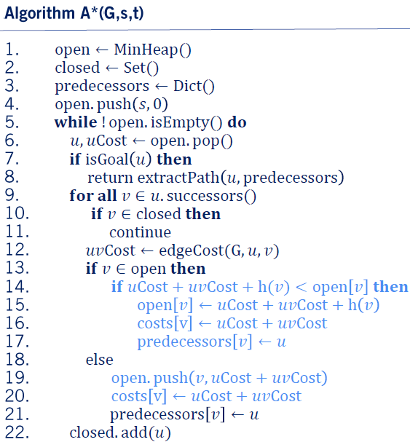
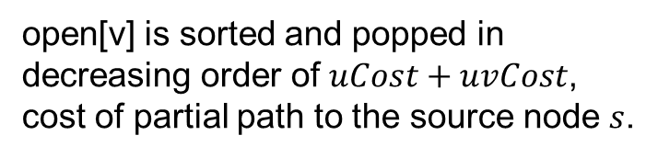
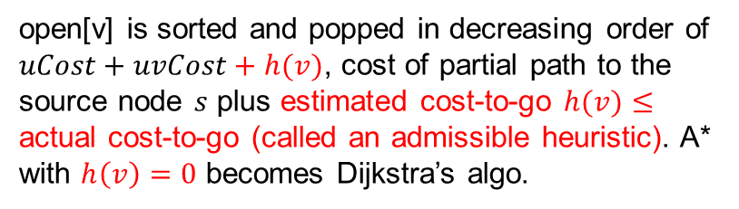
A* Algorithm (Compare to Dijkstra)
open[v] is sorted and popped in decreasing order of $uCost+uvCost+h(v)$, cost of partial path to the source node $s$ plus estimated cost-to-go $h(v)≤$ actual cost-to-go (called an admissible heuristic). A* with $h\left(v\right)=0$ becomes Dijkstra’s algo.
open[v] is sorted and popped in decreasing order of $uCost+uvCost$, cost of partial path to the source node $s$.

Slide 13

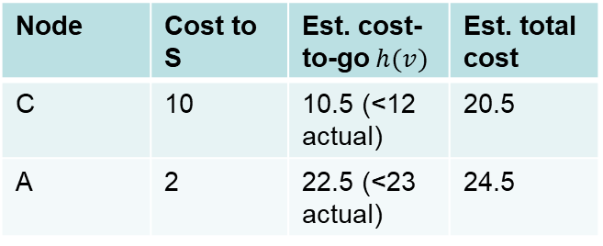

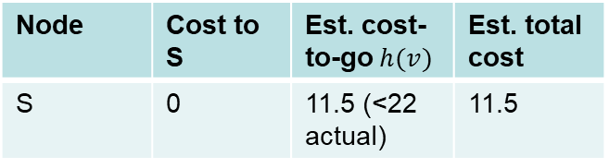

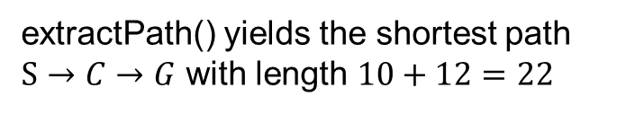
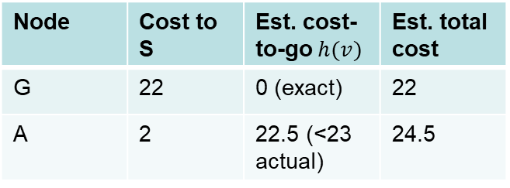

A* Example
S
2
A
3
B
Node | Cost to S | Est. cost-to-go $h(v)$ | Est. total cost
S | 0 | 11.5 (<22 actual) | 11.5
$h\left(S\right)=11.5$
10
20
C
12
G
$h\left(A\right)=22.5$
Node | Cost to S | Est. cost-to-go $h(v)$ | Est. total cost
C | 10 | 10.5 (<12 actual) | 20.5
A | 2 | 22.5 (<23 actual) | 24.5
S
2
A
3
B
10
20
$h\left(C\right)=10.5$
C
12
G
Closed set: S
Closed set: S
$h\left(A\right)=22.5$
Node | Cost to S | Est. cost-to-go $h(v)$ | Est. total cost
G | 22 | 0 (exact) | 22
A | 2 | 22.5 (<23 actual) | 24.5
S
2
A
3
B
10
20
C
12
G
Closed set: S, C
extractPath() yields the shortest path $S→C→G$ with length $10+12=22$

Slide 14

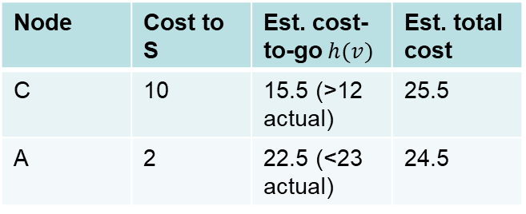

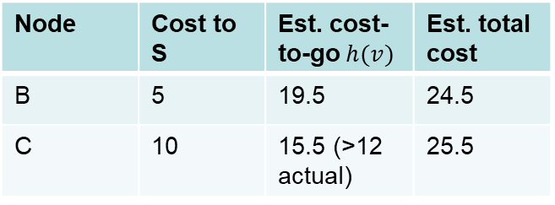

A* Example w Inadmissible Heuristic
S
2
A
3
B
Node | Cost to S | Est. cost-to-go $h(v)$ | Est. total cost
S | 0 | 11.5 (<22 actual) | 11.5
$h\left(S\right)=11.5$
10
20
C
12
G
$h\left(A\right)=22.5$
Node | Cost to S | Est. cost-to-go $h(v)$ | Est. total cost
C | 10 | 15.5 (>12 actual) | 25.5
A | 2 | 22.5 (<23 actual) | 24.5
S
2
A
3
B
10
20
$h\left(C\right)=15.5$
C
12
G
Closed set: S
Closed set: S
$h\left(B\right)=19.5$
Node | Cost to S | Est. cost-to-go $h(v)$ | Est. total cost
B | 5 | 19.5 | 24.5
C | 10 | 15.5 (>12 actual) | 25.5
S
2
A
3
B
10
$h\left(C\right)=15.5$
20
C
12
G
Closed set: S, C

Slide 15
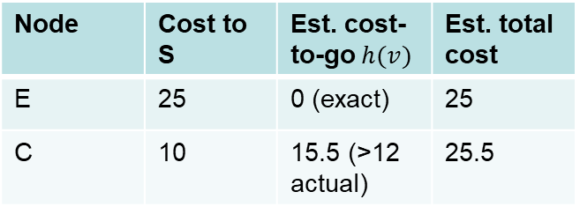
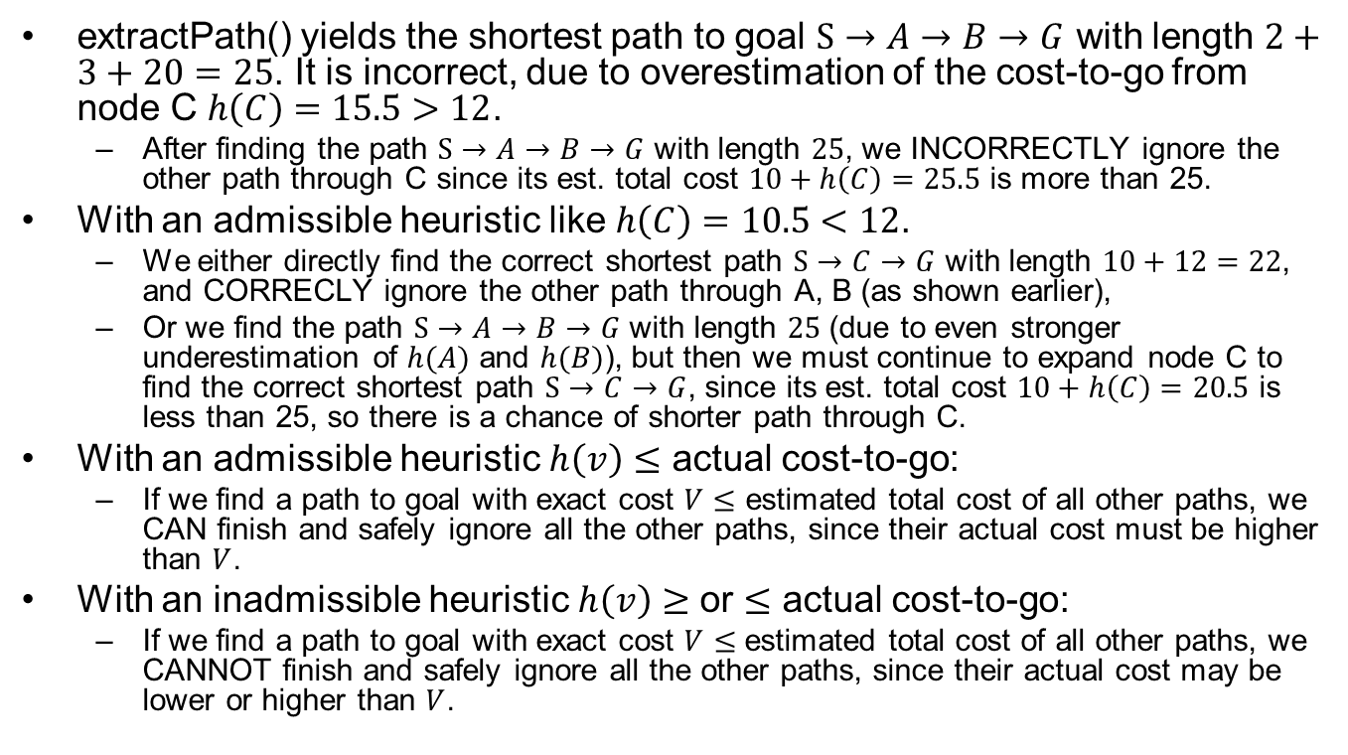

A* Example w Inadmissible Heuristic
Node | Cost to S | Est. cost-to-go $h(v)$ | Est. total cost
E | 25 | 0 (exact) | 25
C | 10 | 15.5 (>12 actual) | 25.5
S
2
A
3
B
10
$h\left(C\right)=15.5$
20
C
12
G
Closed set: S, A, B
extractPath() yields the shortest path to goal $S→A→B→G$ with length $2+3+20=25$. It is incorrect, due to overestimation of the cost-to-go from node C $h\left(C\right)=15.5>12$.
  After finding the path $S→A→B→G$ with length $25$, we INCORRECTLY ignore the other path through C since its est. total cost $10+h\left(C\right)=25.5$ is more than 25.
With an admissible heuristic like $h\left(C\right)=10.5<12$.
  We either directly find the correct shortest path $S→C→G$ with length $10+12=22$, and CORRECLY ignore the other path through A, B (as shown earlier),
  Or we find the path $S→A→B→G$ with length $25$ (due to even stronger underestimation of $h(A)$ and $h(B)$), but then we must continue to expand node C to find the correct shortest path $S→C→G$, since its est. total cost $10+h\left(C\right)=20.5$ is less than 25, so there is a chance of shorter path through C.
With an admissible heuristic $h\left(v\right)≤$ actual cost-to-go:
  If we find a path to goal with exact cost $V≤$ estimated total cost of all other paths, we CAN finish and safely ignore all the other paths, since their actual cost must be higher than $V$.
With an inadmissible heuristic $h\left(v\right)$ $≥$ or $≤$ actual cost-to-go:
  If we find a path to goal with exact cost $V$ $≤$ estimated total cost of all other paths, we CANNOT finish and safely ignore all the other paths, since their actual cost may be lower or higher than $V$.
Notes:
extractPath() yields the shortest path $S→A→B→E$ with length $2+3+20=25$. It is incorrect, due to overestimation of the cost-to-go from node C $h\left(C\right)=15.5>12$. After finding the path $S→A→B→E$ with length $25$, we
With an admissible heuristic like $h\left(C\right)=10.5<12$.

Slide 16
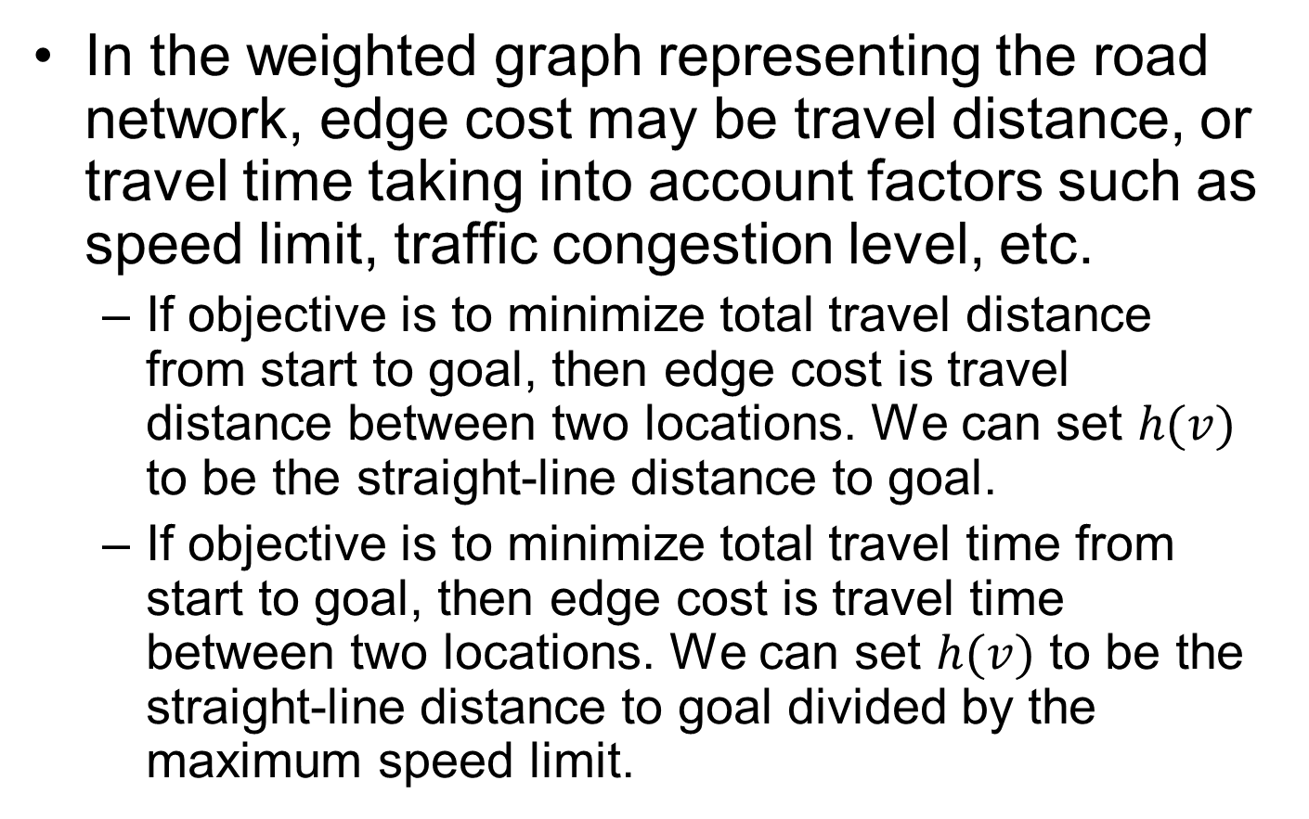
How to Design an Admissible Heuristic?
In the weighted graph representing the road network, edge cost may be travel distance, or travel time taking into account factors such as speed limit, traffic congestion level, etc.
  If objective is to minimize total travel distance from start to goal, then edge cost is travel distance between two locations. We can set $h(v)$ to be the straight-line distance to goal.
  If objective is to minimize total travel time from start to goal, then edge cost is travel time between two locations. We can set $h(v)$ to be the straight-line distance to goal divided by the maximum speed limit.

Slide 17
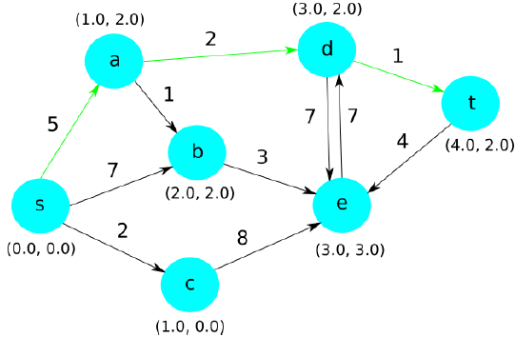
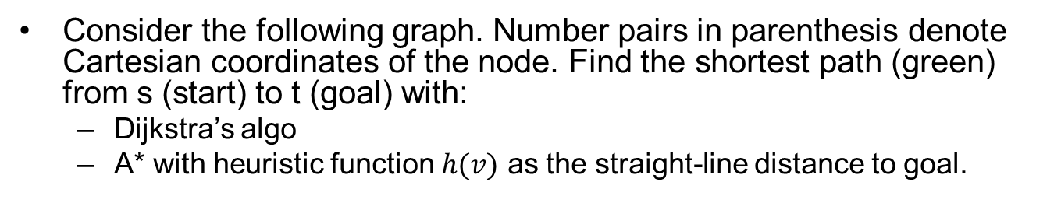
Exercise
Consider the following graph. Number pairs in parenthesis denote Cartesian coordinates of the node. Find the shortest path (green) from s (start) to t (goal) with:
  Dijkstra’s algo
  A* with heuristic function $h(v)$ as the straight-line distance to goal.

Slide 18
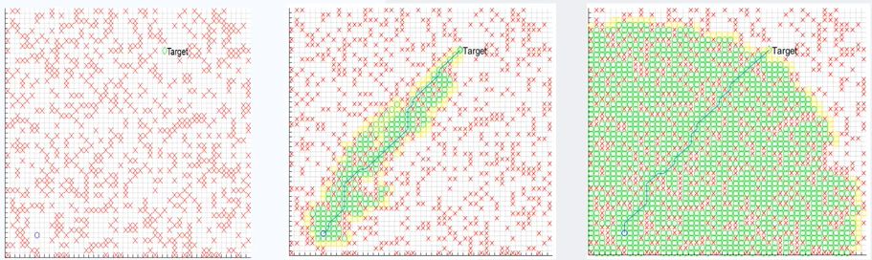
A* vs. Dijkstra
Red crosses denote obstacles.
Green circles denote explored positions.
A* search is more efficient, as it is directed towards the target; Dijkstra’s algorithm explores in every direction and less efficient.
Grid Map
A* Algorithm
Dijkstra’s Algorithm

Slide 19
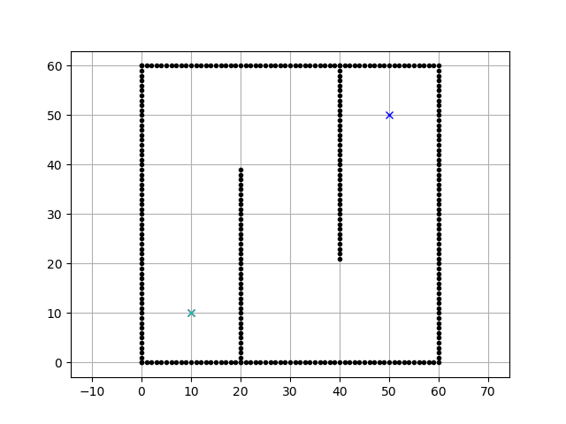

A* vs. Dijkstra (Animation)
Dijkstra
A*
More animations https://qiao.github.io/PathFinding.js/visual/
https://github.com/AtsushiSakai/PythonRobotics

Slide 20
Outline
Route planning
Behavior planning
Motion Planning
Responsibility-Sensitive Safety (RSS)
Paden B, Čáp M, Yong S Z, et al. A survey of motion planning and control techniques for self-driving urban vehicles[J]. IEEE Transactions on intelligent vehicles, 2016, 1(1): 33-55.
Notes:
Safety plan
The safety plan gives an overview of how you are going to achieve a safe system. A few of the major elements include:
what system is under consideration
the goal of the project
what steps will be taken to ensure safety
the roles and personnel involved in the project
the project timeline

Slide 21
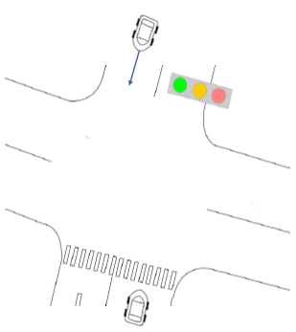
Behavior Planner
Plan the set of high-level driving actions, or maneuvers to safely achieve the driving mission under various driving situations based on:
  Rules of the road (traffic lights, stop signs…)
  Static objects (parked vehicles…)
  Dynamic objects (moving vehicles, cyclists, pedestrians…). Need behavior prediction.

Slide 22
Driving Maneuvers
Track speed
  Maintain current speed consistent with other vehicles on the road.
Follow leader
  Match speed of the leading vehicle and maintain a safe distance.
Decelerate to stop
  Begin decelerating and stop before a given space.
Stop
  Remain stopped in the current position.
Change lanes
Turn
  Left, right, U-turn…
Pass
  Complex maneuver involving changing lanes, passing, (optional) changing back to ego-lane.
Notes:
Choose a maneuver (stop, go straight, turn left, turn right..),

Slide 23
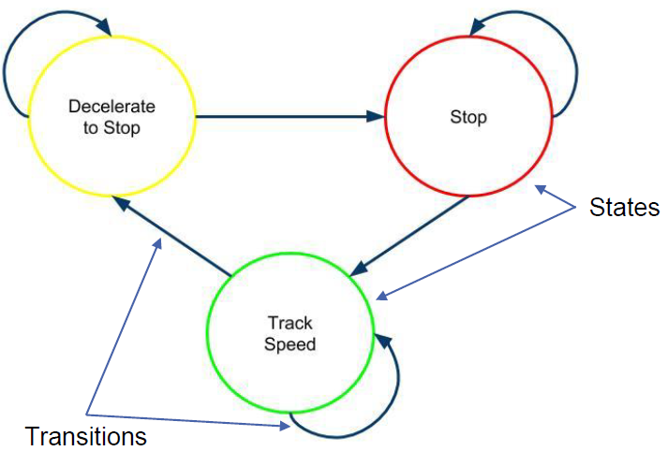
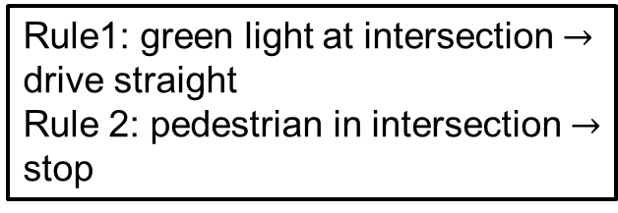
Behavior Planning Approaches
Finite State Machine-based
  Transitions triggered by inputs
Rule-based: Logical statements with priorities
Reinforcement Learning-based
  Learned from trial-and-error to maximize cumulative reward.
FSM-based example: traffic light changing color
Rule1: green light at intersection $→$ drive straight
Rule 2: pedestrian in intersection $→$ stop
Rule-based planning example: Rule 2 has higher priority and overrides Rule 1
Notes:
Explicitly designed by experts

Slide 24
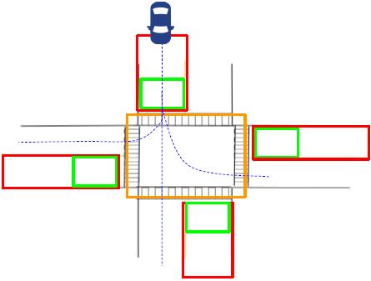
An Intersection Scenario without Dynamic Objects
4-way intersection
Two-lane road
Stop sign in every direction
No other dynamic objects
Discretized into
  Approaching zone (red box)
  At zone (green box)
  On zone (orange box)
Size of each zone determined by
  Ego vehicle speed
  Size of the intersection

Slide 25
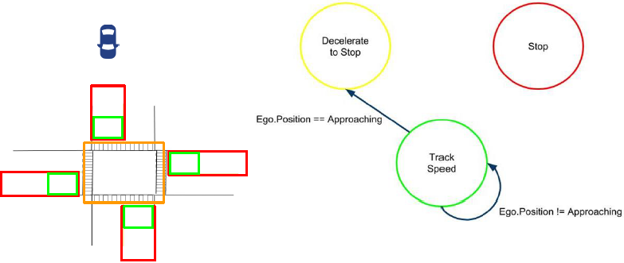
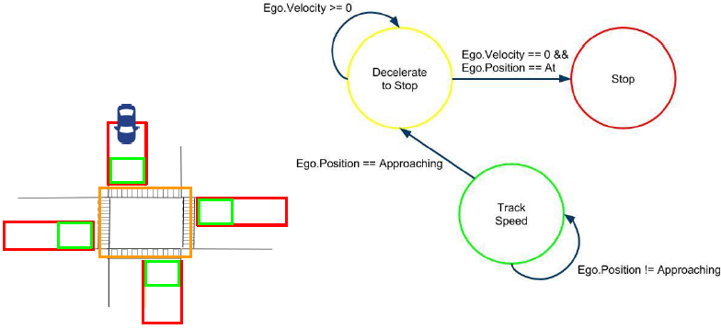
✔
✔
Notes:
(✔

Slide 26
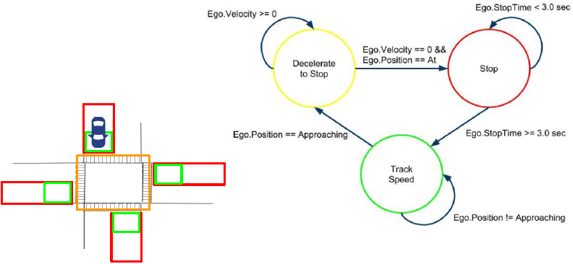
✔
To make the state machine more robust to noise in state estimation, may change Ego.Velocity==0 to Ego.Velocity<=StopThreshold
For an intersection with stop signs, there is no transition from “Decelerate to Stop” to “Track Speed”, since vehicle must come to a complete stop at a Stop sign
For an intersection with traffic lights, there should be such a transition, as the light may turn green while vehicle is decelerating.

Slide 27
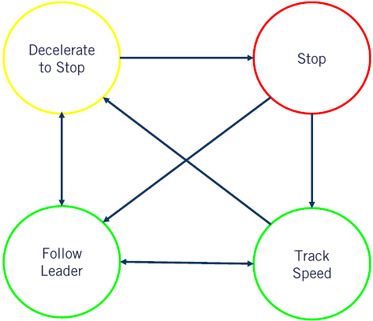
An Intersection Scenario with Dynamic Objects
Additional state “Follow Leader” to handle situation when another vehicle is in front of ego-vehicle.
Again, no transition from “Decelerate to Stop” to “Track Speed”, since vehicle must come to a complete stop at a Stop sign

Slide 28
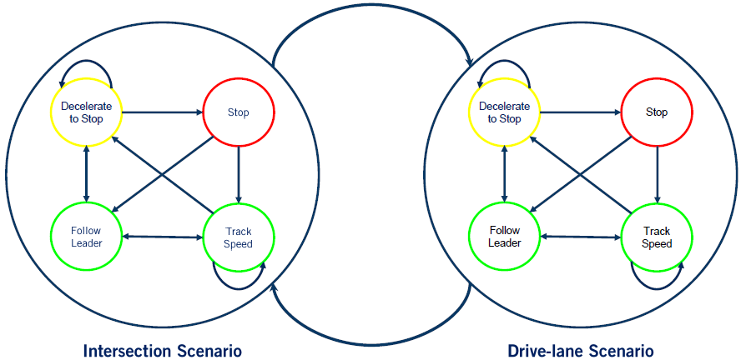
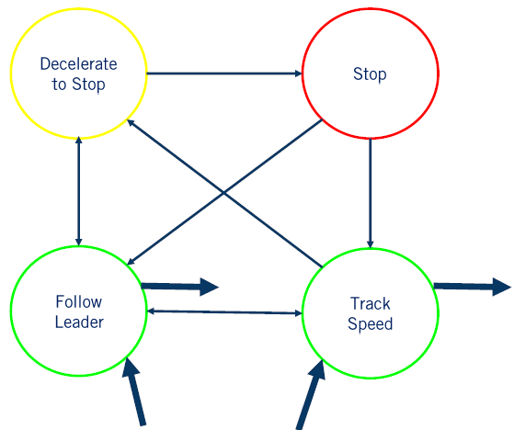
Handling Multiple Scenarios with Hierarchical FSM
Each driving scenario is modeled as a super-state, which contains a low-level FSM for the scenario.
(Each low-level FSM is specific for the scenario, e.g., the two FSMs in the figure have different trigger conditions not shown)
Exit
transitions
Entry transitions

Slide 29
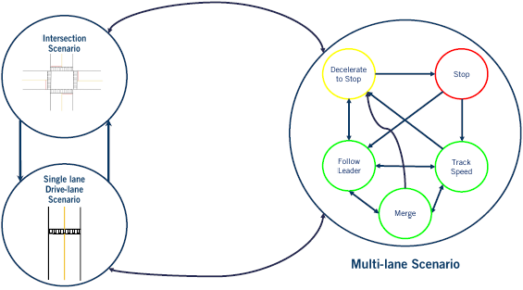
Handling Multiple Scenarios with Hierarchical FSM

Slide 30
Limitations of FSM-based Behavior Planning
State explosion for many and complex scenarios
Dealing with measurement noise and uncertainty of the environment
  Hyperparameters can be used to deal with some noise, but only in some limited situations, e.g., Ego.Velocity<=StopThreshold instead of Ego.Velocity==0
Incapable of dealing with unencountered scenarios
Reinforcement Learning is a promising alternative

Slide 31
Outline
Route planning
Behavior planning
Motion Planning
Responsibility-Sensitive Safety (RSS)
Paden B, Čáp M, Yong S Z, et al. A survey of motion planning and control techniques for self-driving urban vehicles[J]. IEEE Transactions on intelligent vehicles, 2016, 1(1): 33-55.
Notes:
Safety plan
The safety plan gives an overview of how you are going to achieve a safe system. A few of the major elements include:
what system is under consideration
the goal of the project
what steps will be taken to ensure safety
the roles and personnel involved in the project
the project timeline

Slide 32
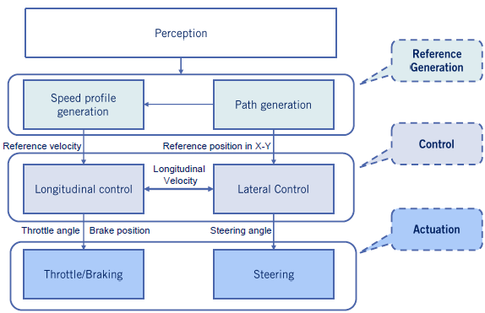
Vehicle Control Architecture

Slide 33
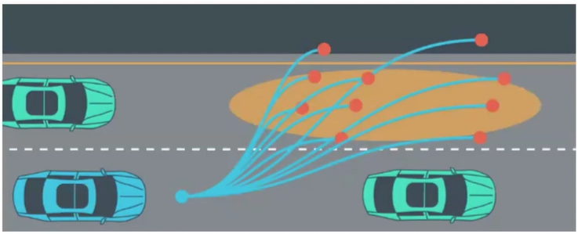
Motion Planning
Generate a feasible (smooth and collision-free) trajectory
  A trajectory is a path parametrized by time

Slide 34
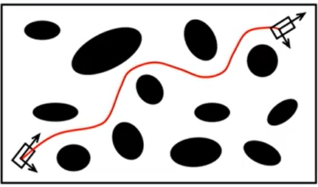
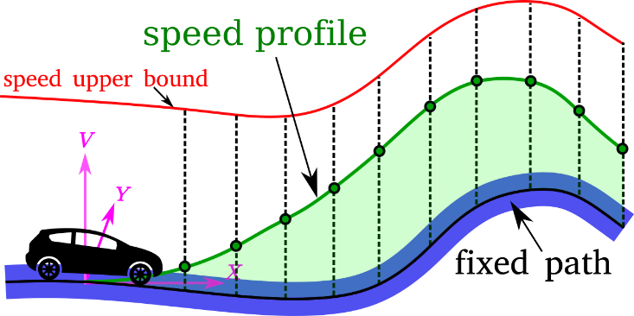
Motion Planning Methods
Also called trajectory planning or local planning, includes path planning and speed profile generation:
  Path planning:
    Plan a path from point A to point B
  Speed profile generation
    Assign a speed value to every point on a given path
  Variational planning: combine both path planning and velocity planning to generate a trajectory in a single-step.
Notes:
Assign speed value to every point on a given path. v
Also called trajectory planning, local planning
Decomposed into path planning and speed profile generation
Generating smooth paths

Slide 35
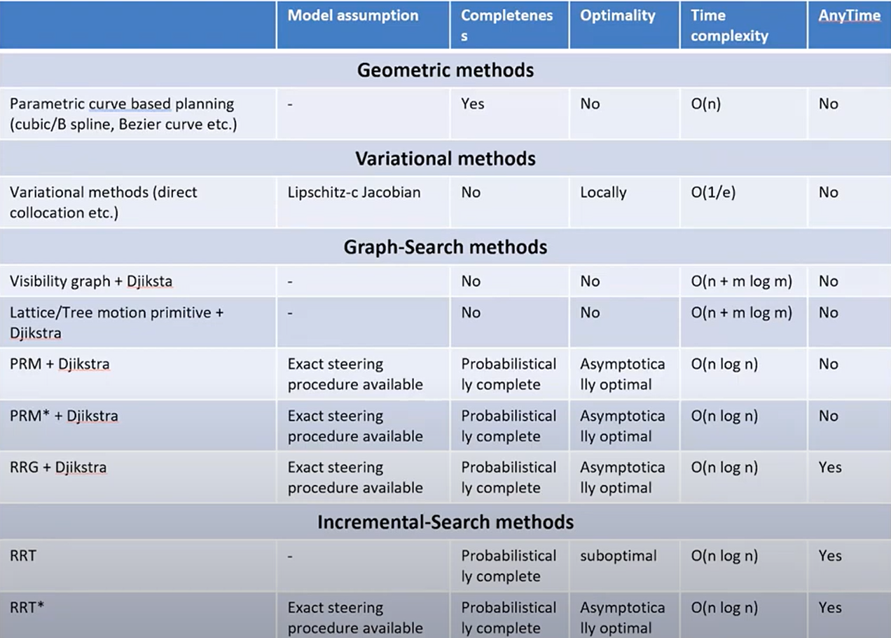
Path Planning Methods
Motion Planning in Autonomous Vehicle (Part -1) | Skill-Lync Workshop
Notes:
Sampling-based algorithms
Rapidly-exploring Random Tree (RRT)
Probabilistic Roadmap (PRM)
Conformal Lattice Planning

Slide 36
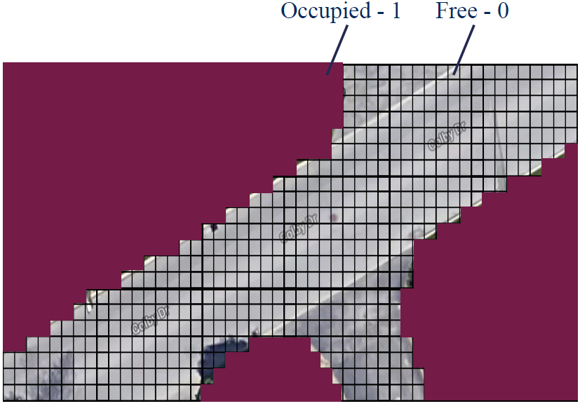
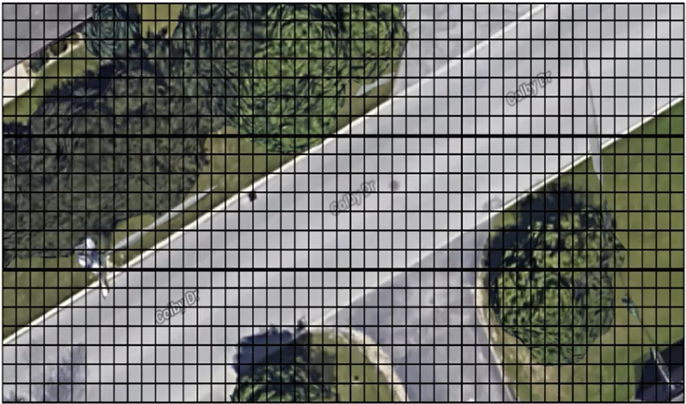
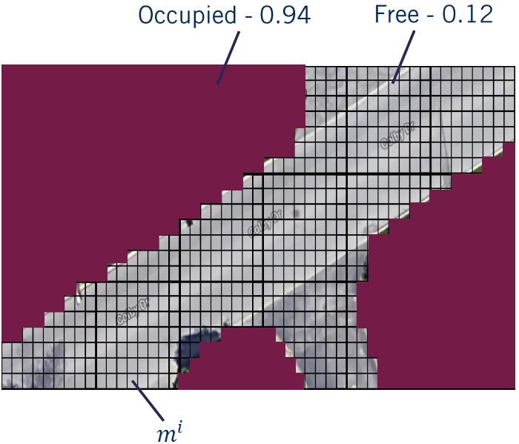
Occupancy Grid
Discretized grid map encoding occupancy of static objects (e.g., all non-drivable surfaces are occupied, incl. trees, buildings, sidewalks, lawns…), obtained with Lidar or camera
Can be binary encoding (upper left), or probabilistic encoding (upper right), using a belief threshold to convert to binary encoding

Slide 37
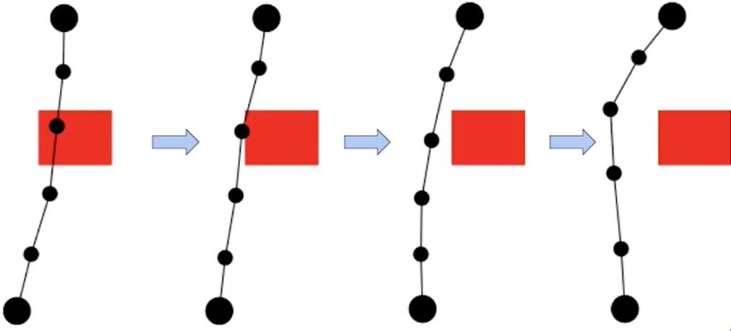
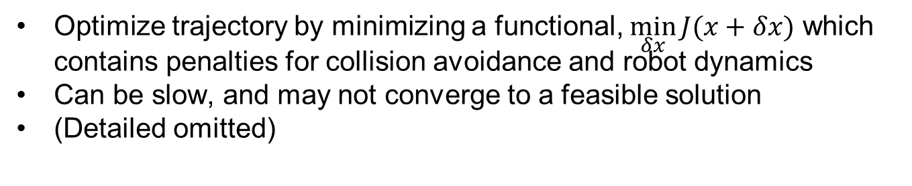
Variational Methods
Optimize trajectory by minimizing a functional, $\min_{δx}{J(x+δx)}$ which contains penalties for collision avoidance and robot dynamics
Can be slow, and may not converge to a feasible solution
(Detailed omitted)

Slide 38
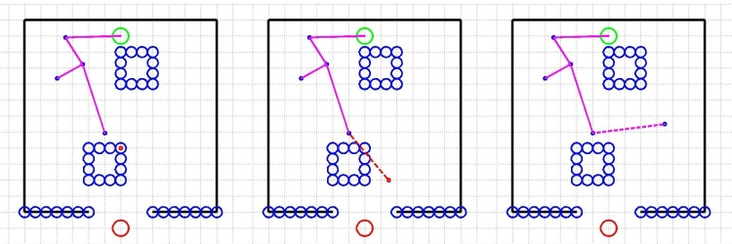

Rapidly-exploring Random Tree (RRT)
Insert start location S in tree
While tree cannot connect to goal
  Sample random point $r$
  Find point $p$ in tree that is closest to $r$
  Add branch between $p$ and $r$
    Another variant is to add branch of predefined length from $p$ in direction of $r$
  If new branch intersects obstacle:
    Discard new branch (or shorten)
Compute path from start (S) to goal (G) through tree
Shortcut path: for any two points in path, add direct line unless direct line intersect an obstacle (collision checking)
1
S
S
S
2
3
6
4
5
G
G
G

Slide 39


Path Smoothing
Left: an example completed path
Right: smoothed path (green), obtained by iteratively sampling points between nodes on the overall path and then checking if two points could be connected to reduce path length
http://coecsl.ece.illinois.edu/ge423/spring13/RickRekoskeAvoid/rrt.html

Slide 40




RRT Animation
RRT growth process (with start location but no goal location)
More animations https://www.youtube.com/watch?v=pOFtvZ_qVsA

Slide 41

Probabilistic Roadmap (PRM)
Map construction:
While # points in roadmap lower than threshold
  Sample random point
  If new point is not in collision:
    Connect new point to all other points in the roadmap with lines, as long as they do not intersect obstacles.
Path finding:
  Connect start location to nearest point in roadmap s.t. connecting line does not intersect obstacle
  Connect goal location to nearest point in roadmap s.t. connecting line does not intersect obstacle
  Find a path between start and goal traversing the roadmap, with algorithms such as as A* or Dijkstra’s algo.
By Eric O. Scott - Own work, CC BY-SA 4.0, https://commons.wikimedia.org/w/index.php?curid=44485745

Slide 42
RRT vs. PRM
With RRT, each time new start/goal locations are given, an entirely new graph must be generated, which may be inefficient.
PRM builds a roadmap graph for traveling through a region, but relies on A* or Dijkstra’s algo to find the shortest path from start to goal traversing the roadmap. Hence the roadmap is reused each time new start/goal locations are given.
Notes:
Repeatedly generating a new graph to find a single path is arguably inefficient, especially if a relatively large area is being explored. An alternative approach that addresses this deficiency is the Probabilistic Roadmap (PRM) algorithm.

Slide 43
RRT & PRM
Many variants of RRT and PRM are probabilistically complete:
  If a path exists, it will be found in finite time
  But in the worst-case, solution time can be very long (even longer than exhaustive search)
No guarantees on solution quality
  May not find the shortest path
    With PRM, A*/Dijkstra is guaranteed to find the shortest path for the given roadmap, but the roadmap may not be optimal.
  Often needs post-processing (e.g., smoothing)

Slide 44
Quiz
Which statement is true for RRT and PRM motion planning algorithms?
  A. Both algorithms will produce the shortest path.
  B. Both algorithms can be used for high dimensional spaces
    Robotic motion planning may be high-dimensional; mobile robot path planning is low-dimensional (3 for ground robot, 6 for aerial robot).
  C. PRM always results in a better path than RRT.
  D. The time for computation is consistent and predictable.
ANS: B

Slide 45


Parametric Curve-based Planning
Non-parametric path: a path is represented as a sequence of points (as in A*, Dijkstra’s algo, RRT/PRM)
Parametric path: a smooth parametric curve that satisfies boundary conditions at 2 end points, constraints on curvature, and optimizes an objective function.
  $\left(x_{0},y_{0},θ_{0},κ_{0}\right),(x_{f},y_{f},θ_{f},κ_{f})$: pose (position and heading angle) and curvature ($κ=\frac{1}{R}$, inverse of radius of rotation) of starting and final points
  $\left|κ\right|≤κ_{max}$: curvature has an upper bound for every point on the curve, to help satisfy kinematic/dynamic constraints, and improve rider comfort.
Example: Quintic splines and polynomial spirals
Coursera MOOC Motion Planning for Self-Driving Cars
Notes:
Path Representation A smooth path with low curvature is easier to track by the controller, and more comfortable

Slide 46


Quintic Spline
Path modeled as 5th-order polynomials, with closed-form solutions for boundary conditions $(x,y,θ,κ)$
  $x\left(u\right)=α_{5}u^{5}+α_{4}u^{4}+α_{3}u^{3}+α_{2}u^{2}+α_{1}u+α_{0}$
  $y\left(u\right)=β_{5}u^{5}+β_{4}u^{4}+β_{3}u^{3}+β_{2}u^{2}+β_{1}u+β_{0}$
  $u∈[0,1]$
  The curve connects from start point $(x\left(0\right),y(0))$ to end point $\left(x\left(1\right),y\left(1\right)\right)$
Pro: path has closed-form equation for given start and end points
Con: curvature function and its derivatives may be discontinuous
https://pythonrobotics.readthedocs.io/en/latest/modules/path_planning.html
Notes:
Pro: path has closed-form equation
Con: curvature function and its derivatives may be discontinuous
$$κ\left(u\right)=\frac{x^{′}\left(u\right)y^{′′}\left(u\right)−y^{′}\left(u\right)x^{′′}\left(u\right)}{{\left(x^{′}{\left(u\right)}^{2}+y^{′}{\left(u\right)}^{2}\right)}^{\frac{3}{2}}}$$

Slide 47


Polynomial Spirals
Curvature defined as polynomial function (cubic or higher):
  $κ\left(s\right)=a_{3}s^{3}+a_{2}s^{2}+a_{1}s+a_{0}$
  It is smooth and never discontinuous, so constraining a few points often enough to constrain the entire curve.
Path modeled based on curvature function:
  $θ\left(s\right)=θ_{0}+\int_{0}^{s}{\left(a_{3}s^{′3}+a_{2}s^{′2}+a_{1}s^{′1}+a_{0}\right)ds′}=θ_{0}+a_{3}\frac{s^{4}}{4}+a_{2}\frac{s^{3}}{3}+a_{1}\frac{s^{2}}{2}+a_{0}s$
  $x\left(s\right)=x_{0}+\int_{0}^{s}{\cos{θ\left(s^{′}\right)ds′}}$
  $y\left(s\right)=y_{0}+\int_{0}^{s}{\sin{θ\left(s^{′}\right)ds′}}$
Pro: curvature function is smooth, so curvature can be given upper bound constraint.
Con: path has no closed-form equation; Fesnel integrals need to be computed with numerical integration using Simpson’s rule, with high computation overhead:
  $\int_{0}^{s}{f\left(s^{′}\right)ds^{′}≈\frac{s}{3n}\left(f\left(0\right)+4f\left(\frac{s}{n}\right)+2f\left(\frac{2s}{n}\right)+…+f(s)\right)}$ (fig below shows example w. $n=2$)

Slide 48


Optimization Objective Function
Consider curvature modeled as Cubic spiral.
Minimize Bending Energy, defined as integral of squared curvature along the path, in order to distribute curvature evenly along spiral:
  Minimize $f_{be}\left(a_{0},a_{1},a_{2},a_{3},s_{f}\right)=\int_{0}^{s_{f}}{{\left(a_{3}s^{3}+a_{2}s^{2}+a_{1}s+a_{0}\right)}^{2}}ds$
  It and its gradient have closed-form solutions.
Subject to constraints:
  End point constraints:
    $\left(x_{s}\left(0\right),y_{s}\left(0\right),θ\left(0\right),κ\left(0\right)\right)=\left(x_{0},y_{0},θ_{0},κ_{0}\right)$
    $\left(x_{s}\left(s_{f}\right),y_{s}\left(s_{f}\right),θ\left(s_{f}\right),κ\left(s_{f}\right)\right)=\left(x_{f},y_{f},θ_{f},κ_{f}\right)$
  Curvature constraints for two intermediate points:
    $\left|κ(\frac{s_{f}}{3})\right|≤κ_{max},\left|κ(\frac{{2s}_{f}}{3})\right|≤κ_{max}$

Slide 49

Example Spline vs. Spiral

Slide 50


Conformal Lattice Planning
To plan a feasible (collision-free) path to goal, exploit road structure, and generate a set of lattice paths laterally offset from a goal point along the road
Goal point is dynamically calculated based on speed and other factors
  Longer lookahead horizon improves ability of collision avoidance, but increases computation time.
Other end points are sampled with lateral offsets from goal according to vehicle heading.
For each end point (incl. goal point), solve the opt problem to get a spiral, then use numerical integration (Trapezoidal rule) to generate points along the paths.
Other end points
Lookahead
horizon
goal point

Slide 51

Collision Checking and Path Selection
Perform collision checking for each point along each path
  Red box denotes an obstacle (a parked car), and red lines denote paths in collision with it.
Among collision free paths, select one based on custom obj function (blue path)
  May prefer paths close to center of road, while penalizing paths that come too close to obstacle.

Slide 52

Full Path
Repeat this process for each planning period in a receding horizon manner
Full path will converge to center of road, after passing the obstacle.

Slide 53





Speed Profile Generation
Behavior planner provides reference speed to local planner
  May be current road speed limit
  Or current maneuver (stopping due to Stop sign or red light, following a lead vehicle…)
Time-To-Collision (TTC) can be computed by difference in speeds $v_{ego}−v_{lead}$ divided by distance (arc length $s$).
  May be computed based on RSS
Notes:
Need to reach the red point at lead vehicle speed to avoid collision.

Slide 54


Curvature and Lateral Acceleration
Speed also bounded by max lateral acceleration and curvature
  $v_{k}≤\sqrt{\frac{a_{lat}}{κ_{i}}}$
Final reference speed selected as minimum of all upper bounds

Slide 55

Speed Profile Examples

Slide 56


Linear Ramp vs. Trapezoidal Profile
Linear ramp profile: constant acceleration to reach reference speed
Trapezoidal profile: constant-0-constant deceleration (e.g., for stopping at red light)

Slide 57


Linear Ramp Profile
Given path length $s$ and initial/final speeds $v_{0},v_{f}$, compute required acceleration $a$:
  $a=\frac{v_{f}^{2}−v_{0}^{2}}{2s}$
  Proof: consider a robot with starting speed $v_{0}$ and constant acceleration $a$. After time $t$, it reaches speed of $v_{0}+at=v_{t}$, and travels a distance of $s=\frac{\left(v_{0}+v_{t}\right)}{2}t=\frac{v_{t}^{2}−v_{0}^{2}}{2a}$.
May clamp acceleration $a$ to improve rider comfort.
For each path segment, compute speed using accumulated path arc length $s_{i}$ up to that point, to generate the speed profile:
  $v_{f_{i}}=\sqrt{2as_{i}+v_{0}^{2}}$

Slide 58



Trapezoidal Profile
Given total path length $s$, initial/final speeds $v_{0},v_{f}$, and transit speed $v_{t}$.
For 1st segment $s_{i}≤s_{a}$:
  Compute path arc length: $s_{a}=\frac{v_{t}^{2}−v_{0}^{2}}{2a_{0}}$
  Then compute speed profile: $v_{fi}=\sqrt{2a_{0}s_{i}+v_{0}^{2}}$
For 2nd segment $s_{a}≤s_{i}≤s_{b}$:
  Speed is constant $v_{fi}=v_{t}$
For 3rd segment $s_{b}≤s_{i}≤s_{f}$,
  Compute path arc length: $s_{f}−s_{b}=\frac{0−v_{t}^{2}}{2a_{0}}$
  Then compute speed profile: $v_{fi}=\sqrt{2a_{0}{(s}_{i}−s_{b})+v_{t}^{2}}$
(Coursera MOOC contains typos here.)
$$s_{f}$$
Notes:
Consider a robot with starting speed $v$ and constant acceleration or deceleration $−{\dot{v}}_{b}$. After time $t$, it reaches speed of $v−{\dot{v}}_{b}t=0$, and travels a distance of $\left(v−\frac{1}{2}{\dot{v}}_{b}t\right)t=\frac{1}{2}{\dot{v}}_{b}t^{2}=\frac{v^{2}}{2{\dot{v}}_{b}}$.

Slide 59
Outline
Route planning
Behavior planning
Motion Planning
Responsibility-Sensitive Safety (RSS)
Paden B, Čáp M, Yong S Z, et al. A survey of motion planning and control techniques for self-driving urban vehicles[J]. IEEE Transactions on intelligent vehicles, 2016, 1(1): 33-55.
Notes:
Safety plan
The safety plan gives an overview of how you are going to achieve a safe system. A few of the major elements include:
what system is under consideration
the goal of the project
what steps will be taken to ensure safety
the roles and personnel involved in the project
the project timeline

Slide 60

Avoid collisions at all cost?
But absolute safety is impossible.
In the scenario below, the AV (yellow car in the center lane) can do nothing to ensure absolute safety.
  If the red car swerves into the AV, collision cannot be prevented
To avoid this scenario, should the AV never drive in the center lane? Or should it never leave the garage?
  Avoiding collisions at all cost leads to a useless system.
Notes:
Not a useful system

Slide 61

Explicit Traffic Rules
Hard rules set limits on vehicle operation. Examples:
  Come to complete stop at red lights
  Don’t cross a double-yellow line
  Obey posted speed limits
  Yield to other road users when signaled
  …
These rules can be programmed into the AV.

Slide 62
Implicit Traffic Rules
A general set of principles applied by the human driver. They are flexible and culturally dependent.
  Keep a safe distance from the car in front of you.
  Drive cautiously under limited visibility.
  Don’t drive slowly in the fast lane.
  Don’t cut off other drivers.
  …
How to formalize and program these rules into the AV?

Slide 63
Responsibility-Sensitive Safety (RSS)
RSS formalizes human notions of safe driving into a verifiable model with logically provable rules, defines appropriate responses, and ensures that only safe decisions are made by the AV, and clearly assigns blame/responsibility in case of accidents.
Goal: An AV should never be responsible for accidents, meaning:
  It should never cause accidents
  It should properly respond to mistakes of other drivers
RSS is a mathematical, interpretable model, formalizing the implicit rules (common sense) of
  What is a dangerous situation?
  What is the proper response to a dangerous situation?
  Who is responsible for an accident?
RSS: Safety Assurance for Automated Vehicles https://www.youtube.com/watch?v=EceAB6TUYzo
  Shalev-Shwartz S, Shammah S, Shashua A. On a formal model of safe and scalable self-driving cars[J]. arXiv preprint arXiv:1708.06374, 2017.
Notes:
Check on AI outputs open, transparent, technology neutral safety model for autonomous driving
How self-driving cars will learn to make life-or-death decisions
https://www.youtube.com/watch?v=EW4EqjxzFq4
It is OK for an AV to be involved in accidents, as long as it is not responsible for causing the accident.
open, transparent, technology neutral safety model for autonomous driving

Slide 64

Five Rules of RSS
1. Do not hit the car in front (safe longitudinal distance. See figure below for example)
2. Do not cut-in recklessly (safe lateral distance)
3. Right-of-Way is given, not taken.
4. Be careful in areas with limited visibility
5. If you can avoid a crash without causing another, you must
Notes:
RULE 1. Do not hit the car in front (longitudinal distance)
RULE 2. Do not cut in recklessly (lateral distance)

Slide 65
RSS: High-Level Description
Define safe distance (longitudinal).
A situation is dangerous if it is non-safe longitudinally.
Blame time: the first moment in which the situation becomes dangerous
Proper response:
  If the longitudinal distance becomes non-safe, brake longitudinally.
Responsibility:
  We prove that a collision can only occur if one of the agents did not respond properly.
  The responsibility is on the agent(s) that did not respond properly.
Notes:
If the lateral distance was becomes non-safe, brake longitudinally
and lateral
A situation is dangerous if it is nonsafe both laterally and longitudinally
Soundness: when the model says that the AV is not responsible for an accident, it should clearly match “common sense” of human judgement
Usefulness: it is possible to efficiently create a driving policy that guarantees to never cause accidents, while still maintaining normal flow of traffic.
Do not avoid collisions at all cost and stay in the garage.
Can we ensure that a driving policy based on RSS does not lead to accidents of our blame?
Not trivial due to butterfly effects, where a small action leads to a chain of events that lead to an accident.
But answer is affirmative: use mathematical induction to construct an efficient procedure for guaranteeing RSS.

Slide 66

Non-safe Lateral Maneuver
Proper response: red should brake laterally,
  since red is cutting into yellow’s lane.
  “Brake laterally” means “brake while steer to the right direction”.

Slide 67

Non-Safe Longitudinal Maneuver
Proper response: yellow should brake,
  Since yellow is driving too fast and getting too close.

Slide 68


Responsibility
Hit from behind
  Yellow is not responsible for the accident.
Side hit
  Red is not responsible for the accident.

Slide 69

Keep Safe Distances
The AV (blue car) should keep safe longitudinal and lateral distances from other cars
  If the front car slams on the brakes, how much longitudinal distance does it need to avoid a rear-end collision?
  If the left or right car suddenly swerves, how much lateral distance does it need to avoid a side collision?

Slide 70


Rule 1: Safe Longitudinal Distance
Consider two cars travelling in the same direction: front car $c_{f}$ and rear car $c_{r}$. In order to ensure that $c_{r}$ will never hit $c_{f}$ from behind, it is the responsibility of $c_{r}$ to keep a safe longitudinal distance $d_{min}$ from $c_{f}$. The worst-case situation is that $c_{f}$ suddenly brakes hard, it will take $c_{r}$ some response time $ρ$ (sensing and reaction delay) to realize this and to start braking as well, and then both cars will decelerate. Assuming known parameters of: $v_{f}$: front vehicle speed; $v_{r}$: rear ego-vehicle speed; $β_{max}$: maximum deceleration rate due to braking for $c_{f}$; $β_{min}$:minimum deceleration rate for $c_{r}$; $α_{max}$:maximum acceleration rate for $c_{r}$, we can derive $d_{min}$ as:
Notes:
Consider a single lane road, where cars cannot perform lateral manoeuvres.
Two cars are travelling in the same direction, front car $c_{f}$ and rear car $c_{r}$. How can $c_{r}$ ensure that it will never hit $c_{f}$ from behind?
It is the responsibility of $c_{r}$ to keep a “safe distance” $d_{min}$ from $c_{f}$ , and $d_{min}$ should be large enough so that no matter what, $c_{r}$ will not hit $c_{f}$. In our simple case, the worst-case situation is that $c_{f}$ will suddenly brake hard, it will take $c_{r}$ some response time $ρ$ (sensing and reaction delay) to figure this out and to brake as well, and then both cars will decelerate.
The common sense rule is “if someone hits you from behind it is not your fault”. So, a first try would be to define that if a rear car, $c_{r}$, hits a front car, $c_{f}$, from behind, then $c_{r}$ is responsbile for the accident.
But, this definition does not always comply with common sense. For example, suppose that both $c_{r}$ and $c_{f}$ are driving slowly up a hill, and then $c_{f}$ slows down and starts rolling backward until it hits $c_{r}$. Even though $c_{r}$ hit $c_{f}$ from behind, the common sense in this situation is that $c_{f}$ should be responsible.
until reaching a full stop

Slide 71





















Safe Longitudinal Distance: the Proof
Collision
$$d=0$$
Red (black) lines indicate accel/velocity/position of front (rear) car.
The initial distance between front car $c_{f}$ and rear car $c_{r}$ is $d_{0}$. Assuming $β_{min}≤β_{max}$, their distance will decrease monotonically with time. To avoid collision, the minimum initial distance $d_{min}$ can be obtained by assuming both cars will come to full stop at some time $t_{c}$ with distance $d=0$.
Time $0$: front car and rear car have initial speeds $v_{f}$ and $v_{r}$, respectively
Time interval $[0,ρ]$: Front car applies brake with constant deceleration $β_{max}$; rear car accelerates with constant acceleration $α_{max}$.
Time $ρ$: rear car reaches speed of $v_{ρ,max}=v_{r}+ρα_{max}$, and travels a distance of $(v_{r}+\frac{1}{2}ρα_{max})ρ=$ $v_{r}ρ+\frac{1}{2}α_{max}ρ^{2}$.
Time interval $[ρ,t_{c}]$: rear car applies brake with constant deceleration $β_{min}$, travels a distance of $\frac{v_{ρ,max}^{2}}{2β_{min}}=\frac{{\left(v_{r}+ρα_{max}\right)}^{2}}{2β_{min}}$.
Time interval $[0,t_{c}]$: front car travels a distance of $\frac{v_{f}^{2}}{2β_{max}}$ (average speed $\frac{v_{f}}{2}$ times time-to-stop $\frac{v_{f}}{β_{max}}$).
Time $t_{c}$: both cars come to full stop with distance $d=0$.
Min initial distance $d_{min}=$distance traveled by rear car before full stop - distance traveled by front car before full stop= ${\left[v_{r}ρ+\frac{1}{2}α_{max}ρ^{2}+\frac{{\left(v_{r}+ρα_{max}\right)}^{2}}{2β_{min}}−\frac{v_{f}^{2}}{2β_{max}}\right]}_{+}$
Position $d$
$$d_{min}$$
$$t_{c}$$
$$t$$
Velocity
$$α_{max}$$
$$β_{max}$$
$$β_{min}$$
$$t$$
Accel
$$v_{r}$$
$$v_{f}$$
$$α_{max}$$
$$d_{min}$$
$$−β_{min}$$
$$ρ$$
$$t$$
$$β_{min}$$
$$β_{max}$$
$$−β_{max}$$
71

Slide 72







Safety vs. Efficiency
RSS allows to formally define the desired balance of safety and efficiency of AVs on the road.
  e.g., $d_{min}$ is larger if we assume a large deceleration rate $β_{max}$ for the front car; or larger acceleration rate $α_{max}$ or smaller deceleration rate $β_{min}$ for the rear car. So the AV will drive more conservatively, resulting in lower efficiency, and vice versa
These parameters should be determined by regulatory authorities working with the car makers.
  E.g., NHTSA (National Highway Traffic Safety Administration) in USA.
$$v_{r}$$
$$v_{f}$$
$$d_{min}$$
$$β_{min}$$
$$β_{max}$$
72

Slide 73

Proper Response
The moment the distance between the two cars is less than $d_{min}$, the AV will perform the proper response: after a response time $ρ$, apply braking of at least $β_{min}$ until a safe following distance is restored or until the vehicle comes to a complete stop.
RSS can be a proactive safety mechanism that improves Automatic Emergency Braking (AEB). Called Automatic Preventive Braking (APB), it determines the moment when a vehicle enters a dangerous situation, then uses comfortable, subtle braking ($β_{min}$) to help return the vehicle to a safer position without waiting for an imminent collision to engage maximum braking force. This preventive approach would provide a stopping distance buffer that could prevent a chain reaction of braking and swerving should an emergency stop occur.
Notes:
the application of RSS to traditional AEB systems would use formulas to determine the moment when a vehicle enters a dangerous situation. It would

Slide 74
Other RSS Rules
Rule 2: Safe Lateral Distance
  Safe lateral distance enables AVs to be aware when their lateral safety may be compromised by unsafe drivers turning into their lanes.
Rule 3. Right of way is given, not taken
  On well-marked roads, the right of way is clear. Lane lines, signs, and traffic lights establish priorities for routes as they intersect one another. However, there are other times when the right of way is less clear, and human drivers must negotiate with one another.
Rule 4. Be cautious in areas with limited visibility
  Drivers must proceed cautiously, especially as they approach crosswalks or pass cars parked along the street
Rule 5. If the vehicle can avoid a crash without causing another one, it must
  It covers scenarios where a dangerous situation may have been imposed so suddenly that a collision cannot be avoided unless a more evasive action is taken. e.g., if boxes fall off the front car, and the next lane is free, the following car can take evasive action to avoid the accident.

Slide 75


Occluded Car Scenario
What if the rear car $c_{r}$ (yellow) is at a non-safe distance w.r.t an occluded car (blue)?
  Consider red car as $c_{f}$. It is traveling fast, so the distance from $c_{r}$ to $c_{f}$ (red car) satisfies $d_{min}$ based on its speed $v_{f}$.
  But If we consider blue car as $c_{f}$. It is very slow or stopped, so the distance from $c_{r}$ to $c_{f}$ may not satisfy $d_{min}$ based on its speed $v_{f}′$.
  Yellow car cannot see blue car, so if red car suddenly swerves to avoid collision with blue car, yellow car may not have enough time to avoid collision with blue car
Solution: assume the worst case, unless the existence of a car in a certain kinematic position is unreasonable (formally defined)
  In this case, “the occluded blue car is very slow or stopped” is an unreasonable situation, and yellow car will not be responsible for causing the accident. Otherwise, the yellow car would need to keep a very large longitudinal distance $d_{min}$ from the front car, which makes Rule 1 useless.
  The red car can see the blue car and should either keep longitudinal distance $d_{min}$ or change lanes according to RSS. So it should never suddenly swerve to avoid collision.

Slide 76


Integration into Apollo and CARLA
RSS is open-source as a C++ library. It has been integrated into Baidu Apollo’s planner module, and the driving simulator CARLA
RSS safety sensor in CARLA
  Use the opensource library to evaluate if a driving situations is safe or unsafe according to RSS. In that regard, a driving situation is composed of the ego vehicle (here in this video the ego vehicle is the one focused by the camera), and another traffic participant (e.g. a leading vehicle). The sensor evaluates longitudinal and lateral conflicts, but does not yet cover intersection conflicts.
  The results are highlighted via green (all safe), yellow (only lateral or longitudinal unsafe) and red lines (dangerous situation that requires to a counter measure according to RSS).
  https://www.youtube.com/watch?v=UxKPXPT2T8Q
Notes:
https://intel.github.io/ad-rss-lib/

Slide 77
NVIDIA Safety Force Field (SFF)
NVIDIA proposed SFF in 2019:
  “SFF is a robust driving policy that analyzes and predicts the vehicle’s environment. It determines a set of acceptable actions to protect the vehicle, as well as others on the road. These actions won’t create, escalate, or contribute to an unsafe situation, and include the measures necessary to mitigate harmful scenarios.”
Criticized by Mobileye to be a close replica of RSS
Introducing NVIDIA Safety Force Field
  https://www.youtube.com/watch?v=R0H77yZSEUk&feature=emb_logo
https://www.nvidia.com/en-us/self-driving-cars/safety-force-field/
https://newsroom.intel.com/editorials/innovation-requires-originality
Notes:
https://techcrunch.com/2019/03/25/mobileye-ceo-clowns-on-nvidia-for-allegedly-copying-self-driving-car-safety-scheme/

Slide 78
Summary
RSS formalizes what is dangerous, what is the proper response to danger, and who is responsible for accidents.
Soundness: it complies with the common sense of human judgement.
Usefulness: we give 100% guarantees to never cause accidents and always properly respond to dangerous situations.

