Slide 1
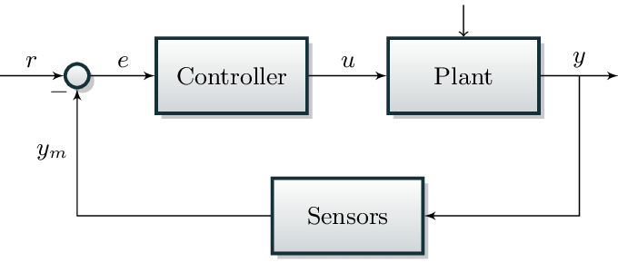
L6 Control
Zonghua Gu, 2021

Slide 2
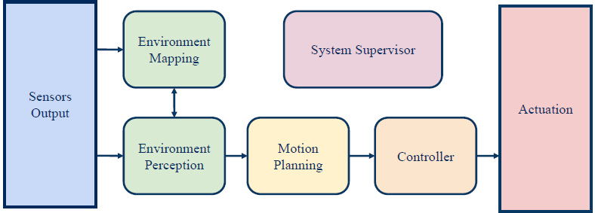
Controller Design
We need to design a controller to follow the trajectory output from motion planning.
  Many control algorithms. We mainly discuss PID and MPC, the two most widely-used control algorithms for AVs.
  We only give the basic intuition and avoid mathematical details.

Slide 3
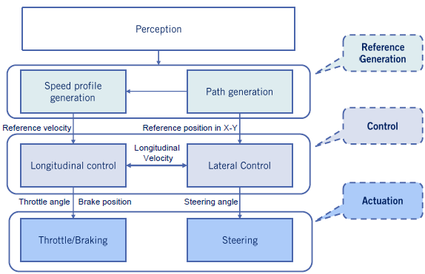
Vehicle Control Architecture
(Local Planning)

Slide 4
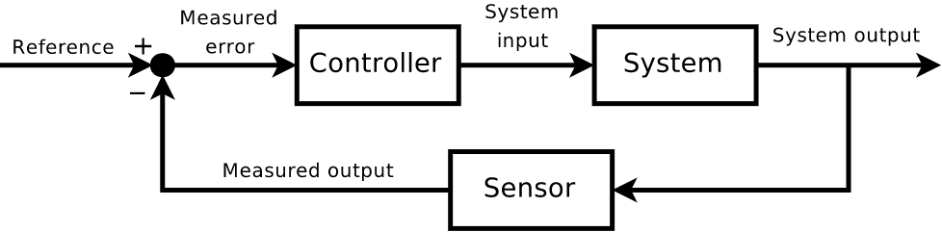
The Feedback Control Problem
Given a system and a reference signal, find a control law such that the closed loop system is stable and follows the reference signal.

Slide 5
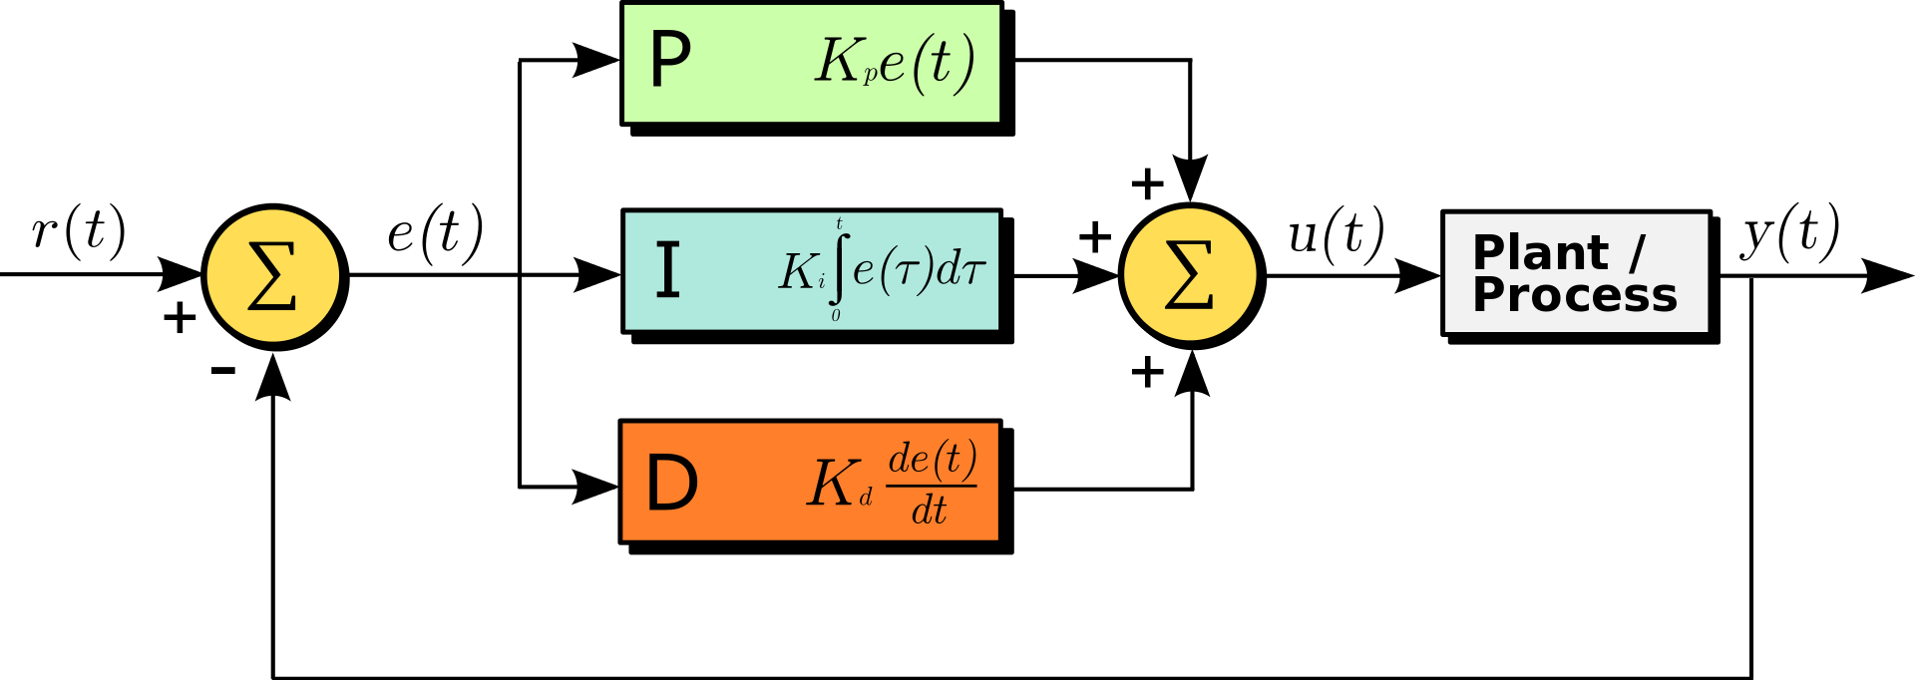

PID Control
Tracking Error: $e\left(t\right)=r\left(t\right)−y(t)$
Control input: $u\left(t\right)=K_{p}e\left(t\right)+K_{i}\int_{0}^{t}{e\left(τ\right)dτ}+K_{d}\dot{e}(t)$
https://en.wikipedia.org/wiki/PID_controller

Slide 6
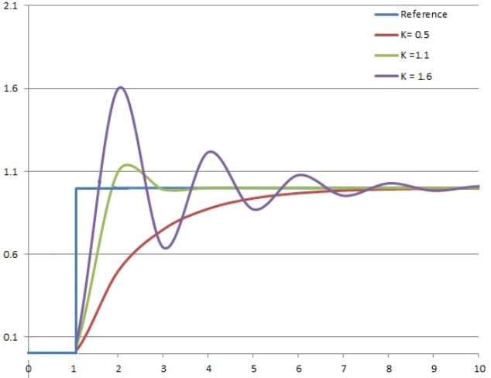
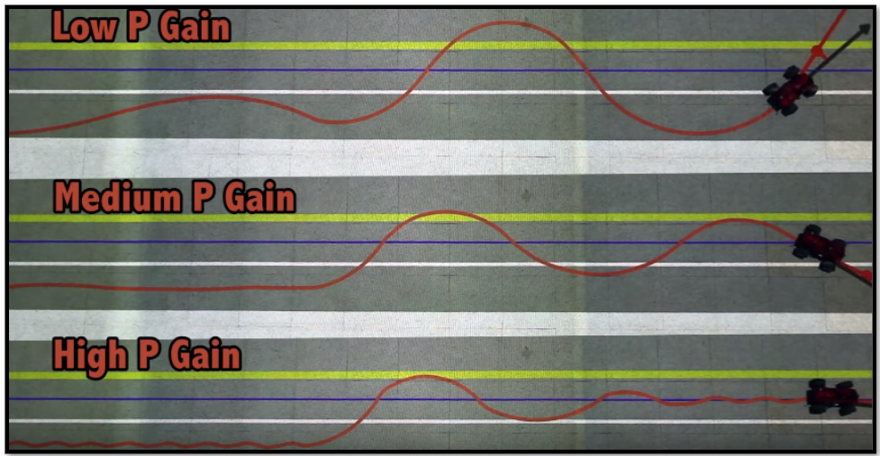
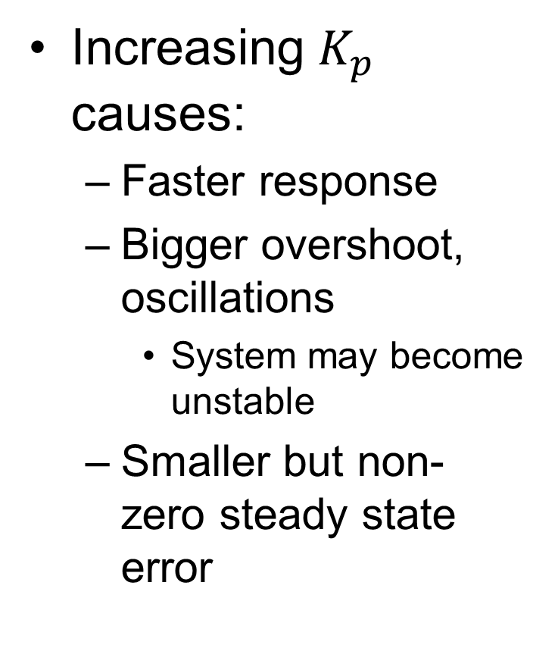
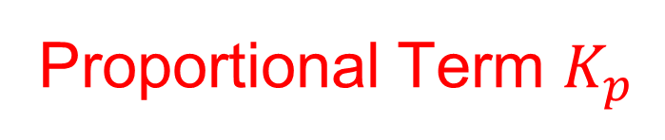
Proportional Term $K_{p}$
Increasing $K_{p}$ causes:
  Faster response
  Bigger overshoot, oscillations
    System may become unstable
  Smaller but non-zero steady state error

Slide 7
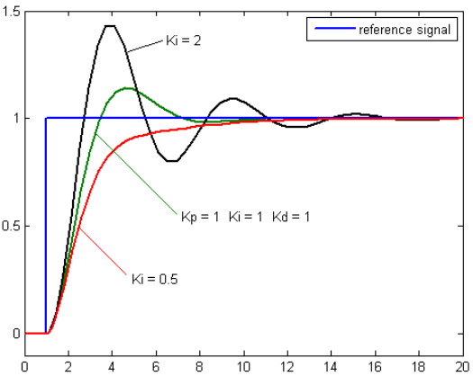
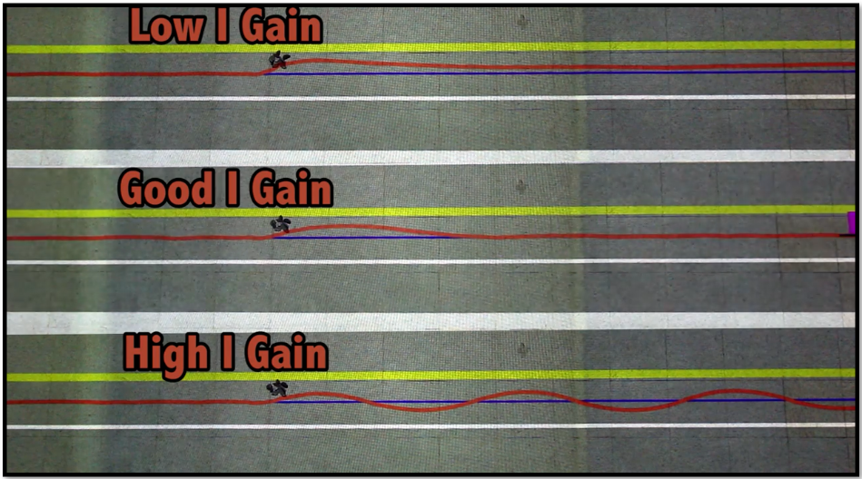
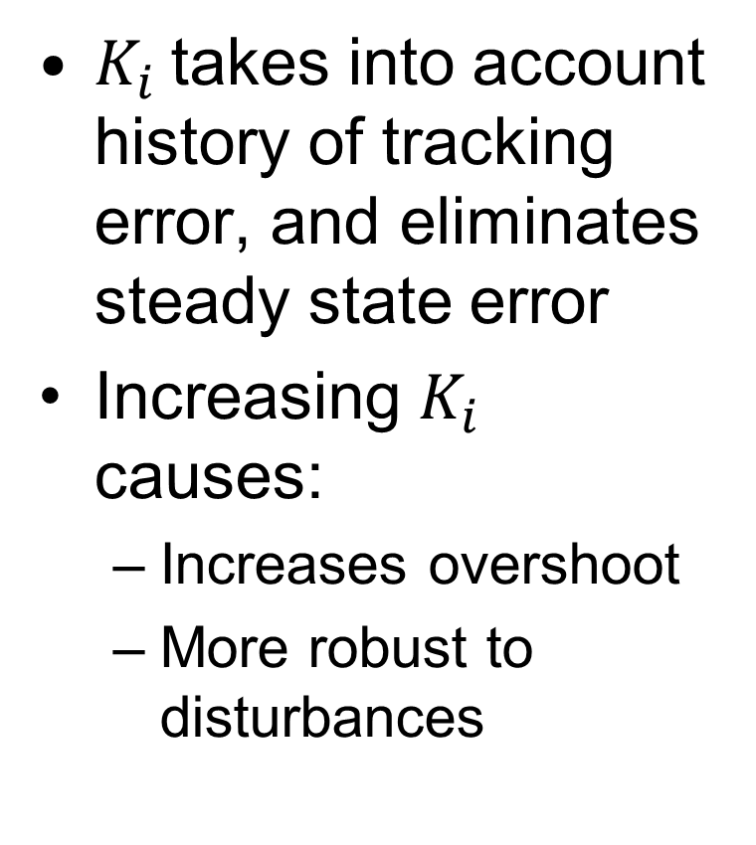
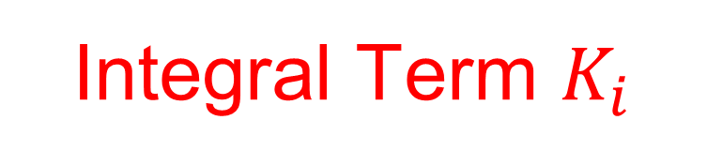
Integral Term $K_{i}$
$K_{i}$takes into account history of tracking error, and eliminates steady state error
Increasing $K_{i}$ causes:
  Increases overshoot
  More robust to disturbances
Notes:
scompensation

Slide 8
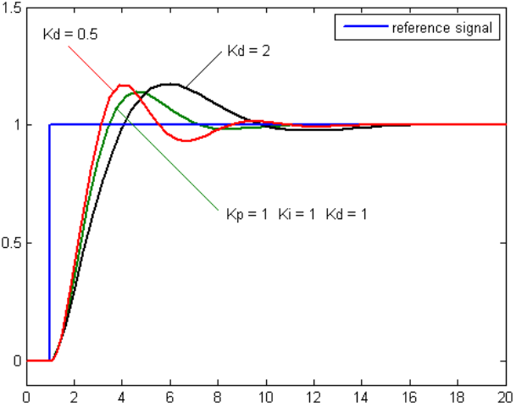
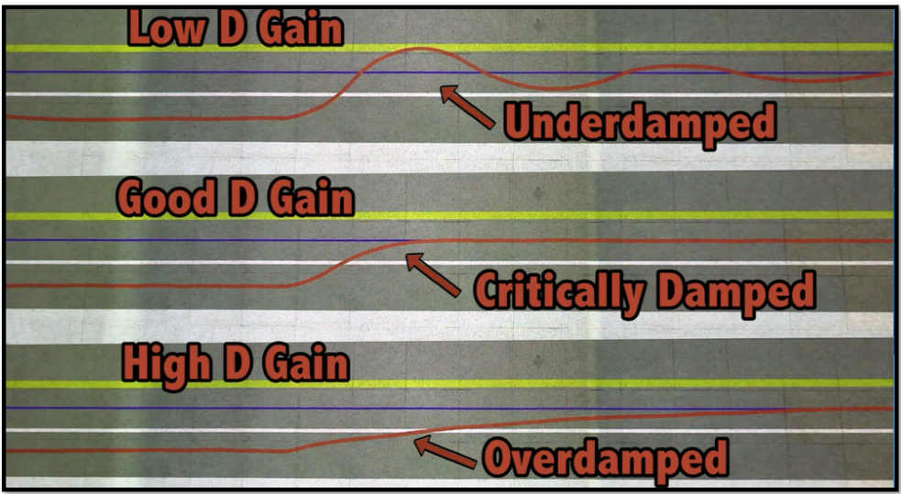
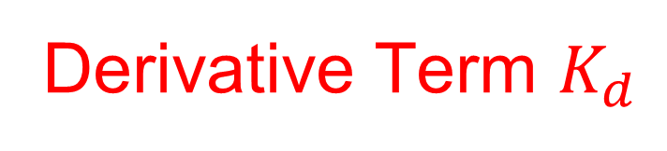
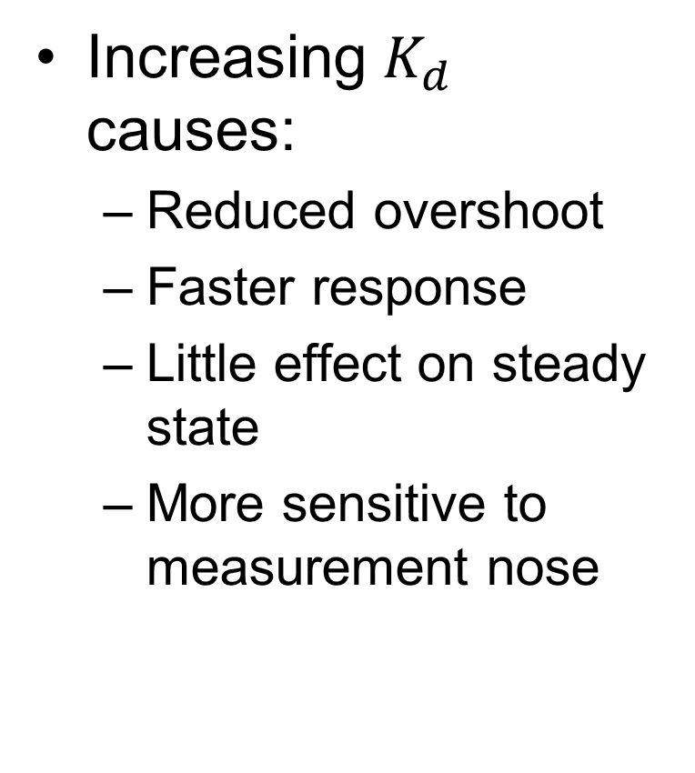
Derivative Term $K_{d}$
Increasing $K_{d}$ causes:
  Reduced overshoot
  Faster response
  Little effect on steady state
  More sensitive to measurement nose
Notes:
Anticipates next step

Slide 9
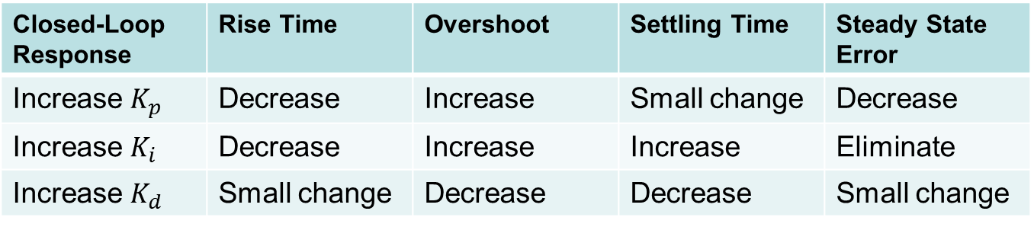
Summary of Effects of PID Gains
Closed-Loop Response | Rise Time | Overshoot | Settling Time | Steady State Error
Increase $K_{p}$ | Decrease | Increase | Small change | Decrease
Increase $K_{i}$ | Decrease | Increase | Increase | Eliminate
Increase $K_{d}$ | Small change | Decrease | Decrease | Small change

Slide 10
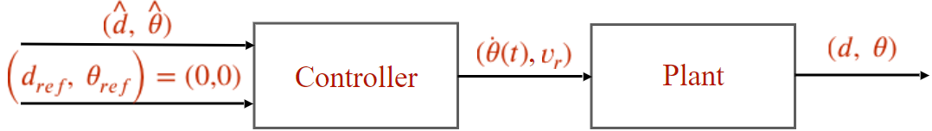
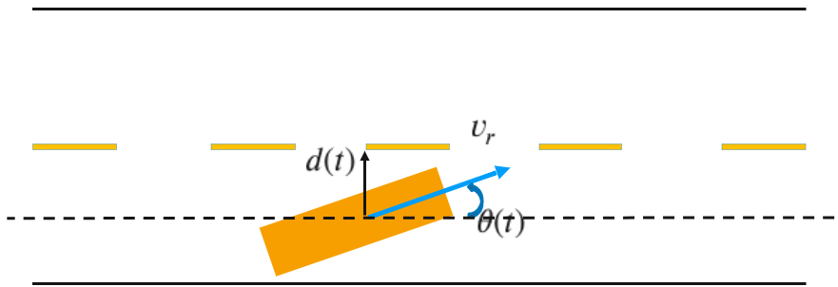
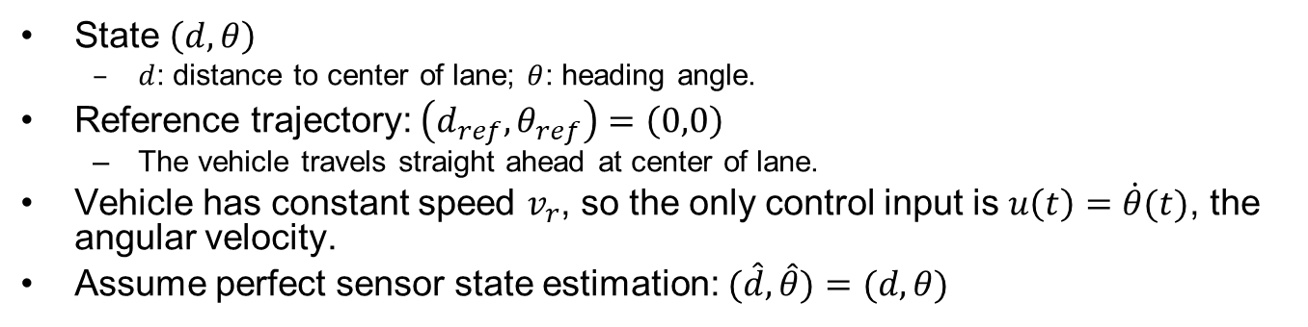
Example: Vehicle Lateral Control
State $\left(d,θ\right)$
  $d$: distance to center of lane; $θ$: heading angle.
Reference trajectory: $\left(d_{ref},θ_{ref}\right)=\left(0,0\right)$
  The vehicle travels straight ahead at center of lane.
Vehicle has constant speed $v_{r}$, so the only control input is $u\left(t\right)=\dot{θ}(t)$, the angular velocity.
Assume perfect sensor state estimation: $(\hat{d}, \hat{θ})=(d, θ)$
Notes:
https://www.icloud.com/keynote/035Qivaw_FXYD70xCbD5R9lDA#control%5FAV

Slide 11
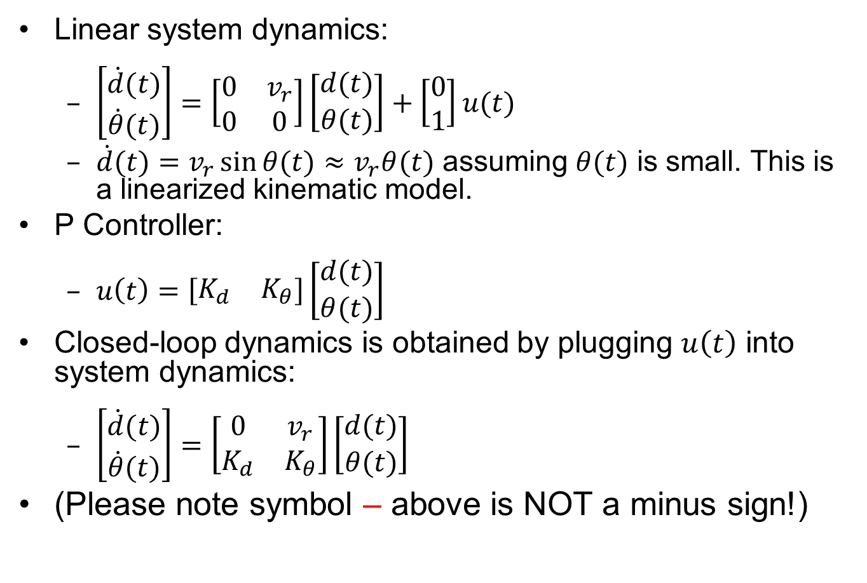
System and Controller Modeling
Linear system dynamics:
  $\left[\begin{matrix}\dot{d}(t) \\ \dot{θ}(t)\end{matrix}\right]=\left[\begin{matrix}0 & v_{r} \\ 0 & 0\end{matrix}\right]\left[\begin{matrix}d(t) \\ θ(t)\end{matrix}\right]+\left[\begin{matrix}0 \\ 1\end{matrix}\right]u(t)$
  $\dot{d}(t)=v_{r}\sin{θ(t)}≈$ $v_{r}θ(t)$ assuming $θ(t)$ is small. This is a linearized kinematic model.
P Controller:
  $u\left(t\right)=\left[\begin{matrix}K_{d} & K_{θ}\end{matrix}\right]\left[\begin{matrix}d(t) \\ θ(t)\end{matrix}\right]$
Closed-loop dynamics is obtained by plugging $u\left(t\right)$ into system dynamics:
  $\left[\begin{matrix}\dot{d}(t) \\ \dot{θ}(t)\end{matrix}\right]=\left[\begin{matrix}0 & v_{r} \\ K_{d} & K_{θ}\end{matrix}\right]\left[\begin{matrix}d(t) \\ θ(t)\end{matrix}\right]$
(Please note symbol – above is NOT a minus sign!)

Slide 12
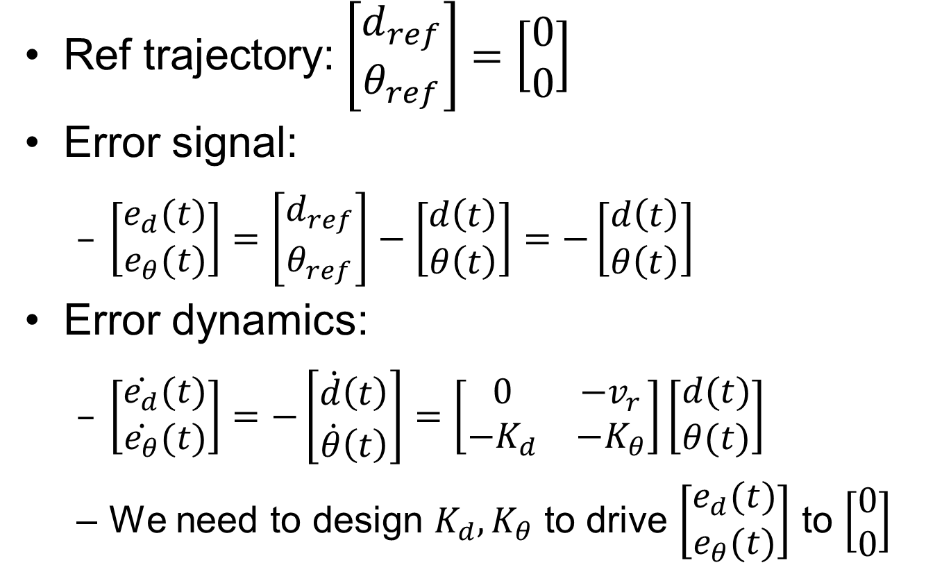
System and Controller Modeling
Ref trajectory: $\left[\begin{matrix}d_{ref} \\ θ_{ref}\end{matrix}\right]=\left[\begin{matrix}0 \\ 0\end{matrix}\right]$
Error signal:
  $\left[\begin{matrix}e_{d}(t) \\ e_{θ}(t)\end{matrix}\right]=\left[\begin{matrix}d_{ref} \\ θ_{ref}\end{matrix}\right]−\left[\begin{matrix}d\left(t\right) \\ θ\left(t\right)\end{matrix}\right]=−\left[\begin{matrix}d\left(t\right) \\ θ\left(t\right)\end{matrix}\right]$
Error dynamics:
  $\left[\begin{matrix}\dot{e_{d}}(t) \\ \dot{e_{θ}}(t)\end{matrix}\right]=−\left[\begin{matrix}\dot{d}\left(t\right) \\ \dot{θ}\left(t\right)\end{matrix}\right]=\left[\begin{matrix}0 & −v_{r} \\ {−K}_{d} & {−K}_{θ}\end{matrix}\right]\left[\begin{matrix}d(t) \\ θ(t)\end{matrix}\right]$
  We need to design $K_{d},K_{θ}$ to drive $\left[\begin{matrix}e_{d}(t) \\ e_{θ}(t)\end{matrix}\right]$ to $\left[\begin{matrix}0 \\ 0\end{matrix}\right]$

Slide 13
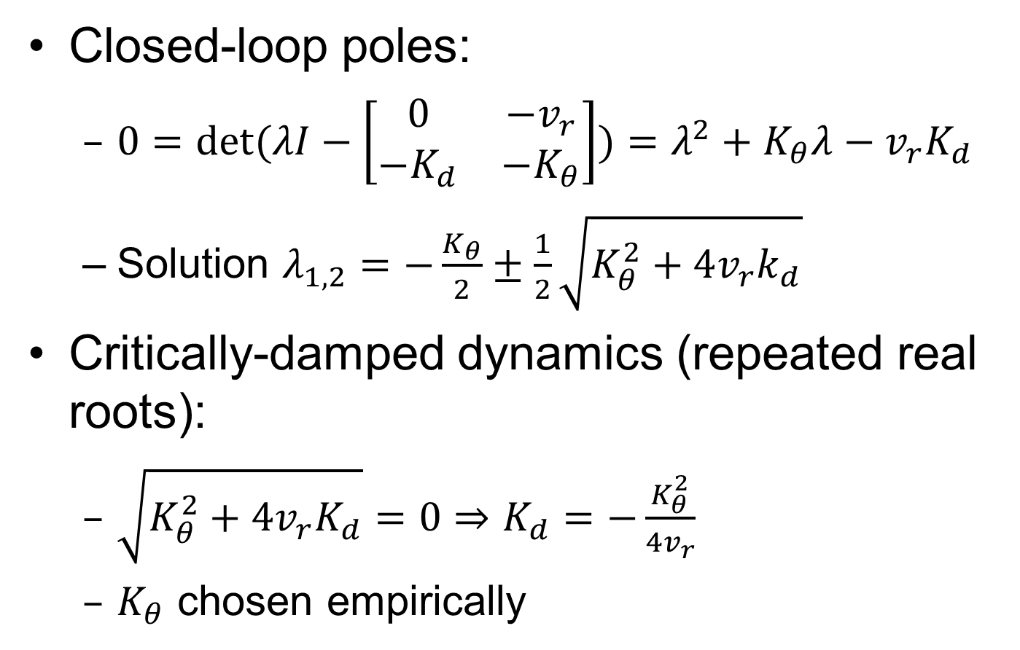
Control Design with Pole Placement (not covered in this course)
Closed-loop poles:
  $0=\det{(λI−\left[\begin{matrix}0 & −v_{r} \\ −K_{d} & {−K}_{θ}\end{matrix}\right])}=λ^{2}+K_{θ}λ−v_{r}K_{d}$
  Solution $λ_{1,2}=−\frac{K_{θ}}{2}±\frac{1}{2}\sqrt{K_{θ}^{2}+4v_{r}k_{d}}$
Critically-damped dynamics (repeated real roots):
  $\sqrt{K_{θ}^{2}+4v_{r}K_{d}}=0⇒K_{d}=−\frac{K_{θ}^{2}}{4v_{r}}$
  $K_{θ}$ chosen empirically

Slide 14
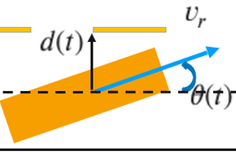
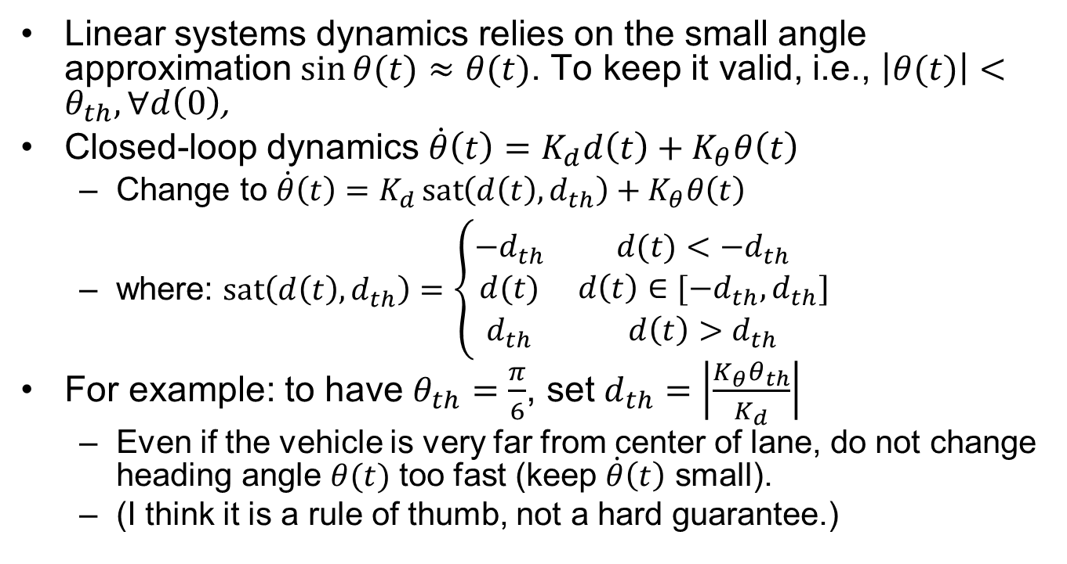
Control Design cont’d
Linear systems dynamics relies on the small angle approximation $\sin{θ(t)}≈$ $θ(t)$. To keep it valid, i.e., $\left|θ(t)\right|<θ_{th},∀d\left(0\right)$,
Closed-loop dynamics $\dot{θ}\left(t\right)=K_{d}d\left(t\right)+K_{θ}θ\left(t\right)$
  Change to ${\dot{θ}\left(t\right)=K}_{d}\operatorname{sat}\left(d\left(t\right),d_{th}\right)+K_{θ}θ\left(t\right)$
  where: $\operatorname{sat}\left(d\left(t\right),d_{th}\right)=\left\{\begin{matrix}−d_{th} & d(t)<−d_{th} \\ d(t) & d\left(t\right)∈[−d_{th},d_{th}] \\ d_{th} & {d\left(t\right)>d}_{th}\end{matrix}\right.$
For example: to have $θ_{th}=\frac{π}{6}$, set $d_{th}=\left|\frac{K_{θ}θ_{th}}{K_{d}}\right|$
  Even if the vehicle is very far from center of lane, do not change heading angle $θ(t)$ too fast (keep $\dot{θ}\left(t\right)$ small).
  (I think it is a rule of thumb, not a hard guarantee.)
Notes:
A rule of thumb

Slide 15
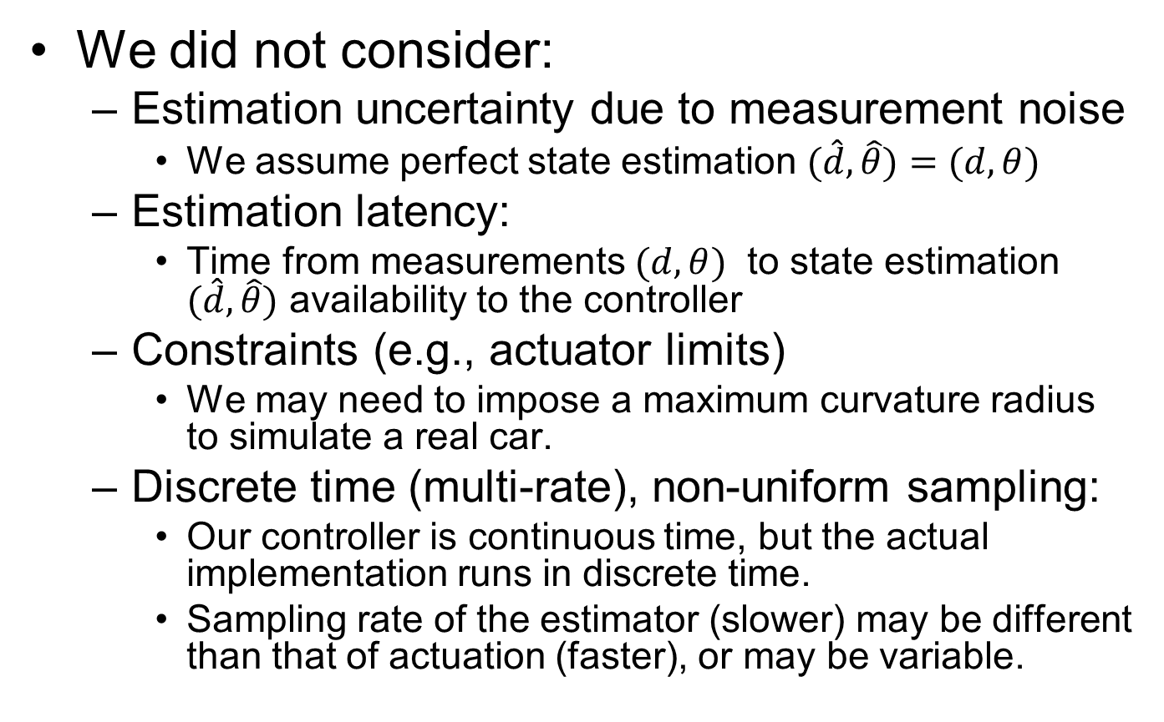
Simplifying Assumptions We Made
We did not consider:
  Estimation uncertainty due to measurement noise
    We assume perfect state estimation $(\hat{d}, \hat{θ})=(d, θ)$
  Estimation latency:
    Time from measurements $(d, θ)$ to state estimation $(\hat{d}, \hat{θ})$ availability to the controller
  Constraints (e.g., actuator limits)
    We may need to impose a maximum curvature radius to simulate a real car.
  Discrete time (multi-rate), non-uniform sampling:
    Our controller is continuous time, but the actual implementation runs in discrete time.
    Sampling rate of the estimator (slower) may be different than that of actuation (faster), or may be variable.

Slide 16
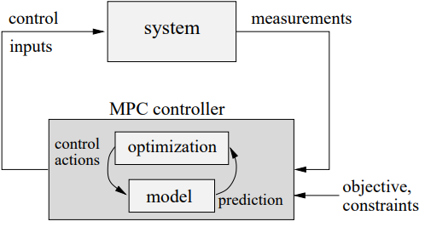
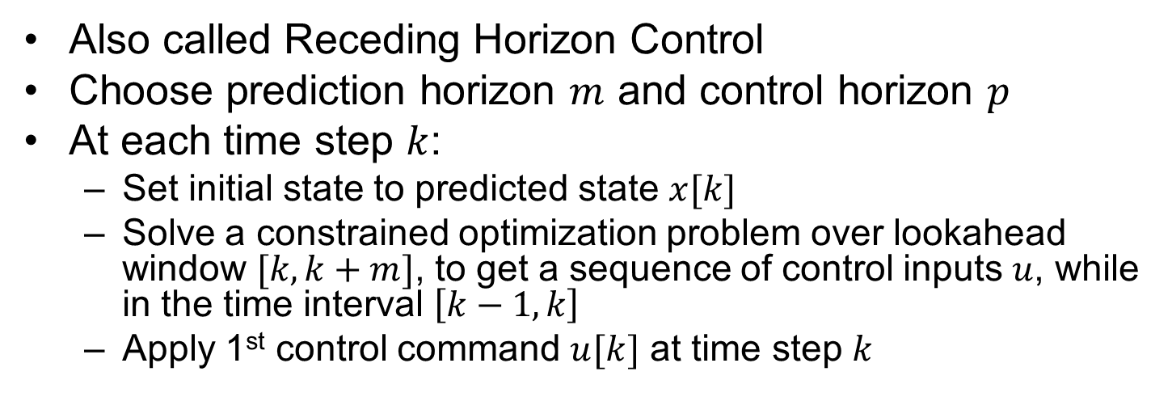
MPC (Model-Predictive Control)
Also called Receding Horizon Control
Choose prediction horizon $m$ and control horizon $p$
At each time step $k$:
  Set initial state to predicted state $x[k]$
  Solve a constrained optimization problem over lookahead window $[k,k+m]$, to get a sequence of control inputs $u$, while in the time interval $\left[k−1,k\right]$
  Apply 1st control command $u[k]$ at time step $k$

Slide 17
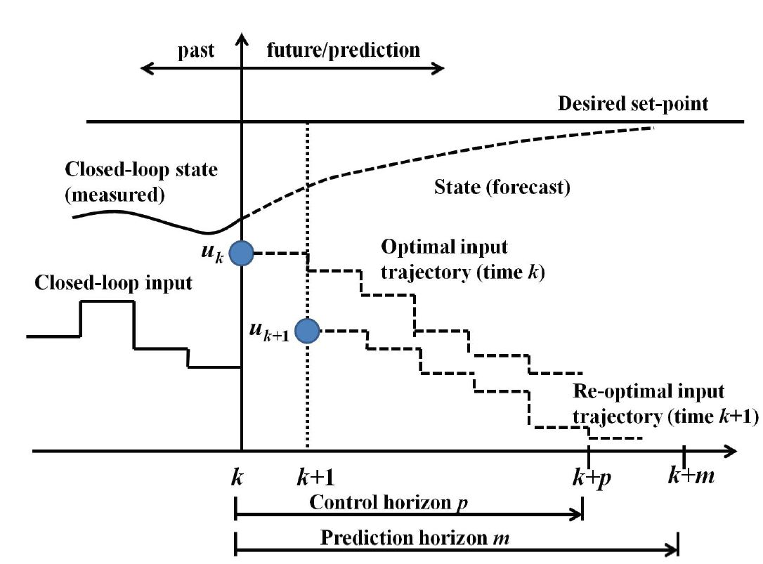
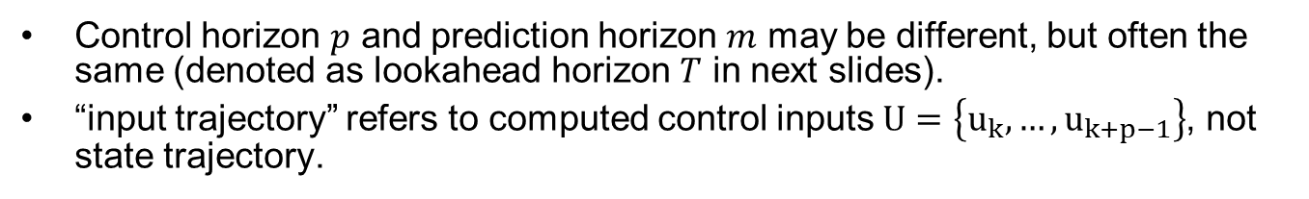
MPC Illustration
Control horizon $p$ and prediction horizon $m$ may be different, but often the same (denoted as lookahead horizon $T$ in next slides).
“input trajectory” refers to computed control inputs $U=\left\{u_{k},…,u_{k+p−1}\right\}$, not state trajectory.
Notes:
, denoted as $T$ with time window $[t,t+T−1]$

Slide 18
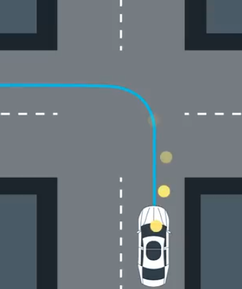
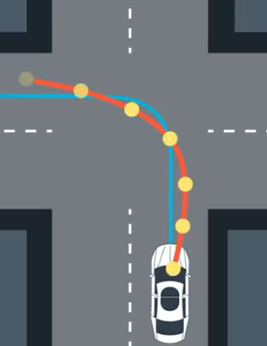
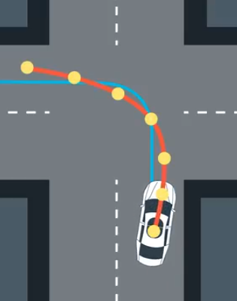
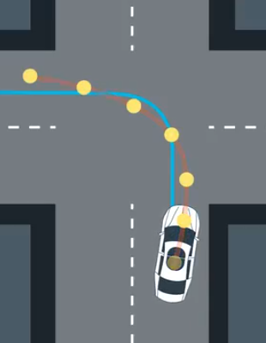
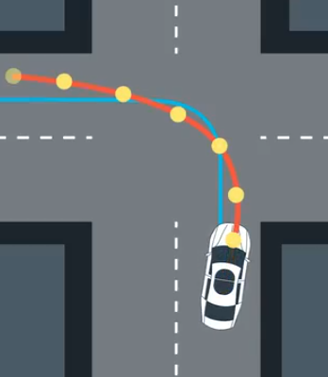
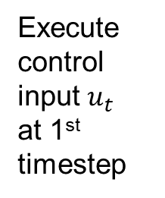
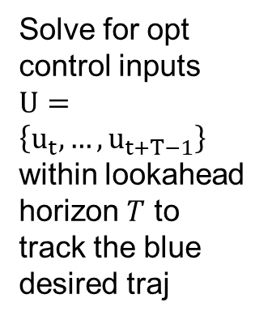
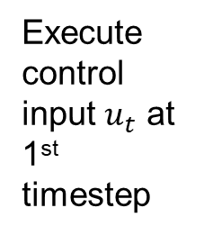
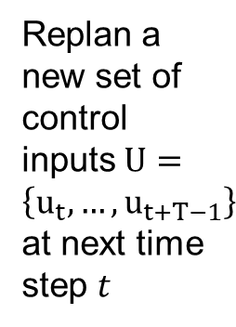
MPC Illustration Con’t
Solve for opt control inputs $U=\left\{u_{t},…,u_{t+T−1}\right\}$ within lookahead horizon $T$ to track the blue desired traj
Execute control input $u_{t}$
at 1st timestep
Execute control input $u_{t}$ at 1st timestep
Replan a new set of control inputs $U=\left\{u_{t},…,u_{t+T−1}\right\}$ at next time step $t$
…

Slide 19
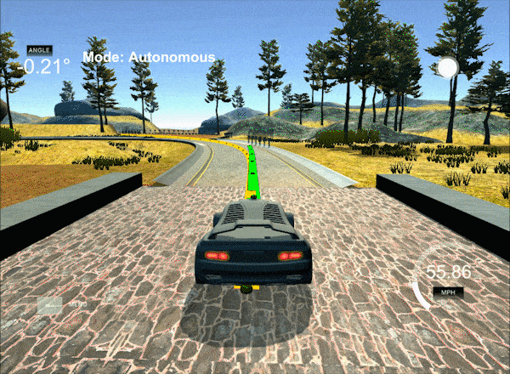
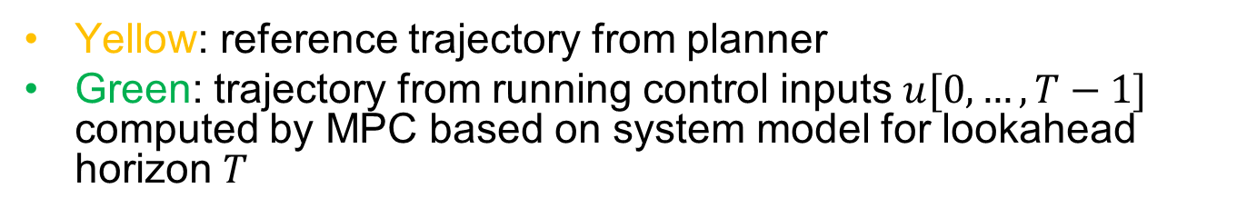
MPC Illustration Con’t
Yellow: reference trajectory from planner
Green: trajectory from running control inputs $u[0,…,T−1]$ computed by MPC based on system model for lookahead horizon $T$
https://medium.com/@david010/vehicle-mpc-controller-33ae813cf3be

Slide 20
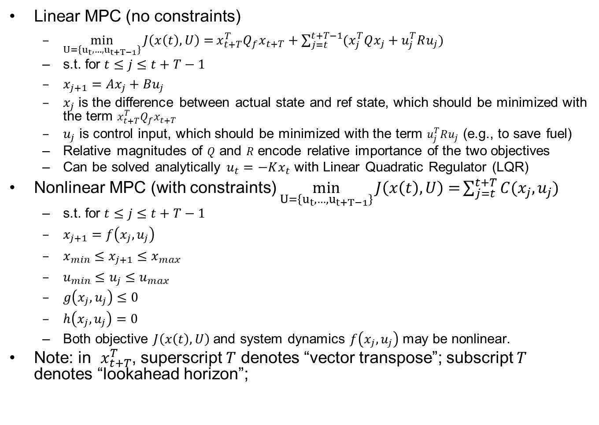
MPC Formulations
Linear MPC (no constraints)
  $\min_{U=\left\{u_{t},…,u_{t+T−1}\right\}}{J\left(x\left(t\right),U\right)=}x_{t+T}^{T}Q_{f}x_{t+T}+\sum_{j=t}^{t+T−1}{(x_{j}^{T}Qx_{j}}+u_{j}^{T}Ru_{j})$
  s.t. for $t≤j≤t+T−1$
  $x_{j+1}=Ax_{j}+Bu_{j}$
  $x_{j}$ is the difference between actual state and ref state, which should be minimized with the term $x_{t+T}^{T}Q_{f}x_{t+T}$
  $u_{j}$ is control input, which should be minimized with the term $u_{j}^{T}Ru_{j}$ (e.g., to save fuel)
  Relative magnitudes of $Q$ and $R$ encode relative importance of the two objectives
  Can be solved analytically $u_{t}=−Kx_{t}$ with Linear Quadratic Regulator (LQR)
Nonlinear MPC (with constraints) $\min_{U=\left\{u_{t},…,u_{t+T−1}\right\}}{J\left(x\left(t\right),U\right)=}\sum_{j=t}^{t+T}{C(x_{j},u_{j}) }$
  s.t. for $t≤j≤t+T−1$
  $x_{j+1}=f\left(x_{j},u_{j}\right)$
  $x_{min}≤x_{j+1}≤x_{max}$
  $u_{min}≤u_{j}≤u_{max}$
  $g\left(x_{j},u_{j}\right)≤0$
  $h\left(x_{j},u_{j}\right)=0$
  Both objective $J\left(x\left(t\right),U\right)$and system dynamics $f\left(x_{j},u_{j}\right)$ may be nonlinear.
Note: in $x_{t+T}^{T}$, superscript $T$ denotes “vector transpose”; subscript $T$ denotes “lookahead horizon”;

Slide 21
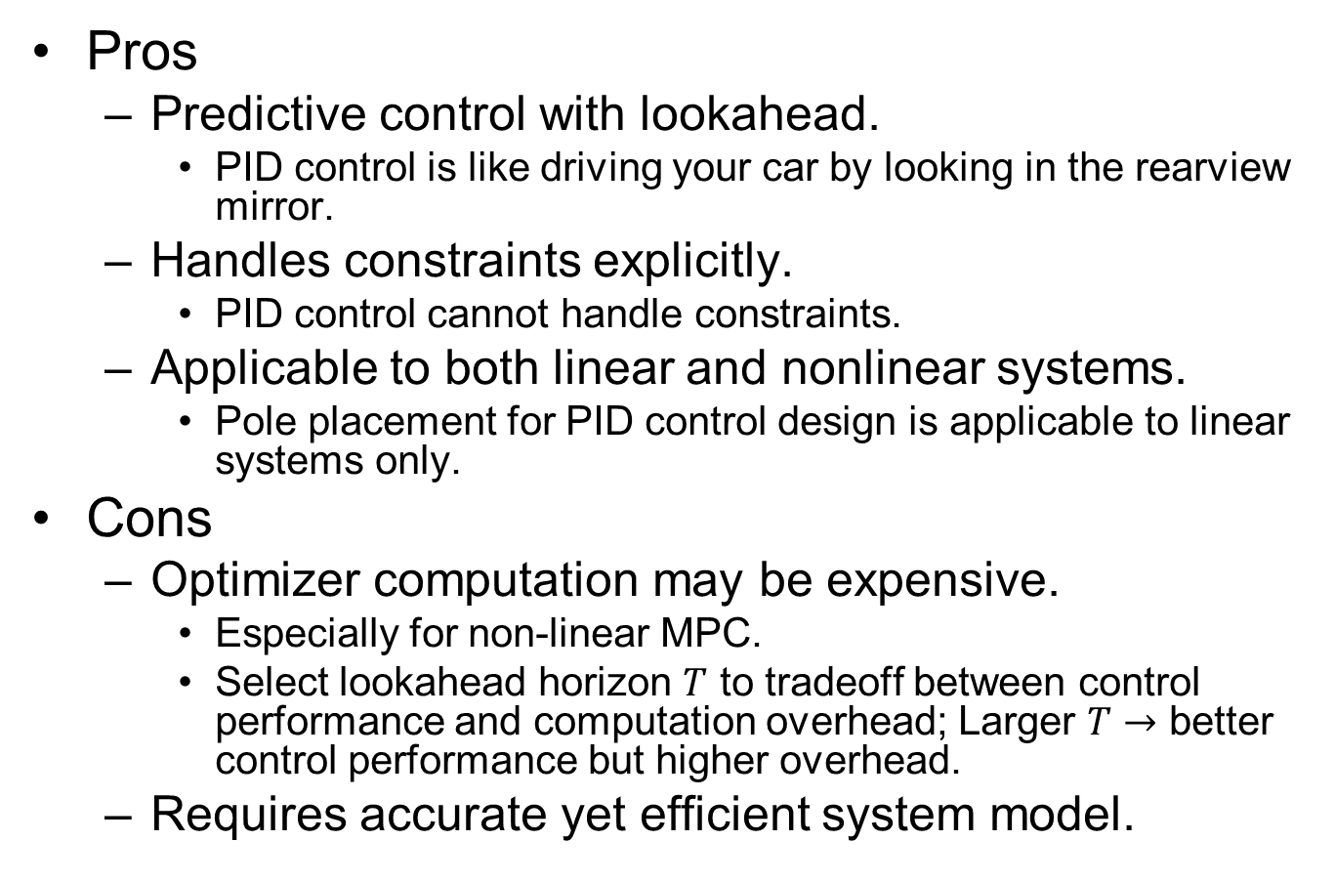
MPC Pros and Cons
Pros
  Predictive control with lookahead.
    PID control is like driving your car by looking in the rearview mirror.
  Handles constraints explicitly.
    PID control cannot handle constraints.
  Applicable to both linear and nonlinear systems.
    Pole placement for PID control design is applicable to linear systems only.
Cons
  Optimizer computation may be expensive.
    Especially for non-linear MPC.
    Select lookahead horizon $T$ to tradeoff between control performance and computation overhead; Larger $T$ $→$ better control performance but higher overhead.
  Requires accurate yet efficient system model.

Slide 22
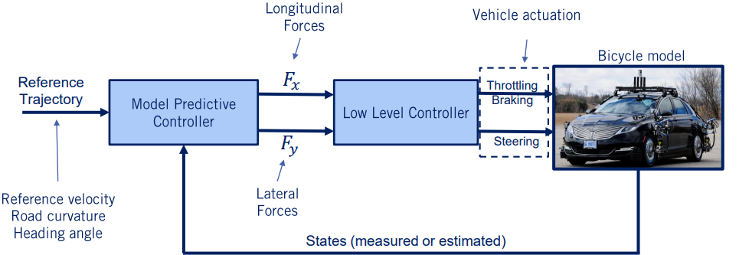
MPC Example: Vehicle Lateral Control
MPC cost function: minimize
  Deviation from desired reference trajectory
  Minimization of control effort (to save fuel)
MPC constraints:
  System dynamics (longitudinal and lateral)
  Tire force limits
Low-level controller takes into account:
  Engine map (a lookup table)
  Actuator models
  Tire force models
It is possible to integrate low-level controller into MPC, so the overall MPC has more complex models and constraints, with increased optimizer computation load.

Slide 23
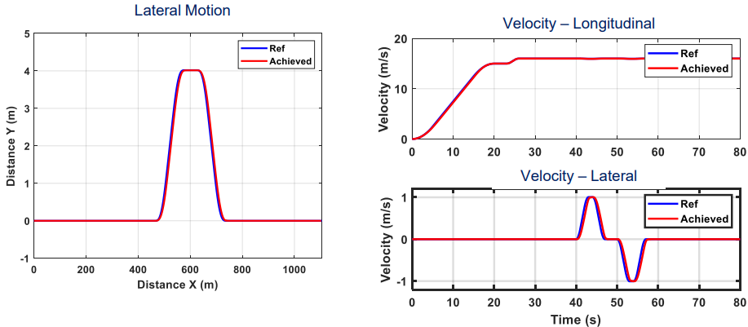
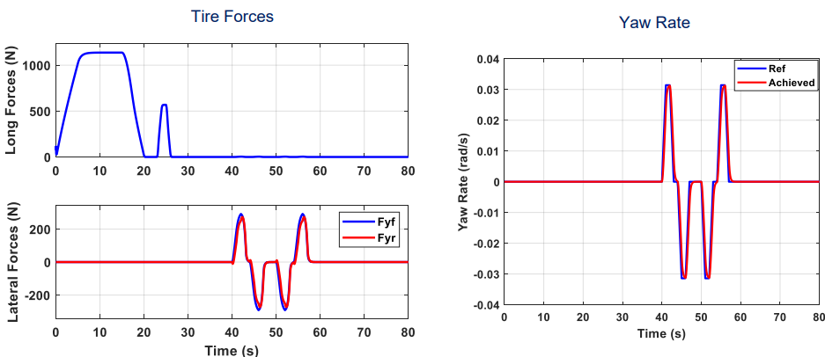
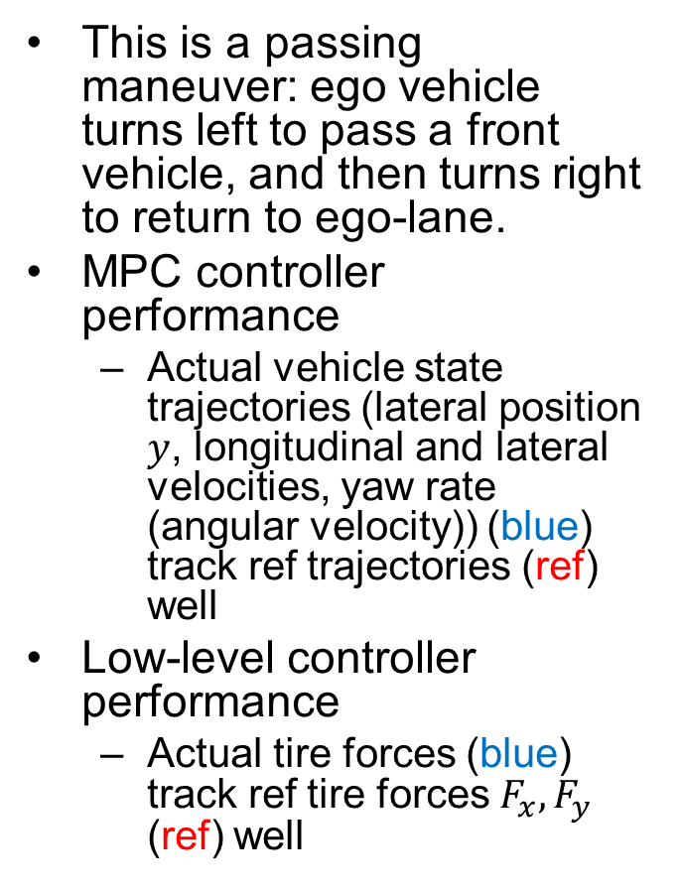
MPC Example Performance
This is a passing maneuver: ego vehicle turns left to pass a front vehicle, and then turns right to return to ego-lane.
MPC controller performance
  Actual vehicle state trajectories (lateral position $y$, longitudinal and lateral velocities, yaw rate (angular velocity)) (blue) track ref trajectories (ref) well
Low-level controller performance
  Actual tire forces (blue) track ref tire forces $F_{x},F_{y}$ (ref) well
https://www.coursera.org/learn/intro-self-driving-cars/lecture/WHPvn/lesson-4-advanced-steering-control-mpc

Slide 24
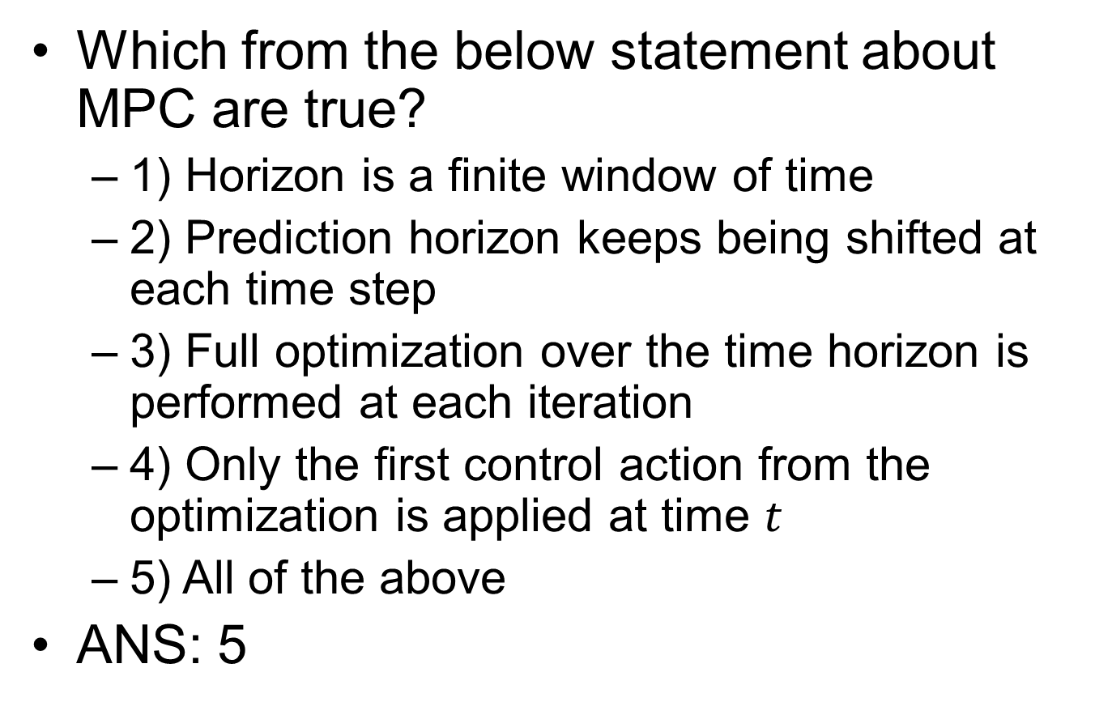
MPC Quiz
Which from the below statement about MPC are true?
  1) Horizon is a finite window of time
  2) Prediction horizon keeps being shifted at each time step
  3) Full optimization over the time horizon is performed at each iteration
  4) Only the first control action from the optimization is applied at time $t$
  5) All of the above
ANS: 5

Slide 25

Kinematics vs. Dynamics
Kinematics is study of motion without considering the forces that affect the motion. It deals with the geometric relationships that govern the system
  A kinematic model: $\dot{x}=v, \dot{v}=\ddot{x}=a$
  Uses position, velocity, acceleration (and/or further derivatives) as control input (e.g. the kinematic bicycle model)
Dynamics is the study of motion taking into account the forces that affect it. It is described by the equations of motion.
  A dynamic model: $F=M\ddot{x}+B\dot{x}$ (Newton’s law with friction)
  Uses force and torque as control input, and takes mass and inertia into consideration.
  e.g., vehicle dynamics model (longitudinal and lateral)
Consider two vehicles with the same geometry but different mass/weight turning a tight corner
  They may have the same kinematic model, but different dynamic model due to different mass $M$.
  If both are controllable kinematically by control input $a$:
    The light vehicle may be controllable dynamically by control input $F$.
    The heavy vehicle may not be controllable dynamically by control input $F$. Due to large $M$, $F$ may exceed the max actuator limit.
Orthogonal issue from control algorithm
  A control algorithm, e.g., PID or MPC, may be either kinematic or dynamic control

Slide 26

Kinematic vs. Dynamic Control
PID controller for kinematic bicycle model with heading angle rate $(\dot{θ})$ and velocity $(v_{r}$, constant here) as control input. ($\dot{θ}$ should be controlled indirectly by controlling steering angle $δ$, with $\dot{θ}=\frac{v\tan{δ}}{L}$.)
MPC for dynamic vehicle model (high-level controller) with forces (longitudinal and lateral) as control input.

Slide 27
PID Control Lab Setup
Based on Udacity course Lesson AI for Robotics, Lesson 15: PID Control
  https://classroom.udacity.com/courses/cs373/
Lateral control of a car to run along a race track (either straight line or circular) with fixed speed.
Notes:
(straight line).

Slide 28


Udacity: Racetrack Control
Lesson 16: Problem Set 5, 4. Quiz: Racetrack control.
Cross-track error (cte): lateral distance (of rear wheel) to desired trajectory, defined as:
  if $x∈[radius, 3∗radius]$: deviation from the straight horizontal track (with the implicit assumption that the car will not deviate from the track for more than $radius$.)
  Otherwise: deviation from each semi-circle track.
For clockwise traversal, cte>0 if car is outside of the track region; cte<0 if inside.
cte>0
cte>0
Initial position
and heading
cte<0
cte<0
Notes:
Cross-track error (cte): lateral distance (of rear wheel) to desired trajectory

Slide 29







Kinematic Bicycle Model
Front wheel steering. Assuming here rear wheel as reference point (may also use front wheel or center of gravity).
State vector: ${\left[\begin{matrix}x & y & θ\end{matrix}\right]}^{T}$: vehicle pose includes its position $(x,y)$ and heading angle $θ$.
Control inputs: ${\left[\begin{matrix}δ & v\end{matrix}\right]}^{T}$: steering angle $δ$ and vehicle speed $v$ (assumed to be constant).
$\tan{δ}=\frac{L}{R}$
  $L$: vehicle length (distance between 2 wheels); $R$: rotation radius of Instantaneous Center of Rotation (ICR), equal to distance between ICR and rear wheel. Curvature $κ=\frac{1}{R}$.
  Line from ICR to each wheel is perpendicular to it.
$\dot{θ}=ω=\frac{v}{R}=\frac{v\tan{δ}}{L}$
  Angular velocity is speed $v$ divided by rotation radius $R$
Typically, angles $δ,θ$ are based on counter-clockwise convention w.r.t reference direction.
  In the fig, $δ≈\frac{π}{6}$ w.r.t ref direction $v$; $θ≈\frac{π}{6}$ w.r.t ref direction east (horizontal); $\dot{θ}>0$ for counter-clockwise rotation.
$$\left[\dot{\begin{matrix}x \\ \dot{y} \\ \dot{θ}\end{matrix}}\right]=v\left[\begin{matrix}\cos{θ} \\ \sin{θ} \\ \frac{\tan{δ}}{L}\end{matrix}\right]$$
$$π/2$$
(Non-linear in $δ$;
Linear in $v$)
$$π/2$$
$$(x,y)$$
Notes:
(angle between vehicle speed $v$ and horizontal axis) $δ∈\left[δ_{min},δ_{max}\right]$
$$v∈\left[v_{min},v_{max}\right]$$

Slide 30

State Update Equation
Circular motion around ICR (accurate):
$\left[\begin{matrix}x(t+dt) \\ y\left(t+dt\right) \\ θ(t+dt)\end{matrix}\right]=\left[\begin{matrix}x(t)−R\sin{θ}+R\sin{(θ}+\dot{θ}dt) \\ y\left(t\right)+R\cos{θ}−R\cos{(θ}+\dot{θ}dt) \\ θ+\dot{θ}dt\end{matrix}\right]$
  $R=\frac{L}{\tan{δ}}=\frac{v}{\dot{θ}}$
Straight-line motion for small $\dot{θ}dt$ (approximate):
$\left[\begin{matrix}x(t+dt) \\ y\left(t+dt\right) \\ θ(t+dt)\end{matrix}\right]=\left[\begin{matrix}x\left(t\right)+vdt\cos{θ} \\ y\left(t\right)+vdt\sin{θ} \\ θ+\dot{θ}dt\end{matrix}\right]$
  $δ→0,\dot{θ}dt→0$

Slide 31








Udacity: State Update based on Kinematic Bicycle Model
# apply noise
steering2 = random.gauss(steering, self.steering_noise)
distance2 = random.gauss(distance, self.distance_noise)
# apply steering drift
steering2 += self.steering_drift
# noise and drift are all set to 0, so steering2 is steering angle $δ$, distance2 is distance traveled per time step $vdt$
# Execute motion
turn = np.tan(steering2) * distance2 / self.length ($\dot{θ}dt=\frac{vdt tan{δ}}{L}$)
if abs(turn) < tolerance: (with small $\dot{θ}dt$)
# approximate by straight line motion
self.x += distance2 * np.cos(self.orientation) ($x+=vdt\cos{θ}$)
self.y += distance2 * np.sin(self.orientation) ($y+=vdt\sin{θ}$)
self.orientation = (self.orientation + turn) % (2.0 * np.pi) ($θ=(θ+\dot{θ}dt$)%($2π$))
else: (with large $\dot{θ}dt$)
# Circular motion around ICR
radius = distance2 / turn ($R=\frac{v}{\dot{θ}}$; can also use $R=\frac{L}{\tan{δ}}$)
# compute ICR’s coordinates (cx, cy)
cx = self.x - (np.sin(self.orientation) * radius) ($cx=x−R\sin{θ}$)
cy = self.y + (np.cos(self.orientation) * radius) ($cy=y+R\cos{θ}$)
self.orientation = (self.orientation + turn) % (2.0 * np.pi) ($θ=(θ+\dot{θ}dt\text{)\%(}2π\text{)}$)
# compute vehicle’s x, y coordinate after rotation around ICR
self.x = cx + (np.sin(self.orientation) * radius) ($x=cx+R\sin{θ}$)
self.y = cy - (np.cos(self.orientation) * radius) ($y=cy−R\cos{θ}$)
$$(cx,cy)$$
$$θ$$
$$R\cos{θ}$$
$\%(2π)$ (modulo $2π$) keeps angles to be within $2π$; It can be omitted since it does not affect results of $cos,sin$ functions (assuming no numeric overflow).
$$−R\sin{θ}$$
$$(x,y)$$

Slide 32

Straight Line vs. Circular Motion
Straight line motion (with steering angle $δ=0$) is a special case of circular motion with radius $∞$.
  $δ→0⇒R=\frac{L}{\tan{δ}}→∞,\dot{θ}=\frac{v}{R}→0$ (small steering angle $δ$ leads to slow angular velocity $\dot{θ}$.)
  We use this special case to improve computational efficiency for small $δ,\dot{θ}$, and avoid division by 0.
$x(t+dt)=x(t)−R\sin{θ}+R\sin{(θ}+\dot{θ}dt)=x+R(\sin{(θ}+\dot{θ}dt)−sin⁡θ)=x+\frac{v}{\dot{θ}}∗\cos{θ}∗\dot{θ}dt= x+vdt\cos{θ}$
  $\sin{(θ}+\dot{θ}dt)−\sin{θ}≈\frac{d}{dt}\sin{θ}∗\dot{θ}dt=\cos{θ}∗\dot{θ}dt$, for small $\dot{θ}dt$.
$y\left(t+dt\right)=y\left(t\right)+R\cos{θ}−R\cos{(θ}+\dot{θ}dt)=y−R(\cos{(θ}+\dot{θ}dt)−cos⁡θ)=y+\frac{v}{\dot{θ}}∗\sin{θ}∗\dot{θ}dt=y+vdt\sin{θ}$
  $\cos{(θ}+\dot{θ}dt)−\cos{θ}≈\frac{d}{dt}\cos{θ}∗\dot{θ}dt=−\sin{θ}∗\dot{θ}dt$, for small $\dot{θ}dt$.
Four special cases of straight line motion:
  $θ=0⇒x^{′}=x+vdt,y^{′}=y$ (east)
  $θ=π⇒x^{′}=x−vdt,y^{′}=y$ (west)
  $θ=\frac{π}{2}⇒x^{′}=x,y^{′}=y+vdt$ (north)
  $θ=\frac{3π}{2}⇒x^{′}=x,y^{′}=y−vdt$ (south)

Slide 33


run()
Implements the PID controller for with PID gains
  params[0] as $K_{p}$; params[1] as $K_{d}$; params[2] as $K_{i}$. (Minus signs can be removed without affecting correctness.)
  Returns actual trajectory as arrays of x_trajectory[], y_trajectory[]; and average error, defined as sum of squared cte.
For clockwise travel direction:
  If cte>0, car is outside of track region; steering angle $δ$ should decrease (turn right according to the counter-clockwise convention).
  If cte<0, car is inside of track region; steering angle $δ$ should increase (turn left).
  Based on the above, $K_{p}$ should be positive (this can be a sanity check for your final solution).
This is for straight line track; need to call myrobot.cte() for circular track.
PID control law

Slide 34


For General $dt$
The Python code assumes controller time step size $dt=1$.
  Also, $v$ is constant. $δ$’s range is unconstrained (steering wheel can be turned to arbitrary angle).
For general $dt$, the following needs to be modified:
  Call myrobot.move(steer, speed*dt), to match its definition move(self, steering, distance,…)
  In the PID control law:
    Differential of error$diffcte=\frac{cte−prevcte}{dt}$
    Integral of error$intcte+=cte∗dt$

Slide 35





twiddle()
Adjust each $p\left[i\right]$ in turn.
Adjust $p\left[i\right]$ to $p\left[i\right]+dp[i]$ and run(). If error decreases, we adjusted in the right direction, keep the original adjustment $p\left[i\right]+dp[i]$, and increase step size to $1.1∗dp\left[i\right]$.
If error increases, we adjusted in the wrong direction, adjust in the opposite direction to $p\left[i\right]−2∗dp[i]$. Run again.
If error decreases, we adjusted in the right direction, keep the original adjustment $p\left[i\right]+dp[i]$, and increase step size to $1.1∗dp\left[i\right]$.
If error increases, we adjusted in the wrong direction, reduce step size to $.9∗dp\left[i\right]$. We do not reverse direction here to avoid oscillation around current $p[i]$ with no progress.

Slide 36

twiddle() vs. Pole Placement
“Gradient descent” approach to tuning PID controller (model-free), by adjusting each PID gain parameter systematically, gradually decreasing or increasing step of adjustment $dp[i]$ (the gradient) until convergence to minimum best_err.
Pole placement for PID controller design is model-based, but requires a linear model
  $\left[\dot{\begin{matrix}x \\ \dot{y} \\ \dot{θ}\end{matrix}}\right]=v\left[\begin{matrix}\cos{θ} \\ \sin{θ} \\ \frac{\tan{δ}}{L}\end{matrix}\right]≈\left[\begin{matrix}v \\ vθ \\ u\end{matrix}\right]$
  With simplifying assumptions:
    $θ$ is small
    Simplified kinematic model: $u=\dot{θ}$ as control input instead of $δ$.

Slide 37


Changing to P Control
Setting $dparams\left[1\right]=dparams\left[2\right]=0$ turns it into a P controller, since $K_{d},K_{i}$ are initialized to 0 and never changed. $P_{p}$ is adjusted in twiddle()
twiddle() is a local optimization algorithm, so perf is dependent on parameter initialization. Here are initialized to 0 for simplicity.
  https://classroom.udacity.com/courses/cs373/lessons/48743150/concepts/f9fe06f9-9b1c-40b1-b9ad-312ca92be287

