Slide 1
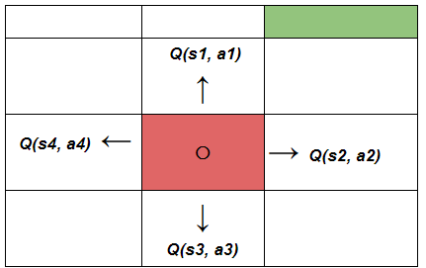
L7.2 Value-based RL
Zonghua Gu 2021
Acknowledgement: slides based on https://www.coursera.org/specializations/reinforcement-learning
And textbook by Sutton and Barto http://incompleteideas.net/book/the-book-2nd.html
Notes:
https://blog.floydhub.com/an-introduction-to-q-learning-reinforcement-learning/

Slide 2
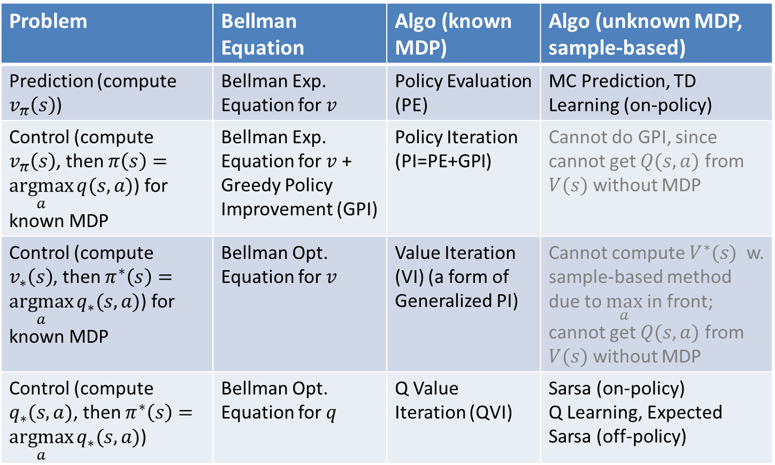
The Big Picture
Important
Problem | Bellman Equation | Algo (known MDP) | Algo (unknown MDP, sample-based)
Prediction (compute $v_{π}\left(s\right)$) | Bellman Exp. Equation for $v$ | Policy Evaluation (PE) | MC Prediction, TD Learning (on-policy)
Control (compute $v_{π}\left(s\right)$, then $π\left(s\right)=\underset{a}{argmax}{q(s,a)}$) for known MDP | Bellman Exp. Equation for $v$ + Greedy Policy Improvement (GPI) | Policy Iteration (PI=PE+GPI) | Cannot do GPI, since cannot get $Q(s,a)$ from $V(s)$ without MDP
Control (compute $v_{∗}\left(s\right)$, then $π^{∗}\left(s\right)=\underset{a}{argmax}{q_{∗}(s,a)}$) for known MDP | Bellman Opt. Equation for $v$ | Value Iteration (VI) (a form of Generalized PI) | Cannot compute $V^{∗}(s)$ w. sample-based method due to $\max_{a}$ in front; cannot get $Q(s,a)$ from $V(s)$ without MDP
Control (compute $q_{∗}(s,a)$, then $π^{∗}\left(s\right)=\underset{a}{argmax}{q_{∗}(s,a)}$) | Bellman Opt. Equation for $q$ | Q Value Iteration (QVI) | Sarsa (on-policy) Q Learning, Expected Sarsa (off-policy)

Slide 3

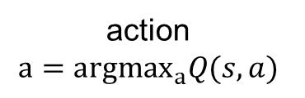




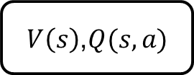



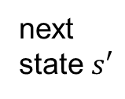
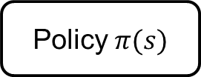
Value-based RL
state $s$
action $a$
state $s$
action $a$
state $s$
action $a$
MDP
$V\left(s\right)$,$Q(s,a)$
Policy $π(s)$
next
state $s′$
reward $r$
action
$$a={argmax}_{a}Q(s,a)$$
action $a=π(s)$
MDP Planning | Value-based RL | Policy-based RL

Slide 4
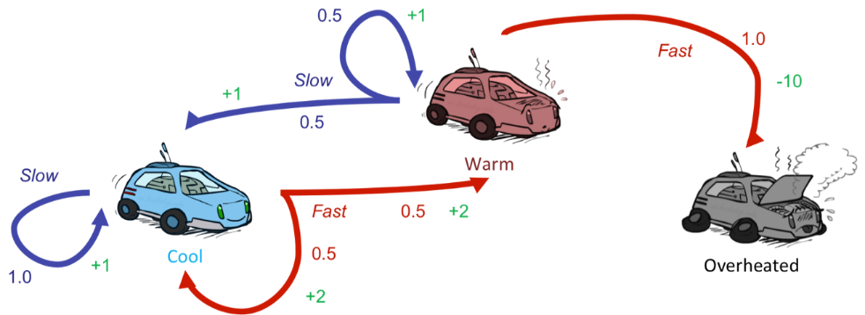
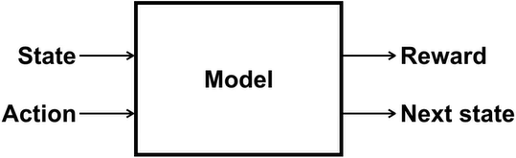

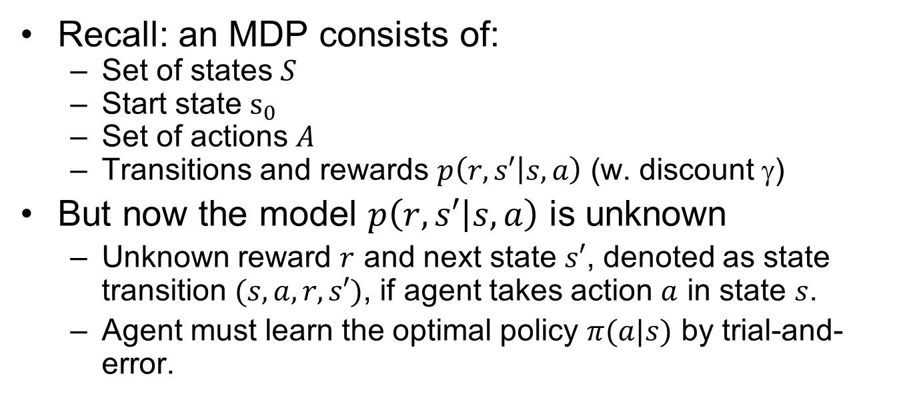
Reinforcement Learning
Recall: an MDP consists of:
  Set of states $S$
  Start state $s_{0}$
  Set of actions $A$
  Transitions and rewards $p\left(r,s′ | s,a\right)$ (w. discount $$)
But now the model $p\left(r,s′ | s,a\right)$ is unknown
  Unknown reward $r$ and next state $s′$, denoted as state transition $(s,a,r,s′)$, if agent takes action $a$ in state $s$.
  Agent must learn the optimal policy $π(a|s)$ by trial-and-error.
$$p\left(r,s′ | s,a\right)$$
Notes:
Still assume an MDP:
A set of states s ∈ S
A set of actions (per state) A
A model T(s,a,s’)
We The same $(s,a)$ may lead to different reward $r$ and next state $s′$, denoted as state transition $(s,a,r,s′)$,
I.e. we don’t know which states are good or what the actions do
A reward function R(s,a,s’)

Slide 5
Characteristics of RL
There is no supervisor, only a reward signal (may be sparse)
Feedback is delayed, not instantaneous
Sequential, non i.i.d data
  Agent's actions affect the subsequent data it receives
Notes:
What makes RL different from other ML paradigms?

Slide 6
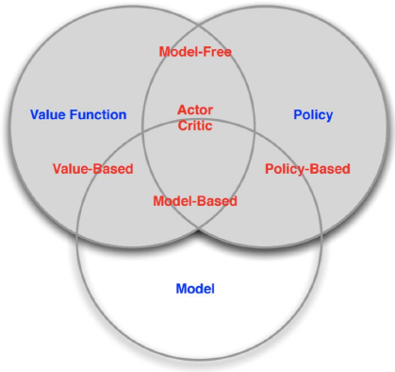
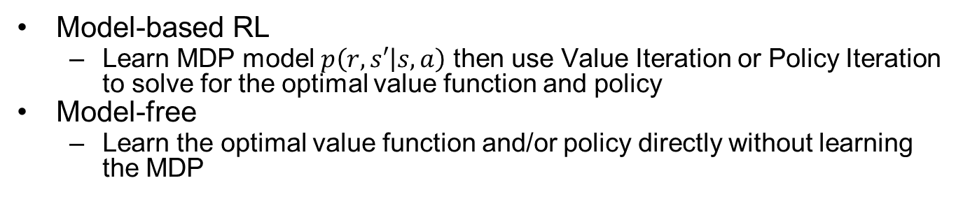
Model-based vs. Model-Free RL
Model-based RL
  Learn MDP model $p\left(r,s′ | s,a\right)$ then use Value Iteration or Policy Iteration to solve for the optimal value function and policy
Model-free
  Learn the optimal value function and/or policy directly without learning the MDP
Notes:
Learn MDP model $p\left(r,s′ | s,a\right)$, then solve for the optimal policy w. PI or VI.

Slide 7
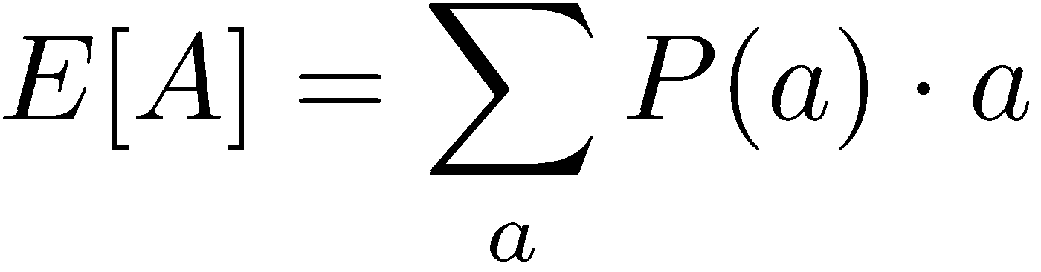
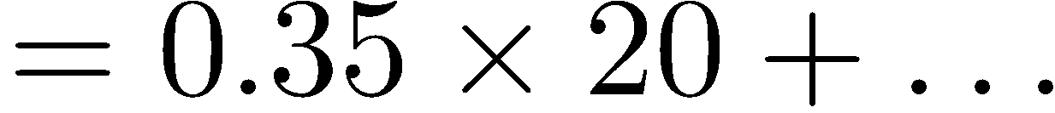
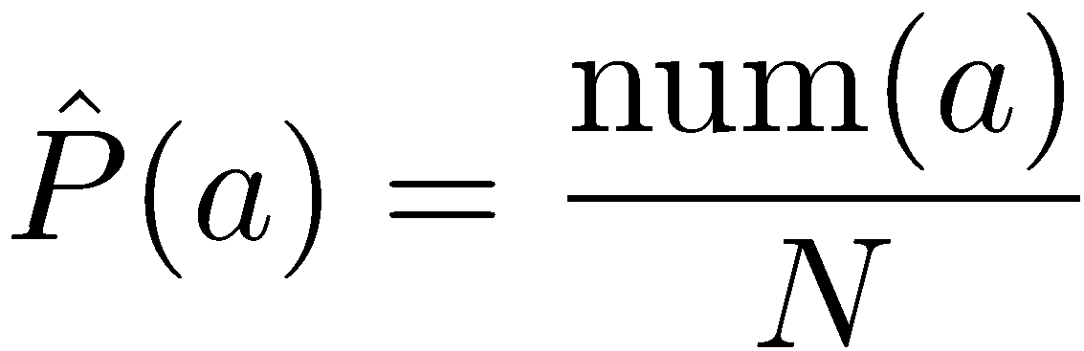
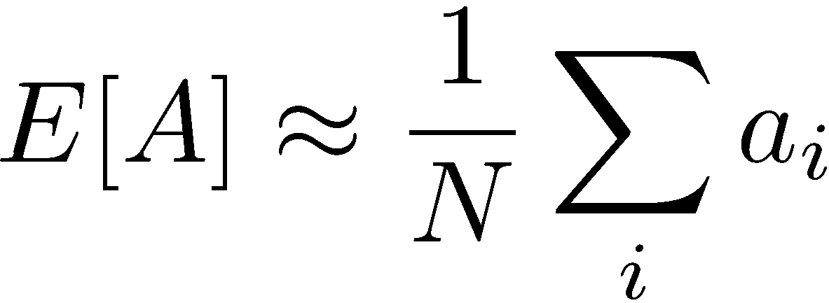
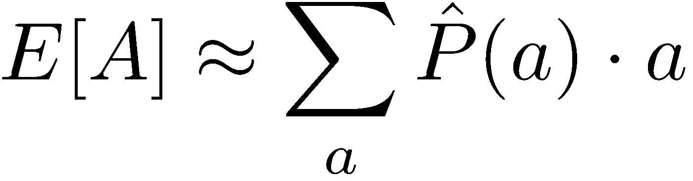
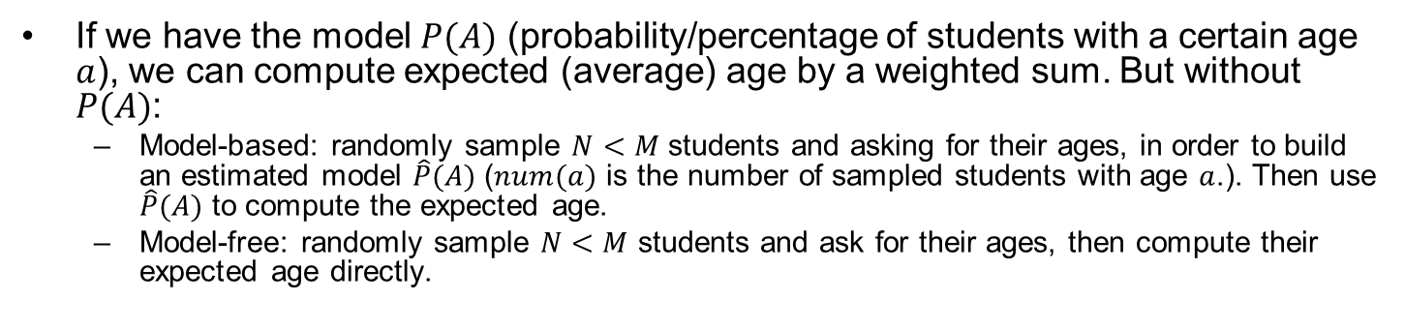
Model-Based vs. Model-Free by Analogy
Goal: Compute expected age of a group of $M$ students
Known P(A)
Without P(A), instead collect samples [a₁, a₂, … a_{N}]
Unknown P(A): “Model-Based”
Unknown P(A): “Model-Free”
Why does this work? Because eventually you learn the right model.
Why does this work? Because samples appear with the right frequencies.
If we have the model $P(A)$ (probability/percentage of students with a certain age $a$), we can compute expected (average) age by a weighted sum. But without $P(A)$:
  Model-based: randomly sample $N<M$ students and asking for their ages, in order to build an estimated model $\hat{P}(A)$ ($num(a)$ is the number of sampled students with age $a$.). Then use $\hat{P}(A)$ to compute the expected age.
  Model-free: randomly sample $N<M$ students and ask for their ages, then compute their expected age directly.

Slide 8
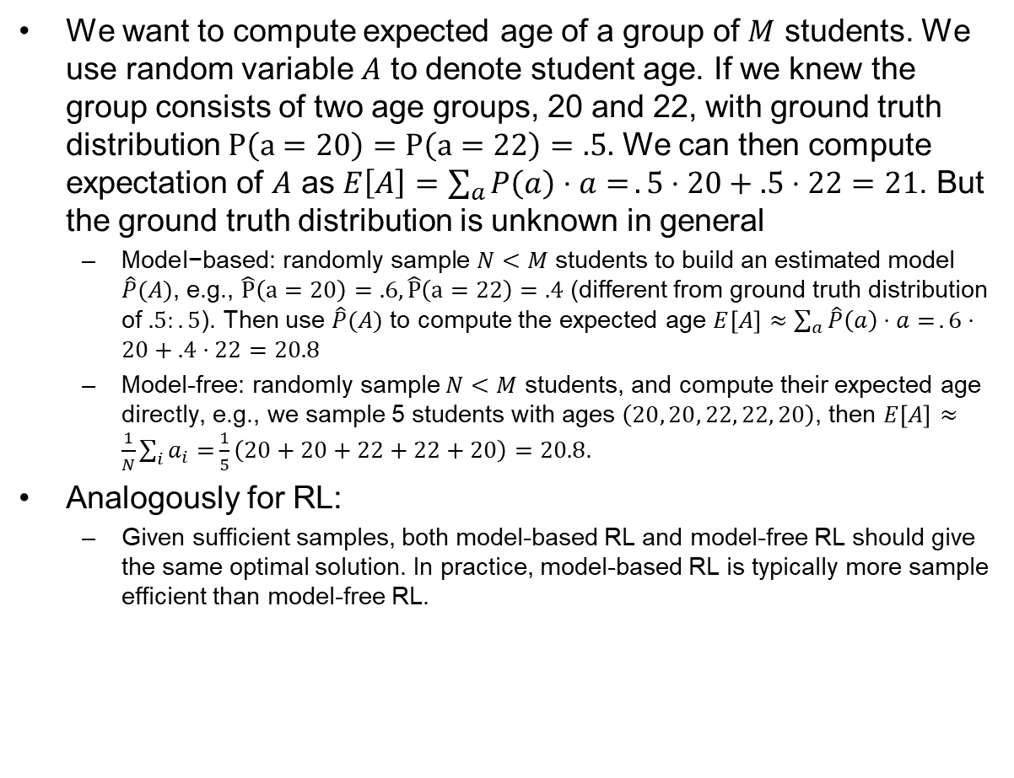
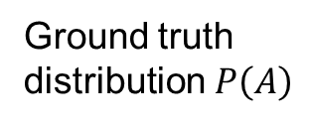
Model-Based vs. Model-Free Example
We want to compute expected age of a group of $M$ students. We use random variable $A$ to denote student age. If we knew the group consists of two age groups, 20 and 22, with ground truth distribution $P\left(a=20\right)=P\left(a=22\right)=.5.$ We can then compute expectation of $A$ as $E\left[A\right]=\sum_{a}{P\left(a\right)⋅a=}.5⋅20+.5⋅22=21$. But the ground truth distribution is unknown in general
  $\text{Model}\text{−}\text{based}\text{: }\text{randomly} \text{sample} N<M \text{students} \text{to} \text{build} \text{an} \text{estimated} \text{model} \hat{P}(A)$, e.g., $\hat{P}\left(a=20\right)=.6, \hat{P}\left(a=22\right)=.4$ (different from ground truth distribution of $.5:.5$). Then use $\hat{P}(A)$ to compute the expected age $E\left[A\right]≈\sum_{a}{\hat{P}\left(a\right)⋅a=}.6⋅20+.4⋅22=20.8$
  Model-free: randomly sample $N<M$ students, and compute their expected age directly, e.g., we sample 5 students with ages $\left(20, 20, 22, 22, 20\right)$, then $E\left[A\right]≈\frac{1}{N}\sum_{i}{a_{i}=}\frac{1}{5}\left(20+20+22+22+20\right)=20.8$.
Analogously for RL:
  Given sufficient samples, both model-based RL and model-free RL should give the same optimal solution. In practice, model-based RL is typically more sample efficient than model-free RL.
50%
50%
20
22
Ground truth
distribution $P\left(A\right)$
Notes:
In this case, both approaches give the exact same results.

Slide 9
Outline
Monte Carlo Methods
TD-Learning
Sarsa & Q-Learning
Function Approximation

Slide 10
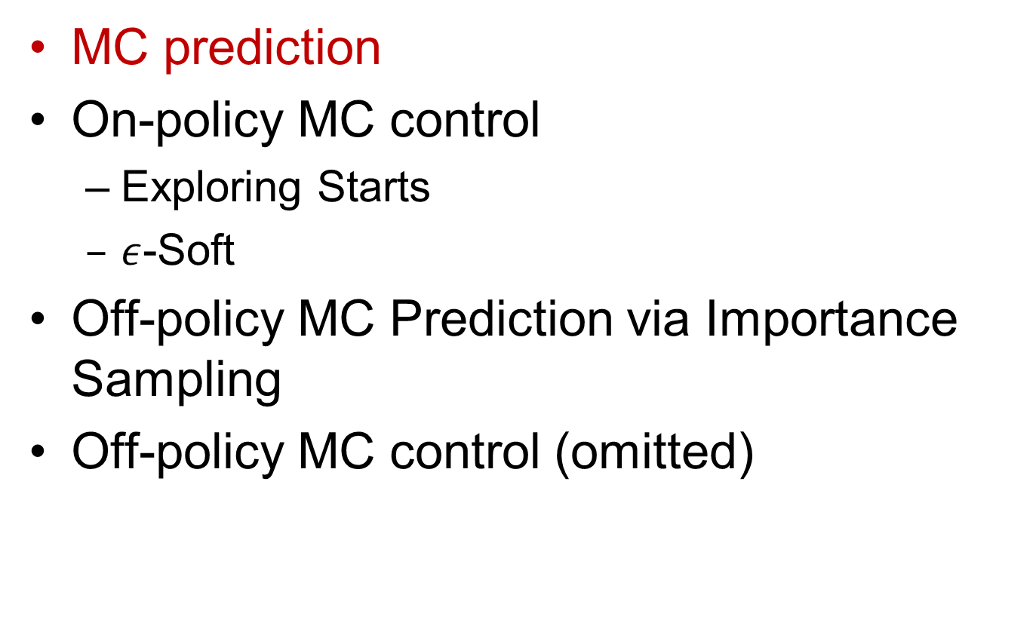
Outline: Monte Carlo Methods
MC prediction
On-policy MC control
  Exploring Starts
  $ε$-Soft
Off-policy MC Prediction via Importance Sampling
Off-policy MC control (omitted)

Slide 11

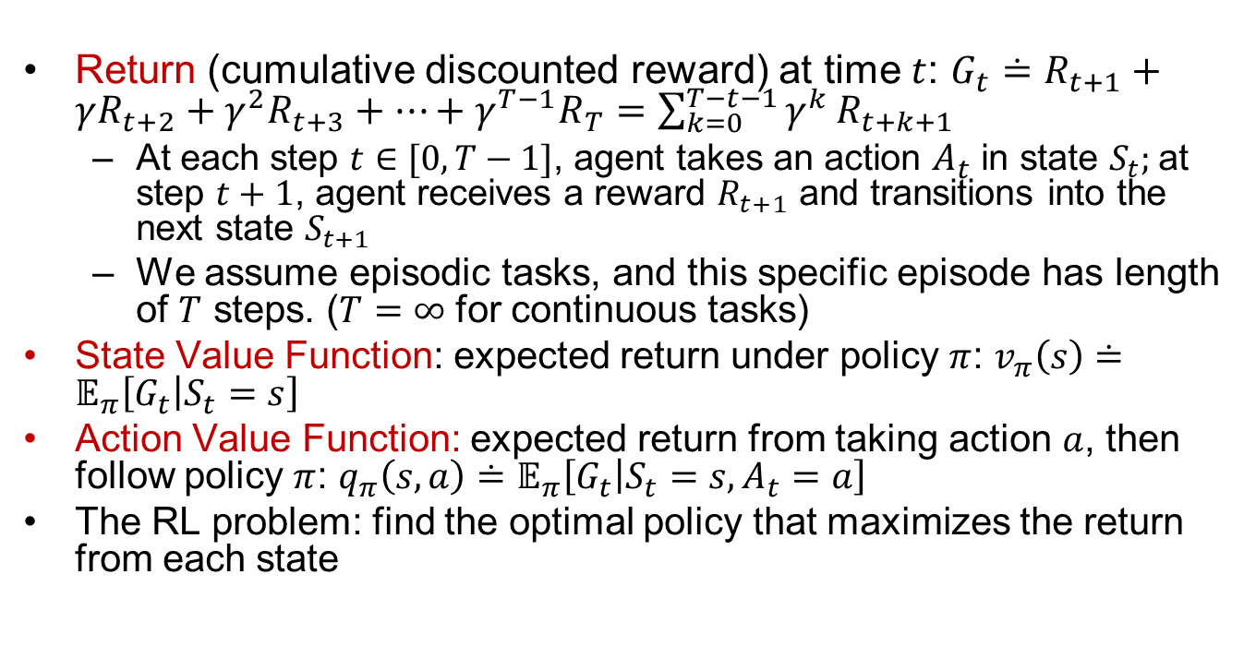

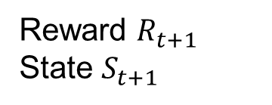
Recall: Definitions of Terms
Return (cumulative discounted reward) at time $t$: $G_{t}≐R_{t+1}+γR_{t+2}+γ^{2}R_{t+3}+…+γ^{T−1}R_{T}=\sum_{k=0}^{T−t−1}{γ^{k}}R_{t+k+1}$
  At each step $t∈[0,T−1]$, agent takes an action $A_{t}$ in state $S_{t}$; at step $t+1$, agent receives a reward $R_{t+1}$ and transitions into the next state $S_{t+1}$
  We assume episodic tasks, and this specific episode has length of $T$ steps. ($T=∞$ for continuous tasks)
State Value Function: expected return under policy $π$: $v_{π}\left(s\right)≐𝔼_{π}\left[G_{t} | S_{t}=s\right]$
Action Value Function: expected return from taking action $a$, then follow policy $π$: $q_{π}\left(s,a\right)≐𝔼_{π}\left[G_{t} | S_{t}=s,A_{t}=a\right]$
The RL problem: find the optimal policy that maximizes the return from each state
$${p(S}_{t+1}|S_{t},A_{t})$$
Environment
Action $A_{t}$
Reward $R_{t+1}$
State $S_{t+1}$
RL Agent

Slide 12
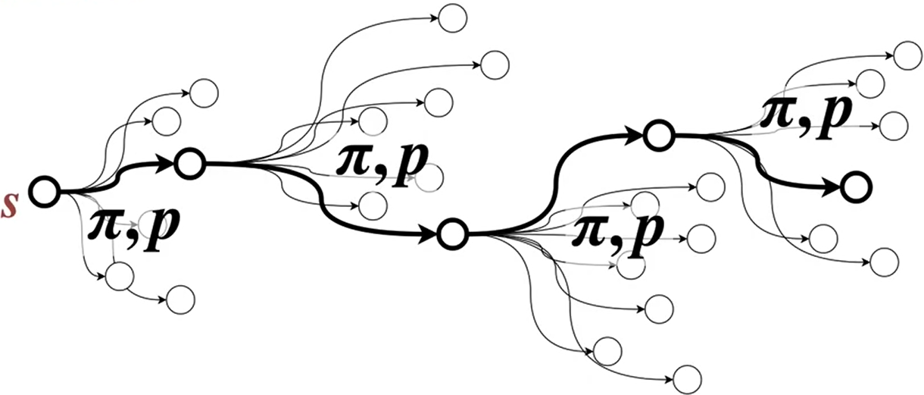
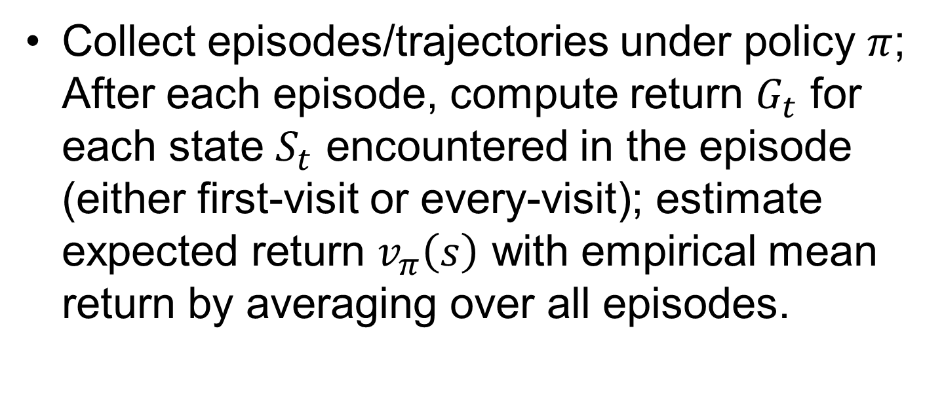
Monte Carlo (MC) Prediction (Policy Evaluation)
Collect episodes/trajectories under policy $π$; After each episode, compute return $G_{t}$ for each state $S_{t}$ encountered in the episode (either first-visit or every-visit); estimate expected return $v_{π}\left(s\right)$ with empirical mean return by averaging over all episodes.
Notes:
containing particular $s$ or $(s,a)$
trajectory starting from $s$ or $(s,a)$
state $S_{t}$
Or 2) Inre
Compare to every-visit MC w.

Slide 13
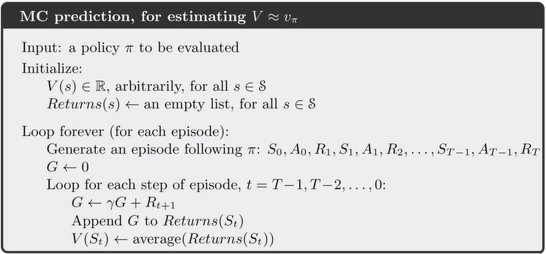
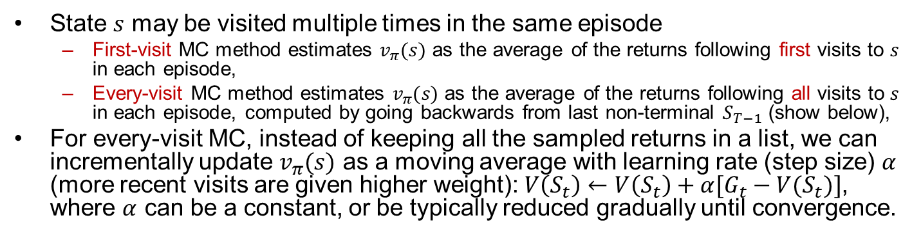
MC Prediction Details
State $s$ may be visited multiple times in the same episode
  First-visit MC method estimates $v_{π}(s)$ as the average of the returns following first visits to $s$ in each episode,
  Every-visit MC method estimates $v_{π}(s)$ as the average of the returns following all visits to $s$ in each episode, computed by going backwards from last non-terminal $S_{T−1}$ (show below),
For every-visit MC, instead of keeping all the sampled returns in a list, we can incrementally update $v_{π}(s)$ as a moving average with learning rate (step size) $α$ (more recent visits are given higher weight): $V\left(S_{t}\right)←V\left(S_{t}\right)+α[G_{t}−V(S_{t})]$, where $α$ can be a constant, or be typically reduced gradually until convergence.
Notes:
First-visit MC method estimates v⇡(s) as the average of the returns following
first visits to s, whereas the every-visit MC method averages the returns following all
visits to s.
State Value Function update (incremental):
$$V\left(S_{t}\right)←V\left(S_{t}\right)+α(G_{t}−V(S_{t}))$$
Can compute running avg w. incremental update $V(S_{t})←_{α}Returns(S_{t})$
; let us call the first time it is visited in an episode the first visit to $s$.

Slide 14
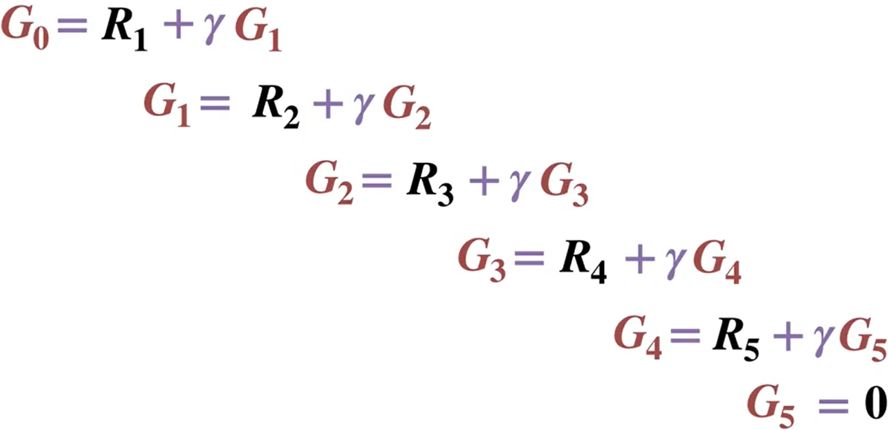
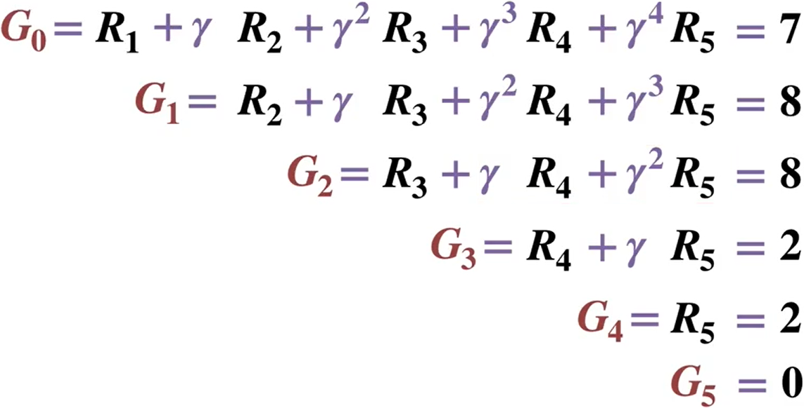







Example: Computing Returns for One Episode
Working backward is more efficient than working forward as it avoids redundant computations.
$$R_{1}$$
$$R_{2}$$
$$R_{3}$$
$$R_{4}$$
$$R_{5}$$
Reward $R_{t+1}$
Step $t$
0
1
2
3
4
5

Slide 15
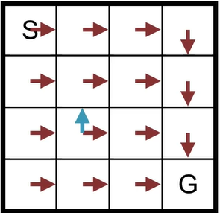
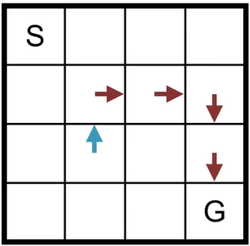
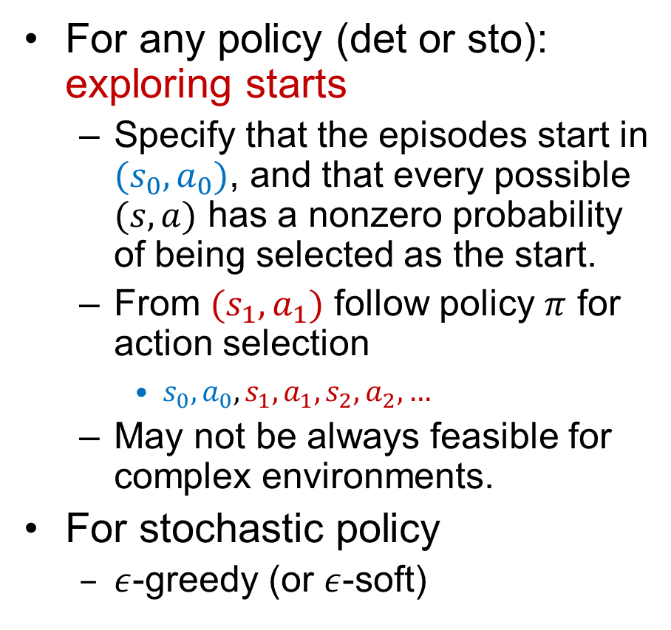
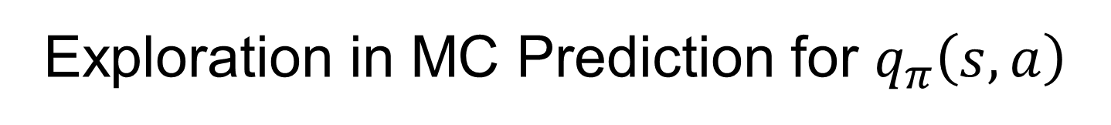
Exploration in MC Prediction for $q_{π}\left(s,a\right)$
For any policy (det or sto): exploring starts
  Specify that the episodes start in $(s_{0},a_{0})$, and that every possible $(s,a)$ has a nonzero probability of being selected as the start.
  From $(s_{1},a_{1})$ follow policy $π$ for action selection
    $s_{0},a_{0},s_{1},a_{1},s_{2},a_{2},…$
  May not be always feasible for complex environments.
For stochastic policy
  $ε$-greedy (or $ε$-soft)

Slide 16
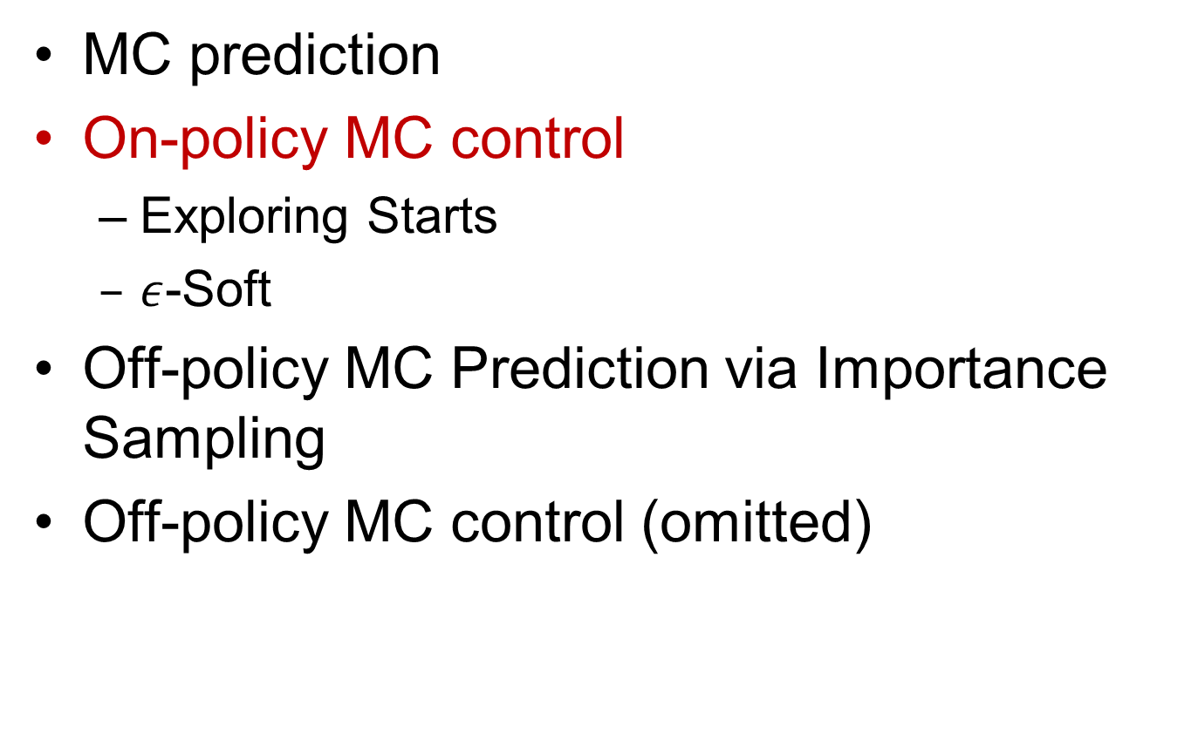
Outline: Monte Carlo Methods
MC prediction
On-policy MC control
  Exploring Starts
  $ε$-Soft
Off-policy MC Prediction via Importance Sampling
Off-policy MC control (omitted)

Slide 17
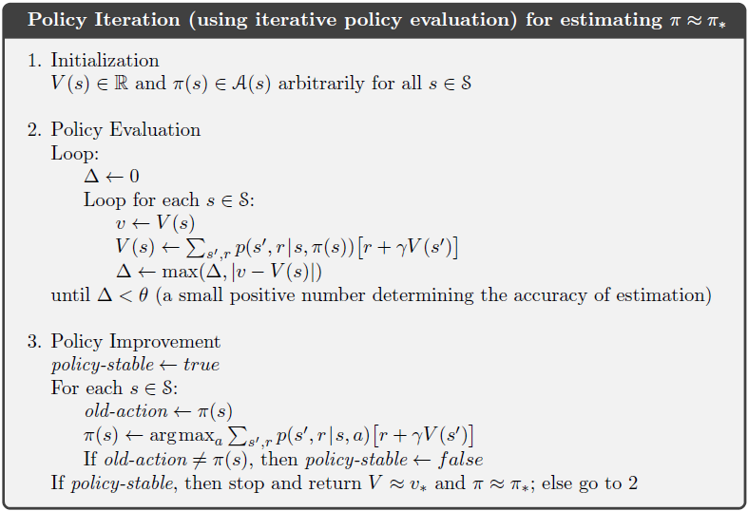
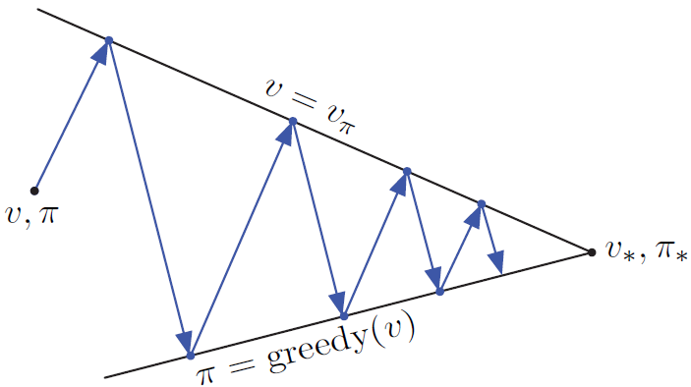
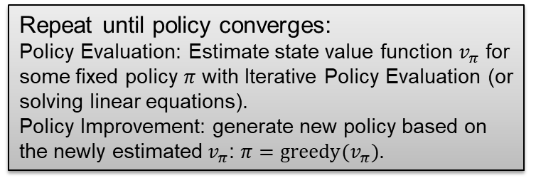
Recall: Policy Iteration for Known MDP
Repeat until policy converges:
Policy Evaluation: Estimate state value function $v_{π}$ for some fixed policy $π$ with Iterative Policy Evaluation (or solving linear equations).
Policy Improvement: generate new policy based on the newly estimated $v_{π}$: $π=greedy(v_{π})$.

Slide 18
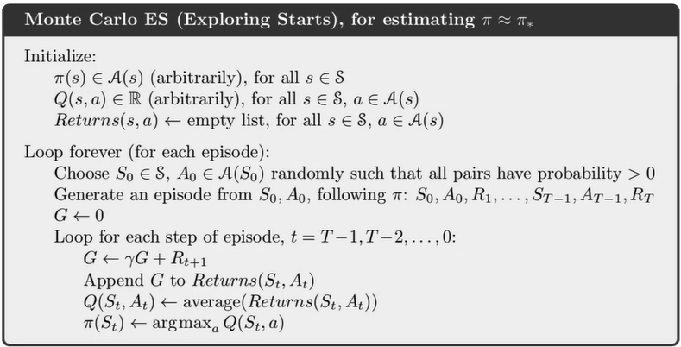
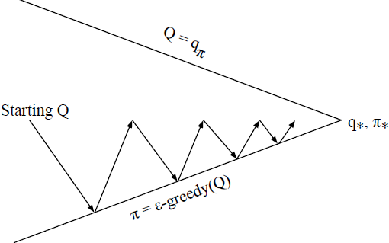
Generalized Policy Iteration with MC ES (Exploring Starts)
GPI w. MC ES: After each episode, the observed returns are used for policy evaluation, and then the policy is improved at all the states visited in the episode.
Notes:
The in-place version of value
iteration is even more extreme; there we alternate between improvement and evaluation
steps for single states.
Lies between two extremes:
Policy Iteration: Iterative Policy Evaluation (IPE) must achieve convergence up to some level of approximation.
Value Iteration: only one iteration of IPE is performed between each step of policy improvement.

Slide 19
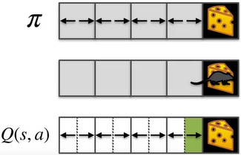
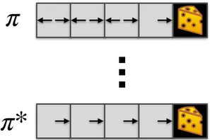
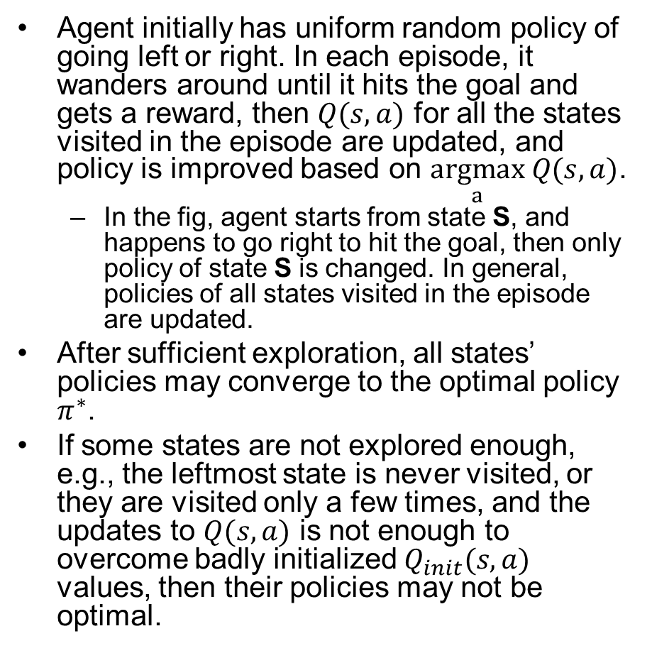
GPI w. MC Example
Agent initially has uniform random policy of going left or right. In each episode, it wanders around until it hits the goal and gets a reward, then $Q(s,a)$ for all the states visited in the episode are updated, and policy is improved based on $\underset{a}{argmax} Q(s,a)$.
  In the fig, agent starts from state S, and happens to go right to hit the goal, then only policy of state S is changed. In general, policies of all states visited in the episode are updated.
After sufficient exploration, all states’ policies may converge to the optimal policy $π^{∗}$.
If some states are not explored enough, e.g., the leftmost state is never visited, or they are visited only a few times, and the updates to $Q(s,a)$ is not enough to overcome badly initialized $Q_{init}(s,a)$ values, then their policies may not be optimal.
S
Policy Evaluation
Policy Improvement
Notes:
(It is likely that only $Q(s,a)$ for state $s_{1}$ next to goal is changed to lead to a different policy for $s_{1}$, but it is also possible that multiple states’ $Q(s,a)$ and policies are changed,esp. if in-pplace )

Slide 20
Exploration-Exploitation Dilemma
The agent has to exploit what it has already experienced in order to obtain reward, but it also has to explore in order to make better action selections in the future.
  Exploitation: to obtain a lot of reward, the agent must prefer actions that it has tried in the past and found to be effective in producing reward.
  Exploration: to discover such actions, it has to try actions that it has not selected before.
Notes:
On a stochastic task, each action must be tried many times to gain a reliable estimate of its expected reward.
The dilemma is that neither exploration nor exploitation can be pursued exclusively without failing at the task. The agent must try a variety of actions and progressively favor those that appear to be best.

Slide 21
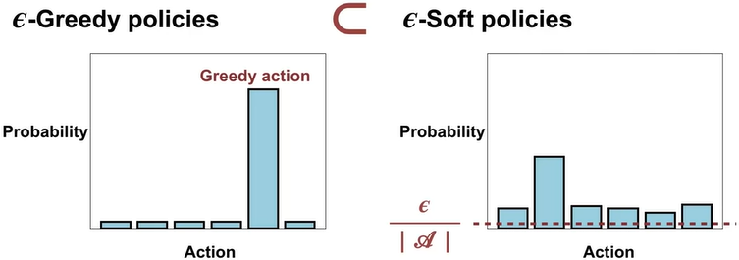
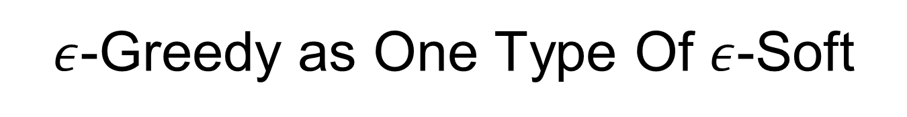
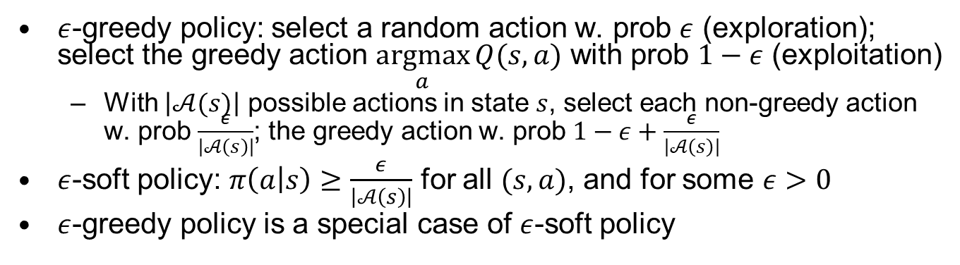
$ε$-Greedy as One Type Of $ε$-Soft
$ε$-greedy policy: select a random action w. prob $ε$ (exploration); select the greedy action $\underset{a}{argmax}{Q(s,a)}$ with prob $1−ε$ (exploitation)
  With $\left|𝒜(s)\right|$ possible actions in state $s$, select each non-greedy action w. prob $\frac{ε}{\left|𝒜\left(s\right)\right|}$; the greedy action w. prob $1−ε+\frac{ε}{\left|𝒜\left(s\right)\right|}$
$ε$-soft policy: $π\left(a | s\right)≥\frac{ε}{\left|𝒜\left(s\right)\right|}$ for all $(s,a)$, and for some $ε>0$
$ε$-greedy policy is a special case of $ε$-soft policy
Notes:
e.g., softmax policy $π\left(a | s\right)∼e^{q\left(s,a\right)}$ w. additional lower bound

Slide 22
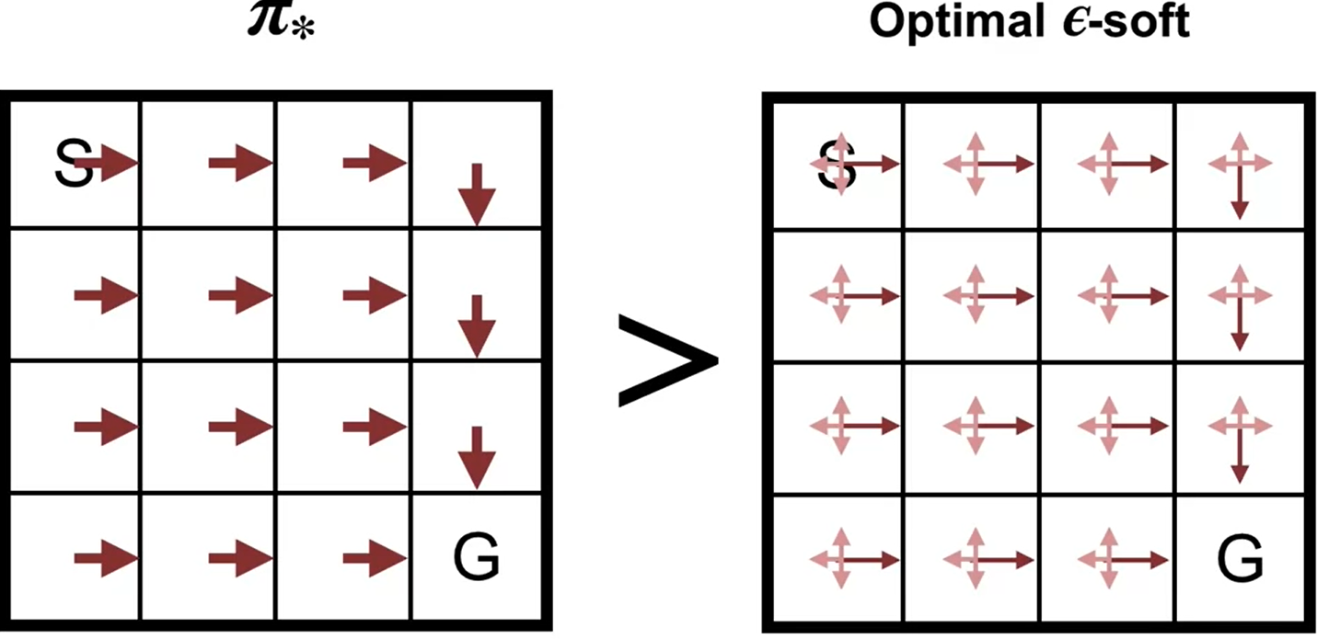

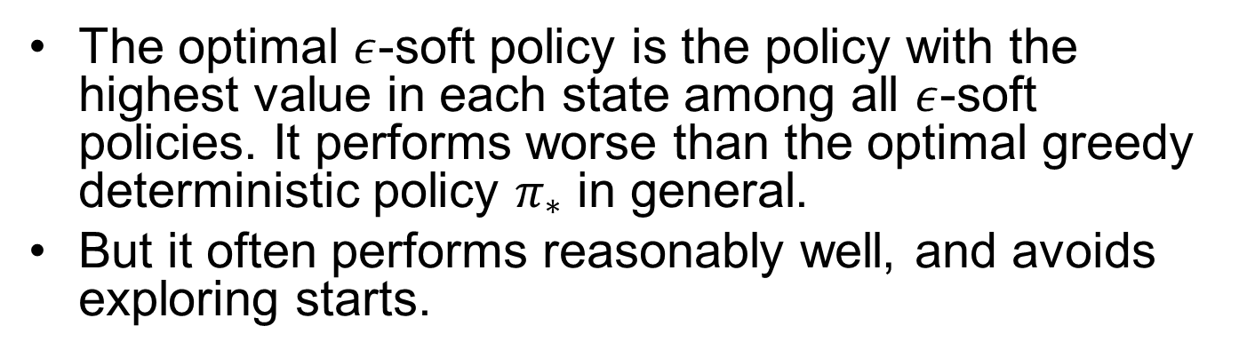
Optimal $ε$-Soft Policy
The optimal $ε$-soft policy is the policy with the highest value in each state among all $ε$-soft policies. It performs worse than the optimal greedy deterministic policy $π_{∗}$ in general.
But it often performs reasonably well, and avoids exploring starts.
Notes:
If our policy always gives at least Epsilon probability to each action, it's impossible to converge to a deterministic optimal policy exploring starts can be used to find the optimal policy. But that's on

Slide 23
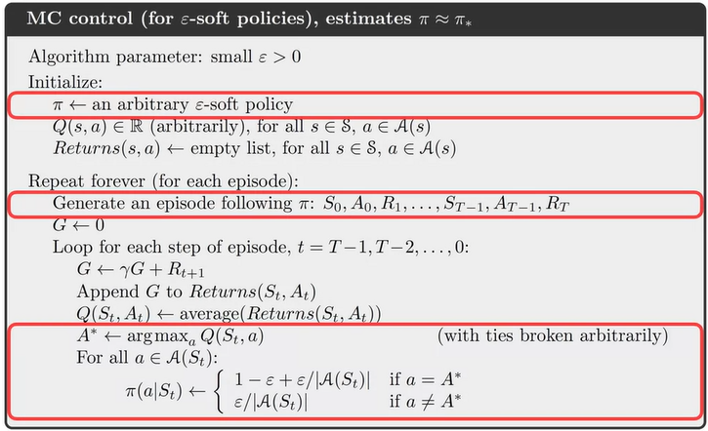
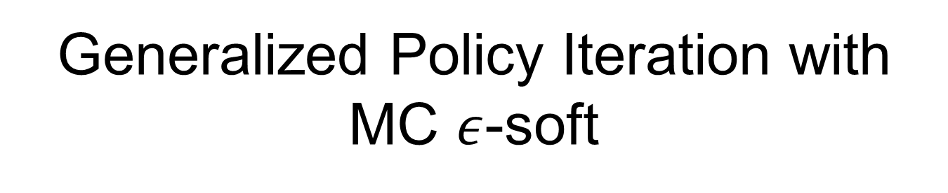


Generalized Policy Iteration with MC $ε$-soft
$ε$-soft policy (not det policy)
No exploring starts
$ε$-soft policy

Slide 24
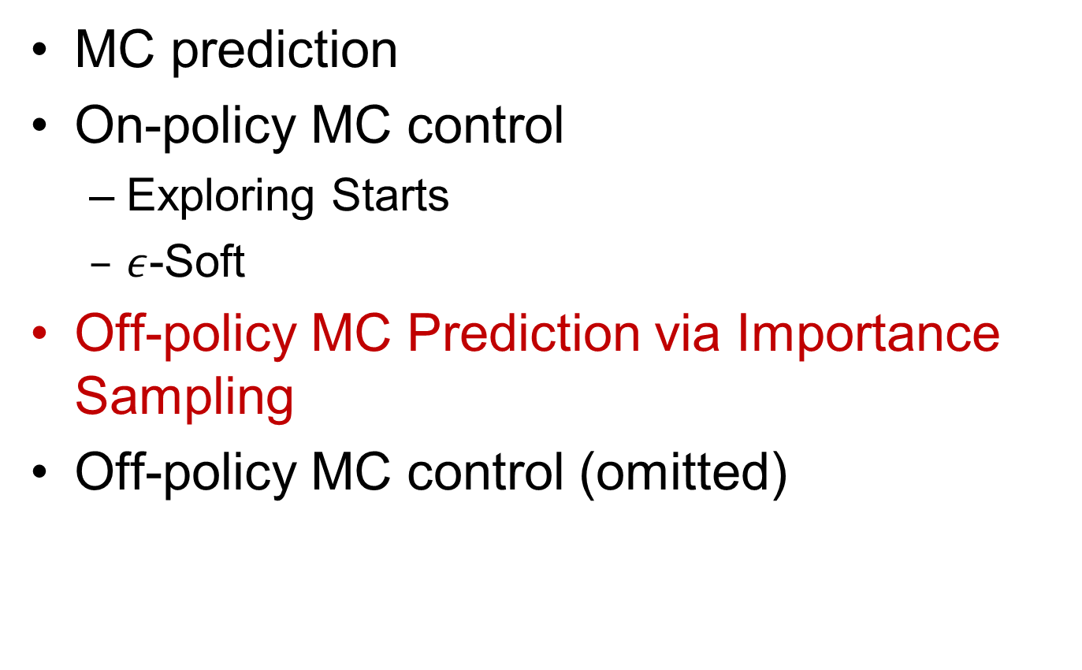
Outline: Monte Carlo Methods
MC prediction
On-policy MC control
  Exploring Starts
  $ε$-Soft
Off-policy MC Prediction via Importance Sampling
Off-policy MC control (omitted)

Slide 25
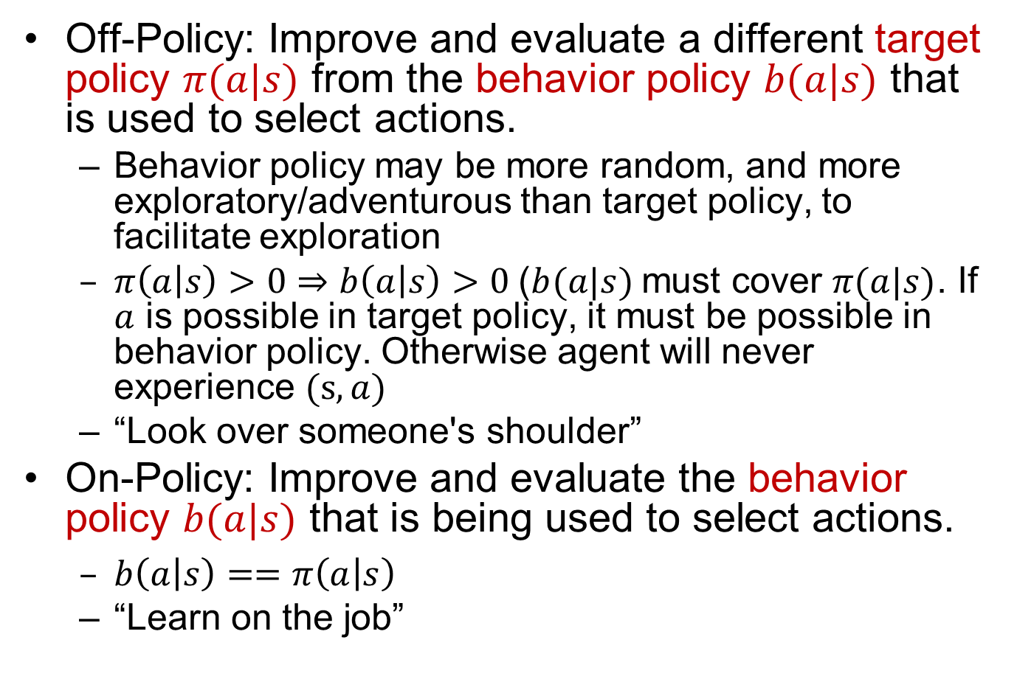
On-Policy and Off-Policy
Off-Policy: Improve and evaluate a different target policy $π(a|s)$ from the behavior policy $b(a|s)$ that is used to select actions.
  Behavior policy may be more random, and more exploratory/adventurous than target policy, to facilitate exploration
  $π\left(a | s\right)>0⇒b\left(a | s\right)>0$($b(a|s)$must cover $π(a|s)$. If $a$ is possible in target policy, it must be possible in behavior policy. Otherwise agent will never experience $(s,a)$
  “Look over someone's shoulder”
On-Policy: Improve and evaluate the behavior policy $b(a|s)$ that is being used to select actions.
  $b\left(a | s\right)==π\left(a | s\right)$
  “Learn on the job”
Notes:
an off-policy learner (e.g., Q-learning) learns the value of the optimal policy independently of the agent's actions.
An on-policy learner learns the value of the policy being carried out by the agent including the exploration steps.

Slide 26

Importance Sampling
We want to estimate $𝔼_{π}\left[X\right]$, expected value of random var $X$ with distribution $π$, by sampling from another distribution $x∼ρ$.
  Capital letter ($X$) denotes a random variable; lower-case letter ($x$) denotes a sampled value of the random var $X$.
$𝔼_{π}\left[X\right]≐\sum_{x∈X}{π\left(x\right)x}=\sum_{x∈X}{b\left(x\right)ρ\left(x\right)x}=𝔼_{b}\left[ρ\left(X\right)X\right]≈\frac{1}{n}\sum_{i=1}^{n}{x_{i}ρ(x_{i})}$
  $ρ\left(x_{i}\right)=\frac{π\left(x_{i}\right)}{b\left(x_{i}\right)},x_{i}∼b$
We compute $𝔼_{π}\left[X\right]$ by sampling from $b$, then performing weighted average with weight $ρ\left(x\right)$.
Notes:
: $x_{i}$is sampled from distribution $b$, not the original $π$.
$X$ denotes a random variable; $x$ denotes a sampled value for $X$.

Slide 27




Importance Sampling Example
$𝔼_{π}\left[X\right]=.3⋅1+.4⋅2+.1⋅3+.2⋅4=2.2$
1st sample from $b(x)$: get $x=1$ w. prob $0.85$
  $𝔼_{b}\left[X\right]=\frac{1}{1}\sum_{1}^{1}{xρ(x)}=1×\frac{.3}{.85}=0.35$
2nd sample from $b(x)$: get $x=3$ w. prob $0.05$
  $𝔼_{b}\left[X\right]=\frac{1}{2}\sum_{1}^{2}{xρ(x)}=\frac{1}{2}\left(1×\frac{.3}{.85}+3×\frac{.1}{.05}\right)≈3.18$
3rd sample from $b(x)$: get $x=1$ w. prob $0.85$
  $𝔼_{b}\left[X\right]=\frac{1}{3}\sum_{1}^{3}{xρ(x)}=\frac{1}{3}\left(1×\frac{.3}{.85}+3×\frac{.1}{.05}+1×\frac{.3}{.85}\right)≈2.24$

Slide 28

Computing Weighting Factors
Prob of each off-policy trajectory under behavior policy $b$: $ℙ\left(traj under b\right)≐ℙ\left(A_{t},S_{t+1}, A_{t+1},…,S_{T} | S_{t},A_{t:T}\right)=\prod_{k=t}^{T−1}{b\left(A_{k} | S_{k}\right)}p\left(S_{k+1} | S_{k},A_{k}\right)$
  Due to the Markov property.
$ρ_{t:T−1}≐\frac{ℙ\left(traj under π\right)}{ℙ\left(traj under b\right)}=\prod_{k=t}^{T−1}{\frac{π\left(A_{k} | S_{k}\right)p\left(S_{k+1} | S_{k},A_{k}\right)}{b\left(A_{k} | S_{k}\right)p\left(S_{k+1} | S_{k},A_{k}\right)}}=\prod_{k=t}^{T−1}{\frac{π\left(A_{k} | S_{k}\right)}{b\left(A_{k} | S_{k}\right)}}$
  Work backwards to compute incrementally $W_{1}←ρ_{T−1};W_{2}←W_{1}ρ_{T−2};W_{3}←W_{2}ρ_{T−3}$
Value function update w. importance sampling:
  $V\left(S_{t}\right)←V\left(S_{t}\right)+α(ρ_{t:T−1}G_{t}−V(S_{t}))$
Notes:
$$W_{t+1}←W_{t}ρ_{T−3}$$

Slide 29





On-Policy vs. Off-Policy MC Prediction
Improve and evaluate a different target policy $π(a|s)$ from the behavior policy $b(a|s)$ that is used to select actions.
Use behavior policy $b$
Add weighting factor $W$

Slide 30
Outline
Monte Carlo Methods
TD-Learning
Sarsa & Q-Learning
Function Approximation

Slide 31

Exponential Moving Average
The running average update: ${\overline{x}}_{n}←\left(1−α\right){\overline{x}}_{n−1}+αx_{n}={\overline{x}}_{n−1}+α(x_{n}−{\overline{x}}_{n−1})$
  Shorthand notation ${\overline{x}}_{n}←_{α}x_{n}$
Makes recent samples more important (since later ones are more accurate estimates)
  ${\overline{x}}_{n}=α\left(x_{n}+\left(1−α\right)(αx_{n−1}+\left(1−α\right)(…)\right))$
  $$=α\left(x_{n}+\left(1−α\right)x_{n−1}+{\left(1−α\right)}^{2}x_{n−2}+…\right)=\frac{x_{n}+\left(1−α\right)x_{n−1}+{\left(1−α\right)}^{2}x_{n−2}+…}{1+\left(1−α\right)+{\left(1−α\right)}^{2}+…}$$
  Since $\frac{1}{α}=$ $1+\left(1−α\right)+{\left(1−α\right)}^{2}+…$
Forgets about the past gradually (distant past values are likely to be wrong, esp. for changing env.)
Decreasing learning rate $α$ gradually can give converging average.
Notes:
More recent samples are better because the estimates for vk are better

Slide 32


TD Learning
Recall Bellman Exp. Equation:
  $v_{π}\left(s\right)=\sum_{a}{π\left(a | s\right)}\sum_{r,s^{′}}{p\left(r,s′ | s,a\right)}\left[r+γv_{π}\left(s^{′}\right)\right]=𝔼_{π}[R_{t+1}+γv_{π}(S_{t+1})|S_{t}=s]$
  To solve it with dynamic programming, we need the MDP model $p\left(r,s′ | s,a\right)$.
TD Learning: compute $v_{π}\left(s\right)$ in model-free way by sampling.
  $V\left(S_{t}\right)=𝔼\left[R_{t+1}+γR_{t+2}+γ^{2}R_{t+3}+…\right]$
  $V\left(S_{t+1}\right)=𝔼\left[R_{t+2}+γR_{t+3}+γ^{2}R_{t+4}+…\right]$
  TD Target: $R_{t+1}+γV\left(S_{t+1}\right)=R_{t+1}+γ𝔼\left[R_{t+2}+γR_{t+3}+γ^{2}R_{t+4}+…\right]$
  XXX
At every timestep $t$, update $V\left(S_{t}\right)$ for current state $S_{t}$:
  $V\left(S_{t}\right)←V\left(S_{t}\right)+α(R_{t+1}+γV\left(S_{t+1}\right)−V(S_{t}))$
  TD Target: $R_{t+1}+γV\left(S_{t+1}\right)$
  TD Error: $δ_{t}=R_{t+1}+γV\left(S_{t+1}\right)−V(S_{t})$
Notes:
Shorthand: $V\left(S_{t}\right)←_{α}(R_{t+1}+γV\left(S_{t+1}\right))$
$$G_{t}≐R_{t+1}+γR_{t+2}+γ^{2}R_{t+3}+…+γ^{T−1}R_{T}$$
$$V\left(S_{t}\right)=R_{t+1}+γR_{t+2}+γ^{2}R_{t+3}$$

Slide 33

Update Equations: MC vs. TD
MC (every-visit): After every episode, update $V\left(S_{t}\right)$ for all states encountered in the episode:
  On-policy MC:$V\left(S_{t}\right)←V\left(S_{t}\right)+α(G_{t}−V(S_{t}))$
  Off-policy MC w. Importance Sampling: $V\left(S_{t}\right)←V\left(S_{t}\right)+α(ρ_{t:T−1}G_{t}−V(S_{t}))$
    $ρ_{t:T−1}=\prod_{k=t}^{T−1}{\frac{π\left(A_{k} | S_{k}\right)}{b\left(A_{k} | S_{k}\right)}}$
TD: At every timestep $t$, update $V\left(S_{t}\right)$ for current state $S_{t}$:
  On-policy TD:$V\left(S_{t}\right)←V\left(S_{t}\right)+α(R_{t+1}+γV\left(S_{t+1}\right)−V(S_{t}))$
  Off-policy TD w. Importance Sampling: $V\left(S_{t}\right)←V\left(S_{t}\right)+α({ρ_{t}(R}_{t+1}+γV\left(S_{t+1}\right))−V(S_{t}))$
    $ρ_{t}=\frac{π\left(A_{t} | S_{t}\right)}{b\left(A_{t} | S_{t}\right)}$
    Much lower variance than MC w. Importance Sampling: $V\left(S_{t}\right)←V\left(S_{t}\right)$.

Slide 34


Tabular TD(0)
MC updates $V(S)$ at the end of each episode.
TD updates $V(S)$ at every time step.
  Bootstrapping $V(S)$ from $V(S^{′})$

Slide 35


TD vs. MC: Random Walk Example
Agent has uniform random policy, w. equal prob of going left or right at each timestep. Env is deterministic. All episodes start in state $C$. Episodes terminate either on the left or on the right. The reward is $0$ on all transitions except $1$ for terminating on the right. Discount factor $γ=1$: learning rate $α=0.5$.
Value of state $V(s)$ is the probability of terminating on the right when starting from state $s$. For known MDP, they can be computed by Policy Evaluation w. the set of Bellman Exp Equations,w. solution shown in the figure:
  $V\left(A\right)=0.5V(B)$
  $V\left(B\right)=0.5V\left(A\right)+0.5V(C)$
  $V\left(C\right)=0.5V\left(B\right)+0.5V(D)$
  $V\left(D\right)=0.5V\left(C\right)+0.5V(E)$
  $V\left(E\right)=0.5V\left(D\right)+0.5⋅1$
Next, for unknown MDP, we use TD or MC to learn $V(s)$. Initialize all $V(⋅)=0.5.$
Notes:
Agent takes a random action of left or right
https://www.coursera.org/learn/sample-based-learning-methods/lecture/CEzFc/comparing-td-and-monte-carlo

Slide 36




Episode1 $(C,r,0,D,r,0,E,r,1,T)$
TD:
  $V\left(C\right)←V\left(C\right)+α\left[R_{t+1}+γV\left(D\right)−V\left(C\right)\right]=.5+.5\left(0+.5−.5\right)=0.5$
  $V\left(D\right)←V\left(D\right)+α\left[R_{t+1}+γV\left(E\right)−V\left(D\right)\right]=.5+.5\left(0+.5−.5\right)=0.5$
  $V\left(E\right)←V\left(E\right)+α\left[R_{t+1}+γV\left(T\right)−V\left(E\right)\right]=.5+.5\left(1+0−.5\right)=0.75$
MC: (every-visit. when used as subscript, $T$ denotes the time instant of reaching the terminal state)
  $G\left(E\right)=R_{T}=1,G\left(D\right)=R_{T−1}+γG\left(E\right)=0+1⋅1=1,G\left(C\right)=R_{T−2}+γG\left(D\right)=0+1⋅1=1$
  $V\left(C\right)←V\left(C\right)+α\left[G(C)−V\left(C\right)\right]=.5+.5\left(1−.5\right)=0.75$
  $V\left(D\right)←V\left(D\right)+α\left[G(D)−V\left(D\right)\right]=.5+.5\left(1−.5\right)=0.75$
  $V\left(E\right)←V\left(E\right)+α\left[G(E)−V\left(E\right)\right]=.5+.5\left(1−.5\right)=0.75$
  $$V\left(S_{t}\right)←V\left(S_{t}\right)+α(G_{t}−V(S_{t}))$$
_{t=T}
_{t=T-3}
_{t=T-2}
_{t=T-1}
Notes:
Agent Terminating On The Right for 1st Time
$$V\left(D\right)←V\left(D\right)+α\left[G(D)−V\left(D\right)\right]=.5+.5\left(1−.75\right)=0.75$$
$$V\left(C\right)←V\left(C\right)+α\left[G−V\left(C\right)\right]=.5+.5\left(1−.5\right)=0.75$$
MC update equation: $V\left(S_{t}\right)←V\left(S_{t}\right)+α\left(G_{t}−V\left(S_{t}\right)\right)=G_{t}$
TD update equation: $V\left(S_{t}\right)←V\left(S_{t}\right)+α\left(R_{t+1}+γV\left(S_{t+1}\right)−V\left(S_{t}\right)\right)=R_{t+1}+γV\left(S_{t+1}\right)$

Slide 37

Quiz on TD vs. MC
Q: Is the following a more efficient TD update sequence with backward, in-place updates?
  $V\left(E\right)←V\left(E\right)+α\left[R_{t+1}+γV\left(T\right)−V\left(E\right)\right]=.5+.5\left(1+0−.5\right)=0.75$
  $V\left(D\right)←V\left(D\right)+α\left[R_{t+1}+γV\left(E\right)−V\left(D\right)\right]=.5+.5\left(0+.75−.5\right)=0.625$
  $V\left(C\right)←V\left(C\right)+α\left[R_{t+1}+γV\left(D\right)−V\left(C\right)\right]=.5+.5\left(0+.625−.5\right)=0.5625$
A: This is not feasible since TD updates $V(S)$ at every time step, and does not keep track of the history of visited states
Q: Can we use backward, in-place updates for MC?
  $V\left(E\right)←V\left(E\right)+α\left[G(E)−V\left(E\right)\right]=.5+.5\left(1−.5\right)=0.75$
  $V\left(D\right)←V\left(D\right)+α\left[G(D)−V\left(D\right)\right]=.5+.5\left(1−.5\right)=0.75$
  $V\left(C\right)←V\left(C\right)+α\left[G(C)−V\left(C\right)\right]=.5+.5\left(1−.5\right)=0.75$
A: Yes, but it makes no difference in this example whether you use forward or backward update for $V(S_{t})$, which is based on $G(S_{t})$, not bootstrapped off $V(S_{t+1})$.
For every-visit MC using $V\left(S_{t}\right)←V\left(S_{t}\right)+α[G_{t}−V(S_{t})]$ to update each state’s value function, we should use forward update to give more recent visits higher weight, in case the same state is visited multiple times in one episode (refer to p.13 “MC Prediction Details”)
Notes:
For every-visit MC, instead of keeping all the sampled returns in a list, we can incrementally update $v_{π}(s)$ as a moving average with learning rate (step size) $α$ (more recent visits are given more weight): $V\left(S_{t}\right)←V\left(S_{t}\right)+α[G_{t}−V(S_{t})]$, where $α$ can be constant, or be typically reduced gradually until convergence.

Slide 38



Episode2 Pt1 $(C,r,0,D,r,0,E)$
TD:
  $V\left(C\right)←V\left(C\right)+α\left[R_{t+1}+γV\left(D\right)−V\left(C\right)\right]=.5+.5\left(0+.5−.5\right)=0.5$
  $V\left(D\right)←V\left(D\right)+α\left[R_{t+1}+γV\left(E\right)−V\left(D\right)\right]=.5+.5\left(0+.75−.5\right)=0.625$
MC:
  No update since episode has not ended.

Slide 39



Episode2 Pt2 $(E,l,0,D,l,0,C)$
TD:
  $V\left(E\right)←V\left(E\right)+α\left[R_{t+1}+γV\left(D\right)−V\left(E\right)\right]=.75+.5\left(0+.625−.75\right)≈0.688$
  $V\left(D\right)←V\left(D\right)+α\left[R_{t+1}+γV\left(C\right)−V\left(D\right)\right]=.625+.5\left(0+.5−.625\right)≈0.563$
MC:
  No update since episode has not ended.

Slide 40



Episode2 Pt3 $(C,r,0,D,r,0,E)$
TD:
  $V\left(C\right)←V\left(C\right)+α\left[R_{t+1}+γV\left(D\right)−V\left(C\right)\right]=.5+.5\left(0+.563−.5\right)≈0.531$
  $V\left(D\right)←V\left(D\right)+α\left[R_{t+1}+γV\left(E\right)−V\left(D\right)\right]=.563+.5\left(0+.688−.563\right)≈0.625$
MC:
  No update since episode has not ended.

Slide 41


Episode2 Pt4 $(E,r, 1,T)$
TD:
  $V\left(E\right)←V\left(E\right)+α\left[R_{t+1}+γV\left(T\right)−V\left(E\right)\right]=.688+.5\left(1+0−.688\right)=0.844$
0.531
0.625
0.844
0.938
0.969
0.938
Notes:
TD:
MC:$G\left(E\right)=R_{3}=1, V(E)←V\left(E\right)+α\left[G(E)−V\left(E\right)\right]=.5+.5\left(1−.5\right)=0.75$
$$G\left(D\right)=R_{2}+γG\left(E\right)=0+1⋅1=1, V(D)←V\left(D\right)+α\left[G(D)−V\left(D\right)\right]=.5+.5\left(1−.5\right)=0.75$$
$$G\left(C\right)=R_{1}+γG\left(D\right)=0+1⋅1=1, V\left(C\right)←V\left(C\right)+α\left[G\left(C\right)−V\left(C\right)\right]=.5+.5\left(1−.5\right)=0.75$$

Slide 42


Episode2 Pt4 $(E,r, 1,T)$
MC (every-visit w. episode $C′→D′′→E′→D′→C→D→E→T$):
Update $G\left(s\right)$ backward:
  $G\left(E\right)=R_{T}=1, G\left(D\right)=R_{T−1}+γG\left(E\right)=0+1=1, G\left(C\right)=R_{T−2}+γG\left(D\right)=0+1=1$
  $G(D′)=R_{T−1}+γG\left(C\right)=0+1=1 ,G(E′) =R_{T−1}+γG\left(D′\right)=0+1=1$
  $G(D′′)=R_{T−1}+γG(E′)=0+1=1,G(C′)=R_{T−1}+γG(D′′)=0+1=1$
Update $V\left(s\right)$ forward:
  $V\left(C\right)←V\left(C\right)+α\left[G(C′)−V\left(C\right)\right]=.75+.5\left(1−.75\right)=0.875$
  $V\left(D\right)←V\left(D\right)+α\left[G(D′′)−V\left(D\right)\right]=.75+.5\left(1−.75\right)=0.875$
  $V\left(E\right)←V\left(E\right)+α\left[G(E′)−V\left(E\right)\right]=.75+.5\left(1−.75\right)=0.875$
  $V\left(D\right)←V\left(D\right)+α\left[G(D′)−V\left(D\right)\right]=.875+.5\left(1−.875\right)≈0.938$
  $V\left(C\right)←V\left(C\right)+α\left[G\left(C\right)−V\left(C\right)\right]=.875+.5\left(1−.875\right)≈0.938$
  $V\left(D\right)←V\left(D\right)+α\left[G\left(D\right)−V\left(D\right)\right]=0.938+.5\left(1−0.938\right)=0.969$
  $V\left(E\right)←V\left(E\right)+α\left[G\left(E\right)−V\left(E\right)\right]=.875+.5\left(1−.875\right)≈0.938$

Slide 43


TD vs. MC: Random Walk Performance
Left fig shows values learned after various numbers of episodes on a single run of TD(0),
  They are very close to the true values after 100 episodes, but they fluctuate indefinitely in response to the outcomes of the most recent episodes.
Right fig shows Root Mean-Squared (RMS) error between the value function learned and the true value function, averaged over the five states, then averaged over 100 runs.
  TD converges faster than MC. Higher learning rate $α$helps achieve faster convergence, but has large fluctuations.

Slide 44


MC Prediction for MiniGW
Input Policy π
Observed Episodes (Training)
Output Values
Episode 1
Episode 2
-10
 | A
B | C | D
 | E
B, east, C, -1
C, east, D, -1
D, exit, x, +10
B, east, C, -1
C, east, D, -1
D, exit, x, +10
 | A
B | C | D
 | E
+8
+4
+10
Episode 3
Episode 4
E, north, C, -1
C, east, D, -1
D, exit, x, +10
E, north, C, -1
C, east, A, -1
A, exit, x, -10
-2
Assume: γ = 1
State A:
  Episode 4: $G_{t}\left(A\right)=−10$
  $\hat{V}\left(A\right)=\frac{−10}{1}=−10,$
State D:
  Episodes 1,2, 4: $G_{t}\left(D\right)=$ $10$
  $\hat{V}\left(D\right)=\frac{10⋅3}{3}=10,$
State $B$:
  Episodes 1 and 2: $G_{t}\left(B\right)=$ $−1−1+10=8$; $\hat{V}\left(B\right)=\frac{1}{2}\left(8+8\right)=8$
State $C$:
  Episodes 1,2,3: $G_{t}\left(C\right)=−1+10=9$
  Episode 4: $G_{t}\left(C\right)= −1−10=−11$
  $\hat{V}\left(C\right)=\frac{1}{4}\left(9+9+9−11\right)=4$
State $E$:
  Episode 3: $G_{t}\left(E\right)=−1−1+10=8$
  Episode 4: $G_{t}\left(E\right)=−1−1−10=−12$
  $\hat{V}\left(E\right)=\frac{1}{2}\left(8−12\right)=−2$
Notes:
This is called MCTS

Slide 45

MC Prediction for MiniGW
From Policy Evaluation, we have derived $V\left(B\right)=V(E)$. But the MC predicted value functions are inaccurate due to limited sampling:
  $\hat{V}\left(B\right)=8$, since both episodes 1 and 2 start from $B$ and end in $D$ with $V\left(D\right)=10$;
  $\hat{V}\left(E\right)=−2$, since episodes 3 and 4 start from $E$ and end in either $D$ or $A$ with $V\left(D\right)=10,V\left(A\right)=−10$.
If we sample more data, then we can estimate more accurate values.
MC learning is not sample-efficient, since value function of each state must be learned separately.
Output Values
-10
 | A
B | C | D
 | E
+8
+4
+10
-2
If B and E both go to C under this policy, how can their values be different?
Notes:
Pros:
It is model-free
It eventually computes the correct average values, using just sample transitions
Cons:
It wastes information about state connections
Each state must be learned separately
It is not sample efficient

Slide 46


TD Learning, $α=0.5$
4 episodes with transitions {(B, east, C), (C, east, D)}.
TD update: $v_{π}\left(B\right)←_{α}−1+γv_{π }\left(C\right);v_{π}\left(B\right)←_{α}−1+γv_{π }\left(D\right)$
EP1:
Transition (B, east, C): $V^{π}\left(B\right)←0+α\left(−1+0−0\right)=−.5$
Transition (C, east, D): $V^{π}\left(C\right)←0+α\left(−1+10−0\right)=4.5$
EP2:
Transition (B, east, C): $V^{π}\left(B\right)←−.5+α\left(−1+4.5−(−.5)\right)=1.5$
Transition (C, east, D): $V^{π}\left(C\right)←4.5+α\left(−1+10−4.5\right)=6.75$
EP3:
Transition (B, east, C): $V^{π}\left(B\right)←1.5+α\left(−1+6.75−1.5\right)=3.625$
Transition (C, east, D): $V^{π}\left(C\right)←6.75+α\left(−1+10−6.75\right)=7.875$
EP4:
Transition (B, east, C): $V^{π}\left(B\right)←3.625+α\left(−1+7.875−3.625\right)=5.25$
Transition (C, east, D): $V^{π}\left(C\right)←7.875+α\left(−1+10−7.875\right)=8.4375$
After many repetitions of the episode {(B, east, C), (C, east, D)}, $V^{π}\left(B\right)≈7,V^{π}\left(C\right)≈9$
Notes:
Suppose we observe transitions (B, east, C, -2) and (C, east, D, -2). After many iterations, TD learning may converge to the true values $V\left(B\right)=8;V\left(C\right)=9$
$$V^{π}\left(s\right)←\left(1−α\right)V^{π}\left(s\right)+α(R(s,π(s),s′)+γV^{π}\left(s′\right))$$

Slide 47


TD Learning, $α=0.9$
4 episodes with transitions {(B, east, C), (C, east, D)}.
TD update: $v_{π}\left(B\right)←_{α}−1+γv_{π }\left(C\right);v_{π}\left(B\right)←_{α}−1+γv_{π }\left(D\right)$
EP1:
Transition (B, east, C): $V^{π}\left(B\right)←0+α\left(−1+0−0\right)=−.9$
Transition (C, east, D): $V^{π}\left(C\right)←0+α\left(−1+10−0\right)=8.1$
EP2:
Transition (B, east, C): $V^{π}\left(B\right)←−.9+α\left(−1+8.1−(−.9)\right)=3.1$
Transition (C, east, D): $V^{π}\left(C\right)←8.1+α\left(−1+10−8.1\right)=8.91$
EP3:
Transition (B, east, C): $V^{π}\left(B\right)←3.1+α\left(−1+8.91−3.1\right)=5.505$
Transition (C, east, D): $V^{π}\left(C\right)←8.91+α\left(−1+10−8.91\right)=8.991$
EP4:
Transition (B, east, C): $V^{π}\left(B\right)←5.505+α\left(−1+8.991−5.505\right)=6.748$
Transition (C, east, D): $V^{π}\left(C\right)←8.991+α\left(−1+10−8.991\right)=8.9991$
After many repetitions of the episode {(B, east, C), (C, east, D)}, $V^{π}\left(B\right)≈7,V^{π}\left(C\right)≈9$. Converges faster than $α=0.5$
Notes:
Suppose we observe transitions (B, east, C, -2) and (C, east, D, -2).

Slide 48


Backup Diagrams: MC vs. TD vs. DP
Important

Slide 49

MC vs. TD
TD can learn before knowing the final outcome
  TD can learn online after every step
  MC must wait until end of each episode before return is known
TD can learn without the final outcome
  TD can learn from incomplete episodes
  MC can only learn from complete episodes
  TD works in continuing (non-terminating) environments
  MC only works for episodic (terminating) environments
MC has high variance, zero bias
  Return $G_{t}≐\sum_{k=0}^{T−1}{γ^{k}R_{t+k+1}}$ is unbiased estimate of $v_{π}(S_{t})$; converges to $v_{π}(S_{t})$ (even with function approximation)
  Return depends on many random actions, transitions, rewards in each episode
  Not very sensitive to initial value
TD has low variance, some bias
  TD target $R_{t+1}+γV\left(S_{t+1}\right)$ is biased estimate of $v_{π}(S_{t})$; TD(0) converges to $v_{π}(S_{t})$ (but not always with function approximation)
  TD target depends on one random action, transition, reward
  More sensitive to initial value
MC does not exploit Markov property
  More effective in non-Markov environments, e.g., Partially Observed MDP (POMDP)
TD exploits Markov property
  Does not work well for POMPDP
Notes:
Usually more ecient than MC
May need many samples to get accurate estimate, due to high variance caused by random policy and stochastic environment.

Slide 50
Outline
Monte Carlo Methods
TD-Learning
Sarsa & Q-Learning
Function Approximation

Slide 51

Problems with TD Learning
TD is a model-free way to learn $V\left(S\right)$ by sampling
However, if we want to get the optimal policy, we need the MDP model $p\left(r,s′ | s,a\right)$to go from $V(S)$ to $Q(S,A)$
  $q\left(s,a\right)=\sum_{r,s^{′}}{p\left(r,s′ | s,a\right)}\left[r+γv\left(s′\right)\right]$
Then use greedy action selection
  $π(s)=\underset{a}{argmax}{q(s,a)}$
Sarsa and Q learning: learn $Q(S,A)$ instead of $V\left(S\right)$, for use in Generalized Policy Iteration (GPI) for control. This makes action selection model-free too.
Notes:
mimicking Bellman updates with running sample averagesMakes action selection ($\underset{a}{argmax}$) model-free too!

Slide 52


TD, Sarsa, Q Learning
Important
TD solves [BEV] by sampling:
  $V\left(S_{t}\right)←V\left(S_{t}\right)+α(R_{t+1}+γV\left(S_{t+1}\right)−V(S_{t}))$
Sarsa and Expected Sarsa solve [BEA] by sampling:
  $Q\left(S_{t},A_{t}\right)←Q\left(S_{t},A_{t}\right)+α(R_{t+1}+γQ\left(S_{t+1},A_{t+1}\right)−Q\left(S_{t},A_{t}\right))$
  $Q\left(S_{t},A_{t}\right)←Q\left(S_{t},A_{t}\right)+α(R_{t+1}+γ\sum_{a′}{π(a′|S_{t+1})Q\left(S_{t+1},a′\right)}−Q\left(S_{t},A_{t}\right))$
Q Learning solves [BOA] by sampling:
  $Q\left(S_{t},A_{t}\right)←Q\left(S_{t},A_{t}\right)+α(R_{t+1}+γ\max_{a′}{Q\left(S_{t+1},a′\right)}−Q\left(S_{t},A_{t}\right))$
[BEV] Bellman Expectation Equation for State Value Function:
  $v_{π}\left(s\right)=\sum_{a}{π\left(a | s\right)}\sum_{r,s^{′}}{p\left(r,s′ | s,a\right)}\left[r+γv_{π}\left(s^{′}\right)\right]$
[BEA] Bellman Expectation Equation for Action Value Function
  $q_{π}\left(s,a\right)=\sum_{r,s^{′}}{p\left(r,s′ | s,a\right)}\left[r+γ\sum_{a′}{π\left(a′ | s′\right)q_{π}\left(s′,a′\right)}\right]$
[BOA] Bellman Optimality Equation for Optimal Action Value Function:
  $q_{∗}\left(s,a\right)=\sum_{r,s^{′}}{p\left(r,s′ | s,a\right)}\left[r+γ\max_{a′} q_{∗}\left(s′,a′\right)\right]$

Slide 53








Backup Diagrams
Important
TD
(on-policy,
$a$ is taken)
Sarsa
(on-policy,
$a′$ is taken)
Bellman Exp Eqn for $v_{π}\left(s\right)$
Bellman Exp Eqn for $q_{π}\left(s,a\right)$
Expected
Sarsa
(off-policy,
$a′$ may not be taken)
QL (off-policy,
$a′$ may not be taken)
exp
max
max
Bellman Exp Eqn for $q_{π}\left(s,a\right)$
Bellman Opt Eqn for $q_{∗}\left(s,a\right)$

Slide 54


Did We Miss One Bellman Equation?
[BEV] Bellman Optimality Equation for Optimal State Value Function:
  $v_{∗}\left(s\right)=$ $\max_{a}{\sum_{r,s^{′}}{p\left(r,s′ | s,a\right)}\left[r+γv_{∗}\left(s^{′}\right)\right]}$
Due to $\max_{a}$ in front, it is not an expectation over a distribution, hence cannot solve for $v_{∗}(s)$ by sampling.
max
Bellman Opt Eqn for $v_{∗}\left(s\right)$

Slide 55

Another View
From https://www.davidsilver.uk/teaching/. Expected Sarsa is missing here.

Slide 56




Sarsa
On-policy, Policy Iteration: in state $S$, Q update w. one-step lookahead $Q(S^{′},A′)$ for a specific action $A′$ (e.g., based on $ε$-greedy).
Off-policy, Value Iteration: in state $S$, Q update w. one-step lookahead $Q(S^{′},a)$ by taking $\max_{a}{Q(S^{′},a)}$ among all possible actions.

Slide 57



QL is Off-Policy
QL’s target policy $π$ is always greedy w.r.t $Q(s,a)$
  $\sum_{a′}{π(a′|S_{t+1})}Q\left(S_{t+1},a′\right)=\max_{a′}{Q\left(S_{t+1},a′\right)}$
Behavior policy $b$ is typically more exploratory, e.g., $ε$-greedy, or uniform random, or even arbitrary policy.
No need for Importance Sampling.

Slide 58

Expected Sarsa and QL
Expected Sarsa and QL are both off-policy.
  Target for Expected Sarsa: $R_{t+1}+γ\sum_{a′}{π(a′|S_{t+1})}Q\left(S_{t+1},a′\right)$
  Target for QL: $R_{t+1}+γ\max_{a′}{Q\left(S_{t+1},a′\right)}$
Expected Sarsa improves over Sarsa by eliminating variance due to the random selection of $A_{t+1}$, with cost of increased computation overhead.
Notes:
Expected Sarsa subsumes and generalizes QL. Expected Sarsa with greedy target policy $π$ ($ε=0$) is exactly QL.
while behavior policy $b$ is more exploratory
is more complex computationally than Sarsa but, in return, it Expected Sarsa eliminates the variance due to the random selection of $A_{t+1}$ in Sarsa.

Slide 59



Example 6.6: Cliff Walking
Reward is −1 on all transitions except those into the region marked “The Cliff.” Stepping into this region incurs a reward of −100 and sends the agent instantly back to the start. Env is deterministic.
Graph shows the performance of the Sarsa and Q-learning methods with $ε$-greedy action selection, $ε=0.1$. After an initial transient, Q-learning learns values for the optimal policy, that which travels right along the edge of the cliff. Unfortunately, this results in its occasionally falling off the cliff because of the $ε$- greedy action selection. Sarsa, on the other hand, takes the action selection into account and learns the longer but safer path through the upper part of he grid. Although Q-learning learns the values of the optimal policy, its online performance is worse than that of Sarsa.
If $ε$ were gradually reduced to $0$, then both methods would asymptotically converge to the optimal policy.
Notes:
Although Q-learning
learns the values of the optimal
policy, its online performance
is worse than that of Sarsa, which
learns the roundabout policy. Of course,

Slide 60

Model-Based RL
Recall
If MDP is not available, we can use Model-Based RL:
Step 1: Learn empirical MDP model
  Execute some policy $π$ (may be random), and keeping track of outcomes $r,s′$ for each $s, a$in the observed episodes. These form the training set for supervised learning of the model $p\left(r,s′ | s,a\right)$.
Step 2: Do planning w. the learned MDP w. Dynamic Programming (Value Iteration or Policy Iteration)
Notes:
Learn an approximate MSP based on experiences, then solve the learned MDP
counting transitions out of each state
CH08: Planning and Learning
Normalize to estimate the probabilities $p\left(r,s′ | s,a\right)$

Slide 61

Two Types of Models
Sample models: produce just one of the possible outcomes, sampled according to the probabilities.
  Can approximate probability of each outcome; requires little memory.
Distribution models: produce the complete probability distribution of all possible outcomes.
  Can compute exact probability of each expected outcome; requires more memory for storage.
  Ex. Table Lookup, Linear Expectation, Linear Gaussian, Gaussian Process, Deep Belief Network…
Dynamic Programming approaches (Value Iteration and Policy Iteration) require distribution models for state-space planning. Q-planning can use either type of model.
Notes:
e.g., consider modeling the sum of a dozen dice. a distribution model would produce all possible sums and their probabilities of occurring. e.g., a sample model would produce an individual sum drawn according to this probability distribution
State space planning vs. policy space planning.

Slide 62

Random-Sample One-Step Tabular Q-Planning
Indirect RL (model-learning then Q planning): real experience is used to improve the model (to make it more accurately match the real environment), which is used for Q planning using simulated/imagined experience generated by a model
  vs. Direct RL with Q learning: real experience is used to directly improve the value function and policy.
Notes:
Modelfree
methods can choose only among the states and state–action pairs actually
encountered, but model-based methods can choose arbitrarily.
c.f. learning uses real experience generated by the environment.

Slide 63

Dyna-Q: Integrated Planning, Acting, and Learning
Dyna-Q combines learning and planning: an agent uses planning to learn that moving right and falling off the cliff is bad, so it avoids the moving right action without actually doing it.

Slide 64



Dyna-Q: Integrated Planning, Acting, and Learning
Tabular Dyna-Q = Q learning + Q planning
  Model-learning is table-based and assumes deterministic environment. After each transition $S_{t},A_{t}→R_{t+1}, S_{t+1}$, the model records in its table entry for $S_{t},A_{t}$ the prediction that $R_{t+1}, S_{t+1}$ will deterministically follow. If the model is queried with a state–action pair that has been experienced before, it simply returns the last-observed next state and next reward as its prediction.
  During planning, the Q-planning algorithm randomly samples from state–action pairs that have previously been experienced.

Slide 65


Dyna-Q Maze Example
1st episode: agent follows random policy and stumbles upon the goal G. Afterwards, policy of only one state leading to G is updated.
  QL ($n=0$): all experience before reaching G is discarded.
  Dyna-Q ($n>0$): learn a model by keeping track of all experience before reaching G: makes better use of env interactions.
Future episodes:
  QL ($n=0$): each episode adds only one additional step to the policy (influences the neighboring states)
  Dyna ($n>0$): agent uses the learned model to plan better policies for all previously-visited states. By the end of the 3rd episode a complete optimal policy has been found (right fig.).

Slide 66







Dyna-Q Maze Example ($n=100$)
Notes:
Modelfree methods can choose only among the states and state–action pairs actually encountered, but model-based methods can choose arbitrarily.
If dark grids are bad states with negative reward instead of obstacles, then Dyna can use planning even during the 1st episode. Whenever a reward signal occurs, Dyna can plan and propagate the reward further inside faster than direct RL.

Slide 67


Prioritized Sweeping
Prioritized sweeping focuses backward on the predecessors of states whose values have recently changed
A queue is maintained of every state–action pair whose estimated value would change nontrivially if updated , prioritized by the size of the change. When the top pair in the queue is updated, the effect (TD error) on each of its predecessor pairs is computed. If the effect is greater than some small threshold, then the pair is inserted in the queue with the new priority In this way the effects of changes are efficiently propagated backward until quiescence.
e.g., for Maze example, work backward from the goal state by giving higher priority to states leading to the goal state than those far away from it.
Notes:
(if there is a previous entry of the pair in the queue, then insertion
results in only the higher priority entry remaining in the queue).

Slide 68


Planning w. Inaccurate Model
Models may be incorrect because the environment is stochastic and only a limited number of samples have been observed, or because the model was learned using function approximation that has generalized imperfectly, or simply because the environment has changed and its new behavior has not yet been observed.
When the model is incorrect, the planning process is likely to compute a suboptimal policy. But the error will be later discovered and corrected by real experience by exploration.

Slide 69




Dyna-Q+
Exploration (explore env to improve model accuracy) vs exploitation (use current model to improve policy).
Dyna-Q+ is Dyna-Q with an exploration bonus that encourages exploration.
  If the modeled reward for a transition is $r$, and the transition has not been tried in $τ$ time steps, then planning updates are done as if that transition produced a reward of $r+κ\sqrt{τ}$, for some small $κ$.
Right fig: The left environment was used for the first 1000 steps, the right environment for the rest.

Slide 70

Tabular Methods Summary

Slide 71
Outline
Monte Carlo Methods
TD-Learning
Sarsa & Q-Learning
Function Approximation

Slide 72

Q Learning vs. DQN
https://www.analyticsvidhya.com/blog/2019/04/introduction-deep-q-learning-python/

Slide 73



Function Approximations of Value Functions
Upper:
  Left: state value function $\hat{v}(s,w)$ with params $w$.
  Middle: action value function $\hat{q}(s,a,w)$ with params $w$.
  Right: action value functions $\hat{q}(s,a_{i},w)$ with params $w$, since we need all Q-values for computing greedy policy ${argmax}_{a}{\hat{q}(s,a,w)}$.
Lower:
  Use Neural Network as action value functions (corresponds to upper middle and right).

Slide 74


Mean Squared Error
Optimization objective is to minimize Value Error
  $\overline{VE}=𝔼_{π}{\left[v_{π}\left(s\right)−\hat{v}\left(s,w\right)\right]}^{2}=\sum_{s∈𝒮}{μ\left(s\right){\left[v_{π}\left(s\right)−\hat{v}\left(s,w\right)\right]}^{2}}$
  $μ\left(s\right)$ is the fraction of time spent in state $s$ when following policy $π$, called the on-policy distribution under policy $π$, $\sum_{s∈𝒮}{μ\left(s\right)}=1$. A larger $μ\left(s\right)$denotes state $s$ is visited more frequently, hence estimation error of $v_{π}\left(s\right)$ is given more weight
Notes:
i.e., probability distribution of state $s$ when following policy $π$,the on-policy
distribution under ⇡ (see

Slide 75



Gradient Descent
The $x$-axis corresponds to weight vector $w$, and the $y$-axis to the objective value (i.e., loss function) $L(w)$ for weight $w$.
To minimize $L(w)$, we adjust weight vector $w$ in the direction of the negative of the gradient $w←w−α∇L\left(w\right)$
  $α$ is step-size parameter that is typically gradually reduced
$$L(w)$$
Notes:
Because we have a single weight, $,∇L\left(w\right)={\left(\frac{∂J\left(w\right)}{∂w_{1}},\frac{∂L\left(w\right)}{∂w_{2}},…,\frac{∂L\left(w\right)}{∂w_{n}}\right)}^{T}$
this means our gradient is just a scalar derivative.

Slide 76

Stochastic Gradient Descent (SGD)
Gradient Descent for minimizing Mean Squared Value Error (impractical for a large number of states)
  $∇\overline{VE}=∇\sum_{s∈𝒮}{μ_{π}\left(s\right){\left[v_{π}\left(s\right)−\hat{v}\left(s,w\right)\right]}^{2}}=\sum_{s∈𝒮}{μ_{π}{∇\left[v_{π}\left(s\right)−\hat{v}\left(s,w\right)\right]}^{2}}=−2\sum_{s∈𝒮}{μ_{π}\left[v_{π}(s)−\hat{v}\left(s,w\right)\right]}∇\hat{v}\left(s,w\right)$
  $w←w−\frac{1}{2}α∇\overline{VE}=w+α\sum_{s∈𝒮}{μ_{π}\left[v_{π}(s)−\hat{v}\left(s,w\right)\right]}∇\hat{v}\left(s,w\right)$
SGD: on each step, update $w$ based on a single new state $S_{t}$ and its value $v_{π}{(S}_{t})$:
  $w←w+α[v_{π}\left(S_{t}\right)−\hat{v}\left(S_{t},w\right)]∇\hat{v}\left(S_{t},w\right)$
Notes:
that is gradually reduced

Slide 77


Gradient Monte Carlo
Gradient Monte Carlo: Use MC target $G_{t}$ as unbiased estimate of $v_{π}\left(S_{t}\right)$.
  $w←w+α[G_{t}−\hat{v}\left(S_{t},w\right)]∇\hat{v}\left(S_{t},w\right)$
  Recall $G_{t}≐\sum_{k=0}^{T−1}{γ^{k}}R_{t+k+1}$

Slide 78




Semi-Gradient TD(0) for Estimating $\hat{v}≈v_{π}$
Use TD target $R_{t+1}+γ\hat{v}\left(S_{t+1},w\right)$ as biased estimate of $v_{π}\left(S_{t}\right)$.
$w←w−\frac{1}{2}α∇{\left[R_{t+1}+γ\hat{v}\left(S_{t+1},w\right)−\hat{v}\left(S_{t},w\right)\right]}^{2}≠w+α[R_{t+1}+γ\hat{v}\left(S_{t+1},w\right)−\hat{v}\left(S_{t},w\right)]∇\hat{v}\left(S_{t},w\right)$
  Since $∇\left(R_{t+1}+γ\hat{v}\left(S_{t+1},w\right)\right)≠0$
Semi-Gradient TD(0): use the semi-gradient as approximation to the real gradient
  $w←w+α[R_{t+1}+γ\hat{v}\left(S_{t+1},w\right)−\hat{v}\left(S_{t},w\right)]∇\hat{v}\left(S_{t},w\right)$
It may not converge to local minimum, but it converges faster than Gradient MC due to more frequent (per timestep instead of per episode) and less noisy updates.

Slide 79

TD vs. Supervised Learning
TD tries to learn parametrize value function $\hat{v}\left(s,w\right)≈v_{π}(s)$
  Learn mapping $S_{t}→R_{t+1}+γ\hat{v}(S_{t+1},w)$ from training dataset: $\left\{\left(S_{1},R_{2}+γ\hat{v}(S_{2},w)\right),\left(S_{2},R_{3}+γ\hat{v}(S_{3},w)\right),\left(S_{3},R_{4}+γ\hat{v}(S_{4},w)\right),…\right\}$
  Target $R_{t+1}+γ\hat{v}(S_{t+1},w)$ depends on $w$. (non i.i.d)
c.f. Supervised Learning, with fixed and given target (i.i.d)
  Learn mapping $X_{i}→\hat{y}(X_{i},w)$ from training dataset: $\left\{\left(X_{1},Y_{1}\right),\left(X_{2},Y_{2}\right),\left(X_{3},Y_{3}\right)…\right\}$
Notes:
Monte-Carlo: $\left\{\left(S_{1},G_{1}\right),\left(S_{2},G_{2}\right),\left(S_{1},G_{3}\right),…\right\}$ Policy Evaluation vs. Supervised Learning ($w$ is a set of weights)
Recall tabular TD:
$$V\left(S_{t}\right)←V\left(S_{t}\right)+α(R_{t+1}+γV\left(S_{t+1}\right)−V(S_{t}))$$

Slide 80

TD w. Linear Function Approximation
For linear value function approximation $\hat{v}\left(s,w\right)≐w^{T}x(s)$, we have $∇\hat{v}\left(s,w\right)=x(s)$
  e.g. for feature vector of size 2:
  $\hat{v}\left(s,w\right)≐\left[\begin{matrix}w_{1} & w_{2}\end{matrix}\right]\left[\begin{matrix}x_{1}\left(s\right) \\ x_{2}\left(s\right)\end{matrix}\right]=w_{1}x_{1}\left(s\right)+w_{2}x_{2}\left(s\right)$
  $∇\hat{v}\left(s,w\right)=\left[\begin{matrix}\frac{∂\hat{v}\left(s,w\right)}{∂w_{1}} \\ \frac{∂\hat{v}\left(s,w\right)}{∂w_{2}}\end{matrix}\right]=\left[\begin{matrix}x_{1}\left(s\right) \\ x_{2}\left(s\right)\end{matrix}\right]$
Semi-gradient TD:
  $w←w+α[R_{t+1}+γ\hat{v}\left(S_{t+1},w\right)−\hat{v}\left(S_{t},w\right)]x(S_{t})$
  Weight update = step size $×$ TD error $×$ feature value
A theorem relating Linear TD’s fixed-point and minimum of Value Error:
  $\overline{VE}\left(w_{TD}\right)≤\frac{1}{1−γ}\min_{w}{\overline{VE}(w)}$
Notes:
($γ$ is discount factor)

Slide 81

Tabular TD is a Special Case of Linear TD
For Tabular TD, feature vector is one-hot encoding of states: ${x\left(s_{i}\right)=\left[0 …0 1 0 …0\right]}^{T}$, with $1$ for the $i$-th element and $0$ for all others. This assigns a value to each individual state $\hat{v}\left(s_{i},w\right)=w_{i}$
  e.g., for 2 states $s_{1},s_{2}$, we have 2 features: $x\left(s_{1}\right)=\left[\begin{matrix}1 \\ 0\end{matrix}\right],x\left(s_{2}\right)=\left[\begin{matrix}0 \\ 1\end{matrix}\right]$
  $\hat{v}\left(s_{1},w\right)≐w^{T}x\left(s_{1}\right)=\left[\begin{matrix}w_{1} & w_{2}\end{matrix}\right]\left[\begin{matrix}1 \\ 0\end{matrix}\right]=w_{1}$
  $\hat{v}\left(s_{2},w\right)≐w^{T}x\left(s_{2}\right)=\left[\begin{matrix}w_{1} & w_{2}\end{matrix}\right]\left[\begin{matrix}0 \\ 1\end{matrix}\right]=w_{2}$
Semi-gradient TD becomes:
  $w_{i}←w_{i}+α\left[R_{t+1}+γ\hat{v}\left(S_{t+1},w\right)−\hat{v}\left(S_{t},w\right)\right]⋅1$
  Same as Tabular TD: $V\left(S_{t}\right)←V\left(S_{t}\right)+α(R_{t+1}+γV\left(S_{t+1}\right)−V(S_{t}))$
Similarly, tabular MC is a special case of Linear Gradient MC.

Slide 82


CH10 On-policy Control with Approximation
Top: Generalized Policy Iteration (GPI) for tabular setting, updating $Q\left(S_{t},A_{t}\right)$ for each $\left(S_{t},A_{t}\right)$ in each iteration.
Bottom: GPI for function approximation setting, updating $w$ in $\hat{q}\left(s,a,w\right)$ for any $\left(s,a\right)$ in each iteration

Slide 83

Action Value Function Update Equations
Recall Sarsa:
  $Q\left(S_{t},A_{t}\right)←Q\left(S_{t},A_{t}\right)+α(R_{t+1}+γQ\left(S_{t+1},A_{t+1}\right)−Q\left(S_{t},A_{t}\right))$
Semi-Gradient Sarsa w. function approximation:
  $w←w+α(R_{t+1}+γ\hat{q}\left(S_{t+1},A_{t+1},w\right)−\hat{q}\left(S_{t},A_{t},w\right))∇\hat{q}\left(S_{t},A_{t},w\right)$
Recall Expected Sarsa:
  $Q\left(S_{t},A_{t}\right)←Q\left(S_{t},A_{t}\right)+α(R_{t+1}+γ\sum_{a′}{π(a′|S_{t+1})Q\left(S_{t+1},a′\right)}−Q\left(S_{t},A_{t}\right))$
Semi-Gradient Expected Sarsa w. Function Approximation:
  $w←w+α(R_{t+1}+γ\sum_{a^{′}}{π\left(a^{′} | S_{t+1}\right)\hat{q}\left(S_{t+1},a^{′},w\right)}−\hat{q}\left(S_{t},A_{t},w\right))∇\hat{q}\left(S_{t},A_{t},w\right)$
Recall QL:
  $Q\left(S_{t},A_{t}\right)←Q\left(S_{t},A_{t}\right)+α(R_{t+1}+γ\max_{a′}{Q\left(S_{t+1},a′\right)}−Q\left(S_{t},A_{t}\right))$
Semi-Gradient QL w. Function Approximation:
  $w←w+α(R_{t+1}+γ\max_{a^{′}}{\hat{q}\left(S_{t+1},a^{′},w\right)}−\hat{q}\left(S_{t},A_{t},w\right))∇\hat{q}\left(S_{t},A_{t},w\right)$
(Optional) linear function approximation $\hat{q}\left(s,a,w\right)≐w^{T}x(s,a)$
Notes:
Recall Semi-Gradient TD(0): $w←w+α[R_{t+1}+γ\hat{v}\left(S_{t+1},w\right)−\hat{v}\left(S_{t},w\right)]∇\hat{v}\left(S_{t},w\right)$

