Slide 1

Lab3 DQN for Highway Driving
Zonghua Gu 2021
Acknowledgement: slides based on https://github.com/eleurent/highway-env

Slide 2
Highway Env
A collection of environments for autonomous driving and tactical decision-making tasks, by Edouard Leurent
  Source code: https://github.com/eleurent/highway-env
  Documentation: https://eleurent.github.io/highway-env/

Slide 3
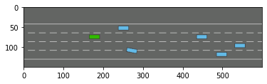
Making an env with gym.make()
import gym
import highway_env
from matplotlib import pyplot as plt
%matplotlib inline
env = gym.make('highway-v0’)
# 5 environments: Highway, Merge, Roundabout, Parking, Intersection,
env.reset()
for _ in range(3):
action = env.action_type.actions_indexes["IDLE"]
obs, reward, done, info = env.step(action)
env.render()
plt.imshow(env.render(mode="rgb_array"))
plt.show()
(Lab3 uses a different method env = load_environment(env_config))

Slide 4
Training an agent
RL agents can be trained using libraries such as rl-agents (by Leurent), OpenAI baselines or stable-baselines3.

Slide 5
rl-agents
A collection of RL agents authored by Leurent: https://github.com/eleurent/rl-agents
Planning
  Value Iteration
  Cross-Entropy Method
  Monte-Carlo Tree Search
    Upper Confidence Trees
    Deterministic Optimistic Planning
    Open Loop Optimistic Planning
    Trailblazer
    PlaTγPOOS
Safe planning
  Robust Value Iteration
  Discrete Robust Optimistic Planning
  Interval-based Robust Planning
Value-based
  Deep Q-Network
  Fitted-Q
Safe value-based
  Budgeted Fitted-Q

Slide 6
Stable Baselines
A set of improved implementations of RL algorithms based on OpenAI Baselines: https://github.com/DLR-RM/stable-baselines3
Training a PPO (Proximal Policy Gradient) agent with Stable Baselines:
import gym
from stable_baselines.common.policies import MlpPolicy
from stable_baselines import PPO2
env = gym.make('CartPole-v1')
model = PPO2(MlpPolicy, env, verbose=1)
# Train the agent
model.learn(total_timesteps=10000)
# Enjoy trained agent
obs = env.reset()
for i in range(1000):
action, _states = model.predict(obs, deterministic=False)
obs, reward, done, info = env.step(action)
env.render()
if done:
obs = env.reset()
env.close()
Notes:
https://towardsdatascience.com/stable-baselines-a-fork-of-openai-baselines-reinforcement-learning-made-easy-df87c4b2fc82 https://github.com/hill-a/stable-baselines

Slide 7
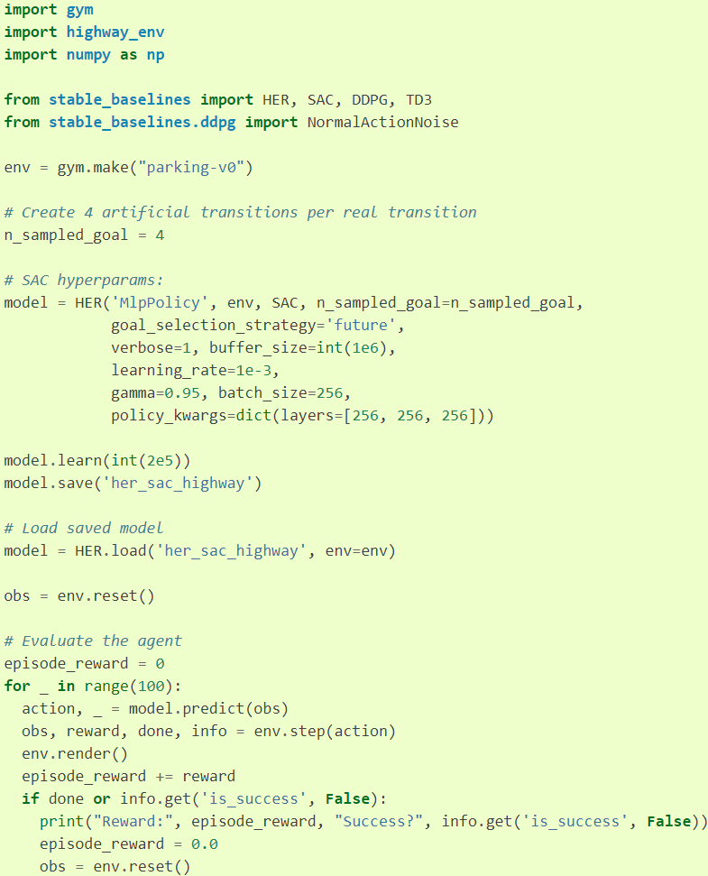
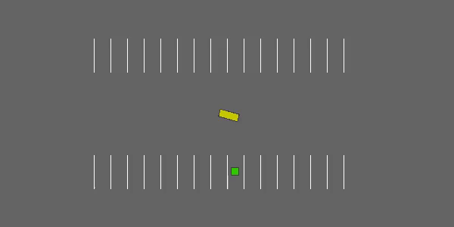
highway-parking-v0 environment trained with HER (Hierarchical Experience replay).

Slide 8
highway_env.py
The vehicle is driving on a straight highway with several lanes, and is rewarded for reaching a high speed, staying on the rightmost lanes and avoiding collisions.
The observations, actions, dynamics and rewards of an environment are parametrized by a configuration, defined as a config dictionary. After environment creation, the configuration can be accessed using the config attribute. Here are the default config values:
Notes:
https://github.com/eleurent/highway-env/blob/master/highway_env/envs/highway_env.py
https://github.com/eleurent/highway-env/blob/d6ef0d6d766c3b54a9f06cba3f09677d718109c3/docs/source/rewards/index.rst
Printing env.config:
import pprint
pprint.pprint(env.config)

Slide 9
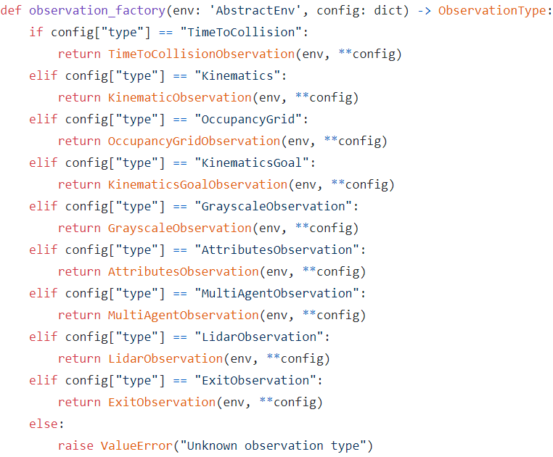
observation.py
GrayscaleObservation(ObservationType)
  Observes the image rendered by the simulator (top-down view)
KinematicObservation(ObservationType)
  Observes the kinematics (position, speed, heading angle) of all nearby vehicles within PERCEPTION_DISTANCE=6.0*MDPVehicle.SPEED_MAX
LidarObservation(ObservationType)
  Observes direction and distance to obstacles within line of sight
Notes:
https://github.com/eleurent/highway-env/blob/master/highway_env/envs/common/observation.py
KinematicsGoalObservation(KinematicObservation) TimeToCollisionObservation(ObservationType)

Slide 10
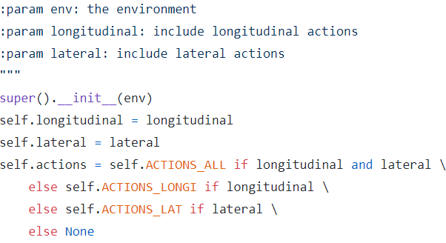
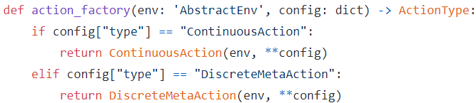
action.py
class ContinuousAction(ActionType)
  Continuous action space for throttle and/or steering angle. If both throttle and steering are enabled, they are set in this order: [throttle, steering]. The space intervals are always [-1, 1], but are mapped to throttle/steering intervals through configurations.
  ACCELERATION_RANGE = (-5, 5.0)
    [-x, x], in m/s²
  STEERING_RANGE = (-np.pi / 4, np.pi / 4)
    [-x, x], in rad
class DiscreteMetaAction(ActionType)
  Discrete action space of meta-actions: lane changes, and cruise control set-point.
  ACTIONS_ALL = {0: 'LANE_LEFT', 1: 'IDLE’, 2: 'LANE_RIGHT', 3: 'FASTER’, 4: 'SLOWER'}
    A mapping of action indexes to labels.
  ACTIONS_LONGI = {0: 'SLOWER', 1: 'IDLE', 2: 'FASTER'}
    A mapping of longitudinal action indexes to labels.
  ACTIONS_LAT = {0: 'LANE_LEFT', 1: 'IDLE', 2: 'LANE_RIGHT’}
    A mapping of lateral action indexes to labels.
Notes:
https://github.com/eleurent/highway-env/blob/master/highway_env/envs/common/action.py

Slide 11
Actions are controller targets
The :py:class:`~highway_env.envs.common.action.DiscreteMetaAction` type adds a layer of :ref:`speed and steering controllers <vehicle_controller>` on top of the continuous low-level control, so that the ego-vehicle can automatically follow the road at a desired velocity. Then, the available meta-actions consist in changing the target lane and speed that are used as setpoints for the low-level controllers.
Notes:
https://github.com/eleurent/highway-env/blob/d6ef0d6d766c3b54a9f06cba3f09677d718109c3/docs/source/actions/index.rst

Slide 12
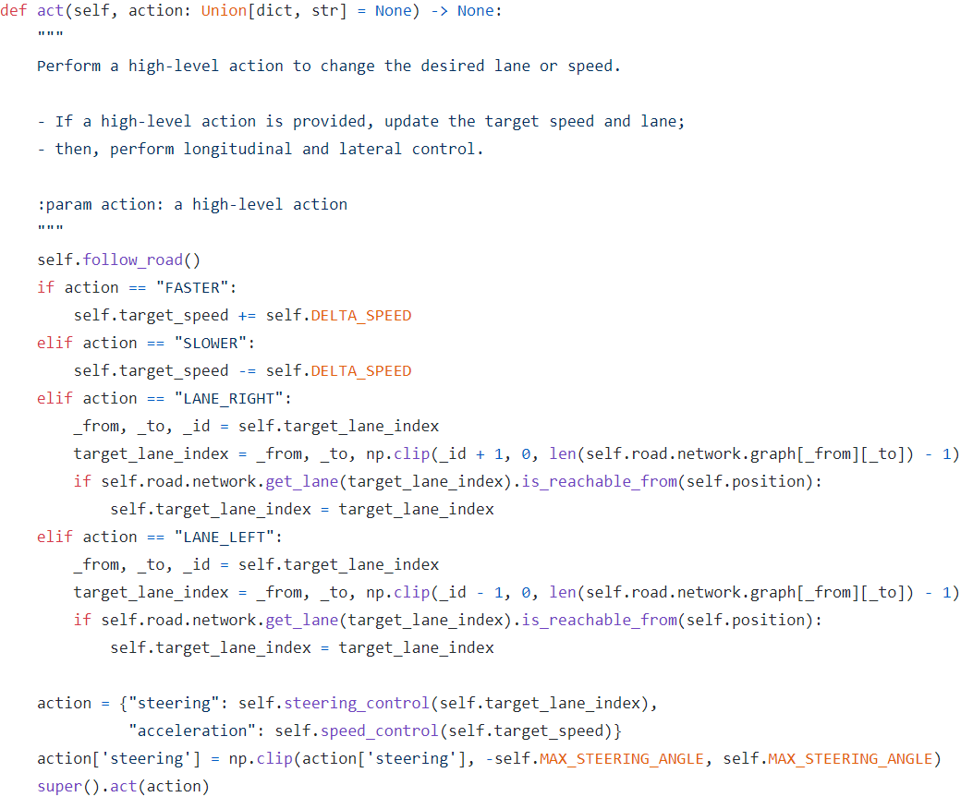
vehicle/controller.py
A vehicle piloted by two low-level controllers, allowing high-level actions such as cruise control and lane changes.
  The longitudinal controller is a speed controller;
  The lateral controller is a heading controller cascaded with a lateral position controller.
  Control algorithm is Proportional control.
  Vehicle model is dynamical bicycle model, with tire friction and slipping.
Notes:
https://github.com/eleurent/highway-env/blob/master/highway_env/vehicle/controller.py
def speed_to_index(self, speed: float) -> int: """ Find the index of the closest speed allowed to a given speed. :param speed: an input speed [m/s] :return: the index of the closest speed allowed [] """ x = (speed - self.SPEED_MIN) / (self.SPEED_MAX - self.SPEED_MIN) return np.int(np.clip(np.round(x * (self.SPEED_COUNT - 1)), 0, self.SPEED_COUNT - 1))

Slide 13
highway_env.py default_config
In def default_config(cls) -> dict:
  "collision_reward": -1, # The reward received when colliding with a vehicle.
  "right_lane_reward": 0.1, # The reward received when driving on the right-most lanes, linearly mapped to zero for other lanes.
  "high_speed_reward": 0.4, # The reward received when driving at full speed, linearly mapped to zero for lower speeds according to config["reward_speed_range"].
  "lane_change_reward": 0, # The reward received at each lane change action.
  "reward_speed_range": [20, 30],
Notes:
https://github.com/eleurent/highway-env/blob/master/highway_env/envs/highway_env.py
RIGHT_LANE_REWARD: float = 0.1
"""The reward received when driving on the right-most lanes, linearly mapped to zero for other lanes."""
HIGH_SPEED_REWARD: float = 0.4
"""The reward received when driving at full speed, linearly mapped to zero for lower speeds according to config["reward_speed_range"]."""
LANE_CHANGE_REWARD: float = 0
"""The reward received at each lane change action.""“

Slide 14
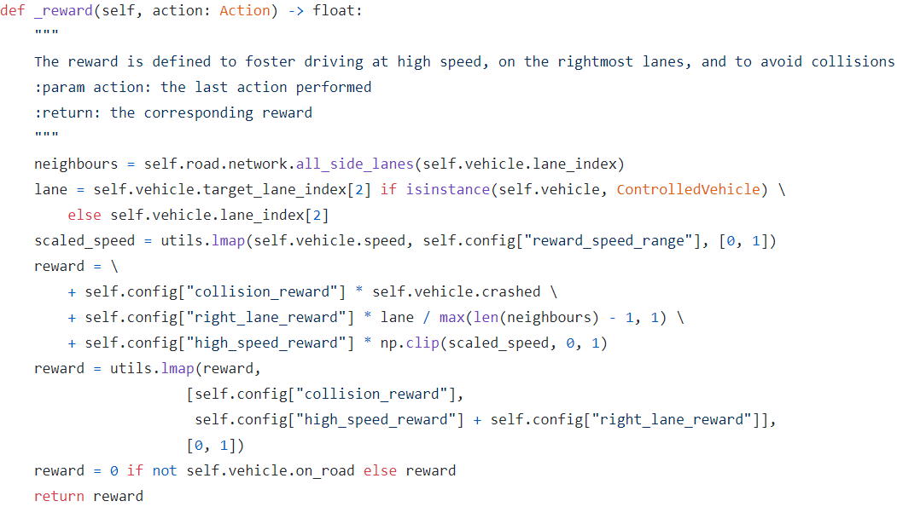
highway_env.py _reward()
Notes:
https://github.com/eleurent/highway-env/blob/master/highway_env/envs/highway_env.py
def all_side_lanes(self, lane_index: LaneIndex) -> List[LaneIndex]: """ :param lane_index: the index of a lane. :return: all lanes belonging to the same road. """ return [(lane_index[0], lane_index[1], i) for i in range(len(self.graph[lane_index[0]][lane_index[1]]))]
https://github.com/eleurent/highway-env/blob/3ef36a0fb17f91769ecac9581206bd51cce41108/highway_env/road/road.py
_from, _to, _id = lane_index
X: [-1, .5] y: [0,1]

Slide 15
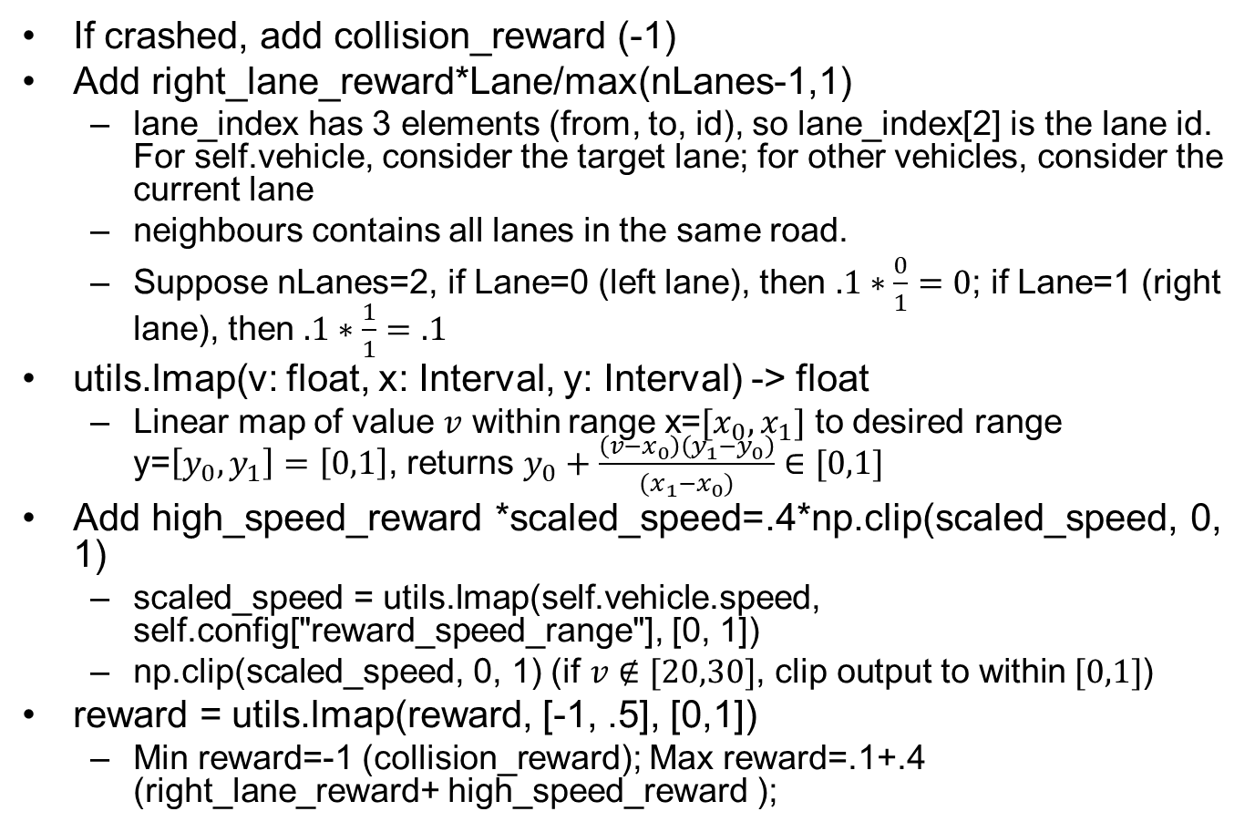
highway_env.py _reward() Explanations
If crashed, add collision_reward (-1)
Add right_lane_reward*Lane/max(nLanes-1,1)
  lane_index has 3 elements (from, to, id), so lane_index[2] is the lane id. For self.vehicle, consider the target lane; for other vehicles, consider the current lane
  neighbours contains all lanes in the same road.
  Suppose nLanes=2, if Lane=0 (left lane), then $.1∗\frac{0}{1}=0$; if Lane=1 (right lane), then $.1∗\frac{1}{1}=.1$
utils.lmap(v: float, x: Interval, y: Interval) -> float
  Linear map of value $v$ within range x=$[x_{0},x_{1}]$ to desired range y=$\left[y_{0},y_{1}\right]=\left[0,1\right]$, returns $y_{0}+\frac{\left(v−x_{0}\right)\left(y_{1}−y_{0}\right)}{(x_{1}−x_{0})}∈[0,1]$
Add high_speed_reward *scaled_speed=.4*np.clip(scaled_speed, 0, 1)
  scaled_speed = utils.lmap(self.vehicle.speed, self.config["reward_speed_range"], [0, 1])
  np.clip(scaled_speed, 0, 1) $\text{(}\text{if} v∉[20,30]$, $\text{clip} \text{output} \text{to} \text{within} [0,1]$)
reward = utils.lmap(reward, [-1, .5], [0,1])
  Min reward=-1 (collision_reward); Max reward=.1+.4 (right_lane_reward+ high_speed_reward );
Notes:
With default values of "collision_reward": -1, "right_lane_reward": 0.1, "high_speed_reward": 0.4, lmap(reward, [-1, .5], [0,1])
def _reward(self, action: Action) -> float:

Slide 16
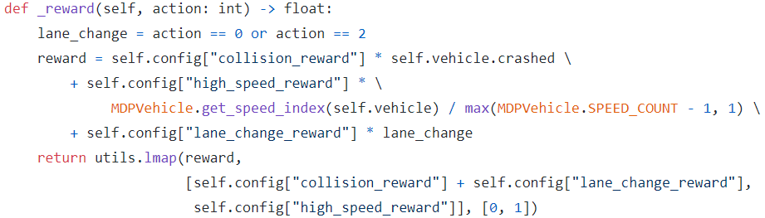
roundabout_env.py _reward(self, action: int)
In def default_config(cls) -> dict: "collision_reward": -1, "high_speed_reward": 0.2, "right_lane_reward": 0, "lane_change_reward": -0.05
If crashed, add collision_reward(-1)
Add high_speed_reward*scaled speed index
Add lane_change_reward*lane_change
reward = utils.lmap(reward, [-1.05, .2], [0,1])
Notes:
https://github.com/eleurent/highway-env/blob/master/highway_env/envs/roundabout_env.py
https://github.com/eleurent/highway-env/blob/3b534f0f42e769cd8a91911064255e791f188213/highway_env/envs/common/finite_mdp.py
State reward – action reward
The state reward is defined from a occupancy grid over different TTCs and lanes. The grid cells encode the probability that the ego-vehicle will collide with another vehicle if it is located on a given lane in a given duration, under the hypothesis that every vehicles observed will maintain a constant speed (including the ego-vehicle) and not change lane (excluding the ego-vehicle).
For instance, in a three-lane road with a vehicle on the left lane with collision predicted in 5s the grid will be:
[0, 0, 0, 0, 1, 0, 0,
0, 0, 0, 0, 0, 0, 0,
0, 0, 0, 0, 0, 0, 0]
The TTC-state is a coordinate (lane, time) within this grid.

Slide 17
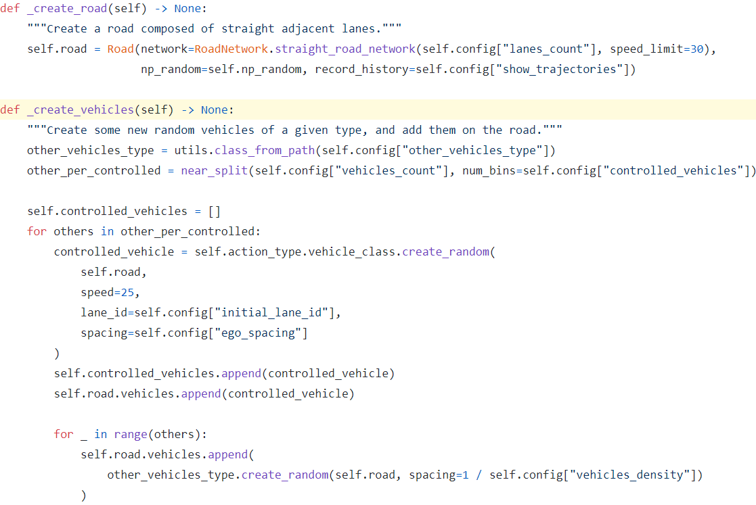
create_road(), create_vehicles()
Notes:
A :py:meth:`~highway_env.envs.common.abstract.AbstractEnv.default_config` method, that provides a default configuration dictionary that can be overloaded.
A :py:meth:`~highway_env.envs.common.abstract.AbstractEnv.define_spaces` method, that gives access to a choice of observation and action types, set from the environment configuration
A :py:meth:`~highway_env.envs.common.abstract.AbstractEnv.step` method, which executes the desired actions (at policy frequency) and simulate the environment (at simulation frequency)
A :py:meth:`~highway_env.envs.common.abstract.AbstractEnv.render` method, which renders the environment.

Slide 18
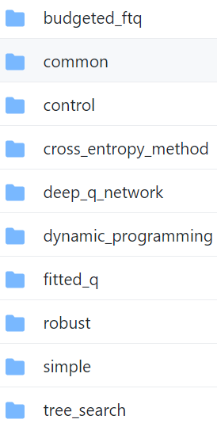
agents
In random.py:
def act(self, state):
  return self.env.action_space.sample()
In deep_q_network/abstract.py:
def act(self, state, step_exploration_time=True):
  if step_exploration_time:
  self.exploration_policy.step_time()
  values = self.get_state_action_values(state)
  self.exploration_policy.update(values)
  return self.exploration_policy.sample()
Notes:
https://github.com/eleurent/rl-agents/tree/master/rl_agents/agents

Slide 19
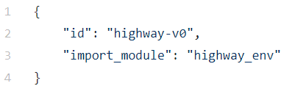
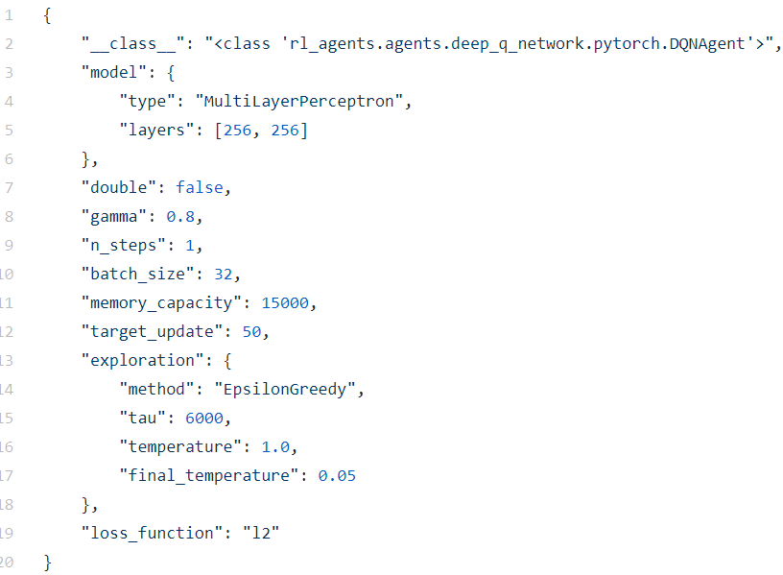
Env and Agent Configs
env_config = 'configs/HighwayEnv/env.json’
agent_config = 'configs/HighwayEnv/agents/DQNAgent/dqn.json'
env.json
(empty)
dqn.json
Notes:
https://github.com/eleurent/rl-agents/blob/master/scripts/configs/HighwayEnv/env.json
https://github.com/eleurent/rl-agents/blob/master/scripts/configs/HighwayEnv/agents/DQNAgent/dqn.json

Slide 20
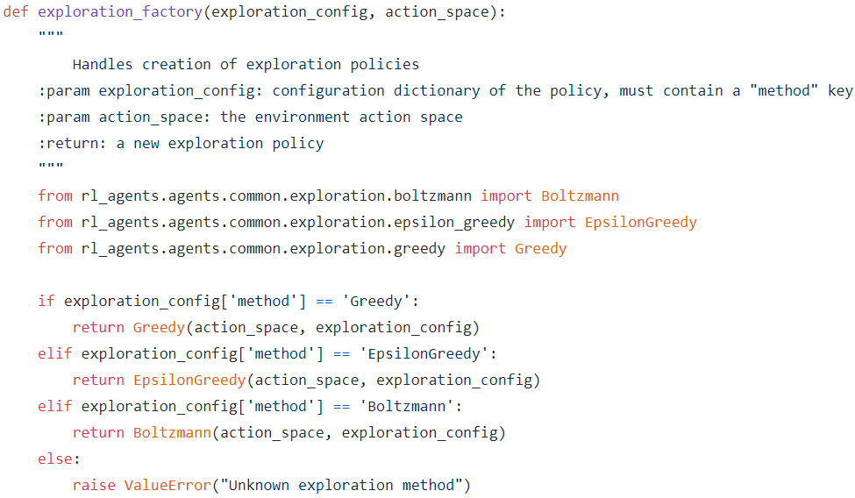
abstract.py exploration_factory
Notes:
https://github.com/eleurent/rl-agents/blob/e4abed7233c6e727394ab9a671ee81761856e81a/rl_agents/agents/common/exploration/abstract.py#L14

Slide 21
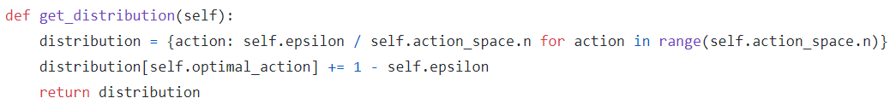

epsilon_greedy.py get_distribution()
$n$: discrete action space size (# actions)
For each action: $dist=\frac{ε}{n}$
For the optimal action: $dist=\frac{ε}{n}+1−ε$
Notes:
Uniform distribution with probability $ε$, and optimal action with probability $1−ε$

Slide 22
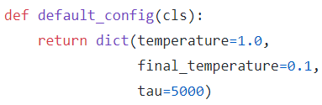
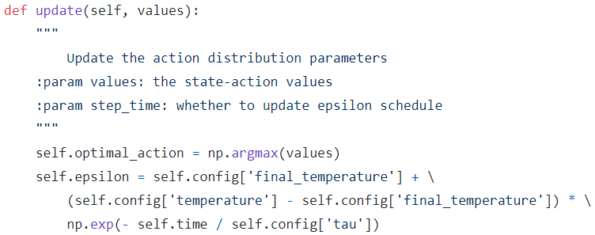
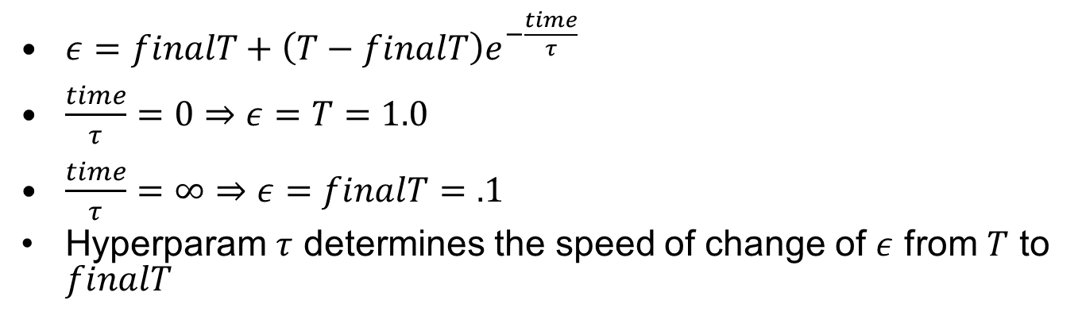
epsilon_greedy.py update()
$ε=finalT+\left(T−finalT\right)e^{−\frac{time}{τ}}$
$\frac{time}{τ}=0⇒ε=T=1.0$
$\frac{time}{τ}=∞⇒ε=finalT=.1$
Hyperparam $τ$ determines the speed of change of $ε$ from $T$ to $finalT$
Notes:
https://github.com/eleurent/rl-agents/blob/e4abed7233c6e727394ab9a671ee81761856e81a/rl_agents/agents/common/exploration/epsilon_greedy.py

