Slide 1

L2 Introduction to Machine Learning
Zonghua Gu 2022

Slide 2
ML Taxonomy
Supervised Learning:
  The system is presented with example inputs and their desired outputs, given by a “teacher”, and the goal is to learn a general rule that maps inputs to outputs.
    Classification (cat or dog?)
    Regression (housing price next year?)
Unsupervised Learning:
  No labels are given to the learning algorithm, leaving it on its own to find structure in its input. Unsupervised learning can be a goal in itself (discovering hidden patterns in data) or a means towards an end (feature learning).
    Parametric UL (e.g., Gaussian Mixture Models)
    Non-parametric UL
Notes:
Three categories
Supervised learning (w. labeled data), incl.
Classification (cat vs. dog?)
Regression (housing price next year?)
Unsupervised learning (no labeled data), incl.
Custering
Game playing (AlphaGo)
Deep Learning (DL) is a type of ML algorithm that is based on neural networks
Many other ML algorithms besides DL Learn a function: $y=f\left(x\right)$
Depending on the type of output $y$:
Regression: $y$ is continuous (e.g. temperature value y = {19º, 23.5º, 22.9º})
Classification: $y$ is discrete (e.g. y = {cat, dog})

Slide 3
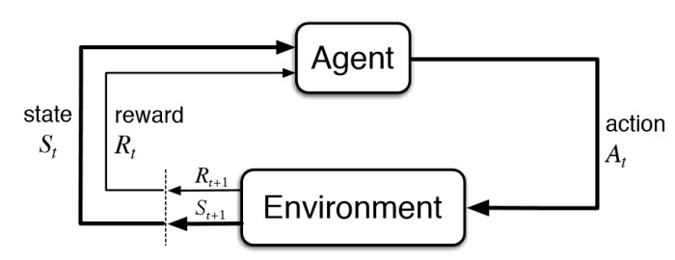
ML Taxonomy
Reinforcement Learning:
  An agent interacts with a dynamic environment in which it must perform a certain goal. The agent is provided feedback in terms of rewards and it tries to learn an optimal policy that maximizes its cumulative rewards.
  Algorithms: Model-based; Model-free (Value-based, Policy-based)
  Applications: Game playing (AlphaGo); Robotics; AD…

Slide 4
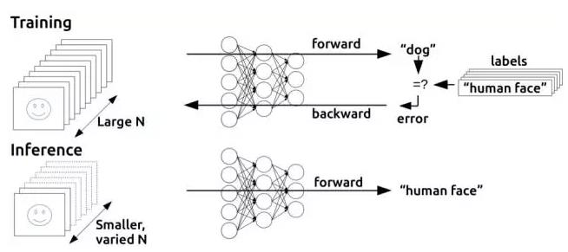
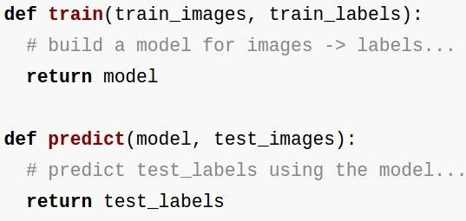
Training vs. Inference
Training: millions of iterations of forward pass + back propagation to adjust model params (e.g., NN weights); requires large CPU/GPU clusters and days/weeks of training time
Inference (also called prediction): a single forward pass; can be run on edge devices

Slide 5
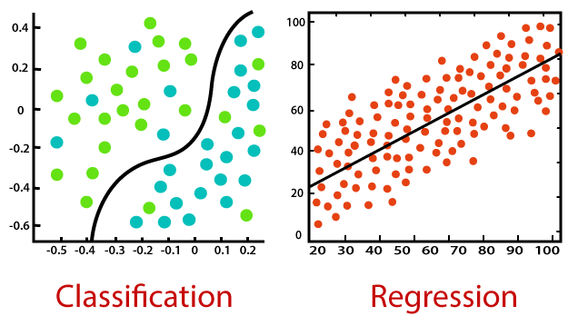




Supervised Learning: Classification and Regression
Classification is used to predict/classify discrete labels such as Male or Female, True or False, Spam or Not Spam, etc.
Regression is used to predict continuous values such as price, salary, age, etc.
Both are Supervised Learning algorithms that require ground-truth values as labels.
Both need loss functions to measure how the predicted value differs from ground-truth value.
$$x_{2}$$
Cat vs. Dog
$$y$$
$$x_{1}$$
$$x$$
https://www.javatpoint.com/regression-vs-classification-in-machine-learning

Slide 6
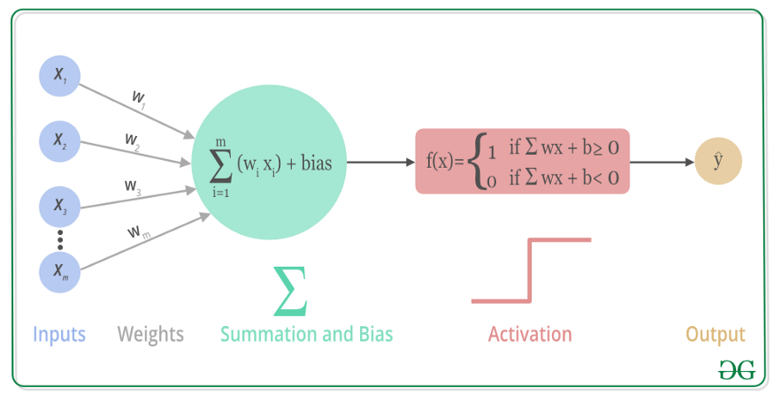
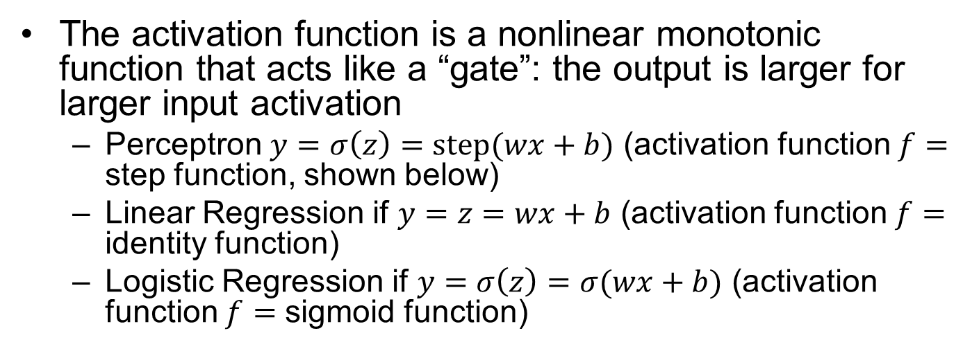
A Neuron and its Activation Function
The activation function is a nonlinear monotonic function that acts like a “gate”: the output is larger for larger input activation
  Perceptron $y=σ\left(z\right)=step(wx+b)$ (activation function $f=$ step function, shown below)
  Linear Regression if $y=z=wx+b$ (activation function $f=$ identity function)
  Logistic Regression if $y=σ\left(z\right)=σ(wx+b)$ (activation function $f=$ sigmoid function)
Notes:
Many variants: step, sigmoid, tanh, ReLU, leaky-ReLU, PReLU, SoftPlus, Swish…

Slide 7
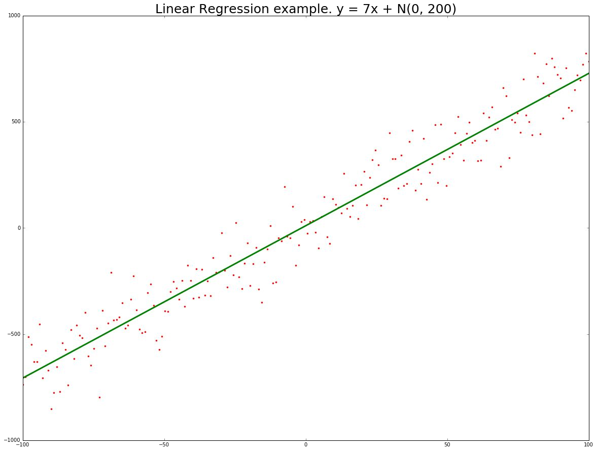
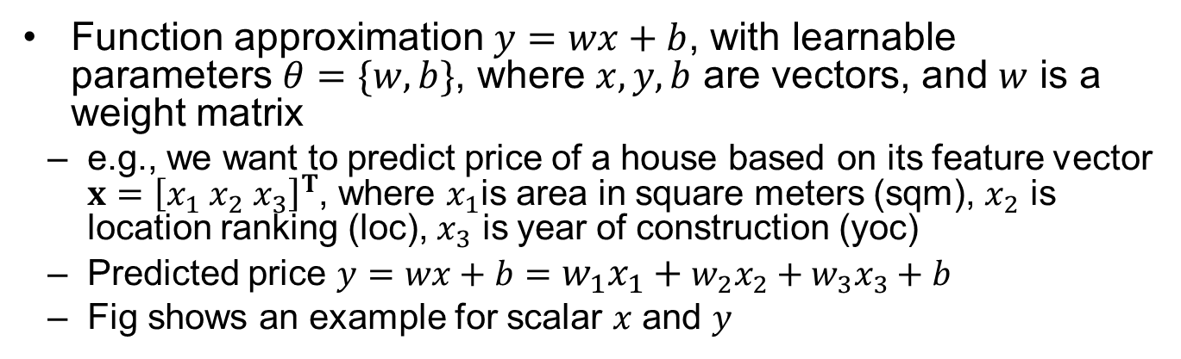
Linear Regression for Regression
Function approximation $y=wx+b$, with learnable parameters $θ=\{w,b\}$, where $x,y,b$ are vectors, and $w$ is a weight matrix
  e.g., we want to predict price of a house based on its feature vector $x={\left[x_{1} x_{2} x_{3}\right]}^{T}$, where $x_{1}$is area in square meters (sqm), $x_{2}$ is location ranking (loc), $x_{3}$ is year of construction (yoc)
  Predicted price $y=wx+b=w_{1}x_{1}+w_{2}x_{2}+w_{3}x_{3}+b$
  Fig shows an example for scalar $x$ and $y$

Slide 8
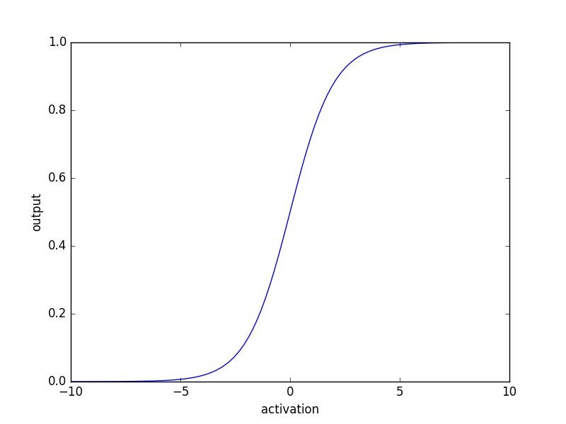
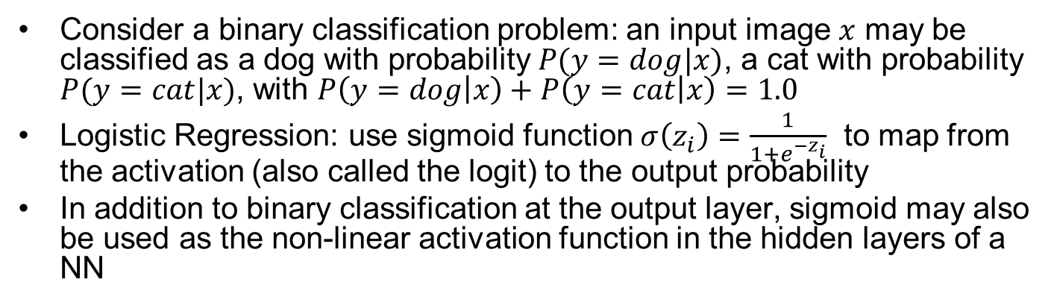
Logistic Regression for Binary Classification
Consider a binary classification problem: an input image $x$ may be classified as a dog with probability $P(y=dog|x)$, a cat with probability $P(y=cat|x)$, with $P\left(y=dog | x\right)+P\left(y=cat | x\right)=1.0$
Logistic Regression: use sigmoid function $σ\left(z_{i}\right)=\frac{1}{1+e^{−z_{i}}}$ to map from the activation (also called the logit) to the output probability
In addition to binary classification at the output layer, sigmoid may also be used as the non-linear activation function in the hidden layers of a NN
Class 1
classifier
Class 2
Notes:
For classification, the output is a list of probabilities

Slide 9
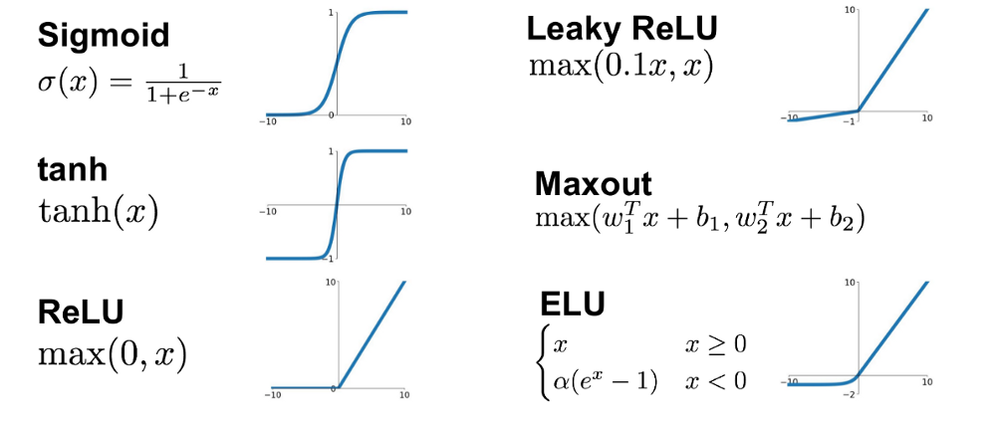
Common Activation Functions used in DL
https://laptrinhx.com/complete-guide-of-activation-functions-574622854/

Slide 10
Deep Neural Networks
We can stack many hidden layers to form a DNN if we have enough data and computing power to train it
The high model capacity of DNN comes from non-linear mappings: hidden units must be followed by a non-linear activation function
  Without non-linear activation functions, a DNN with many layers can be collapsed into an equivalent single-layer NN

Slide 11
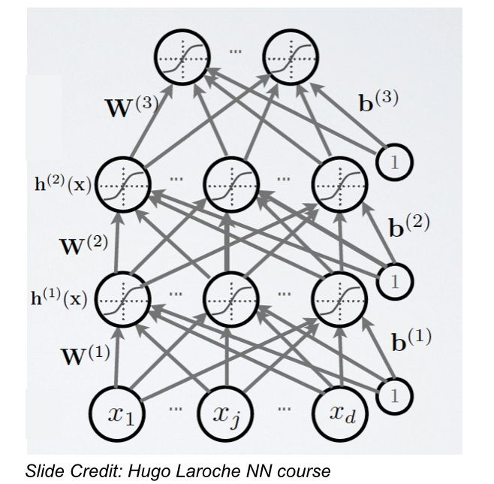
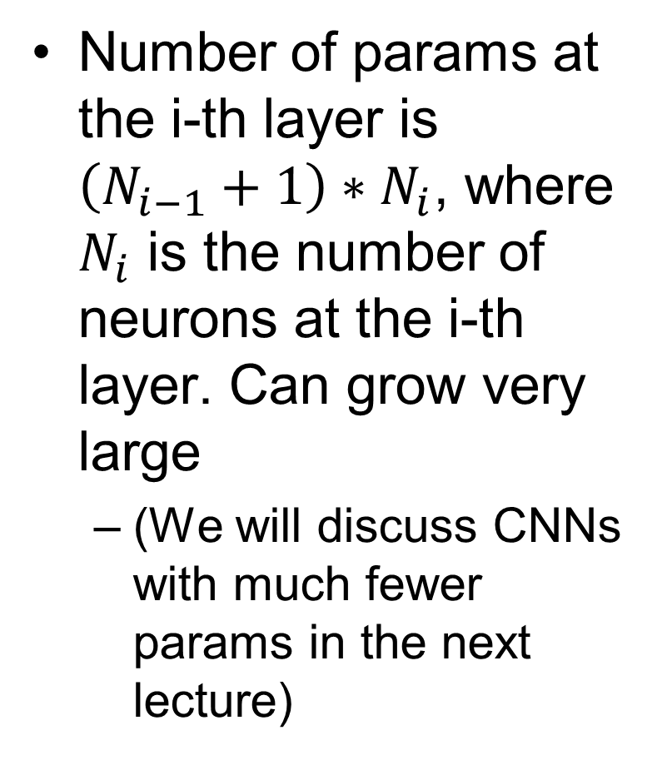
Fully-Connected NNs
Number of params at the i-th layer is $\left(N_{i−1}+1\right)∗N_{i}$, where $N_{i}$ is the number of neurons at the i-th layer. Can grow very large
  (We will discuss CNNs with much fewer params in the next lecture)
A 3-layer NN
Notes:
The i-th layer’s activation $h_{i}=f\left(W_{i}⋅h_{i−1}\right)+b_{i}$, where $W_{i}$ is the weight matrix, and $b_{i}$ is the bias, between (i-1)-th and i-th layer
Also called Multi-Layer Perceptrons (MLPs)

Slide 12
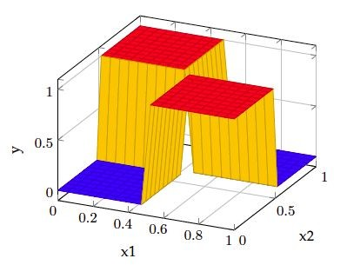
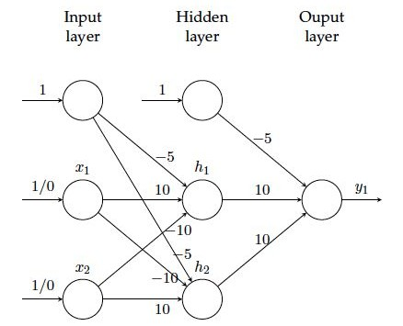
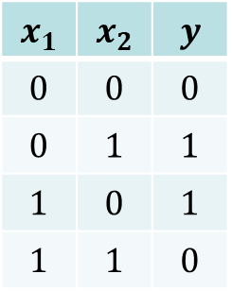
Example: Two-Layer Fully-Connected NN for Solving XOR
The NN consists of one input, one hidden, and one output layer, with sigmoid activations
2 hidden units with sigmoid activations
$$x_{1}$$ | $$x_{2}$$ | $$y$$
$$0$$ | $$0$$ | $$0$$
$$0$$ | $$1$$ | $$1$$
$$1$$ | $$0$$ | $$1$$
$$1$$ | $$1$$ | $$0$$
output unit with sigmoid activation

Slide 13
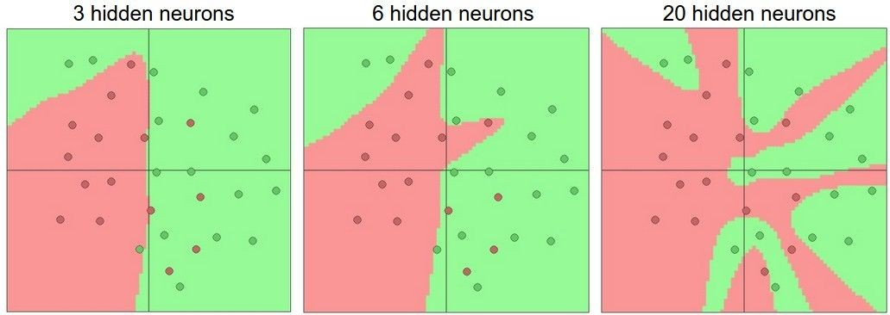
Setting # Layers and Their Sizes
An example illustrating adding more hidden neurons increases model capacity and reduces training error
But too many layers and neurons may lead to overfitting

Slide 14
Loss Functions
Classification
  Cross-Entropy Loss, Log Loss, Focal Loss, Exponential Loss, Hinge Loss…
Regression
  MSE (Mean Squared Error)/L2 Loss/Quadratic Loss, MAE (Mean Absolute Error)/L1 Loss, Huber Loss, Log Cosh Loss, Quantile Loss…
https://heartbeat.fritz.ai/5-regression-loss-functions-all-machine-learners-should-know-4fb140e9d4b0

Slide 15
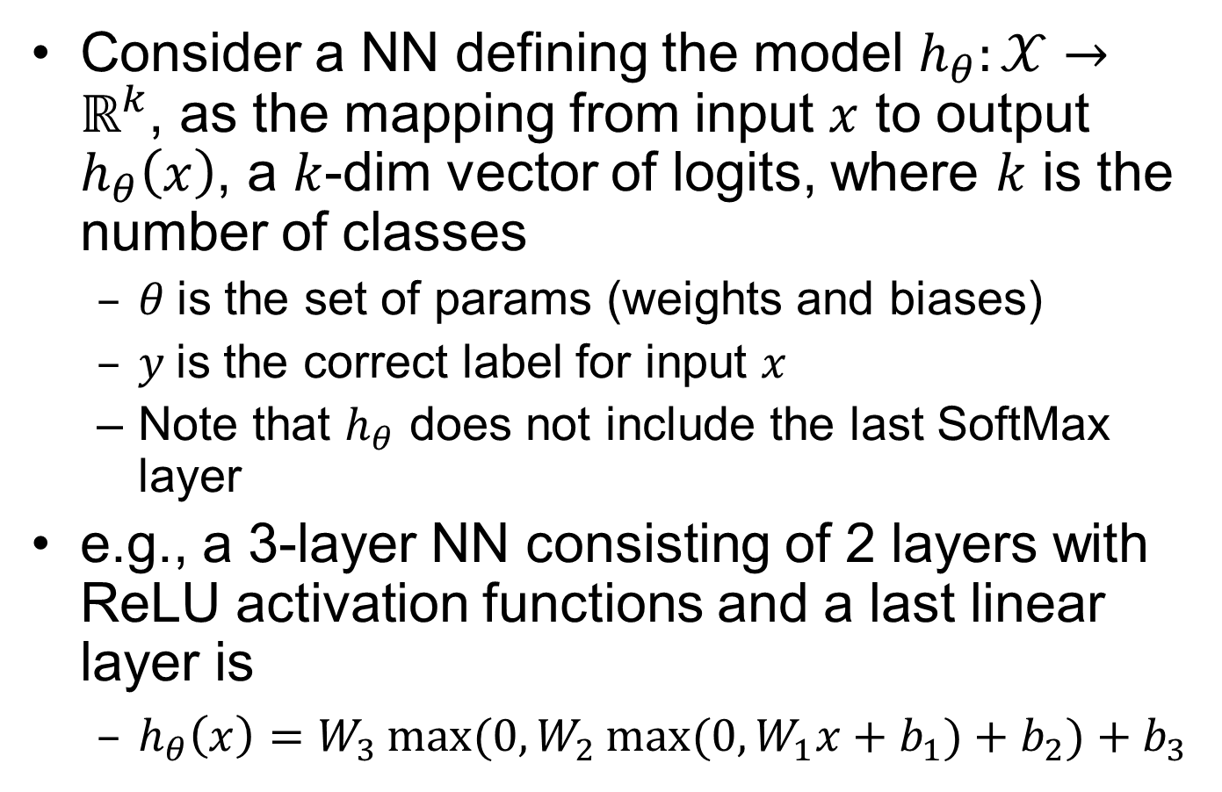
NN for Multi-Class Classification
Consider a NN defining the model $h_{θ}:𝒳→ℝ^{k}$, as the mapping from input $x$ to output $h_{θ}\left(x\right)$, a $k$-dim vector of logits, where $k$ is the number of classes
  $θ$ is the set of params (weights and biases)
  $y$is the correct label for input $x$
  Note that $h_{θ}$ does not include the last SoftMax layer
e.g., a 3-layer NN consisting of 2 layers with ReLU activation functions and a last linear layer is
  $h_{θ}\left(x\right)=W_{3}\max{(0,W_{2}\max{(0,W_{1}x+b_{1})}+b_{2})}+b_{3}$
Notes:
(e.g., a color image is a 3D tensor)
Consider a NN classifier $f_{θ}\left(x\right)=y$
$x$: the input (image)
$y$: the prediction result (e.g., panda or gibbon), which has the maximum probability in the probability vector over all classes. We assume $y$ to be the correct prediction
$f_{θ}$: the NN with params $θ$ (weights and biases)

Slide 16
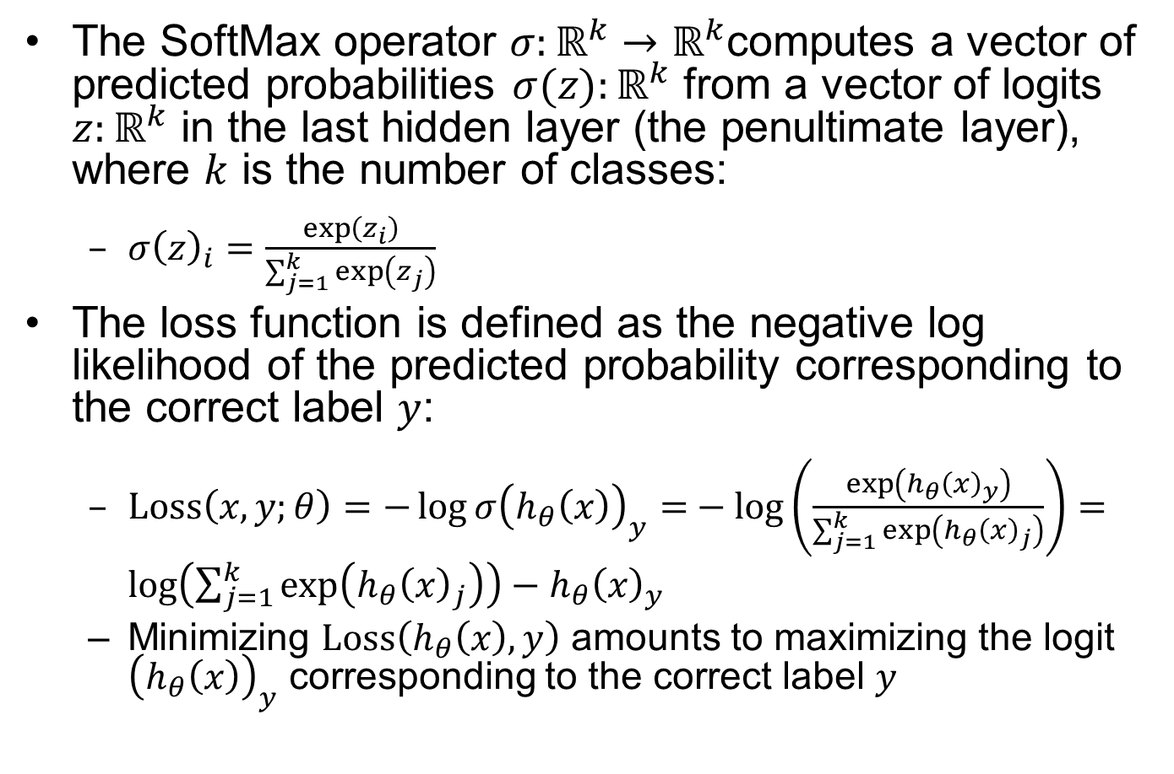
Cross-Entropy Loss for Multi-Class Classification
Important
The SoftMax operator $σ:ℝ^{k}→ℝ^{k}$computes a vector of predicted probabilities $σ(z):ℝ^{k}$ from a vector of logits $z:ℝ^{k}$ in the last hidden layer (the penultimate layer), where $k$ is the number of classes:
  $σ{\left(z\right)}_{i}=\frac{\exp\left(z_{i}\right)}{\sum_{j=1}^{k}{\exp\left(z_{j}\right)}}$
The loss function is defined as the negative log likelihood of the predicted probability corresponding to the correct label $y$:
  $Loss\left(x,y;θ\right)=−\log{σ{\left(h_{θ}\left(x\right)\right)}_{y}=}−\log\left(\frac{\exp\left(h_{θ}{\left(x\right)}_{y}\right)}{\sum_{j=1}^{k}{\exp\left(h_{θ}{\left(x\right)}_{j}\right)}}\right)=\log\left(\sum_{j=1}^{k}{\exp\left(h_{θ}{\left(x\right)}_{j}\right)}\right)−h_{θ}{\left(x\right)}_{y}$
  Minimizing $Loss\left(h_{θ}\left(x\right),y\right)$ amounts to maximizing the logit ${\left(h_{θ}\left(x\right)\right)}_{y}$ corresponding to the correct label $y$
Notes:
$$Loss\left(x+δ,y;θ\right)=\log{\sum_{i}{\exp{h_{θ}{\left(x+δ\right)}_{i}−h_{θ}{\left(x\right)}_{y}}}}$$
Pred now contains a 1000 dimensional vector containing the class logits for the 1000 imagenet classes (i.e., if you wanted to convert this to a probability vector, you would apply the softmax operator to this vector). To find the highest likelihood class, we simply take the index of maximum value in this vector, and we can look this up in a list of imagenet classes to find the corresponding label.
$$Loss\left(h_{θ}\left(x\right),y\right)=$$

Slide 17
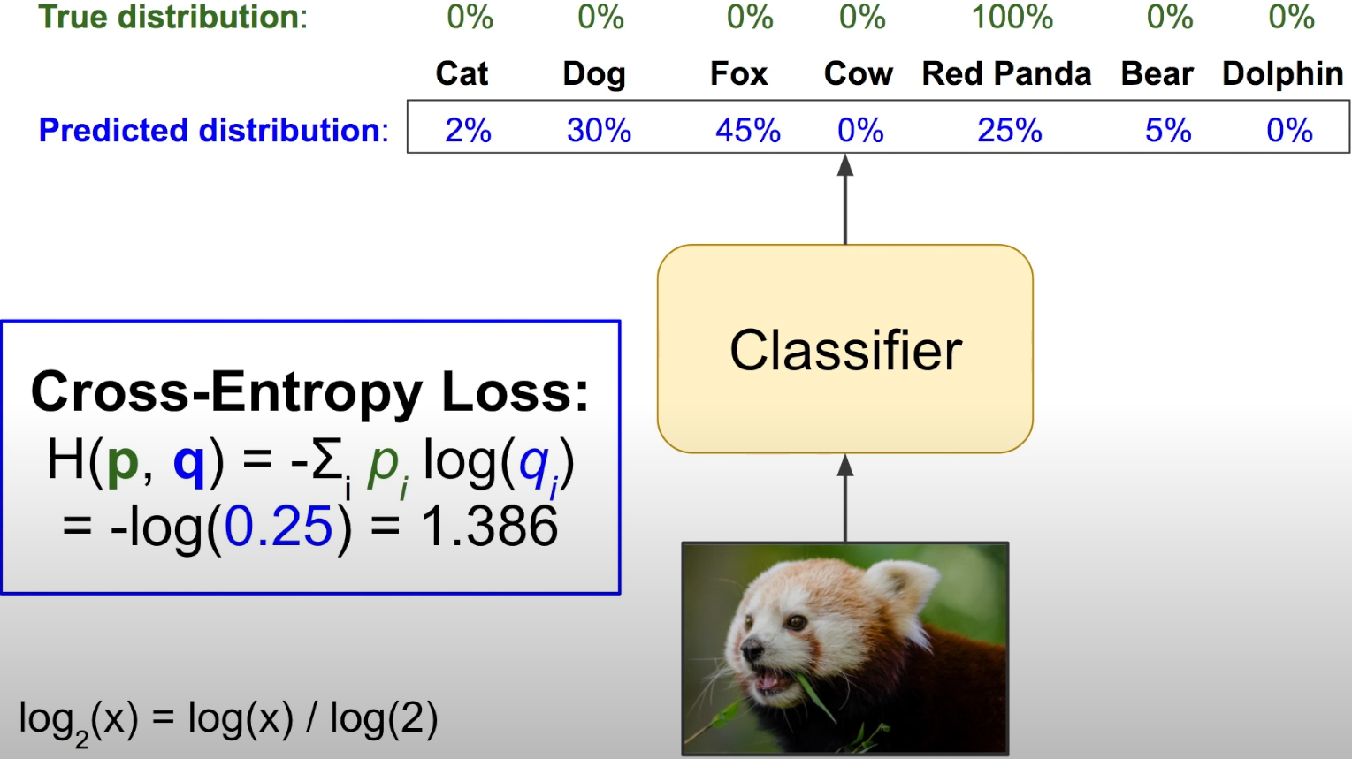
Cross-Entropy Loss Example
Aurélien Géron A Short Introduction to Entropy, Cross-Entropy and KL-Divergence (YouTube)
Notes:
$$H\left(p,q\right)=−\sum_{i}{p_{i}\log{q_{i}}}$$
$p_{i}$: true distribution; $q_{i}$: predicted distribution.

Slide 18
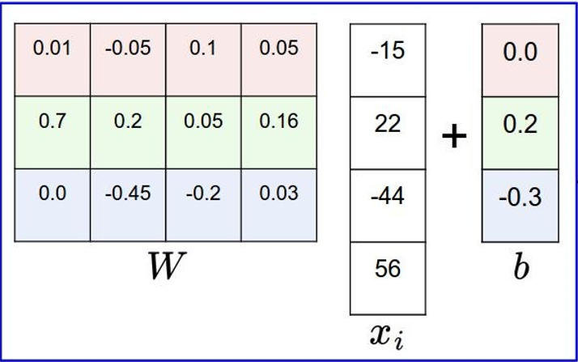
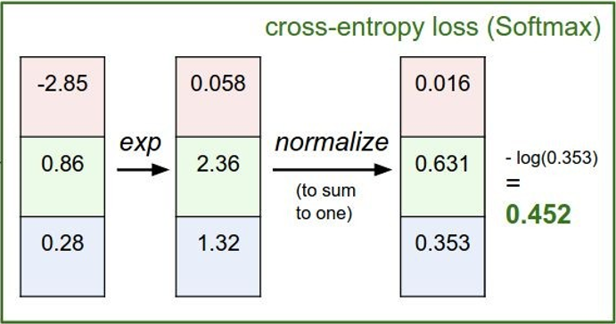
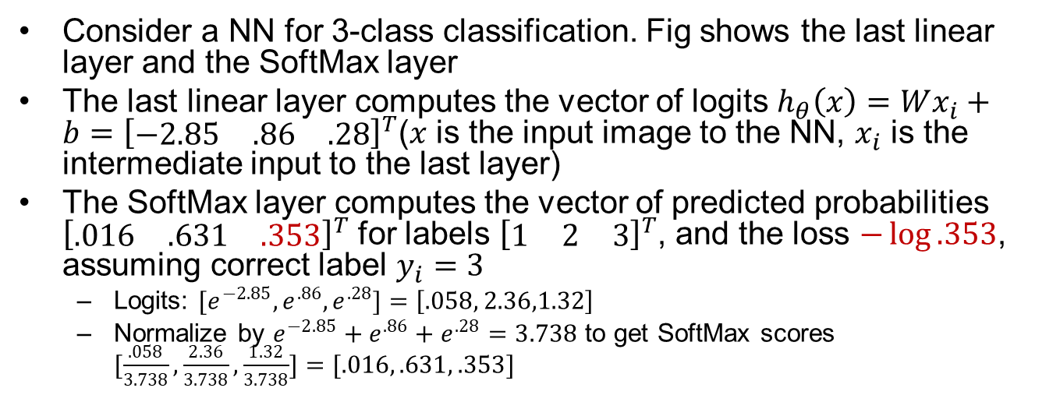
Cross-Entropy Loss Example
Consider a NN for 3-class classification. Fig shows the last linear layer and the SoftMax layer
The last linear layer computes the vector of logits $h_{θ}\left(x\right)=Wx_{i}+b={\left[\begin{matrix}−2.85 & .86 & .28\end{matrix}\right]}^{T}$($x$ is the input image to the NN, $x_{i}$ is the intermediate input to the last layer)
The SoftMax layer computes the vector of predicted probabilities ${\left[\begin{matrix}.016 & .631 & .353\end{matrix}\right]}^{T}$ for labels ${\left[\begin{matrix}1 & 2 & 3\end{matrix}\right]}^{T}$, and the loss $−\log{.353}$, assuming correct label $y_{i}=3$
  Logits: ${[e}^{−2.85}, e^{.86},e^{.28}]=\left[.058, 2.36,1.32\right]$
  Normalize by $e^{−2.85}+e^{.86}+e^{.28}=3.738$ to get SoftMax scores $[\frac{.058}{3.738},\frac{2.36}{3.738},\frac{1.32}{3.738}]=[.016, .631, .353]$
correct
label
Last Linear Layer
SoftMax Layer
Notes:
exp(−2.85)+exp(.86)+exp(.28)=3.744
exp(−2.85)/3.744=

Slide 19
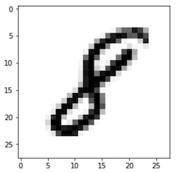
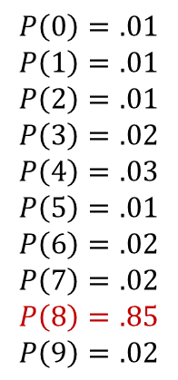
Example CV Task: Multi-Class Image Classification
Two stages: feature extraction from input, and classification based on extracted features
Classifier returns output as a list of probabilities with size equal to the number of classes, but it may also return the top-1 or top-5 results with highest probability ranking
$$P\left(0\right)=.01$$
$$P\left(1\right)=.01$$
$$P\left(2\right)=.01$$
$$P\left(3\right)=.02$$
$$P\left(4\right)=.03$$
$$P\left(5\right)=.01$$
$$P\left(6\right)=.02$$
$$P\left(7\right)=.02$$
$$P\left(8\right)=.85$$
$$P\left(9\right)=.02$$
Feature
Extraction
Classifier
sum
to 1.0
CNN
(or classic CV algo)
SoftMax
Notes:
Collect a dataset of images and labels
Use Machine Learning to train an image classifier
Evaluate the classifier on test images

Slide 20
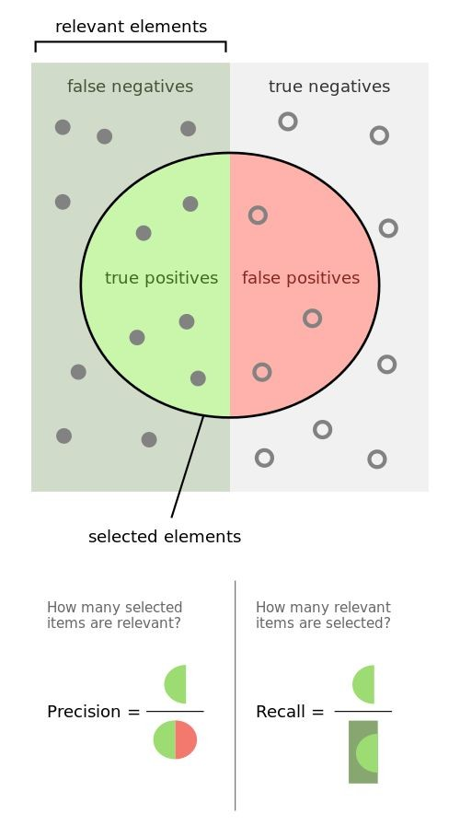
Binary Classification Metrics
The relevant class is considered “positive” in a binary classifier
e.g., for a medical test that aims to diagnose people with a certain disease. “Positive” denotes sick (has disease), and “negative” denotes healthy (no disease)
  TP: a sick person is diagnosed as sick
  TN: a healthy person is diagnosed as healthy
  FP: a healthy person is misdiagnosed as sick
  FN: a sick person is misdiagnosed as healthy
Never Forget Again! // Precision vs Recall with a Clear Example of Precision and Recall by Kimberly Fessel
  https://www.youtube.com/watch?v=qWfzIYCvBqo

Slide 21
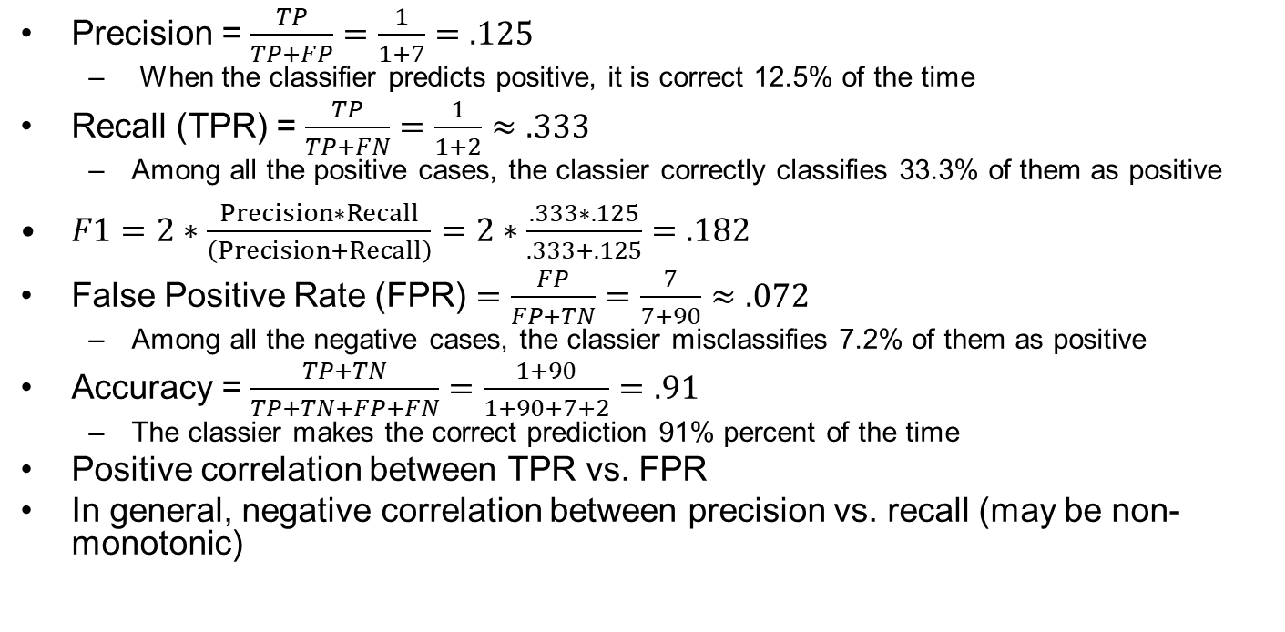
Example Confusion Matrix 1
Precision = $\frac{TP}{TP+FP}=\frac{1}{1+7}=.125$
  When the classifier predicts positive, it is correct 12.5% of the time
Recall (TPR) = $\frac{TP}{TP+FN}=\frac{1}{1+2}≈.333$
  Among all the positive cases, the classier correctly classifies 33.3% of them as positive
$F1=2∗\frac{Precision∗Recall}{\left(Precision+Recall\right)}=2∗\frac{.333∗.125}{.333+.125}=.182$
False Positive Rate (FPR) $=\frac{FP}{FP+TN}=\frac{7}{7+90}≈.072$
  Among all the negative cases, the classier misclassifies 7.2% of them as positive
Accuracy = $\frac{TP+TN}{TP+TN+FP+FN}=\frac{1+90}{1+90+7+2}=.91$
  The classier makes the correct prediction 91% percent of the time
Positive correlation between TPR vs. FPR
In general, negative correlation between precision vs. recall (may be non-monotonic)
 |  | Ground Truth
 |  | Positive | Negative
Predicted | Neg | False Negative (FN)=2 | True Negative (TN)=90
 | Pos | True Positive (TP)=1 | False Positive (FP)=7
https://medium.com/swlh/recall-precision-f1-roc-auc-and-everything-542aedf322b9
Notes:
Recall = $\frac{TP}{TP+FN}$ Precision = $\frac{TP}{TP+FP}$ Accuracy = $\frac{TP+TN}{TP+TN+FP+FN}$

Slide 22
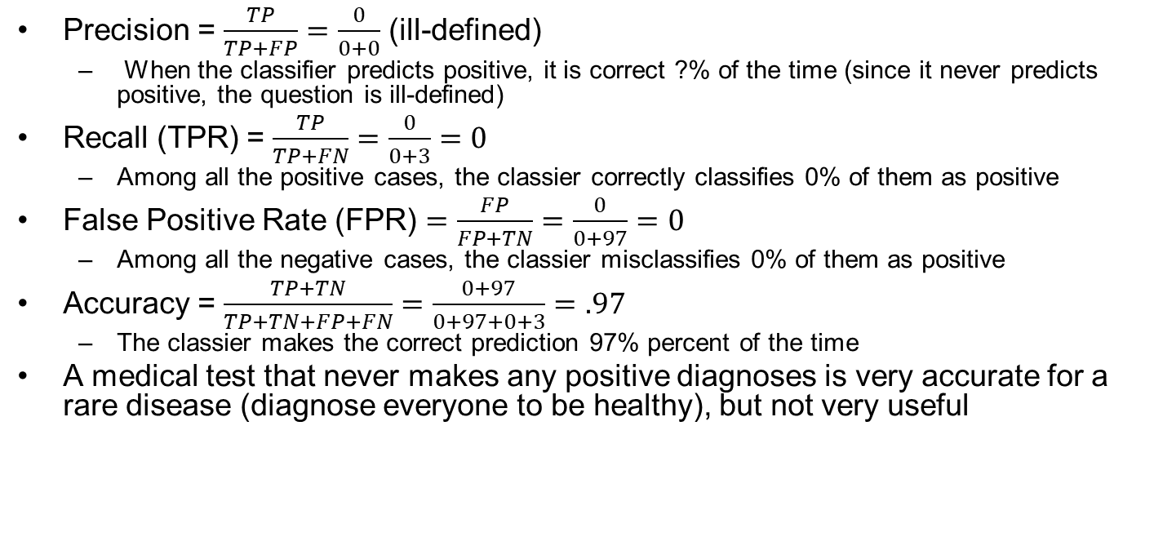
Example Confusion Matrix 2
Precision = $\frac{TP}{TP+FP}=\frac{0}{0+0}$ (ill-defined)
  When the classifier predicts positive, it is correct ?% of the time (since it never predicts positive, the question is ill-defined)
Recall (TPR) = $\frac{TP}{TP+FN}=\frac{0}{0+3}=0$
  Among all the positive cases, the classier correctly classifies 0% of them as positive
False Positive Rate (FPR) $=\frac{FP}{FP+TN}=\frac{0}{0+97}=0$
  Among all the negative cases, the classier misclassifies 0% of them as positive
Accuracy = $\frac{TP+TN}{TP+TN+FP+FN}=\frac{0+97}{0+97+0+3}=.97$
  The classier makes the correct prediction 97% percent of the time
A medical test that never makes any positive diagnoses is very accurate for a rare disease (diagnose everyone to be healthy), but not very useful
 |  | Ground Truth
 |  | Positive | Negative
Predicted | Neg | False Negative (FN)=3 | True Negative (TN)=97
 | Pos | True Positive (TP)=0 | False Positive (FP)=0

Slide 23
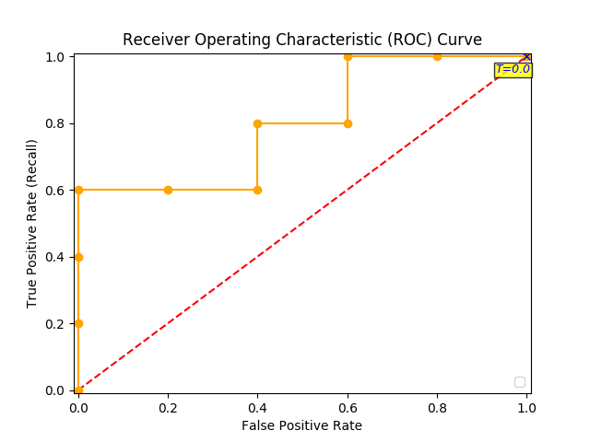
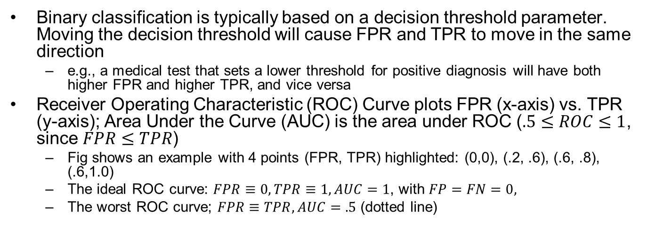
ROC and AUC
Binary classification is typically based on a decision threshold parameter. Moving the decision threshold will cause FPR and TPR to move in the same direction
  e.g., a medical test that sets a lower threshold for positive diagnosis will have both higher FPR and higher TPR, and vice versa
Receiver Operating Characteristic (ROC) Curve plots FPR (x-axis) vs. TPR (y-axis); Area Under the Curve (AUC) is the area under ROC ($.5≤ROC≤1$, since $FPR≤TPR$)
  Fig shows an example with 4 points (FPR, TPR) highlighted: (0,0), (.2, .6), (.6, .8), (.6,1.0)
  The ideal ROC curve: $FPR≡0,TPR≡1, AUC=1$, with $FP=FN=0,$
  The worst ROC curve; $FPR≡TPR, AUC=.5$ (dotted line)
Decision
thresh.
Distribution of negative data items
Distribution of positive data items
TN
TP
FN
FP
Feature
Predict negative
Predict positive
Notes:
It is not possible for FPR to be larger than TPR

Slide 24
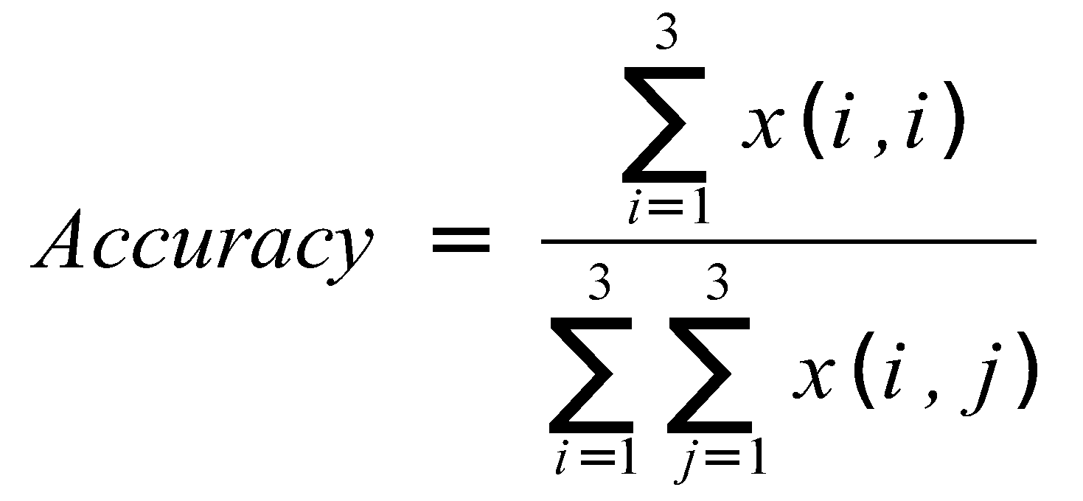
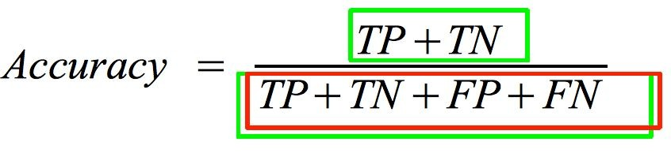
Confusion Matrix for Multi-Class Classification
Binary classification is a special case of multi-class classification:
Binary
 |  | Ground Truth
 |  | Cls1 | Cls2 | Cls3
Pred. | Cls3
 | Cls2
 | Cls1
 |  | Ground Truth
 |  | Pos | Neg
Pred. | Pos | FN | TN
 | Neg | TP | FP

Slide 25
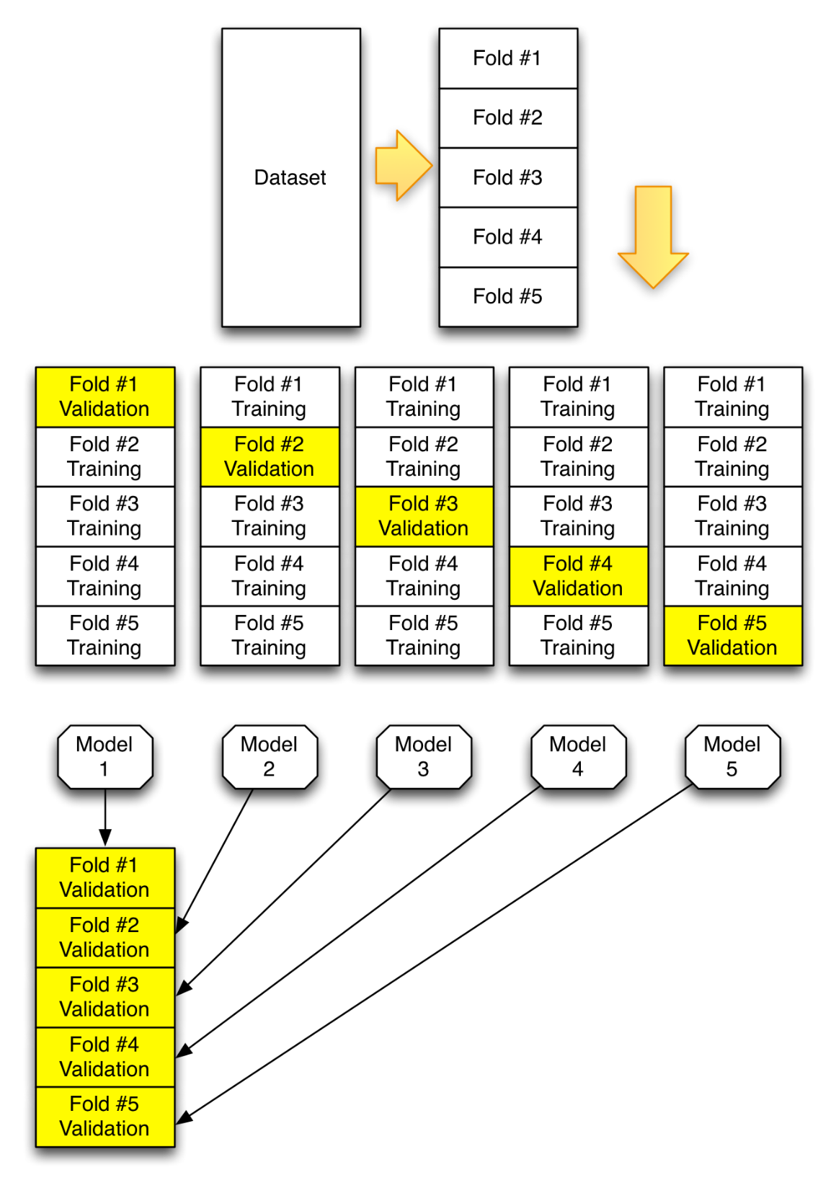
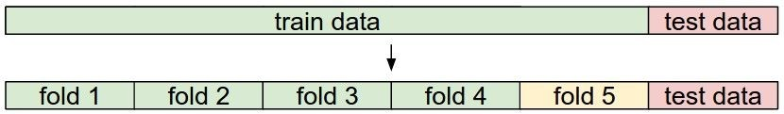
K-Fold Cross-Validation
Divide data into train data and test data
Since we cannot peek at the test data during training time, we use part of the train data for Cross-Validation:
e.g., Divide training data into K=5 parts (folds). Use each fold as validation data, and the other 4 folds as training data. Cycle through the choice of which fold used for validation and average results.
https://github.com/jeffheaton/t81_558_deep_learning/blob/master/t81_558_class_05_2_kfold.ipynb

Slide 26
Training Neural Networks

Slide 27

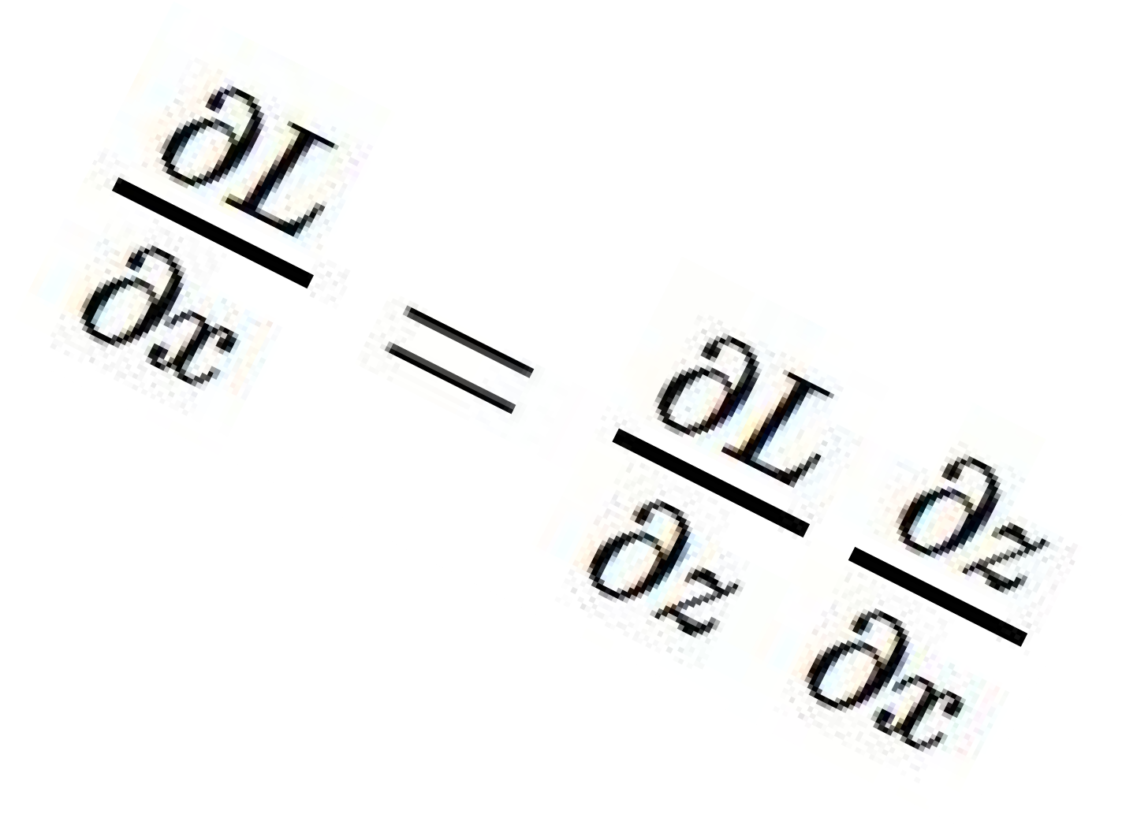




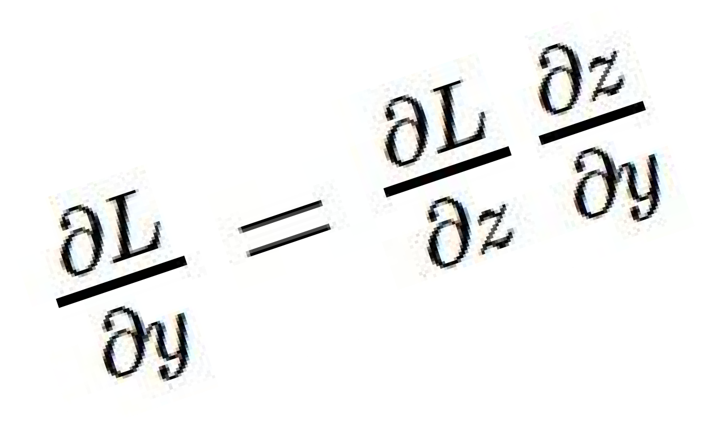
Local Gradient at One Neuron
activations
“local gradient”
f
gradients

Slide 28
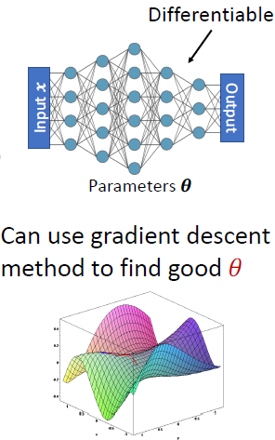
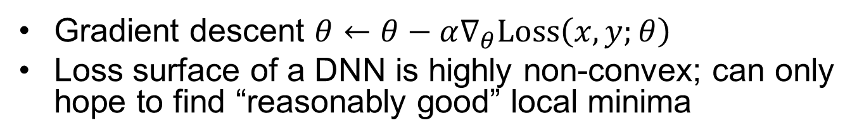


Gradient Descent
Gradient descent $θ←θ−α∇_{θ}Loss\left(x,y;θ\right)$
Loss surface of a DNN is highly non-convex; can only hope to find “reasonably good” local minima
$$𝔼_{\left(x,y\right)∼D}Loss(x,y;θ)$$
$$θ$$

Slide 29
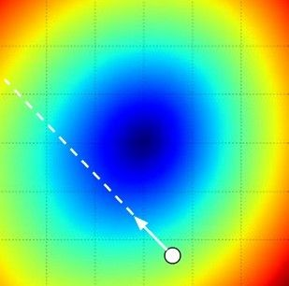
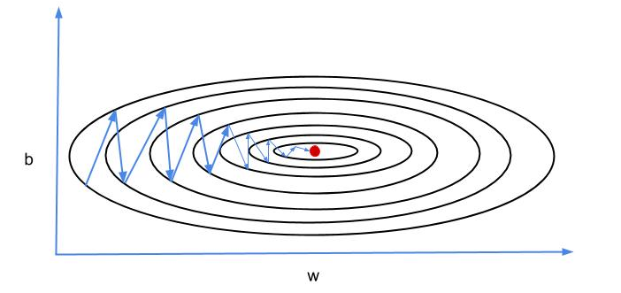



Gradient Descent Algorithms
Steepest descent may result in in efficient zig-zag path
More advanced GD methods exploit momentum, e.g., Nesterov, AdaGrad, RMSProp, Adam…
$$θ_{2}$$
$$θ$$
Negative gradient direction
$$θ_{1}$$
http://dataplusplus.ca/blog/2017/gradient-descent-with-momentum

Slide 30
Mini-batch Stochastic Gradient Descent
Only use a small portion (a mini-batch) of the training data to compute the gradient
Common mini-batch sizes are 32/64/128 examples
Loop:
  Sample a mini-batch of data
  Forward prop it through the graph, get loss
  Backprop to calculate the gradients
  Update the parameters using gradient descent

Slide 31
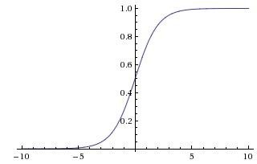
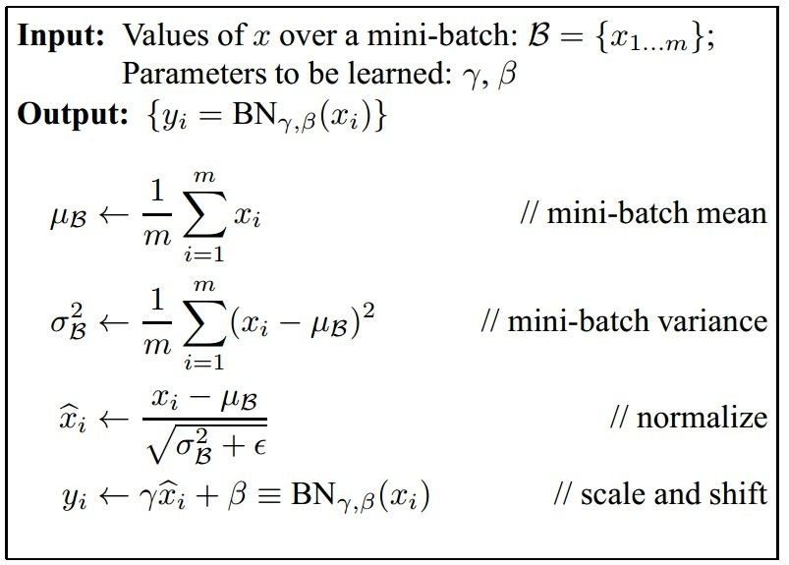
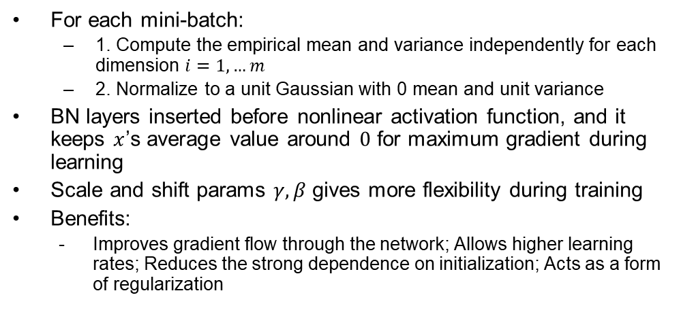
Batch Normalization
For each mini-batch:
  1. Compute the empirical mean and variance independently for each dimension $i=1,…m$
  2. Normalize to a unit Gaussian with 0 mean and unit variance
BN layers inserted before nonlinear activation function, and it keeps $x$’s average value around $0$ for maximum gradient during learning
Scale and shift params $γ,β$ gives more flexibility during training
Benefits:
  Improves gradient flow through the network; Allows higher learning rates; Reduces the strong dependence on initialization; Acts as a form of regularization
CONV
BN
tanh
FC
BN
tanh
...
Notes:
Improves gradient flow through the network
Allows higher learning rates
Reduces the strong dependence on initialization
Acts as a form of regularization Subtracting the mini-batch mean $μ_{ℬ}$ and dividing by the mini-batch
$${\hat{x}}_{i}←\frac{x_{i}−μ_{ℬ}}{\sqrt{σ_{ℬ}^{2}+ε}}$$

Slide 32
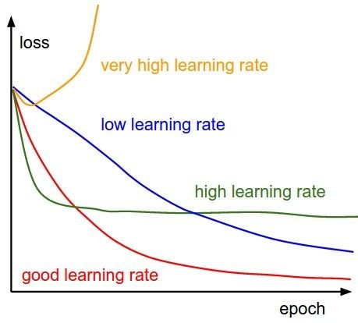
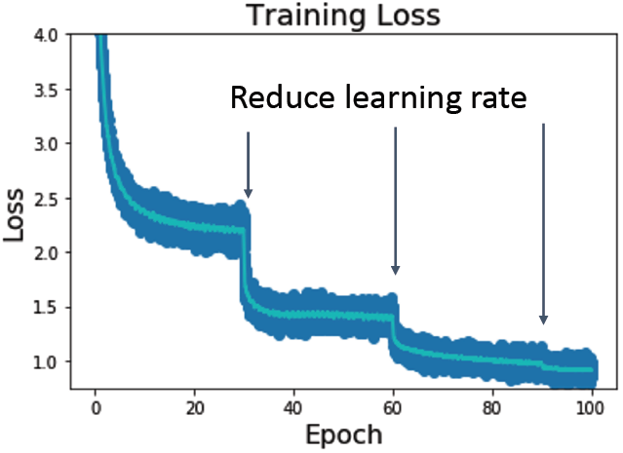
Learning Rate Schedule during Training

Slide 33
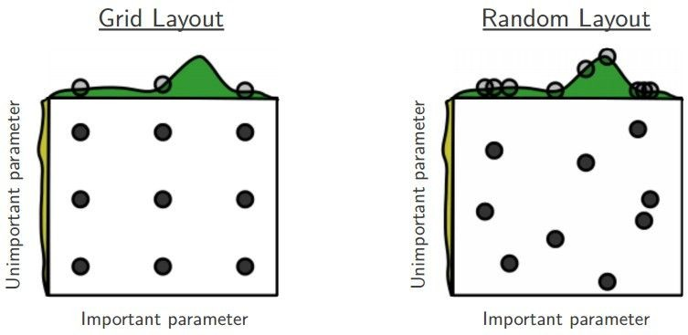
Hyperparameter Optimization
Example hyperparams
  Network architecture
  Learning rate, its decay schedule, update type
  Regularization (L2/Dropout strength)
Grid search vs. random search
  Random search can use the computing budget more effectively
  With 9 evaluations, random search explored 9 different values for the important parameter; grid search only explored 3.

Slide 34
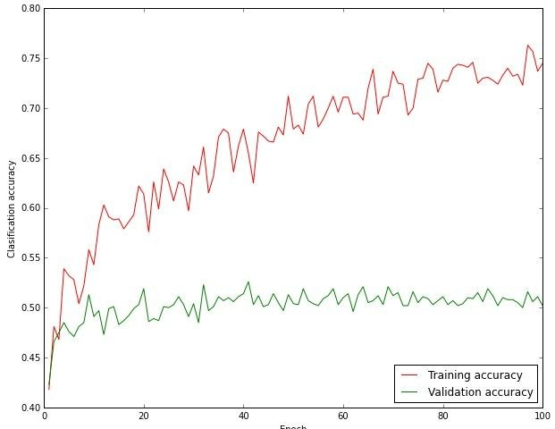
Classification Accuracy
Big gap between training accuracy and validation accuracy may imply overfitting => decrease model capacity?
No gap may imply underfitting => increase model capacity?
Notes:
Activation Functions (use ReLU)
Data Preprocessing (images: subtract mean)
Weight Initialization (use Xavier init)
Batch Normalization (use)
Babysitting the Learning process
Hyperparameter Optimization

Slide 35
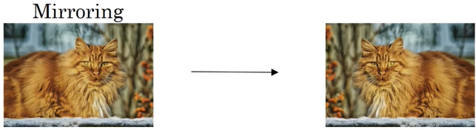
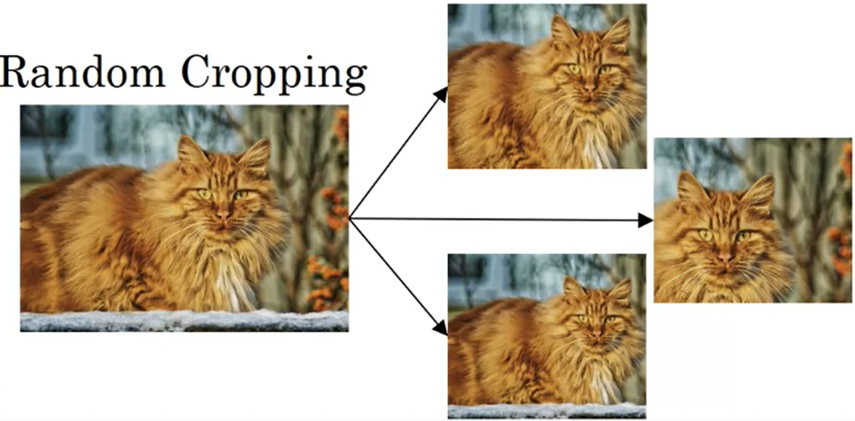
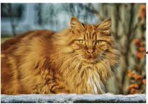

Data Augmentation for Enlarging Training Dataset
Mirroring, random cropping, color shifting, rotation, shearing, local warping…
Color Shifting

